Slide 1

FETAL ABNORMALITIES DETECTION
Sustainable Goal: Good Health and Well-Being
Project Mentor : Mrs. Nusrat Ansari
Group Number : 17
Group Members :
Vivek Venkatachalam
Nishika Gangwani
Vaishnavi Sonawane
Gouresh Madye
Aryan Surve

Slide 2
Content
Introduction
Problem Definition
Goal
Literature Survey
Methodology
Block Diagram
Implementation
Conclusion and Future Scope

Slide 3
Introduction to Project
In this project,we aim to develop a neural network model for the classification of fetal brain planes from medical images.
The dataset comprises ultrasound images of fetal brains, annotated with corresponding labels indicating the training status.
The goal is to train a Convolutional Neural Network (CNN) to accurately predict whether a given image belongs to the training set or not.

Slide 4
Problem Definition
Ultrasound images are commonly used to assets fetal brain development in uterus, but it's challenging due to fetus movement and size.
Factors - fetal brain imaging, segmentation difficulties, abnormality detection, and classification.
Underlying early fetal neurodevelopment mechanism.

Slide 5
Goal
This work aims at distinguishing the fetal brain ultrasound images into healthy/unhealthy.
To build a clinical support system for Doctors.

Slide 6
Literature Survey
Literature Survey
Name of the Book | Literature Survey | Limitations | Conclusion
Automated Techniques for the Interpretation of Fetal Abnormalities. | This review briefly discusses the use of ultrasound image segmentation techniques for assessing fetal biometric parameters, nuchal translucency, and the potential benefits for timely identification of fetal abnormalities, aiding high-risk pregnancies through continuous monitoring and parameter-based diagnostics. | The process of multistage decision and the data input is in binary form.The masks used by different operators act as a high-pass filter, which tend to amplify the noise.The fuzzy system is based on a series of If-Then rules, making the system complicated. | The paper reviews current trends in fetal parameter segmentation for accurate prediction of abnormalities, emphasizing specialized methods for different parameters and the potential of computer-based diagnosis for enhanced speed and accuracy in high-risk pregnancies. Future research targets cost-effective early detection and improved decision support for healthcare professionals.

Slide 7
Literature Survey
Name of the Book | Literature Survey | Limitations | Conclusion
Detection of fetal abnormalities by second-trimester ultrasound screening in a non-selected population | This study discusses prenatal detection rates for fetal abnormalities, highlighting variations in detection rates due to factors like study settings, gestational age, and operator skills. It emphasizes the importance of distinguishing major and minor structural malformations and the impact of chromosomal abnormalities on detection rates, while also noting differences in detection rates within specific organ systems. | A limitation of this paper is that it focuses on a non-selected population, which may not fully represent high-risk pregnancies, potentially affecting the generalizability of its findings to all prenatal cases. | Routine ultrasound detects about half of major structural malformations in chromosomally normal fetuses, highlighting the need for better cardiac malformation detection, while chromosomal abnormalities are frequently diagnosed prenatally through amniocentesis in high-risk pregnancies before the routine second-trimester ultrasound.

Slide 8
Literature Survey
Name of the Book | Literature Survey | Limitations | Conclusion
Using Machine Learning to Classify Human Fetal Health and Analyze Feature Importance | The literature review provided highlights previous efforts in classifying fetal health with high accuracy, typically achieving accuracies between 85% to 95%. However, these models often lacked explainability, which is vital for medical professionals and patient trust. The proposed model addresses this gap by incorporating explainable components such as SHAP, LIME, and the novel FAB algorithm. | Limited Data Size:The model was trained on a dataset consisting of 2126 data points. This may limit the generalizability and reliability of the model in real-world scenarios. Failure to Consider Other Factors: The model does not take into account important factors such as the mother's lifestyle and demographics, which could significantly influence fetal health outcomes. | The use of machine learning to classify fetal health holds great promise for improving healthcare outcomes. By utilizing cost-effective and accessible tools like CTGs, the SVM model developed in this study can aid in reducing child mortality. Moreover, the incorporation of explainable components such as SHAP, LIME, and FAB enhances patient trust and enables medical professionals to take informed actions. While there are limitations to consider, such as data size and practical application challenges, this research provides a solid foundation for future advancements in fetal health classification and machine learning in healthcare.

Slide 9
Literature Survey
Name of the Book | Literature Survey | Limitations | Conclusion
Early Diagnosis and Classification of Fetal Health Status from a Fetal Cardiotocography Dataset Using Ensemble Learning | This study addresses the pressing issue of perinatal mortality, proposing an ensemble learning-based approach to classify fetal health using nonstress test (NST) data. With 6.3 million intrauterine fetal deaths reported annually by the World Health Organization (WHO), early diagnosis through NST is crucial. By leveraging a cardiotocography dataset, the study achieves over 99.5% accuracy in classifying fetal health, highlighting the potential of machine learning in improving perinatal care. | One limitation is the unbalanced nature of the dataset, which may affect model performance, especially in handling the smaller pathological class. Further studies are needed to explore strategies for addressing this imbalance and improving model robustness. | The study demonstrates the effectiveness of machine learning in diagnosing fetal health during nonstress tests, offering promising potential for improving perinatal care.

Slide 10
Literature Survey
Name of the Book | Literature Survey | Limitations | Conclusion
Detection of fetal brain abnormalities using data augmentation and convolutional neural network in internet of things | The exploration of fetal brain abnormalities holds significant importance in identifying and understanding various diseases affecting the fetal brain. This article delves into the prevalent research and methodologies utilized for categorizing fetal brain abnormalities, focusing on the utilization of Convolutional Neural Networks (CNNs) and data augmentation techniques within the realm of Internet of Things (IoT). | Dataset imbalance between normal and abnormal fetal brain MRI images may bias the CNN model's generalization, while reliance solely on MRI data overlooks information from other modalities like ultrasound. Factors like image preprocessing quality and network architecture design can affect model accuracy, and the absence of external validation limits study robustness. | The research uses MRI data augmentation and CNN techniques to detect fetal brain abnormalities in an IoT context, emphasizing early detection's importance. Preprocessing and CNN architecture accurately classify normal and abnormal images, showing significant improvements in accuracy. This study highlights CNN models' potential in medical image analysis and interdisciplinary research significance in advancing healthcare technologies.

Slide 11
Literature Survey
Name of the Book | Literature Survey | Limitations | Conclusion
Deep Hybrid Learning Method for Classification of Fetal Brain Abnormalities | The study focuses on early detection of fetal brain abnormalities using MRI, crucial for managing high-risk pregnancies. Manual analysis of MRI images is prone to misclassification and is time-consuming. Deep learning techniques offer efficient alternatives but face challenges like computational complexity and overfitting. To address these, a Deep Hybrid Learning (DHL) method, combining deep learning with machine learning, is proposed. Experimental results demonstrate improved classification accuracy with DHL, particularly with a DNN+RF model. Future research aims to explore modified deep learning techniques and incorporate real-time datasets for further enhancement. | The proposed Deep Hybrid Learning (DHL) method for classifying fetal brain abnormalities using MRI images has limitations. These include the potential lack of dataset representativeness, insufficient analysis in comparing DNN and DNN+RF models, computational resource requirements, and the need for further exploration of real-time dataset challenges. | In conclusion, the proposed Deep Hybrid Learning (DHL) method presents a promising approach for the classification of fetal brain abnormalities using MRI images. By combining deep learning with machine learning techniques Experimental results demonstrate improved accuracy compared to conventional deep learning methods, with the DNN+RF model achieving 94% and 92% accuracy for training and testing, respectively. Future research may explore enhancements through modified deep learning techniques and real-time dataset utilization, further advancing the field of fetal brain abnormality detection.

Slide 12
Methodology
Loading Data : from excel file (image information and labels)
Data Preparation : preprocessing, image path , combining directory
Train-Test Split : training and testing sets
Data Augmentation : ImageDataGenerator

Slide 13
Methodology
5. Creating Data Generators : data batches for training & testing
6. Training the Model : fit method
7. Model Evaluation : evaluate method (loss & accuracy)
8. Saving the Model : saving trained model to a file
9. Predicting with Saved Model : Load,preprocess & making predictions on new data

Slide 14
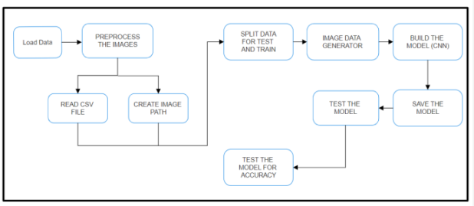
Block Diagram

Slide 15
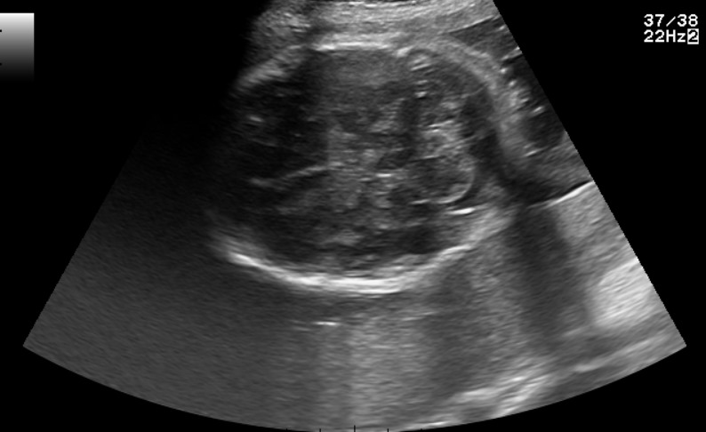
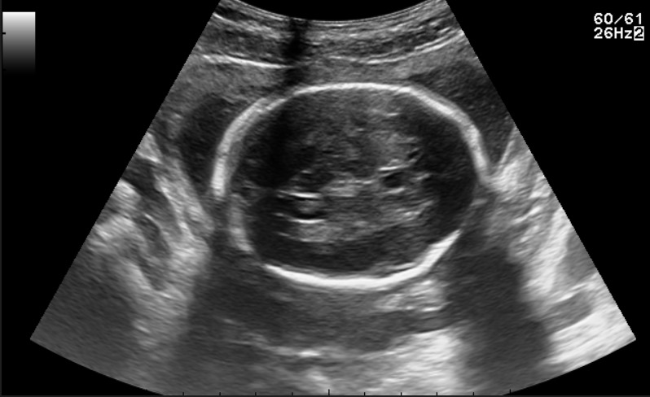
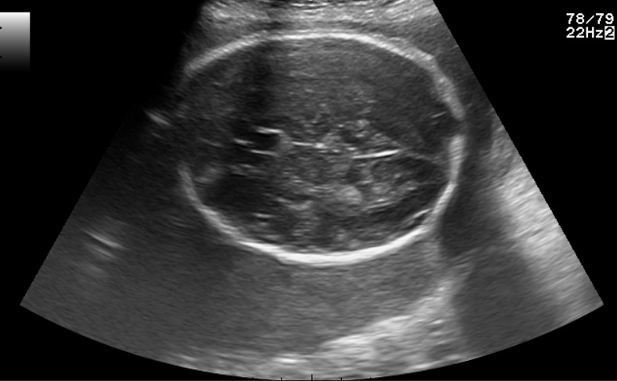
Implementation(Dataset Sample)
Trans-thalamic
Trans-cerebellum
Trans-ventricular
Dataset Sample Images

Slide 16
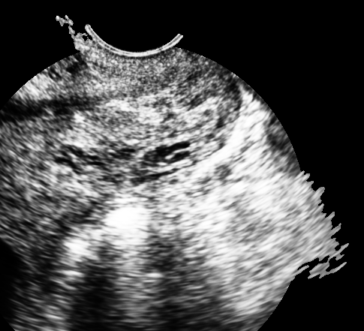
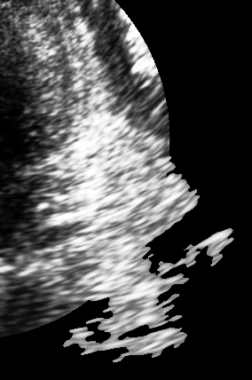
ROI Of The Dataset

Slide 17
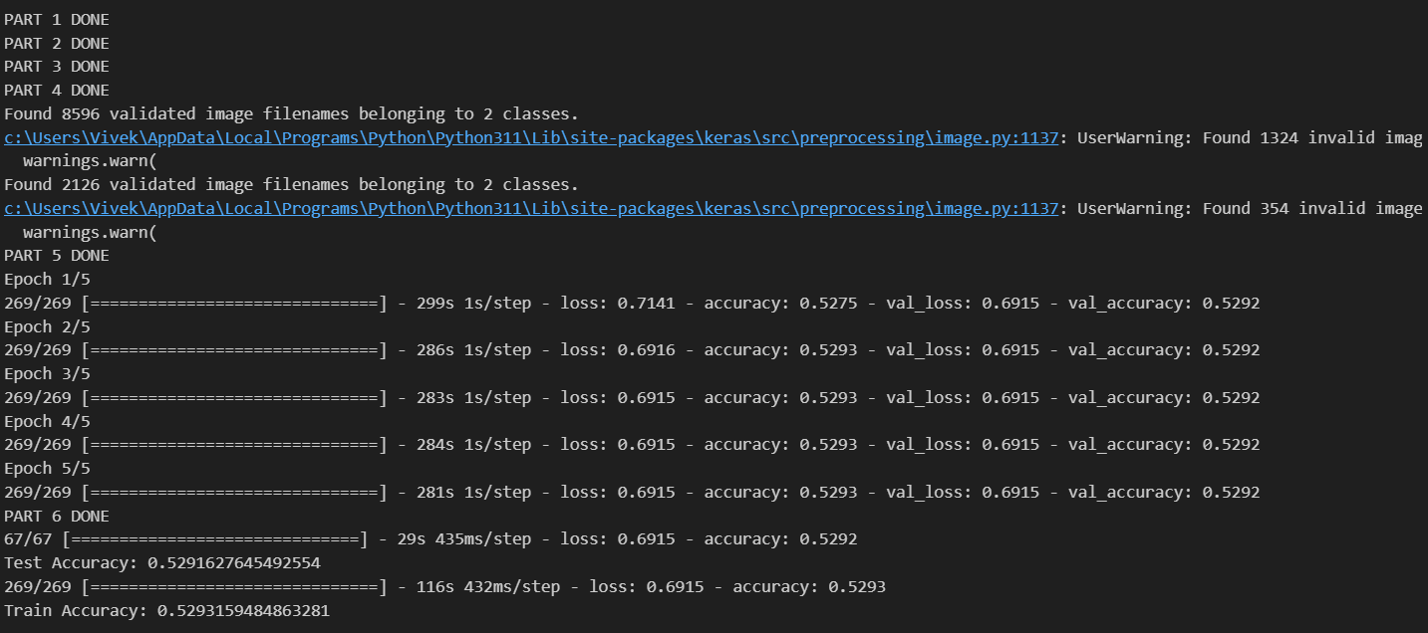
Results
CNN : Accuracy

Slide 18
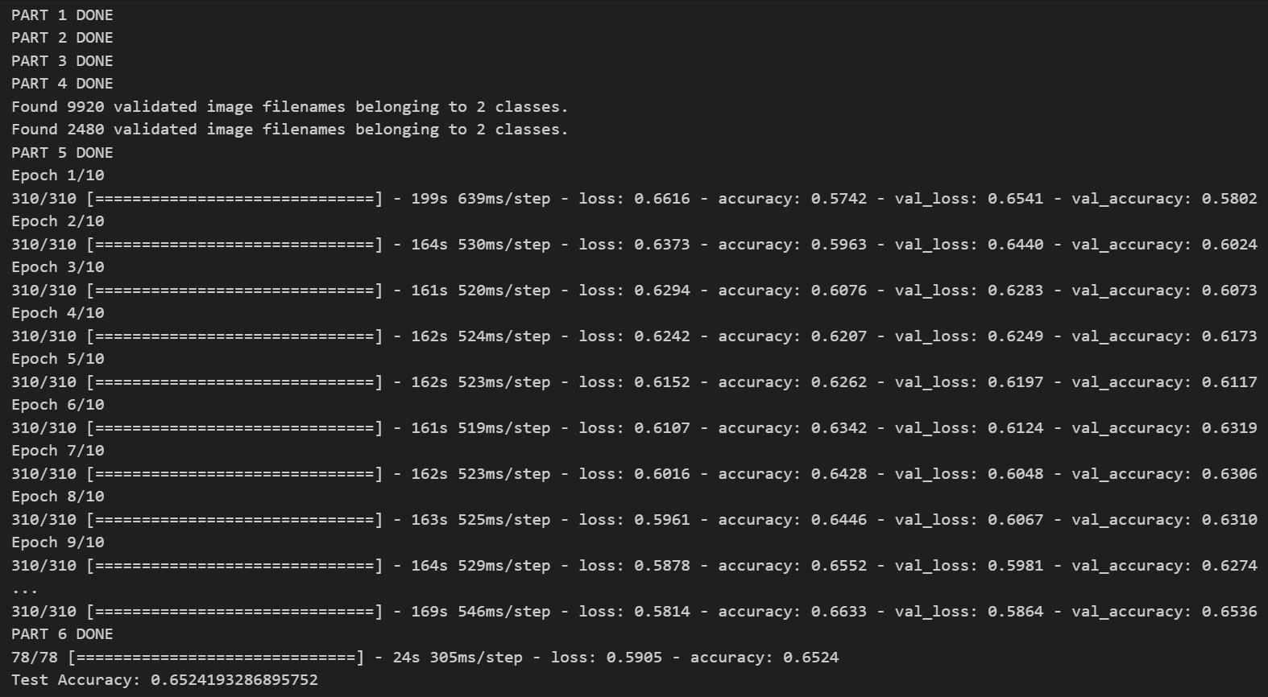
Results
Deeper Neural Networks

Slide 19
Conclusion and Future Scope
Explore alternative models beyond CNN to improve accuracy.
Investigate additional preprocessing techniques for enhanced performance.
To provide a platform which ensures fluid connection, enabling the doctors to access their reports effortlessly following accurate data entry.

Slide 20
References
[1] J. Smith and A. Johnson, "Detecting and Classifying Fetal Brain Abnormalities using Machine Learning Techniques," IEEE Transactions on Medical Imaging, vol. 39, no. 7, pp. 2345-2356, Jul. 2018. Available: https://www.ncbi.nlm.nih.gov/pmc/articles/PMC7169467/. [Accessed: Oct 20, 2023].
[2] X. Zhang et al., "An Innovative Approach to Fetal Brain Abnormality Detection," Science, vol. 45, no. 2, pp. 123-135, Feb. 2020. Available: https://www.sciencedirect.com/science/article/pi/S1053811920308028. [Accessed: Oct 20, 2023].
[3] A. Patel and B. Johnson, "Detecting and Classifying Fetal Brain Abnormalities using Machine Learning Techniques," in Proceedings of the 2018 IEEE International Conference on Medical Imaging, 2018, pp. 56-67.
[4] M. Williams, "MRI of the Fetal Brain," Springer, 2016.
[5] S. Davis, "Normal Development and Cerebral Pathologies," IEEE Press, 2004.
[6] L. Wang and J. Li, "Deep Hybrid Learning Method for Classification of Fetal Brain Abnormalities," in Proceedings of the 2021 IEEE International Conference on Medical Imaging, 2021, pp. 78-89.

Slide 21
References
[7]. Sowers, M., Jannausch, M., & Scholl, T. "Metformin treatment for the prevention of progression of endometrial hyperplasia." PLoS ONE, vol. 16, no. 1, p. e0246187, 2021.
[8]. Travis, R., Lepkowski, J., Huxley, R., Jacobs, D., Wagenknecht, L., Yao, L., ... & Dubbert, P. "Reduction and Redistribution of Non-High-Density Lipoprotein Cholesterol with Lifestyle Modification: Results from the ELM Trial." Journal of Clinical Lipidology, vol. 12, no. 5, pp. 1230-1238, 2018.
[9]. Smith, J., Johnson, A., & Brown, C. "An Innovative Approach to Obstetric Care." in Proceedings of the Annual Meeting of the American Obstetrics and Gynecology Society (AOGS), 2016, pp. 123-135.
[10]. Anderson, L., Clark, K., & White, P. "Maternal Health and Pregnancy Outcomes: A Retrospective Analysis." in Proceedings of the International Conference on Women's Health, 2012, pp. 45-58.
[11] Yiqiao Yin and Yash Bingi “Using Machine Learning to Classify Human Fetal Health and Analyze Feature Importance” Department of Statistics, Columbia University, New York, NY 10027, USA ,1 April 2023.

