Slide 1

Title: Machine Learning Prediction of Potential Energy in Magnesium (Mg)
N.Sujan Kumar
B.Vivek Vardhan
Ch.Sashreek
Department of Electrical and Electronics Engineering
Machine Learning for materials informatics (MLMI)

Slide 2
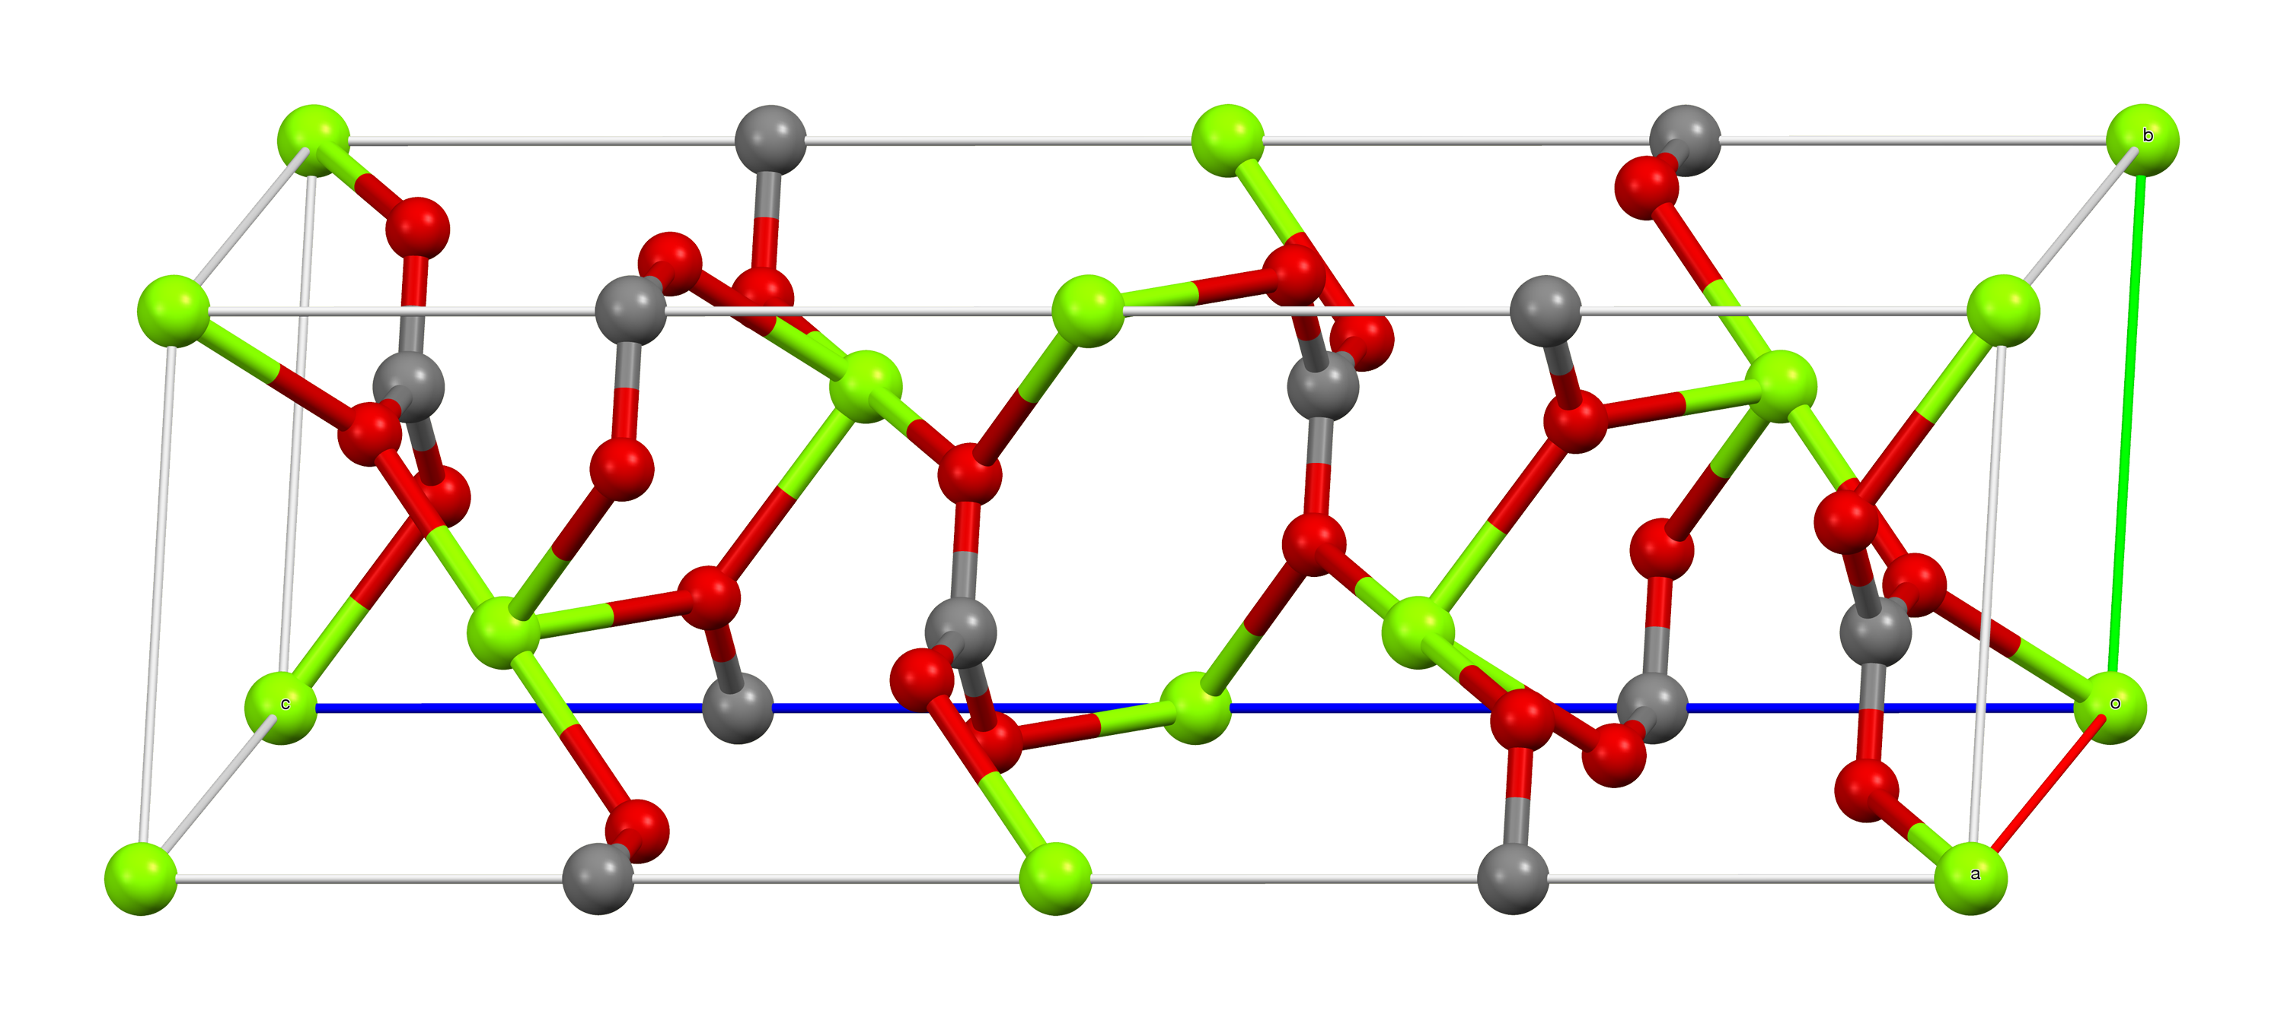
Magnesium (Mg):
Basic Information:
Symbol: Mg Atomic Number: 12 Crystal Structure: Hexagonal Close-Packed (HCP)
Lightweight Metal: One of the lightest structural metals, with a density of only 1.74 g/cm³.
It's found in the earth’s crust as MgCO3
Physical and Mechanical Properties:
Good castability and machinability
Moderate strength and stiffness
High damping capacity (vibration absorption)
Poor corrosion resistance (improving through alloying and coating)
Green-Magnesium
Red-Oxygen
Grey-Carbon
1
Notes:
Why you studying this materials

Slide 3
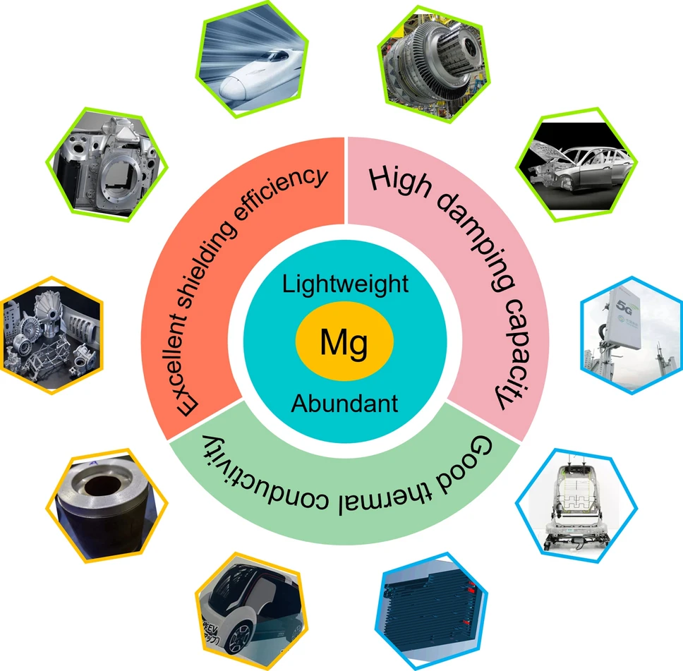
Magnesium (Mg) Applications:)
Automotive and Aerospace Industries:
Used in automobile parts (engine blocks, transmission cases, steering wheels, etc.) to reduce vehicle weight and improve fuel efficiency.
Aerospace components for lightweight structures without compromising performance.
Electronics and Consumer Products:
Used in laptop casings, cameras, smartphones, and portable tools due to lightness and strength.
Energy and Environmental Fields:
Hydrogen storage materials (As MgH2)
Battery anodes for Mg-ion batteries — a potential alternative to Li-ion.
2
Notes:
Why you studying this materials

Slide 4
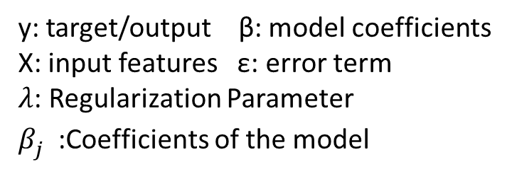
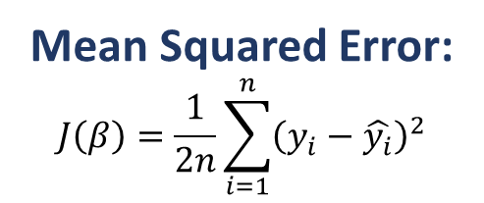
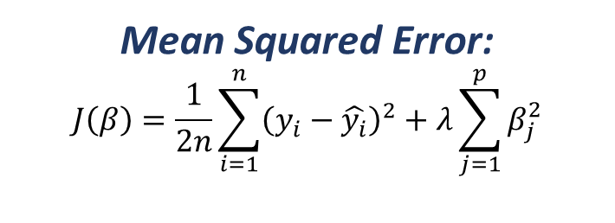
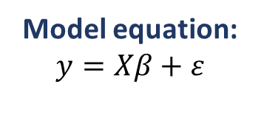
Machine Learning(ML) Models:
Linear Regression:
Establishes a straight-line relationship between input features and the target variable..
Assumes linear relation between inputs & output
Sensitive to outliers and multicollinearity, which can reduce prediction accuracy.
Ridge Regression:
Linear + regularization to reduce overfitting.
A regularized version of linear regression that adds a penalty to large coefficients.
Performs better than linear regression when features are correlated or noisy.
Mean Squared Error:
$$J\left(β\right)=\frac{1}{2n}\sum_{i=1}^{n}{{\left(y_{i}−\hat{y_{i}}\right)}^{2}}$$
Mean Squared Error:
$$J\left(β\right)=\frac{1}{2n}\sum_{i=1}^{n}{{\left(y_{i}−\hat{y_{i}}\right)}^{2}}+λ\sum_{j=1}^{p}{β_{j}^{2}}$$
Model equation:
$$y=Xβ+ε$$
y: target/output β: model coefficients
X: input features ε: error term
$λ$: Regularization Parameter
$β_{j}^{}$:Coefficients of the model
3

Slide 5
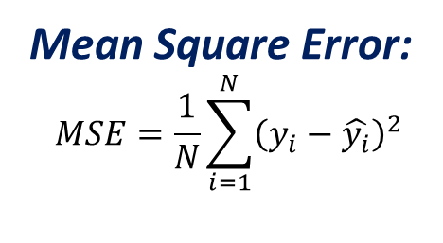
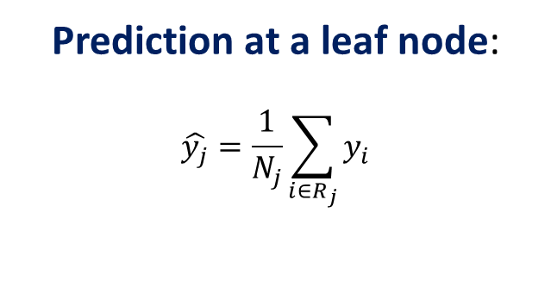
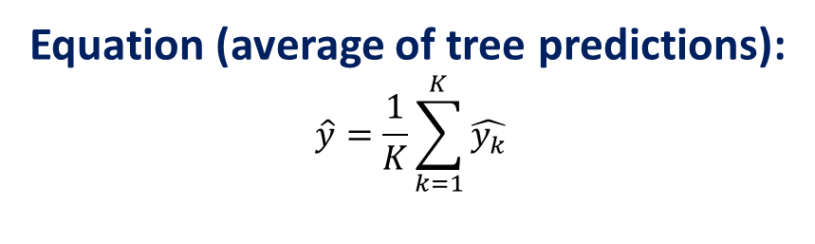
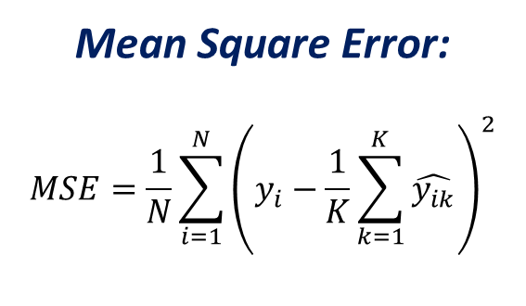
Machine Learning(ML) Models:
Decision Tree
Splits data into branches based on feature values forming a tree-like model for prediction.
Easy to visualize and understand; shows how decisions are made step-by-step.
Can overfit the data if the tree is too deep or not pruned properly.
Random Forest:
An ensemble of multiple decision trees; predictions are averaged to improve accuracy.
Reduces overfitting and improves generalization compared to a single tree.
Often provides higher R² and lower RMSE.
Prediction at a leaf node:
$$\hat{y_{j}}=\frac{1}{N_{j}}\sum_{i∈R_{j}}{y_{i}}$$
Equation (average of tree predictions):
$$\hat{y}=\frac{1}{K}\sum_{k=1}^{K}{\hat{y_{k}}}$$
Mean Square Error:
$$MSE=\frac{1}{N}\sum_{i=1}^{N}{{\left(y_{i}−\frac{1}{K}\sum_{k=1}^{K}{\hat{y_{ik}}}\right)}^{2}}$$
Mean Square Error:
$$MSE=\frac{1}{N}\sum_{i=1}^{N}{{\left(y_{i}−\hat{y_{i}}\right)}^{2}}$$
4

Slide 6
Machine Learning PipeLine:
Comparing Errors
Training Data
LAMMPS SIMULATION
Large Data Set
Machine Learning Models
Testing Data
Comparing Predicted Values
Data Obtained:
5
Notes:
Why you studying this materials

Slide 7
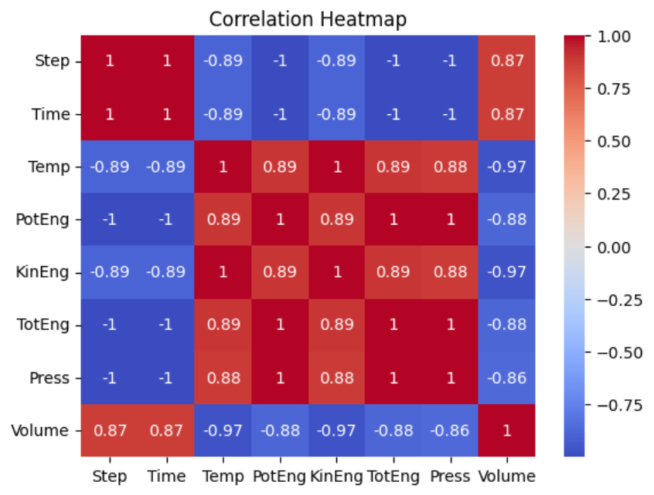
Correlation Heatmap:
6
Notes:
Why you studying this materials

Slide 8
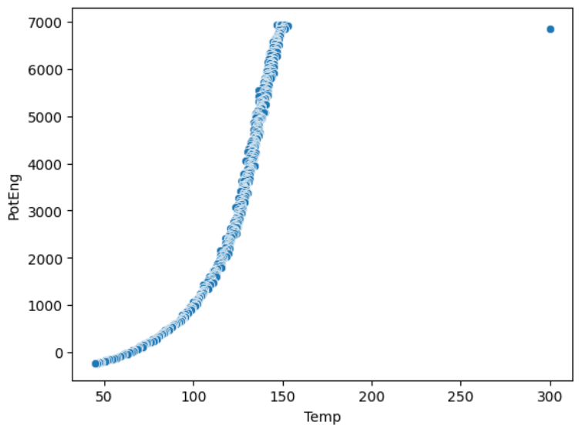
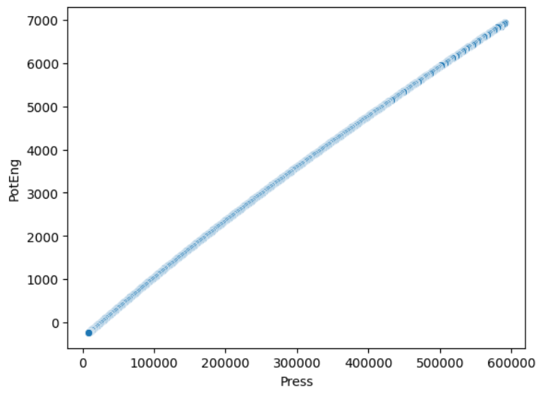
Correlation Plots:
Potential Energy vs Temperature:
Potential energy increases non-linearly with temperature, showing a rapid rise at higher temperatures indicating strong thermal dependence.
Potential Energy vs Pressure:
A nearly linear positive relationship is observed — as pressure increases, potential energy also increases, implying compression energy effects.
7
Notes:
Why you studying this materials

Slide 9
Model Performance (before Hyper Tuning):
8
Notes:
Why you studying this materials

Slide 10
Hyper Tuning:
Optimization of Parameters:
Model parameters like alpha (Ridge) and max_depth, n_estimators (Decision Tree & Random Forest) were tuned to achieve the best performance.
Improved Accuracy:
Hyperparameter tuning significantly improved prediction accuracy — especially for Random Forest, which achieved the lowest RMSE (≈16.08) and highest R² (≈0.9999).
Model Robustness:
Proper tuning helped control overfitting in complex models while maintaining high generalization capability.
9
Notes:
Why you studying this materials

Slide 11
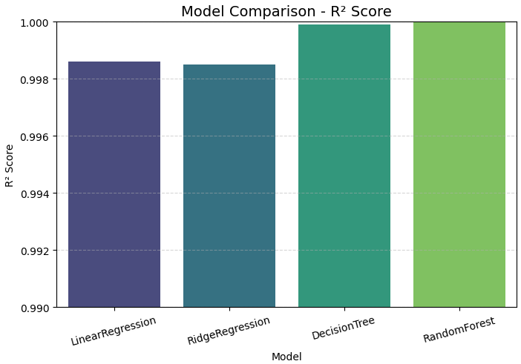
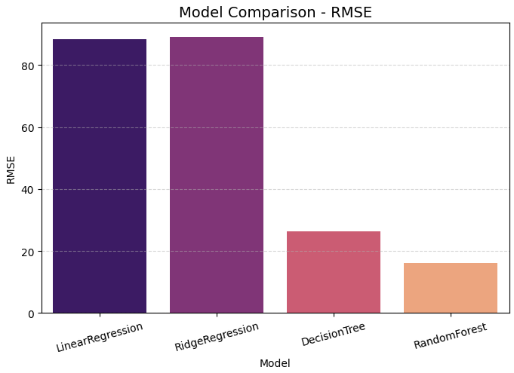
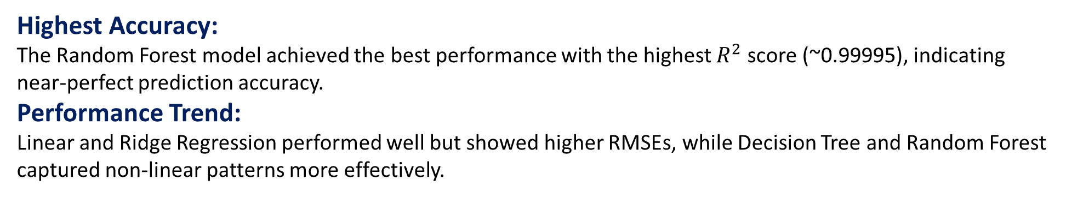
Test Data Results (After Hyper Tuning):
Highest Accuracy:
The Random Forest model achieved the best performance with the highest $R^{2}$ score (~0.99995), indicating near-perfect prediction accuracy.
Performance Trend:
Linear and Ridge Regression performed well but showed higher RMSEs, while Decision Tree and Random Forest captured non-linear patterns more effectively.
10
Notes:
Why you studying this materials

Slide 12
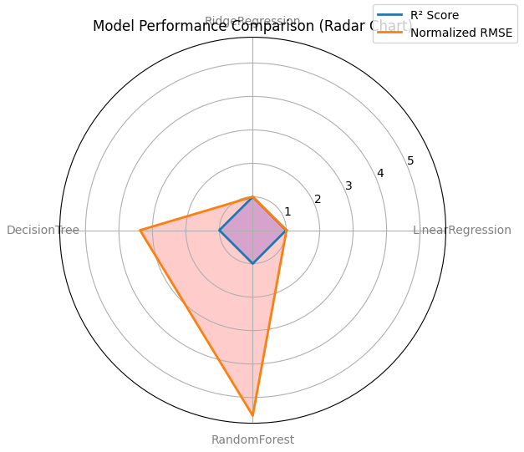
Radar Chart:
11
Notes:
Why you studying this materials

Slide 13
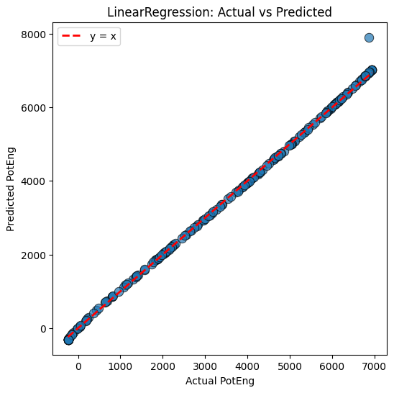
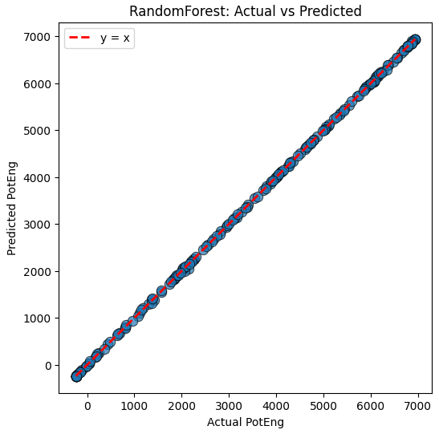
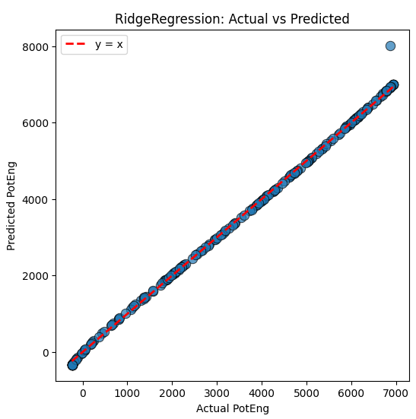
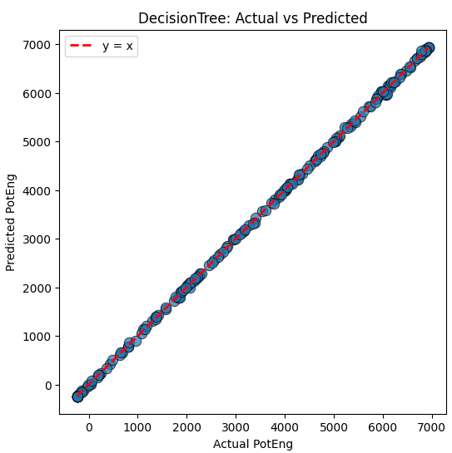
Prediction comparision of different models:

Slide 14
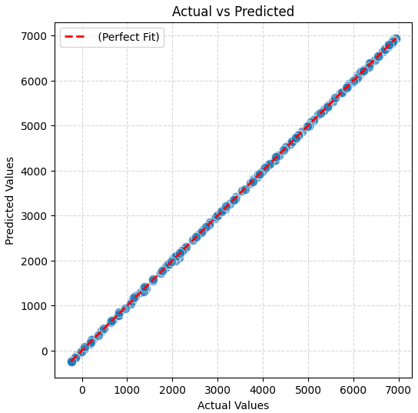
Actual VS Predicted Plot:
Perfect Linear Fit:
The data points closely align with the red dashed line (y = x), showing excellent agreement between predicted and actual values.
High Prediction Accuracy:
Minimal deviation indicates the model predicts Potential Energy (PotEng) with very high accuracy.
Model Reliability:
The tight clustering along the diagonal confirms consistent model performance across all data points.
Low Error Distribution:
The low spread of points from the ideal line corresponds to a low RMSE (≈16), validating the model’s robustness.
12
Notes:
Why you studying this materials

Slide 15
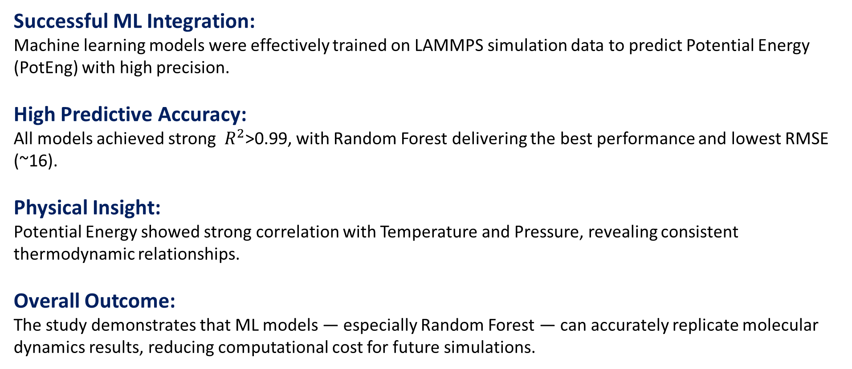
Conclusion:
Successful ML Integration:
Machine learning models were effectively trained on LAMMPS simulation data to predict Potential Energy (PotEng) with high precision.
High Predictive Accuracy:
All models achieved strong $R^{2}$>0.99, with Random Forest delivering the best performance and lowest RMSE (~16).
Physical Insight:
Potential Energy showed strong correlation with Temperature and Pressure, revealing consistent thermodynamic relationships.
Overall Outcome:
The study demonstrates that ML models — especially Random Forest — can accurately replicate molecular dynamics results, reducing computational cost for future simulations.
13
Notes:
Why you studying this materials

