Slide 1
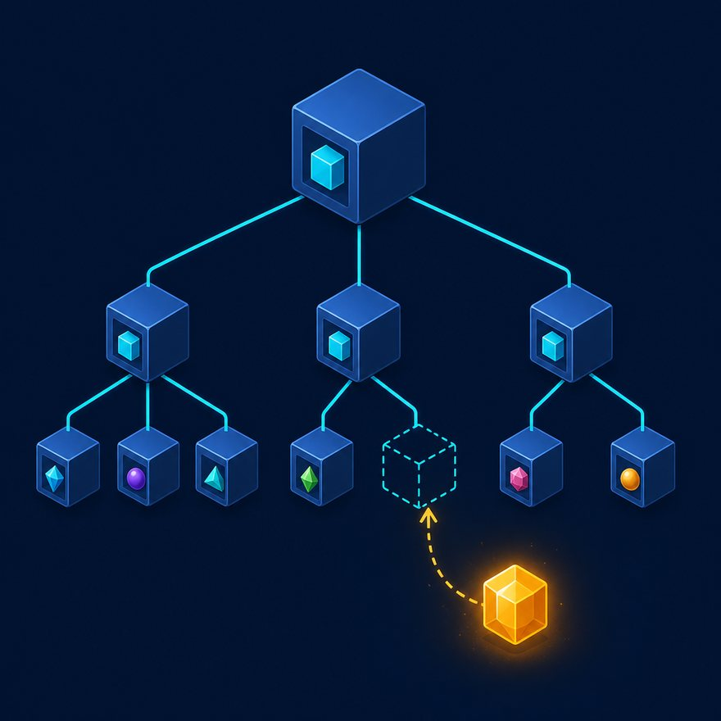
LAB 16
Object keys to array of { key, value }
Show the failing starter first. Hold the pause card before any solution.
easy · 6–10 min · LAB-16-object-keys-to-array-of-key-value.mp4
Notes:
Open PowerPoint Slide Show (F5). Share this window. Switch to Playground on code slides.

Slide 2
LAB 16
The job
• This is Lab 16. Object keys to array of { key, value }. Convert a config object { "timeout": 30, "retries": 3 } to entries for logging or CSV.
• pluck turns a config object into loggable key-value rows.
Notes:
This is Lab 16. Object keys to array of `{ key, value }`. Convert a config object `{ "timeout": 30, "retries": 3 }` to entries for logging or CSV. pluck turns a config object into loggable key-value rows.

Slide 3
LAB 16
Paste the payload
• Set the MIME type to match the sample.

Slide 4
LAB 16
Input
{ "timeout": 30, "retries": 3 }
Notes:
Type this. Read the header: percent dw two point oh, output, dash dash dash.

Slide 5

PAUSE CARD
Pause — try Lab 16
• Pause the video
• Open student/labs/01-fundamentals/16-object-keys-to-array-of-key-value/
• Finish transform.dwl — wrong is fine
• Resume when you have an attempt
Notes:
Hold 3–5 seconds. Do not show the solution yet.

Slide 6
LAB 16
Welcome back
• Welcome back. I will type the reference script. Follow along; do not paste blindly. Header first: percent dw two point oh, output, dash dash dash.
• That should match Expected:

Slide 7
LAB 16
Solution
%dw 2.0
output application/json
---
payload pluck ((v, k) -> { key: k as String, value: v })
Notes:
Type this. Read the header: percent dw two point oh, output, dash dash dash.

Slide 8
LAB 16
Expected
[{ "key": "timeout", "value": 30 }, { "key": "retries", "value": 3 }]
Notes:
Type this. Read the header: percent dw two point oh, output, dash dash dash.

Slide 9

LAB 16
Interview phrase
• pluck turns a config object into loggable key-value rows.
• If your output differs, check plus versus plus-plus, as Number, and nulls with default. Next lab is the next numbered folder.
• Stop. Do not start Lab 17 in this file.
Notes:
pluck turns a config object into loggable key-value rows. If your output differs, check plus versus plus-plus, as Number, and nulls with default. Next lab is the next numbered folder. Stop. Do not start Lab 17 in this file.

