Slide 1

LAB 25
Merge config overlay (right wins)
Show the failing starter first. Hold the pause card before any solution.
moderate · 6–10 min · LAB-25-merge-config-overlay-right-wins.mp4
Notes:
Open PowerPoint Slide Show (F5). Share this window. Switch to Playground on code slides.

Slide 2
LAB 25
The job
• This is Lab 25. Merge config overlay (right wins). Shallow-merge base with overlay. Right-hand keys win. Both objects live on
• plus-plus shallow merge. Overlay lives on payload so Playground works.
Notes:
This is Lab 25. Merge config overlay (right wins). Shallow-merge `base` with `overlay`. Right-hand keys win. Both objects live on plus-plus shallow merge. Overlay lives on payload so Playground works.

Slide 3
LAB 25
Paste the payload
• Set the MIME type to match the sample.

Slide 4
LAB 25
Input
{
"base": { "timeout": 30, "retries": 2, "region": "us-east-1" },
"overlay": { "retries": 5, "region": "ap-south-1" }
}
Notes:
Type this. Read the header: percent dw two point oh, output, dash dash dash.

Slide 5

PAUSE CARD
Pause — try Lab 25
• Pause the video
• Open student/labs/02-intermediate/25-merge-config-overlay-right-wins/
• Finish transform.dwl — wrong is fine
• Resume when you have an attempt
Notes:
Hold 3–5 seconds. Do not show the solution yet.

Slide 6
LAB 25
Welcome back
• Welcome back. I will type the reference script. Follow along; do not paste blindly. Header first: percent dw two point oh, output, dash dash dash.
• That should match Expected:

Slide 7
LAB 25
Solution
%dw 2.0
output application/json
---
payload.base ++ payload.overlay
Notes:
Type this. Read the header: percent dw two point oh, output, dash dash dash.

Slide 8
LAB 25
Expected
{ "timeout": 30, "retries": 5, "region": "ap-south-1" }
Notes:
Type this. Read the header: percent dw two point oh, output, dash dash dash.

Slide 9
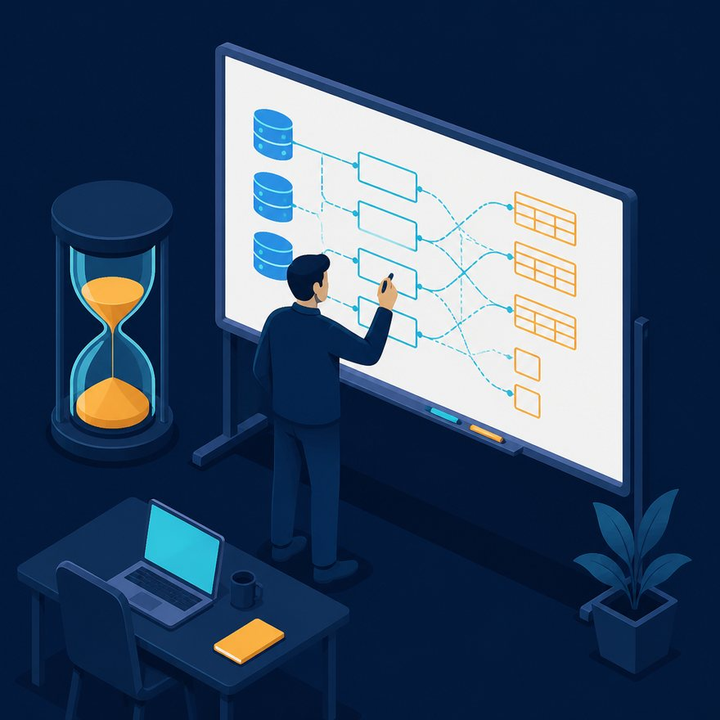
LAB 25
Interview phrase
• plus-plus shallow merge. Overlay lives on payload so Playground works.
• If your output differs, check plus versus plus-plus, as Number, and nulls with default. Next lab is the next numbered folder.
• Stop. Do not start Lab 26 in this file.
Notes:
plus-plus shallow merge. Overlay lives on payload so Playground works. If your output differs, check plus versus plus-plus, as Number, and nulls with default. Next lab is the next numbered folder. Stop. Do not start Lab 26 in this file.

