Slide 1
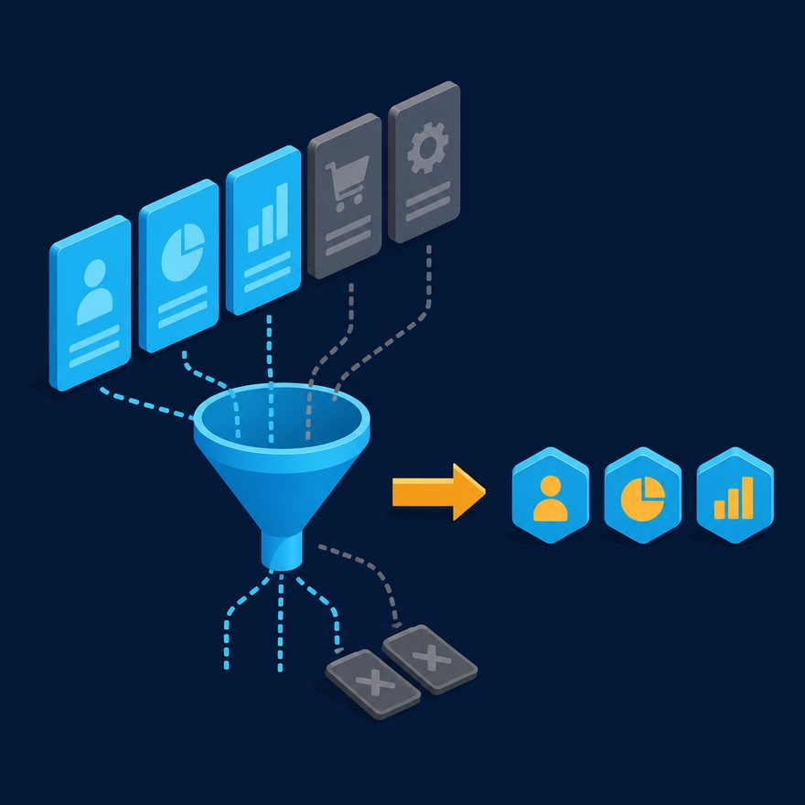
LAB 34
Window / paginate a bulk array
Show the failing starter first. Hold the pause card before any solution.
moderate · 6–10 min · LAB-34-window-paginate-a-bulk-array.mp4
Notes:
Open PowerPoint Slide Show (F5). Share this window. Switch to Playground on code slides.

Slide 2
LAB 34
The job
• This is Lab 34. Window / paginate a bulk array. Page 2, size 2 of a 5-item work queue → items 3 and 4. Import dw::core::Arrays.
• drop then take for bulk pages. Import dw::core::Arrays.
Notes:
This is Lab 34. Window / paginate a bulk array. Page 2, size 2 of a 5-item work queue → items 3 and 4. Import `dw::core::Arrays`. drop then take for bulk pages. Import dw::core::Arrays.

Slide 3
LAB 34
Paste the payload
• Set the MIME type to match the sample.

Slide 4
LAB 34
Input
[10, 20, 30, 40, 50]
Notes:
Type this. Read the header: percent dw two point oh, output, dash dash dash.

Slide 5

PAUSE CARD
Pause — try Lab 34
• Pause the video
• Open student/labs/02-intermediate/34-window-paginate-a-bulk-array/
• Finish transform.dwl — wrong is fine
• Resume when you have an attempt
Notes:
Hold 3–5 seconds. Do not show the solution yet.

Slide 6
LAB 34
Welcome back
• Welcome back. I will type the reference script. Follow along; do not paste blindly. Header first: percent dw two point oh, output, dash dash dash.
• That should match Expected:
• [30, 40]

Slide 7
LAB 34
Solution
%dw 2.0
import * from dw::core::Arrays
output application/json
var page = 2
var size = 2
---
payload drop ((page - 1) * size) take size
Notes:
Type this. Read the header: percent dw two point oh, output, dash dash dash.

Slide 8
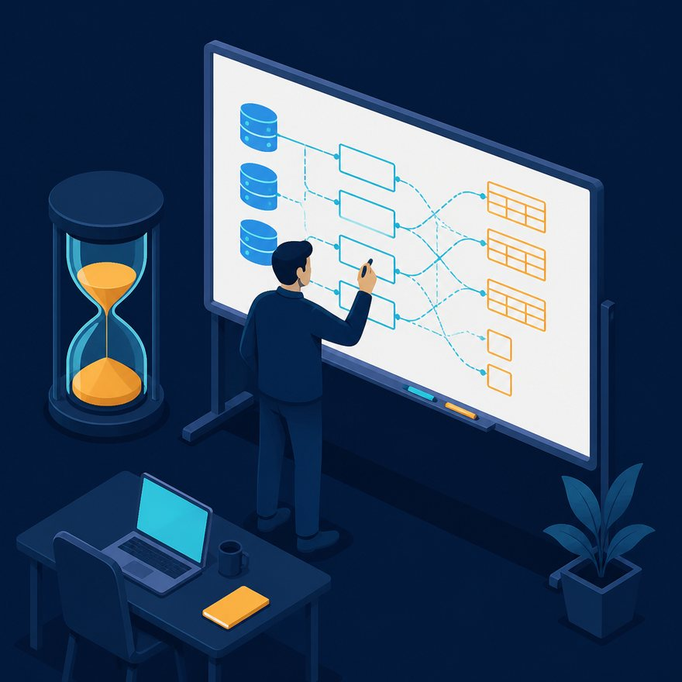
LAB 34
Interview phrase
• drop then take for bulk pages. Import dw::core::Arrays.
• If your output differs, check plus versus plus-plus, as Number, and nulls with default. Next lab is the next numbered folder.
• Stop. Do not start Lab 35 in this file.
Notes:
drop then take for bulk pages. Import dw::core::Arrays. If your output differs, check plus versus plus-plus, as Number, and nulls with default. Next lab is the next numbered folder. Stop. Do not start Lab 35 in this file.

