Slide 1
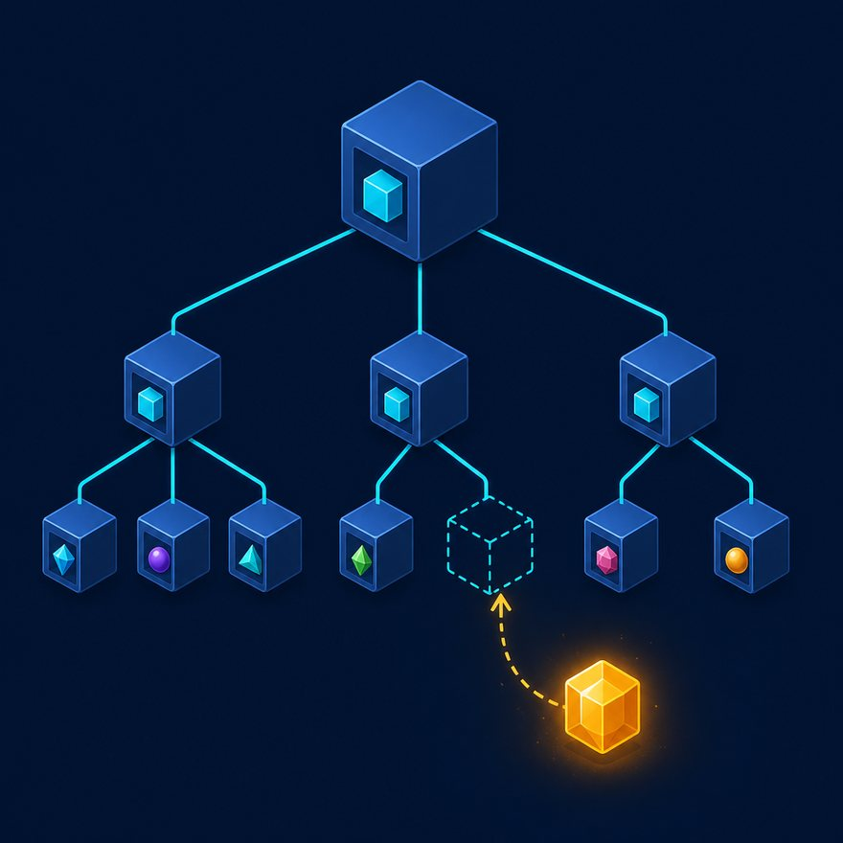
LAB 57
Zip headers with values into an object
Show the failing starter first. Hold the pause card before any solution.
industry · 8–12 min · LAB-57-zip-headers-with-values-into-an-object.mp4
Notes:
Open PowerPoint Slide Show (F5). Share this window. Switch to Playground on code slides.

Slide 2
LAB 57
The job
• This is Lab 57. Zip headers with values into an object. Dynamic columns: headers + values (same length).
• Build { Name: "Asha", Amount: "10.5" } using zip and dynamic keys.
• zip headers with values. Reduce into an object. Parentheses around the key.
Notes:
This is Lab 57. Zip headers with values into an object. Dynamic columns: `headers` + `values` (same length). Build `{ Name: "Asha", Amount: "10.5" }` using `zip` and dynamic keys. zip headers with values. Reduce into an object. Parentheses around the key.

Slide 3
LAB 57
Paste the payload
• Set the MIME type to match the sample.

Slide 4
LAB 57
Input
{
"headers": ["Name", "Amount", "City"],
"values": ["Asha", "10.5", "Pune"]
}
Notes:
Type this. Read the header: percent dw two point oh, output, dash dash dash.

Slide 5

PAUSE CARD
Pause — try Lab 57
• Pause the video
• Open student/labs/04-industry/57-zip-headers-with-values-into-an-object/
• Finish transform.dwl — wrong is fine
• Resume when you have an attempt
Notes:
Hold 3–5 seconds. Do not show the solution yet.

Slide 6
LAB 57
Welcome back
• Welcome back. I will type the reference script. Follow along; do not paste blindly. Header first: percent dw two point oh, output, dash dash dash.
• That should match Expected:

Slide 7
LAB 57
Solution
%dw 2.0
import zip from dw::core::Arrays
output application/json
---
zip(payload.headers, payload.values)
reduce ((pair, acc = {}) -> acc ++ { (pair[0]): pair[1] })
Notes:
Type this. Read the header: percent dw two point oh, output, dash dash dash.

Slide 8
LAB 57
Expected
{ "Name": "Asha", "Amount": "10.5", "City": "Pune" }
Notes:
Type this. Read the header: percent dw two point oh, output, dash dash dash.

Slide 9

LAB 57
Interview phrase
• zip headers with values. Reduce into an object. Parentheses around the key.
• If your output differs, check plus versus plus-plus, as Number, and nulls with default. Next lab is the next numbered folder.
• Stop. Do not start Lab 58 in this file.
Notes:
zip headers with values. Reduce into an object. Parentheses around the key. If your output differs, check plus versus plus-plus, as Number, and nulls with default. Next lab is the next numbered folder. Stop. Do not start Lab 58 in this file.

