Slide 1

LAB 65
Debezium CDC envelope to flat upsert rows
Show the failing starter first. Hold the pause card before any solution.
mapping · 8–12 min · LAB-65-debezium-cdc-envelope-to-flat-upsert-rows.mp4
Notes:
Open PowerPoint Slide Show (F5). Share this window. Switch to Playground on code slides.

Slide 2
LAB 65
The job
• This is Lab 65. Debezium CDC envelope to flat upsert rows. c/u → UPSERT from after; d → DELETE from before. Include tsMs.
• CDC: delete reads before. create and update read after. ts_ms on every row.
Notes:
This is Lab 65. Debezium CDC envelope to flat upsert rows. c/u → UPSERT from after; d → DELETE from before. Include tsMs. CDC: delete reads before. create and update read after. ts_ms on every row.

Slide 3
LAB 65
Paste the payload
• Set the MIME type to match the sample.

Slide 4
LAB 65
Input
{
"changes": [
{ "op": "c", "ts_ms": 100, "before": null, "after": { "id": "A1", "status": "NEW" } },
{ "op": "u", "ts_ms": 101, "before": { "id": "A1", "status": "NEW" }, "after": { "id": "A1", "status": "PAID" } },
{ "op": "d", "ts_ms": 102, "before": { "id": "B9", "status": "X" }, "after": null }
]
}
Notes:
Type this. Read the header: percent dw two point oh, output, dash dash dash.

Slide 5

PAUSE CARD
Pause — try Lab 65
• Pause the video
• Open student/labs/05-mapping/65-debezium-cdc-envelope-to-flat-upsert-rows/
• Finish transform.dwl — wrong is fine
• Resume when you have an attempt
Notes:
Hold 3–5 seconds. Do not show the solution yet.

Slide 6

LAB 65
Welcome back
• Welcome back. I will type the reference script. Follow along; do not paste blindly. Header first: percent dw two point oh, output, dash dash dash.
• That should match Expected:

Slide 7
LAB 65
Solution
%dw 2.0
output application/json
---
payload.changes map (c) -> do {
var row = if (c.op == "d") c.before else c.after
---
{
action: if (c.op == "d") "DELETE" else "UPSERT",
id: row.id,
status: row.status,
tsMs: c.ts_ms
}
}
Notes:
Type this. Read the header: percent dw two point oh, output, dash dash dash.

Slide 8
LAB 65
Expected
[
{ "action": "UPSERT", "id": "A1", "status": "NEW", "tsMs": 100 },
{ "action": "UPSERT", "id": "A1", "status": "PAID", "tsMs": 101 },
{ "action": "DELETE", "id": "B9", "status": "X", "tsMs": 102 }
]
Notes:
Type this. Read the header: percent dw two point oh, output, dash dash dash.

Slide 9
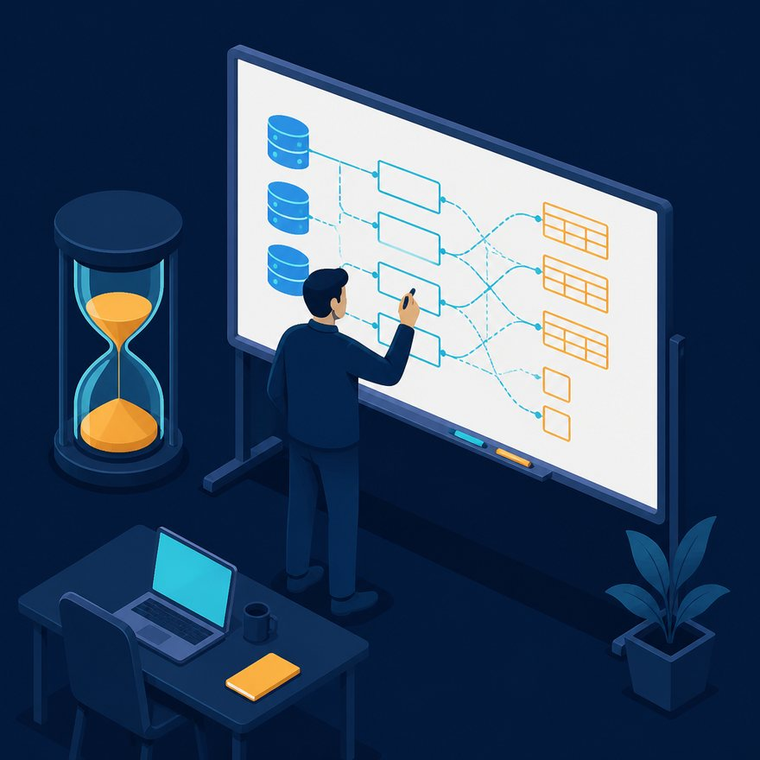
LAB 65
Interview phrase
• CDC: delete reads before. create and update read after. ts_ms on every row.
• If your output differs, check plus versus plus-plus, as Number, and nulls with default. Next lab is the next numbered folder.
• Stop. Do not start Lab 66 in this file.
Notes:
CDC: delete reads before. create and update read after. ts_ms on every row. If your output differs, check plus versus plus-plus, as Number, and nulls with default. Next lab is the next numbered folder. Stop. Do not start Lab 66 in this file.

