Slide 1
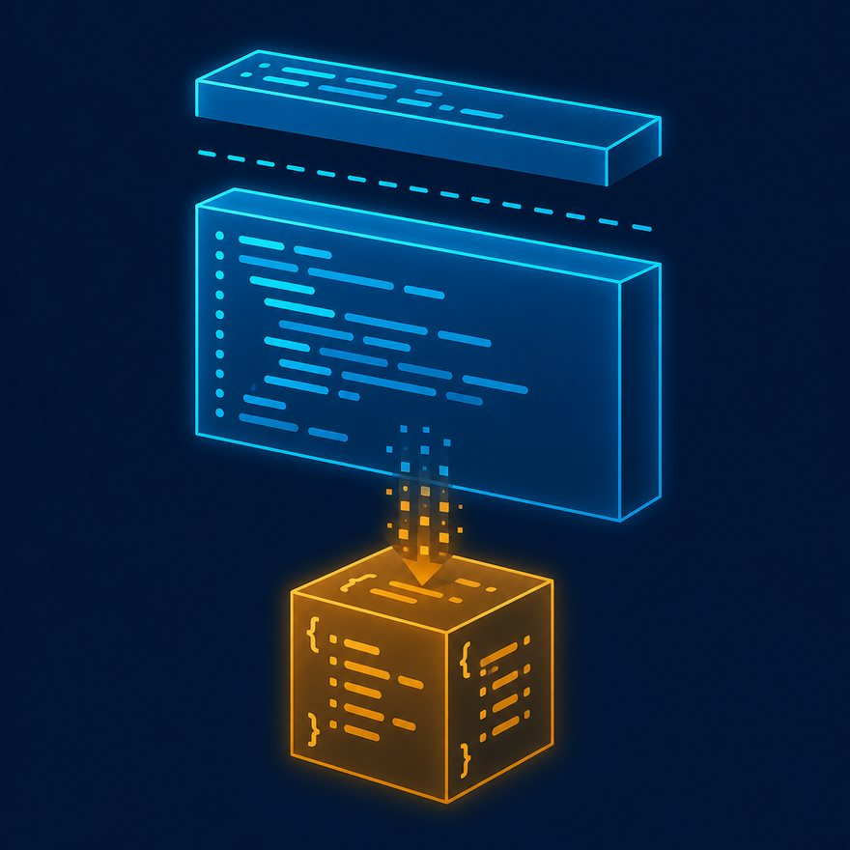
L05
What is DataWeave in Mule 4?
Record from this deck. Switch to the Playground when a code slide appears.
4–6 min · S02-L05-what-is-dataweave.mp4 · Video
Notes:
Open PowerPoint Slide Show (F5). Share this window. Switch to Playground on code slides.

Slide 2
L05
Open
• Open with a Transform Message on screen. Students need a one-sentence definition they can repeat in an interview.
Notes:
Open with a Transform Message on screen. Students need a one-sentence definition they can repeat in an interview.

Slide 3
L05
Q1. What is DataWeave?
• DataWeave is MuleSoft’s functional data transformation language.
• In Mule 4 it is the primary way to map, filter, enrich, and convert payloads between formats such as JSON, XML, CSV, Java objects, and strings.
• Scripts run inside the Transform Message component and also as DataWeave expressions (#[...]) in other processors.
Notes:
DataWeave is MuleSoft’s functional data transformation language. In Mule 4 it is the primary way to map, filter, enrich, and convert payloads between formats such as JSON, XML, CSV, Java objects, and strings. Scripts run inside the Transform Message component and also as DataWeave expressions (`#[...]`) in other processors. Type every DataWeave sample on screen. Read the header out loud: percent dw two point oh, output, dash dash dash.

Slide 4
L05
Next
• Stop. Do not start a new topic.

