Slide 1
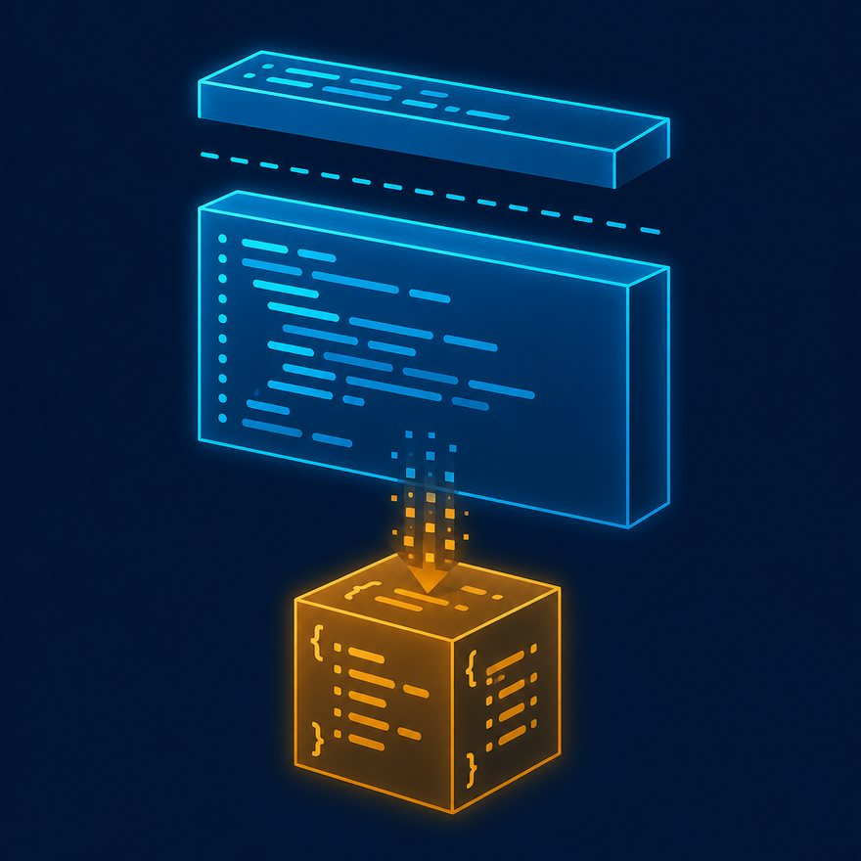
L08
Variables, functions, types, and as
Record from this deck. Switch to the Playground when a code slide appears.
7–10 min · S02-L08-var-fun-types.mp4 · Video
Notes:
Open PowerPoint Slide Show (F5). Share this window. Switch to Playground on code slides.

Slide 2
L08
Open
• One video for vars, functions, types, and as. Keep each beat under two minutes.
Notes:
One video for vars, functions, types, and as. Keep each beat under two minutes.

Slide 3
L08
Q4. How do you declare a variable in DataWeave?
• Use var in the header (script-scoped) or inside a do block.
• Variables are immutable. Comments: // and /* */ in header or body.
Notes:
Use `var` in the header (script-scoped) or inside a `do` block. Variables are immutable. Comments: `//` and `/* */` in header or body. Type every DataWeave sample on screen. Read the header out loud: percent dw two point oh, output, dash dash dash.

Slide 4
L08
Type this
%dw 2.0
output application/json
var taxRate = 0.18
---
{
total: payload.amount * (1 + taxRate)
}
Notes:
Use `var` in the header (script-scoped) or inside a `do` block. Variables are immutable. Comments: `//` and `/* */` in header or body. Type every DataWeave sample on screen. Read the header out loud: percent dw two point oh, output, dash dash dash.

Slide 5
L08
Q5. How do you define a custom function?
• Functions can be overloaded by argument types and arity.
Notes:
Functions can be overloaded by argument types and arity. Type every DataWeave sample on screen. Read the header out loud: percent dw two point oh, output, dash dash dash.

Slide 6
L08
Type this
%dw 2.0
output application/json
fun fullName(first: String, last: String) = first ++ " " ++ last
---
fullName(payload.firstName, payload.lastName)
Notes:
Functions can be overloaded by argument types and arity. Type every DataWeave sample on screen. Read the header out loud: percent dw two point oh, output, dash dash dash.

Slide 7
L08
Q6. What are the main DataWeave data types?
• String, Boolean, Number, Date, DateTime, LocalDateTime, Time, Period, Regex, Array, Object, Null, Binary, Type, and Any.
• Type annotations are optional but useful in interviews and modules:
Notes:
`String`, `Boolean`, `Number`, `Date`, `DateTime`, `LocalDateTime`, `Time`, `Period`, `Regex`, `Array`, `Object`, `Null`, `Binary`, `Type`, and `Any`. Type annotations are optional but useful in interviews and modules: Type every DataWeave sample on screen. Read the header out loud: percent dw two point oh, output, dash dash dash.

Slide 8
L08
Type this
fun add(a: Number, b: Number): Number = a + b
Notes:
`String`, `Boolean`, `Number`, `Date`, `DateTime`, `LocalDateTime`, `Time`, `Period`, `Regex`, `Array`, `Object`, `Null`, `Binary`, `Type`, and `Any`. Type annotations are optional but useful in interviews and modules: Type every DataWeave sample on screen. Read the header out loud: percent dw two point oh, output, dash dash dash.

Slide 9
L08
Q7. How do you convert types (as)?
• Use as for coercion:
• If coercion fails, the script errors unless you use try / default.
Notes:
Use `as` for coercion: If coercion fails, the script errors unless you use `try` / `default`. Type every DataWeave sample on screen. Read the header out loud: percent dw two point oh, output, dash dash dash.

Slide 10
L08
Type this
payload.age as Number
payload.createdAt as Date {format: "yyyy-MM-dd"}
payload as String {encoding: "UTF-8"}
Notes:
Use `as` for coercion: If coercion fails, the script errors unless you use `try` / `default`. Type every DataWeave sample on screen. Read the header out loud: percent dw two point oh, output, dash dash dash.

Slide 11
L08
Next
• Stop. Do not start a new topic.

