Slide 1
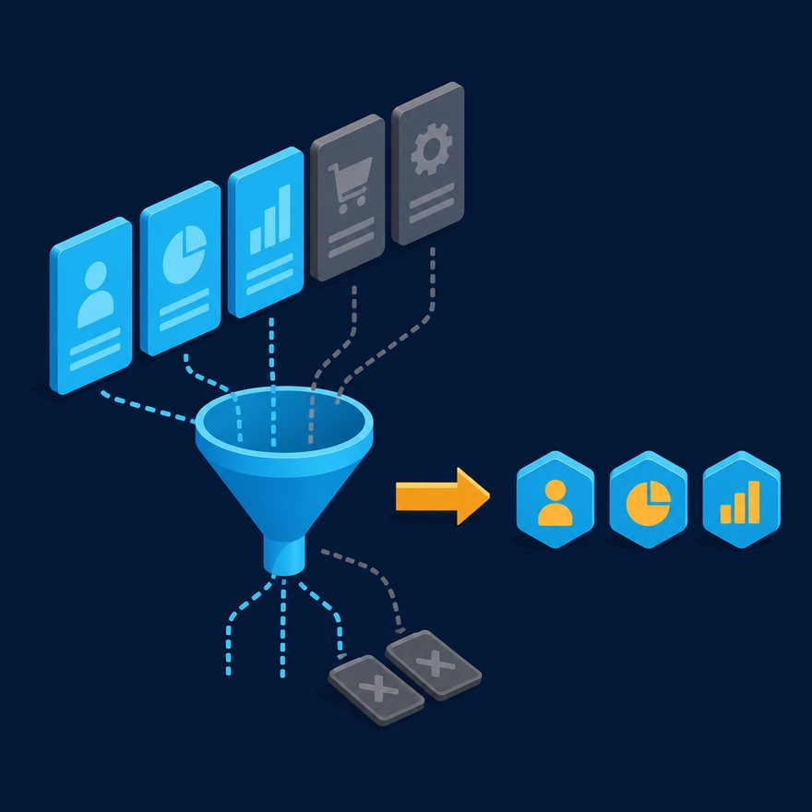
L13
Section bridge: array labs
Record from this deck. Switch to the Playground when a code slide appears.
1–2 min · S03-L13-array-labs-bridge.mp4 · Optional video
Notes:
Open PowerPoint Slide Show (F5). Share this window. Switch to Playground on code slides.

Slide 2
L13
Section bridge: array labs
• Arrays concepts are done. Record Lab 01 and Lab 02 as the on-camera demos. Homework labs 09, 10, 14, and 15 each have their own video.
• Pause, try, then play the matching lab lecture. Then the Arrays quiz.
Notes:
Arrays concepts are done. Record Lab 01 and Lab 02 as the on-camera demos. Homework labs 09, 10, 14, and 15 each have their own video. Pause, try, then play the matching lab lecture. Then the Arrays quiz.

Slide 3
L13
Next
• Stop. Do not start a new topic.

