Slide 1

LAB 14
Index each batch row (1-based)
Show the failing starter first. Hold the pause card before any solution.
easy · 6–10 min · LAB-14-index-each-batch-row-1-based.mp4
Notes:
Open PowerPoint Slide Show (F5). Share this window. Switch to Playground on code slides.

Slide 2
LAB 14
The job
• This is Lab 14. Index each batch row (1-based). Add a 1-based rowNum for error reports. $ is value, $$ is 0-based index.
• Dollar-dollar is the 0-based index. Add one for rowNum in error reports.
Notes:
This is Lab 14. Index each batch row (1-based). Add a 1-based `rowNum` for error reports. `$` is value, `$$` is 0-based index. Dollar-dollar is the 0-based index. Add one for rowNum in error reports.

Slide 3
LAB 14
Paste the payload
• Set the MIME type to match the sample.

Slide 4
LAB 14
Input
["alpha", "beta"]
Notes:
Type this. Read the header: percent dw two point oh, output, dash dash dash.

Slide 5

PAUSE CARD
Pause — try Lab 14
• Pause the video
• Open student/labs/01-fundamentals/14-index-each-batch-row-1-based/
• Finish transform.dwl — wrong is fine
• Resume when you have an attempt
Notes:
Hold 3–5 seconds. Do not show the solution yet.

Slide 6
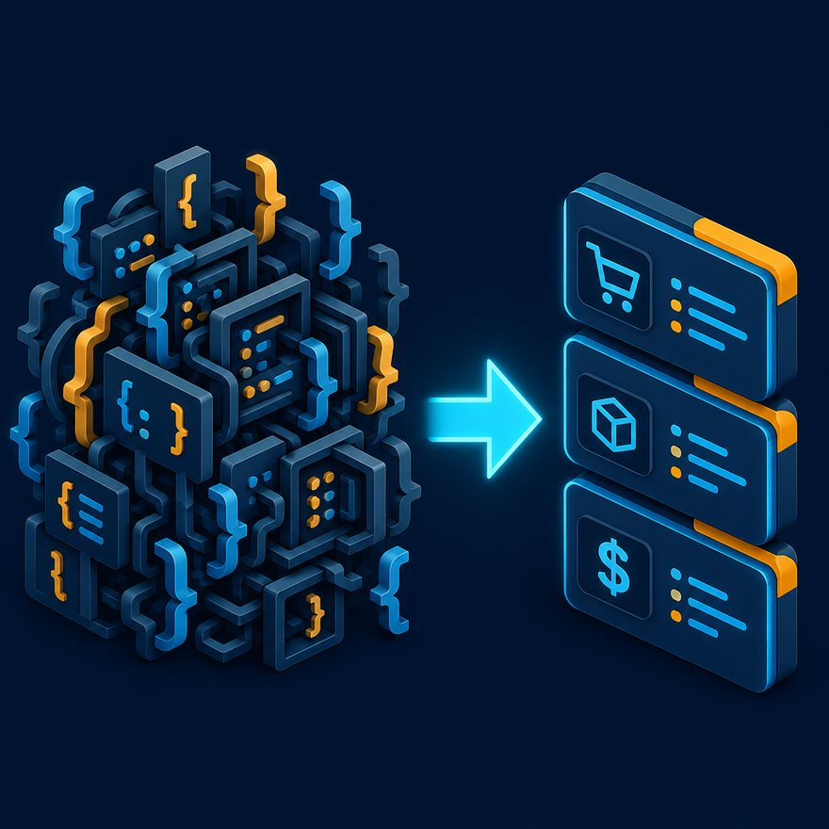
LAB 14
Welcome back
• Welcome back. I will type the reference script. Follow along; do not paste blindly. Header first: percent dw two point oh, output, dash dash dash.
• That should match Expected:

Slide 7
LAB 14
Solution
%dw 2.0
output application/json
---
payload map {
rowNum: $$ + 1,
value: $
}
Notes:
Type this. Read the header: percent dw two point oh, output, dash dash dash.

Slide 8
LAB 14
Expected
[{ "rowNum": 1, "value": "alpha" }, { "rowNum": 2, "value": "beta" }]
Notes:
Type this. Read the header: percent dw two point oh, output, dash dash dash.

Slide 9
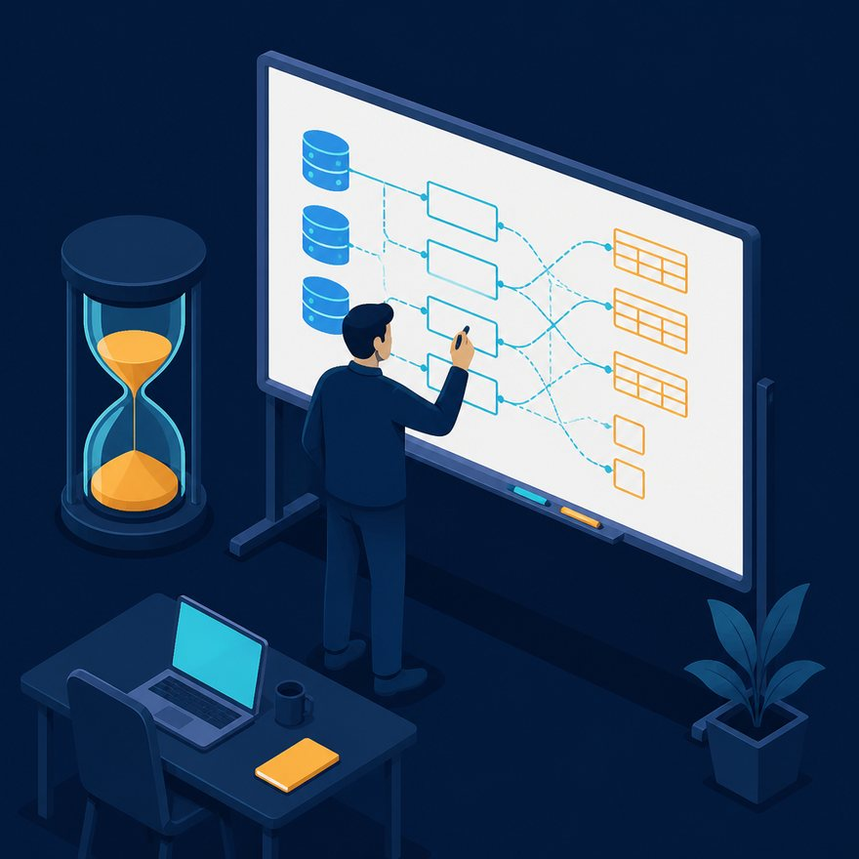
LAB 14
Interview phrase
• Dollar-dollar is the 0-based index. Add one for rowNum in error reports.
• If your output differs, check plus versus plus-plus, as Number, and nulls with default. Next lab is the next numbered folder.
• Stop. Do not start Lab 15 in this file.
Notes:
Dollar-dollar is the 0-based index. Add one for rowNum in error reports. If your output differs, check plus versus plus-plus, as Number, and nulls with default. Next lab is the next numbered folder. Stop. Do not start Lab 15 in this file.

