Slide 1
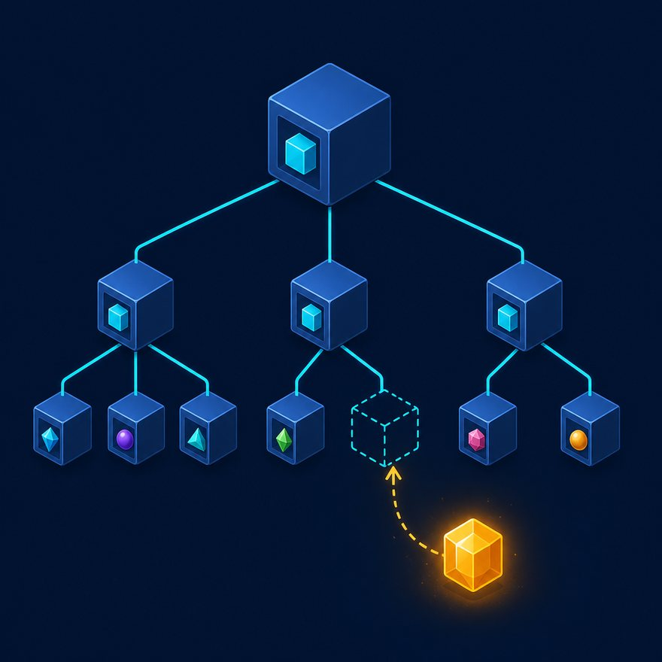
LAB 22
Pivot array to object keyed by Id
Show the failing starter first. Hold the pause card before any solution.
moderate · 6–10 min · LAB-22-pivot-array-to-object-keyed-by-id.mp4
Notes:
Open PowerPoint Slide Show (F5). Share this window. Switch to Playground on code slides.

Slide 2
LAB 22
The job
• This is Lab 22. Pivot array to object keyed by Id. [{ "Id": "001xxA", "Name": "Acme" }] → { "001xxA": "Acme" } for O(1) lookup. Dynamic key
• reduce into an object keyed by Salesforce Id. Parentheses around the key.
Notes:
This is Lab 22. Pivot array to object keyed by Id. `[{ "Id": "001xxA", "Name": "Acme" }]` → `{ "001xxA": "Acme" }` for O(1) lookup. Dynamic key reduce into an object keyed by Salesforce Id. Parentheses around the key.

Slide 3
LAB 22
Paste the payload
• Set the MIME type to match the sample.

Slide 4
LAB 22
Input
[
{ "Id": "001xxA", "Name": "Acme Corp" },
{ "Id": "001xxB", "Name": "Globex" }
]
Notes:
Type this. Read the header: percent dw two point oh, output, dash dash dash.

Slide 5

PAUSE CARD
Pause — try Lab 22
• Pause the video
• Open student/labs/02-intermediate/22-pivot-array-to-object-keyed-by-id/
• Finish transform.dwl — wrong is fine
• Resume when you have an attempt
Notes:
Hold 3–5 seconds. Do not show the solution yet.

Slide 6
LAB 22
Welcome back
• Welcome back. I will type the reference script. Follow along; do not paste blindly. Header first: percent dw two point oh, output, dash dash dash.
• That should match Expected:

Slide 7
LAB 22
Solution
%dw 2.0
output application/json
---
payload reduce ((item, acc = {}) -> acc ++ { (item.Id): item.Name })
Notes:
Type this. Read the header: percent dw two point oh, output, dash dash dash.

Slide 8
LAB 22
Expected
{ "001xxA": "Acme Corp", "001xxB": "Globex" }
Notes:
Type this. Read the header: percent dw two point oh, output, dash dash dash.

Slide 9

LAB 22
Interview phrase
• reduce into an object keyed by Salesforce Id. Parentheses around the key.
• If your output differs, check plus versus plus-plus, as Number, and nulls with default. Next lab is the next numbered folder.
• Stop. Do not start Lab 23 in this file.
Notes:
reduce into an object keyed by Salesforce Id. Parentheses around the key. If your output differs, check plus versus plus-plus, as Number, and nulls with default. Next lab is the next numbered folder. Stop. Do not start Lab 23 in this file.

