Slide 1
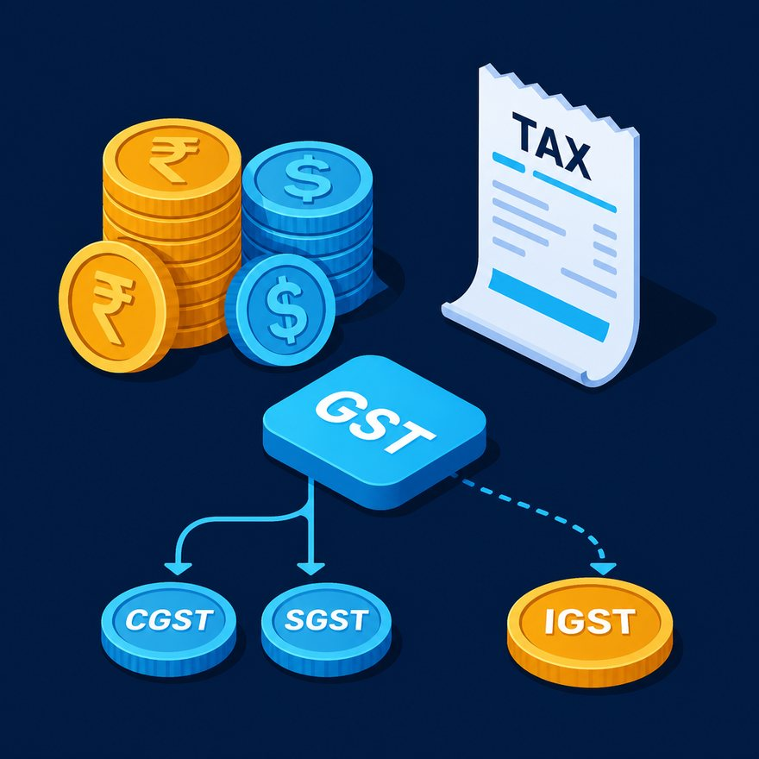
LAB 54
Production invoice: discounts, tax, skip zero qty
Show the failing starter first. Hold the pause card before any solution.
hard · 8–12 min · LAB-54-production-invoice-discounts-tax-skip-zero-qty.mp4
Notes:
Open PowerPoint Slide Show (F5). Share this window. Switch to Playground on code slides.

Slide 2
LAB 54
The job
• This is Lab 54. Production invoice: discounts, tax, skip zero qty.
• Drop lines with qty ≤ 0. lineTotal = qty * price * (1 - discountPct) rounded to 2 decimals. subtotal = sum of line totals. tax = subtotal × taxRate. grandTotal = subtotal + tax.
• Header var / fun money.
• Filter qty greater than zero. Discount then tax. fun money on every currency field.
Notes:
This is Lab 54. Production invoice: discounts, tax, skip zero qty. Drop lines with `qty` ≤ 0. `lineTotal = qty * price * (1 - discountPct)` rounded to 2 decimals. `subtotal` = sum of line totals. `tax` = subtotal × `taxRate`. `grandTotal` = subtotal + tax. Header `var` / `fun money`. Filter qty greater than zero. Discount then tax. fun money on every currency field.

Slide 3
LAB 54
Paste the payload
• Set the MIME type to match the sample.

Slide 4
LAB 54
Input
{
"taxRate": 0.18,
"currency": "INR",
"lines": [
{ "sku": "SKU-A", "qty": 2, "price": 50, "discountPct": 0.10 },
{ "sku": "SKU-B", "qty": 1, "price": 100, "discountPct": 0 },
{ "sku": "SKU-Z", "qty": 0, "price": 999, "discountPct": 0 }
]
}
Notes:
Type this. Read the header: percent dw two point oh, output, dash dash dash.

Slide 5

PAUSE CARD
Pause — try Lab 54
• Pause the video
• Open student/labs/03-advanced/54-production-invoice-discounts-tax-skip-zero-qty/
• Finish transform.dwl — wrong is fine
• Resume when you have an attempt
Notes:
Hold 3–5 seconds. Do not show the solution yet.

Slide 6
LAB 54
Welcome back
• Welcome back. I will type the reference script. Follow along; do not paste blindly. Header first: percent dw two point oh, output, dash dash dash.
• That should match Expected:
• SKU-Z omitted; SKU-A lineTotal 90.00; SKU-B 100.00; subtotal 190.00; tax 34.20; grandTotal 224.20.

Slide 7
LAB 54
Solution
%dw 2.0
output application/json
fun money(n: Number) = n as String {format: "0.00"} as Number
var lines = payload.lines
filter ((l) -> (l.qty as Number) > 0)
map (l) -> do {
var qty = l.qty as Number
var price = l.price as Number
var disc = (l.discountPct default 0) as Number
---
l ++ { lineTotal: money(qty * price * (1 - disc)) }
}
var subtotal = money(sum(lines.lineTotal))
var tax = money(subtotal * payload.taxRate)
---
…
Notes:
Type this. Read the header: percent dw two point oh, output, dash dash dash.

Slide 8

LAB 54
Interview phrase
• Filter qty greater than zero. Discount then tax. fun money on every currency field.
• If your output differs, check plus versus plus-plus, as Number, and nulls with default. Next lab is the next numbered folder.
• Stop. Do not start Lab 55 in this file.
Notes:
Filter qty greater than zero. Discount then tax. fun money on every currency field. If your output differs, check plus versus plus-plus, as Number, and nulls with default. Next lab is the next numbered folder. Stop. Do not start Lab 55 in this file.

