Slide 1

LAB 70
Bank statement lines to signed running ledger
Show the failing starter first. Hold the pause card before any solution.
mapping · 8–12 min · LAB-70-bank-statement-lines-to-signed-running-ledger.mp4
Notes:
Open PowerPoint Slide Show (F5). Share this window. Switch to Playground on code slides.

Slide 2
LAB 70
The job
• This is Lab 70. Bank statement lines to signed running ledger. CR positive, DR negative. Running balance from 0. fun money.
• CR plus, DR minus. reduce running balance. fun money.
Notes:
This is Lab 70. Bank statement lines to signed running ledger. CR positive, DR negative. Running balance from 0. fun money. CR plus, DR minus. reduce running balance. fun money.

Slide 3
LAB 70
Paste the payload
• Set the MIME type to match the sample.

Slide 4
LAB 70
Input
[
{ "nar": "SALARY", "dc": "CR", "amt": "1000.00" },
{ "nar": "UPI", "dc": "DR", "amt": "250.5" },
{ "nar": "REV", "dc": "CR", "amt": "50" }
]
Notes:
Type this. Read the header: percent dw two point oh, output, dash dash dash.

Slide 5

PAUSE CARD
Pause — try Lab 70
• Pause the video
• Open student/labs/05-mapping/70-bank-statement-lines-to-signed-running-ledger/
• Finish transform.dwl — wrong is fine
• Resume when you have an attempt
Notes:
Hold 3–5 seconds. Do not show the solution yet.

Slide 6

LAB 70
Welcome back
• Welcome back. I will type the reference script. Follow along; do not paste blindly. Header first: percent dw two point oh, output, dash dash dash.
• That should match Expected:

Slide 7
LAB 70
Solution
%dw 2.0
output application/json
fun money(n: Number) = n as String {format: "0.00"} as Number
---
payload reduce ((row, acc = { bal: 0, out: [] }) -> do {
var signed = if (row.dc == "DR") -(row.amt as Number) else (row.amt as Number)
var next = acc.bal + signed
---
{
bal: next,
out: acc.out ++ [{
narration: row.nar,
amount: money(signed),
balance: money(next)
}]
…
Notes:
Type this. Read the header: percent dw two point oh, output, dash dash dash.

Slide 8
LAB 70
Expected
[
{ "narration": "SALARY", "amount": 1000.00, "balance": 1000.00 },
{ "narration": "UPI", "amount": -250.50, "balance": 749.50 },
{ "narration": "REV", "amount": 50.00, "balance": 799.50 }
]
Notes:
Type this. Read the header: percent dw two point oh, output, dash dash dash.

Slide 9
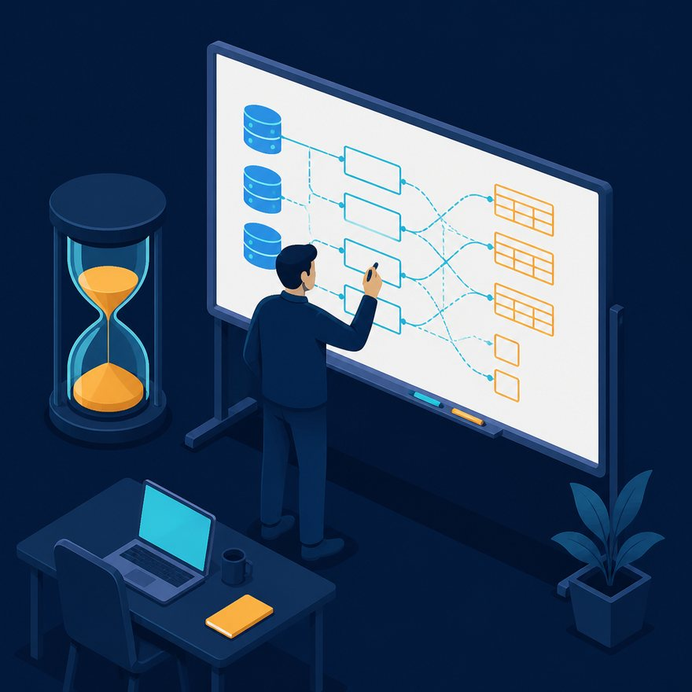
LAB 70
Interview phrase
• CR plus, DR minus. reduce running balance. fun money.
• If your output differs, check plus versus plus-plus, as Number, and nulls with default. Next lab is the next numbered folder.
• Stop. Do not start Lab 71 in this file.
Notes:
CR plus, DR minus. reduce running balance. fun money. If your output differs, check plus versus plus-plus, as Number, and nulls with default. Next lab is the next numbered folder. Stop. Do not start Lab 71 in this file.

