Slide 1
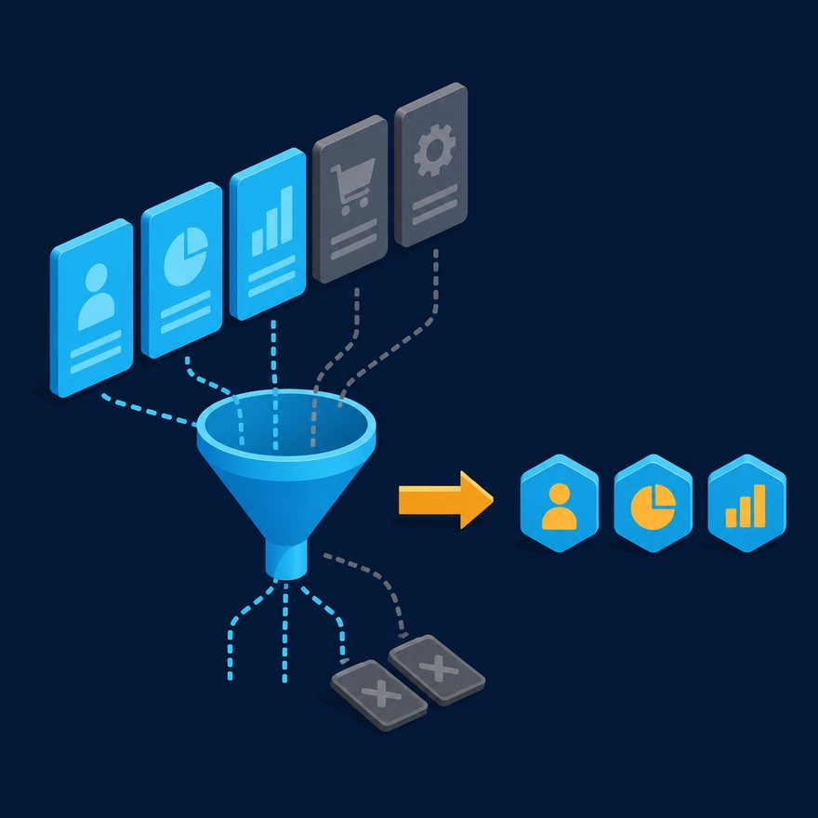
03-ARRAYS-AND-CORE-OPERATORS
Arrays: map, filter, and indexes
Section opener. Then jump into the concept videos and labs.
Notes:
Open PowerPoint Slide Show (F5). Share this window. Switch to Playground on code slides.

Slide 2
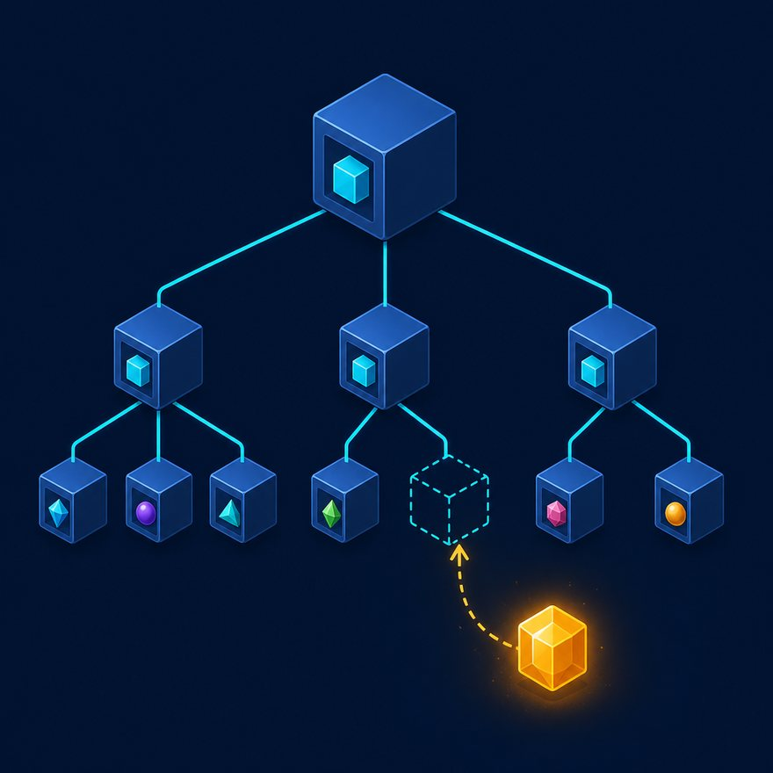
03-ARRAYS-AND-CORE-OPERATORS
Learning objectives
• Use map, filter, $ / $$, sizeOf, isEmpty, and flatten.
• Explain when named lambda parameters are clearer than $.

Slide 3
03-ARRAYS-AND-CORE-OPERATORS
Suggested video breakdown
• Demo Lab 01 (map shape) and Lab 02 (filter) on camera.
• Assign Labs 09–10, 14–15 as homework.

Slide 4
03-ARRAYS-AND-CORE-OPERATORS
Labs in this section
• Lab 01
• Lab 02
• Lab 09
• Lab 10

Slide 5
03-ARRAYS-AND-CORE-OPERATORS
Labs in this section (cont.)
• Lab 14
• Lab 15

Slide 6

03-ARRAYS-AND-CORE-OPERATORS
Interview talking points for this section
• $ is the current item, $$ is the index: payload map { index: $$, value: $ }.
• filter keeps elements where the predicate is true.
• $ — first argument (item / value)
• $$ — second (index / key depending on function)

Slide 7
03-ARRAYS-AND-CORE-OPERATORS
Interview talking points for this section (cont.)
• $$$ — third (index in mapObject / pluck)

Slide 8
03-ARRAYS-AND-CORE-OPERATORS
Interview talking points for this section
%dw 2.0
output application/json
---
payload.orders
filter ((order) -> order.status == "PAID")
map ((order) -> {
id: order.id,
total: order.amount
})
Notes:
Type this. Read the header: percent dw two point oh, output, dash dash dash.

Slide 9

03-ARRAYS-AND-CORE-OPERATORS
The loop
• Concept — one idea, 3–7 minutes
• Pause — hold the card, students try
• Lab — type from the starter, not the solution
• Quiz — Udemy practice test, no video
Notes:
Hit this slide on section openers so students remember the gym loop.

