Slide 1
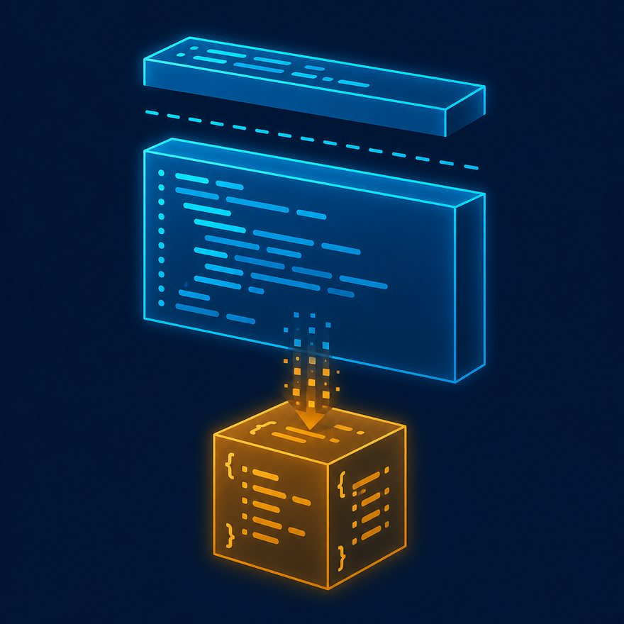
DATAWEAVE 2.0 FUNDAMENTALS
What is DataWeave?
Plain-language walkthrough. Then jump to the matching concept or lab video.
Notes:
Open PowerPoint Slide Show (F5). Share this window. Switch to Playground on code slides.

Slide 2
DATAWEAVE 2.0 FUNDAMENTALS
In one sentence
• DataWeave is MuleSoft’s language for changing data from one shape to another.

Slide 3
DATAWEAVE 2.0 FUNDAMENTALS
Like this in real life
• Think of a translator. A Salesforce Contact comes in as JSON. Your API wants a smaller JSON. DataWeave does that translation.

Slide 4
DATAWEAVE 2.0 FUNDAMENTALS
Tiny example
• Read this slowly. Header first, then the body.

Slide 5
DATAWEAVE 2.0 FUNDAMENTALS
Tiny example
%dw 2.0
output application/json
---
{
name: payload.Name,
email: payload.Email
}
Notes:
Type this. Read the header: percent dw two point oh, output, dash dash dash.

Slide 6
DATAWEAVE 2.0 FUNDAMENTALS
Remember
• In Mule 4 you write DataWeave in Transform Message, and also as #[...] in other steps. It is not Java.
• After you try the lab for this section, replay the concept video. Spoken model answers are on the bootcamp mock video — not in a downloadable answer key.

