Slide 1
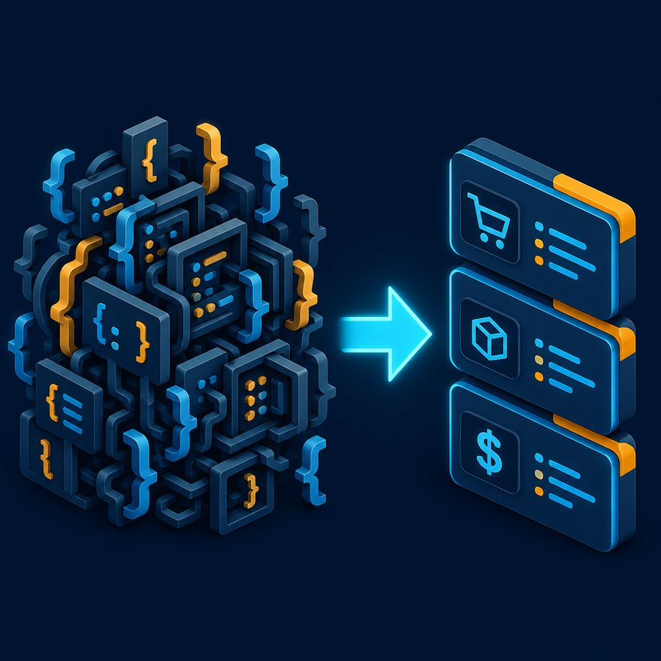
INDEX
Recording slides
Course catalog as a shareable deck. F5, then open the matching lecture or lab PPTX.
Converted from instructor/slides/index.html · 16:9 screen share
Notes:
Open PowerPoint Slide Show (F5). Share this window. Switch to Playground on code slides.

Slide 2
INDEX
How to use this file
• Share this window for a course walkthrough or recording plan.
• Each later slide is one section from the HTML index.
• When you record a video, switch to that file under pptx/lectures or pptx/labs.
• Pause cards stay in the lab decks — not in this index.

Slide 3
INDEX
In this index
• 1. Welcome and setup (5)
• 2. DataWeave 2.0 fundamentals (6)
• 3. Arrays: map, filter, and indexes (4)
• 4. Objects, nulls, and selectors (5)

Slide 4
INDEX
In this index (cont.)
• 5. Strings, numbers, and conditionals (4)
• 6. JSON, XML, and CSV mappings (5)
• 7. Group, reduce, merge, and update (6)
• 8. Dates, pattern matching, and try (4)

Slide 5
INDEX
In this index (cont.)
• 9. Joins, modules, and Mule context (5)
• 10. Advanced: recursion, namespaces, diffs (6)
• 11. Streaming, crypto, modules, and pitfalls (4)
• 12. Industry operators, message, and MIME (5)

Slide 6
INDEX
In this index (cont.)
• 13. DataWeave Mapping (5)
• 14. Interview bootcamp (5)
• 15. Labs 01–88 (88)

Slide 7
INDEX
Welcome and setup
• Section opener — Welcome and setup
• Concept video — L01 — Welcome and what you will build
• Concept video — L02 — How this course works (concept, pause, lab, quiz)
• Concept video — L03 — Getting started: Playground vs Transform Message

Slide 8
INDEX
Welcome and setup (cont.)
• Concept video — L04 — Tour of the student lab folder

Slide 9
INDEX
DataWeave 2.0 fundamentals
• Section opener — DataWeave 2.0 fundamentals
• Concept video — L05 — What is DataWeave in Mule 4?
• Concept video — L06 — DataWeave 1.0 vs 2.0
• Concept video — L07 — Script structure: header, output, body

Slide 10
INDEX
DataWeave 2.0 fundamentals (cont.)
• Concept video — L08 — Variables, functions, types, and as
• Concept video — L09 — Section bridge: fundamentals labs

Slide 11
INDEX
Arrays: map, filter, and indexes
• Section opener — Arrays: map, filter, and indexes
• Concept video — L11 — map, filter, dollar and dollar-dollar
• Concept video — L12 — sizeOf, isEmpty, flatten
• Concept video — L13 — Section bridge: array labs

Slide 12
INDEX
Objects, nulls, and selectors
• Section opener — Objects, nulls, and selectors
• Concept video — L15 — Selectors: dot, brackets, star, descendant
• Concept video — L16 — default, safe selector, skipNullOn
• Concept video — L17 — mapObject and pluck

Slide 13
INDEX
Objects, nulls, and selectors (cont.)
• Concept video — L18 — Section bridge: object labs

Slide 14
INDEX
Strings, numbers, and conditionals
• Section opener — Strings, numbers, and conditionals
• Concept video — L20 — plus-plus vs plus; split, join, case
• Concept video — L21 — if/else expressions (no Java ternary)
• Concept video — L22 — Section bridge: string labs

Slide 15
INDEX
JSON, XML, and CSV mappings
• Section opener — JSON, XML, and CSV mappings
• Concept video — L24 — JSON to XML (single root)
• Concept video — L25 — XML attributes and repeating elements
• Concept video — L26 — CSV to JSON and JSON to CSV

Slide 16
INDEX
JSON, XML, and CSV mappings (cont.)
• Concept video — L27 — Section bridge: format labs

Slide 17
INDEX
Group, reduce, merge, and update
• Section opener — Group, reduce, merge, and update
• Concept video — L29 — groupBy, orderBy, distinctBy
• Concept video — L30 — reduce and flatten
• Concept video — L31 — flatMap line items (concept)

Slide 18
INDEX
Group, reduce, merge, and update (cont.)
• Concept video — L32 — Merge, update, and do
• Concept video — L33 — Homework recap pointer (Lab 20)

Slide 19
INDEX
Dates, pattern matching, and try
• Section opener — Dates, pattern matching, and try
• Concept video — L35 — Dates, formats, and periods
• Concept video — L36 — match and try / orElse
• Concept video — L37 — Section bridge: date labs

Slide 20
INDEX
Joins, modules, and Mule context
• Section opener — Joins, modules, and Mule context
• Concept video — L39 — vars, attributes, and properties
• Concept video — L40 — Modules and Transform Message vs hash-bracket
• Concept video — L41 — Section bridge: join labs 31–32

Slide 21
INDEX
Joins, modules, and Mule context (cont.)
• Concept video — L42 — Why not lookup or Java inside every map

Slide 22
INDEX
Advanced: recursion, namespaces, diffs
• Section opener — Advanced: recursion, namespaces, diffs
• Concept video — L44 — Recursion and match on types
• Concept video — L45 — Deep PII mask (concept)
• Concept video — L46 — XML namespaces read and write

Slide 23
INDEX
Advanced: recursion, namespaces, diffs (cont.)
• Concept video — L47 — Dynamic keys, diffs, last-wins, pagination
• Concept video — L48 — Section bridge: capstone labs 53–54

Slide 24
INDEX
Streaming, crypto, modules, and pitfalls
• Section opener — Streaming, crypto, modules, and pitfalls
• Concept video — L50 — Streaming: what breaks it
• Concept video — L51 — Crypto, binary, reader/writer properties
• Concept video — L52 — Reusable modules and performance pitfalls

Slide 25
INDEX
Industry operators, message, and MIME
• Section opener — Industry operators, message, and MIME
• Concept video — L70 — Arrays helpers: maxBy, firstWith, zip, ranges
• Concept video — L71 — Types, money, timezones, Dates module
• Concept video — L72 — TM targets, Java MIME, readUrl, log, HTTP attributes

Slide 26
INDEX
Industry operators, message, and MIME (cont.)
• Concept video — L73 — XML ns extras, Excel/YAML, DW vs Batch

Slide 27
INDEX
DataWeave Mapping
• Section opener — DataWeave Mapping
• Cluster video — Mapping cluster A — CRM, commerce, payments
• Cluster video — Mapping cluster B — ITSM, CDC, FX, EDI
• Cluster video — Mapping cluster C — IAM, stock, GST, claims

Slide 28
INDEX
DataWeave Mapping (cont.)
• Cluster video — Mapping cluster D — telco, recon, events

Slide 29
INDEX
Interview bootcamp
• Section opener — Interview bootcamp
• Concept video — L54a — How to run the 80-question bank
• Concept video — L55 — Whiteboard mock interview (set of 6)
• Concept video — L56 — Nested XML to canonical JSON (Q60)

Slide 30
INDEX
Interview bootcamp (cont.)
• Concept video — L58 — Next steps and solutions pack

Slide 31
INDEX
Labs 01–88
• Lab video — Lab 01 — Map Salesforce Contact to a shorter API shape
• Lab video — Lab 02 — Filter settled commerce orders
• Lab video — Lab 03 — Sum invoice line amounts (string money)
• Lab video — Lab 04 — Uppercase string fields on an address object

Slide 32
INDEX
Labs 01–88 (cont.)
• Lab video — Lab 05 — Default missing email on an Account
• Lab video — Lab 06 — Split a CSV line into fields
• Lab video — Lab 07 — Join SKUs into a comma-separated string
• Lab video — Lab 08 — Add GST to a unit price (2 decimal money)

Slide 33
INDEX
Labs 01–88 (cont.)
• Lab video — Lab 09 — Extract unique billing cities, sorted
• Lab video — Lab 10 — Count line items in a composite payload
• Lab video — Lab 11 — Convert JSON array to XML with a single root
• Lab video — Lab 12 — Read XML attributes vs element text

Slide 34
INDEX
Labs 01–88 (cont.)
• Lab video — Lab 13 — Classify an HTTP/integration status
• Lab video — Lab 14 — Index each batch row (1-based)
• Lab video — Lab 15 — Flatten one level of nested arrays
• Lab video — Lab 16 — Object keys to array of { key, value }

Slide 35
INDEX
Labs 01–88 (cont.)
• Lab video — Lab 17 — Boolean flag from dirty string
• Lab video — Lab 18 — SKU prefix before hyphen
• Lab video — Lab 19 — Group orders by customerId
• Lab video — Lab 20 — Total amount per customer (groupBy + sum)

Slide 36
INDEX
Labs 01–88 (cont.)
• Lab video — Lab 21 — Sort products by unitPrice descending
• Lab video — Lab 22 — Pivot array to object keyed by Id
• Lab video — Lab 23 — Expand order lines (flatMap)
• Lab video — Lab 24 — Strip password, ssn, and accessToken keys

Slide 37
INDEX
Labs 01–88 (cont.)
• Lab video — Lab 25 — Merge config overlay (right wins)
• Lab video — Lab 26 — Update nested city to uppercase (Mule 4.3+)
• Lab video — Lab 27 — Parse mixed date formats (ISO or dd/MM/yyyy)
• Lab video — Lab 28 — Format an event timestamp as dd-MMM-yyyy

Slide 38
INDEX
Labs 01–88 (cont.)
• Lab video — Lab 29 — CSV to JSON with number coercion
• Lab video — Lab 30 — JSON to CSV for finance export
• Lab video — Lab 31 — Left join orders to customers
• Lab video — Lab 32 — Join without leftJoin (groupBy lookup)

Slide 39
INDEX
Labs 01–88 (cont.)
• Lab video — Lab 33 — Pattern match HTTP status class
• Lab video — Lab 34 — Window / paginate a bulk array
• Lab video — Lab 35 — Deduplicate by email, keep last record (CDC)
• Lab video — Lab 36 — Dynamic object keys from header pairs

Slide 40
INDEX
Labs 01–88 (cont.)
• Lab video — Lab 37 — Recursively flatten nested arrays
• Lab video — Lab 38 — Collect all id fields at any depth
• Lab video — Lab 39 — Deep mask PII keys (ssn, password, email, accessToken)
• Lab video — Lab 40 — Recursively sum all numbers in a mixed tree

Slide 41
INDEX
Labs 01–88 (cont.)
• Lab video — Lab 41 — SOAP namespaced purchase order to canonical JSON
• Lab video — Lab 42 — Write namespaced XML from canonical JSON
• Lab video — Lab 43 — CDC flat diff (before vs after)
• Lab video — Lab 44 — Recursive nested diff

Slide 42
INDEX
Labs 01–88 (cont.)
• Lab video — Lab 45 — Chunk array into batches of N (Salesforce Composite / bulk)
• Lab video — Lab 46 — Running totals (ledger)
• Lab video — Lab 47 — Error-code frequency from log lines
• Lab video — Lab 48 — Validate and partition good vs bad rows

Slide 43
INDEX
Labs 01–88 (cont.)
• Lab video — Lab 49 — Outer-join style merge of two lists by id
• Lab video — Lab 50 — Tree map: apply f to every leaf string
• Lab video — Lab 51 — Cartesian product of SKU options
• Lab video — Lab 52 — Safe unit price with try

Slide 44
INDEX
Labs 01–88 (cont.)
• Lab video — Lab 53 — Build a nested org chart from a flat HR list
• Lab video — Lab 54 — Production invoice: discounts, tax, skip zero qty
• Lab video — Lab 55 — maxBy and firstWith on a work queue
• Lab video — Lab 56 — Shift DateTime to IST for display

Slide 45
INDEX
Labs 01–88 (cont.)
• Lab video — Lab 57 — Zip headers with values into an object
• Lab video — Lab 58 — Simulate Transform Message payload + vars
• Lab video — Lab 59 — Salesforce Account composite to nested customer API
• Lab video — Lab 60 — SAP-style order JSON to canonical invoice with GST

Slide 46
INDEX
Labs 01–88 (cont.)
• Lab video — Lab 61 — Workday workers to HR API (active only)
• Lab video — Lab 62 — Shopify order to ERP sales order
• Lab video — Lab 63 — Stripe charges enriched with customer
• Lab video — Lab 64 — ServiceNow incident plus CMDB lookup

Slide 47
INDEX
Labs 01–88 (cont.)
• Lab video — Lab 65 — Debezium CDC envelope to flat upsert rows
• Lab video — Lab 66 — Product variants color times size SKUs
• Lab video — Lab 67 — Multi-currency lines to USD using FX table
• Lab video — Lab 68 — Normalize IN vs US postal addresses

Slide 48
INDEX
Labs 01–88 (cont.)
• Lab video — Lab 69 — EDI-like PO JSON to procurement canonical
• Lab video — Lab 70 — Bank statement lines to signed running ledger
• Lab video — Lab 71 — IdP userinfo plus groups to application roles
• Lab video — Lab 72 — Allocate warehouse stock to order lines FIFO

Slide 49
INDEX
Labs 01–88 (cont.)
• Lab video — Lab 73 — India GST split CGST SGST vs IGST by state
• Lab video — Lab 74 — Loyalty points from paid orders
• Lab video — Lab 75 — Appointment slots to IST display with duration
• Lab video — Lab 76 — BOM explode one level to pick list

Slide 50
INDEX
Labs 01–88 (cont.)
• Lab video — Lab 77 — RMA restock vs refund split
• Lab video — Lab 78 — Catalog pick locale with English fallback
• Lab video — Lab 79 — Partner catalog XML to JSON products
• Lab video — Lab 80 — Health claims flatten ICD diagnosis codes

Slide 51
INDEX
Labs 01–88 (cont.)
• Lab video — Lab 81 — Telecom CDR aggregate minutes by MSISDN
• Lab video — Lab 82 — Listings filter amenities and map geo
• Lab video — Lab 83 — SCIM-style patch merge on user
• Lab video — Lab 84 — Payment recon: bank UTR vs gateway charges

Slide 52
INDEX
Labs 01–88 (cont.)
• Lab video — Lab 85 — Manufacturing routing duration by work order
• Lab video — Lab 86 — Event-sourced account balance
• Lab video — Lab 87 — Multi-tenant config overlay (deep-ish merge)
• Lab video — Lab 88 — Canonical product GTIN and UoM conversion

Slide 53
INDEX
Tutorials — Welcome and setup
• Article walkthrough — How this course works
• Article walkthrough — Playground vs Transform Message
• Article walkthrough — Folders you will use

Slide 54
INDEX
Tutorials — DataWeave 2.0 fundamentals
• Article walkthrough — What is DataWeave?
• Article walkthrough — DataWeave 1.0 vs 2.0
• Article walkthrough — The three parts of a script
• Article walkthrough — Variables (var)

Slide 55
INDEX
Tutorials — DataWeave 2.0 fundamentals (cont.)
• Article walkthrough — Functions (fun)
• Article walkthrough — Data types
• Article walkthrough — Changing types with as

Slide 56
INDEX
Tutorials — Arrays: map, filter, and indexes
• Article walkthrough — map and filter
• Article walkthrough — sizeOf and isEmpty
• Article walkthrough — Dollar signs in lambdas
• Article walkthrough — flatten

Slide 57
INDEX
Tutorials — Objects, nulls, and selectors
• Article walkthrough — pluck
• Article walkthrough — Missing fields and null
• Article walkthrough — Selectors (dot, brackets, star, dots)
• Article walkthrough — skipNullOn and writer properties

Slide 58
INDEX
Tutorials — Objects, nulls, and selectors (cont.)
• Article walkthrough — mapObject

Slide 59
INDEX
Tutorials — Strings, numbers, and conditionals
• Article walkthrough — plus-plus vs plus
• Article walkthrough — if / else
• Article walkthrough — Split, join, and case
• Article walkthrough — write and read

Slide 60
INDEX
Tutorials — JSON, XML, and CSV mappings
• Article walkthrough — JSON to XML and back
• Article walkthrough — CSV to JSON
• Article walkthrough — JSON to CSV
• Article walkthrough — XML attributes vs elements

Slide 61
INDEX
Tutorials — Group, reduce, merge, and update
• Article walkthrough — groupBy, orderBy, distinctBy
• Article walkthrough — reduce
• Article walkthrough — flatten
• Article walkthrough — Merging objects

Slide 62
INDEX
Tutorials — Group, reduce, merge, and update (cont.)
• Article walkthrough — update
• Article walkthrough — do blocks
• Article walkthrough — filterObject

Slide 63
INDEX
Tutorials — Dates, pattern matching, and try
• Article walkthrough — match
• Article walkthrough — try
• Article walkthrough — Dates and periods

Slide 64
INDEX
Tutorials — Joins, modules, and Mule context
• Article walkthrough — vars, attributes, properties
• Article walkthrough — Transform Message vs #[...]
• Article walkthrough — Modules and import
• Article walkthrough — SQL-style joins

Slide 65
INDEX
Tutorials — Joins, modules, and Mule context (cont.)
• Article walkthrough — Calling Java
• Article walkthrough — startsWith, contains, matches
• Article walkthrough — lookup vs doing it in DataWeave

Slide 66
INDEX
Tutorials — Advanced: recursion, namespaces, diffs
• Article walkthrough — Streaming
• Article walkthrough — Recursion
• Article walkthrough — flatMap
• Article walkthrough — XML namespaces

Slide 67
INDEX
Tutorials — Advanced: recursion, namespaces, diffs (cont.)
• Article walkthrough — keysOf, namesOf, valuesOf, entriesOf
• Article walkthrough — Dynamic keys
• Article walkthrough — Diff two payloads
• Article walkthrough — Function overloading

Slide 68
INDEX
Tutorials — Advanced: recursion, namespaces, diffs (cont.)
• Article walkthrough — Mixed date formats
• Article walkthrough — Pagination (drop / take)
• Article walkthrough — Last-wins dedupe
• Article walkthrough — then and also

Slide 69
INDEX
Tutorials — Advanced: recursion, namespaces, diffs (cont.)
• Article walkthrough — Mask PII in an unknown tree

Slide 70
INDEX
Tutorials — Streaming, crypto, modules, and pitfalls
• Article walkthrough — Streaming
• Article walkthrough — Hash vs HMAC
• Article walkthrough — Reusable .dwl modules
• Article walkthrough — Binary, Base64, multipart

Slide 71
INDEX
Tutorials — Streaming, crypto, modules, and pitfalls (cont.)
• Article walkthrough — Reader and writer properties
• Article walkthrough — Performance pitfalls

Slide 72
INDEX
Tutorials — Industry operators, message, and MIME
• Article walkthrough — maxBy, firstWith, and friends
• Article walkthrough — Ranges and slice
• Article walkthrough — zip
• Article walkthrough — is and typeOf

Slide 73
INDEX
Tutorials — Industry operators, message, and MIME (cont.)
• Article walkthrough — Number helpers and money
• Article walkthrough — Timezones
• Article walkthrough — Dates module helpers
• Article walkthrough — replace, find, substring

Slide 74
INDEX
Tutorials — Industry operators, message, and MIME (cont.)
• Article walkthrough — Several outputs in Transform Message
• Article walkthrough — application/java
• Article walkthrough — readUrl
• Article walkthrough — log and application/dw

Slide 75
INDEX
Tutorials — Industry operators, message, and MIME (cont.)
• Article walkthrough — try vs On Error
• Article walkthrough — HTTP attributes in detail
• Article walkthrough — Default XML namespace and CDATA
• Article walkthrough — YAML, Excel, flat file

Slide 76
INDEX
Tutorials — Industry operators, message, and MIME (cont.)
• Article walkthrough — Values::mask vs recursive mask
• Article walkthrough — and, or, not
• Article walkthrough — Sort by two fields
• Article walkthrough — DataWeave vs For Each vs Batch vs Java

Slide 77
INDEX
Tutorials — DataWeave Mapping
• Article walkthrough — What a canonical mapping is
• Article walkthrough — Join tables that arrived together
• Article walkthrough — Money, zero qty, tax
• Article walkthrough — XML namespaces and CDC envelopes

Slide 78
INDEX
Tutorials — DataWeave Mapping (cont.)
• Article walkthrough — How to drill the 30 mapping labs

Slide 79
INDEX
Tutorials — Interview bootcamp
• Article walkthrough — How to drill the question bank
• Article walkthrough — Whiteboard method
• Article walkthrough — Q60 in easy words

Slide 80
INDEX
Next
• Open pptx/lectures/L01.pptx and press F5 to start recording.
• Rebuild this file with python3 scripts/generate_pptx.py.

