Slide 1
STEGANOGRAPHY

Slide 2
What is a Steganography ?
Steganography is the art and science of writing hidden messages in such a way that no one, apart from the sender and intended recipient, suspects the existence of the message, a form of security through obscurity.

Slide 3
How to implement ?
Message is nothing but it's a group of the characters. So this message can be hide in some another different format file (like media file, picture file etc..).

Slide 4
Bitmap file
A bitmap is a mapping from some domain to bits, that is, values which are zero or one. It is also called a bit array or bitmap index.

Slide 5
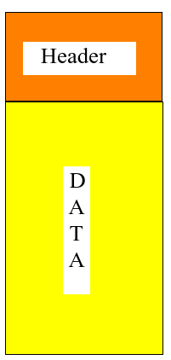
Bitmap file format
54 Bytes

Slide 6
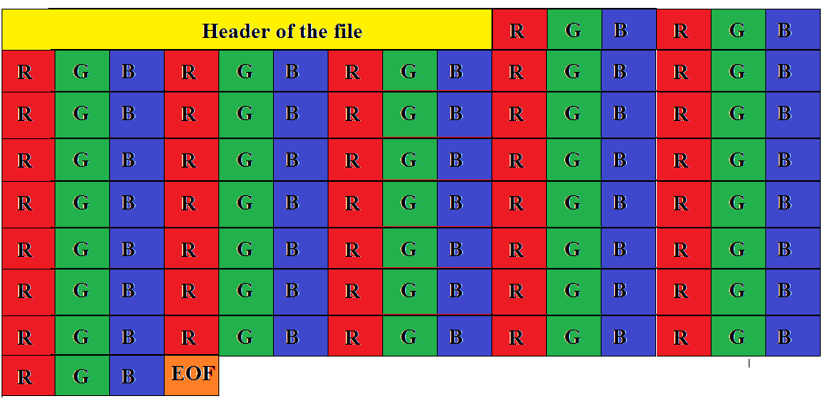
Bitmap file format

Slide 7
Header contains
Offset | size | purpose
0Eh | 4 | the size of this header (40 bytes)
12h | 4 | the bitmap width in pixels (signed integer).
16h | 4 | the bitmap height in pixels (signed integer).
1Ah | 2 | the number of color planes being used. Must be set to 1.
1Ch | 2 | the number of bits per pixel, which is the color depth of the image. Typical values are 1, 4, 8, 16, 24 and 32.
1Eh | 4 | the compression method being used. See the next table for a list of possible values.
22h | 4 | the image size. This is the size of the raw bitmap data (see below), and should not be confused with the file size.
26h | 4 | the horizontal resolution of the image. (pixel per meter, signed integer)
2Ah | 4 | the vertical resolution of the image. (pixel per meter, signed integer)
2Eh | 4 | the number of colors in the color palette, or 0 to default to 2n.
32h | 4 | the number of important colors used, or 0 when every color is important; generally ignored.

