Slide 1
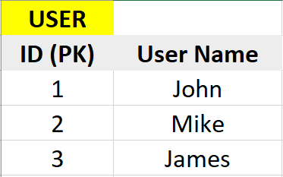
Many-to-many relationship:
When one row of table A can be linked to one or more rows of table B, and vice-versa.
For example:
A user can belong to multiple community, and a community can have multiple users.
One book can be written by multiple authors, and one author can write multiple books

Slide 2
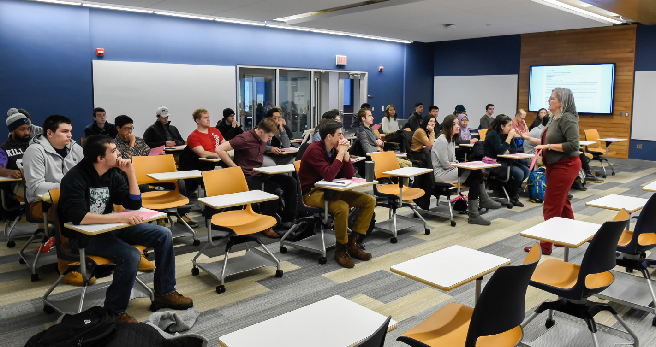
Let’s say, you are building a student enrolment system for a university. You need to record which students are enrolled in which class. You also need to record the fact that a student can be enrolled in multiple classes.
So a student can have many classes, and a class can have many students.

