Slide 1
Data Capture
SELT2018-g010
Rae Ann Corrigan
Nabeel Ahmad Khan
Vivek Mishra
Nicole Tatro

Slide 2
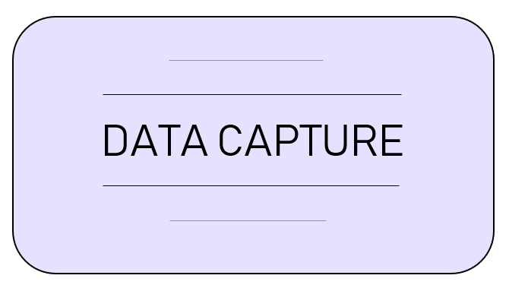
Scope and Objectives
Collecting, curating, and running basic analysis on research data
Inspired by AudioGene and REDCap
Standardizing data collection based on dynamic form creation

Slide 3
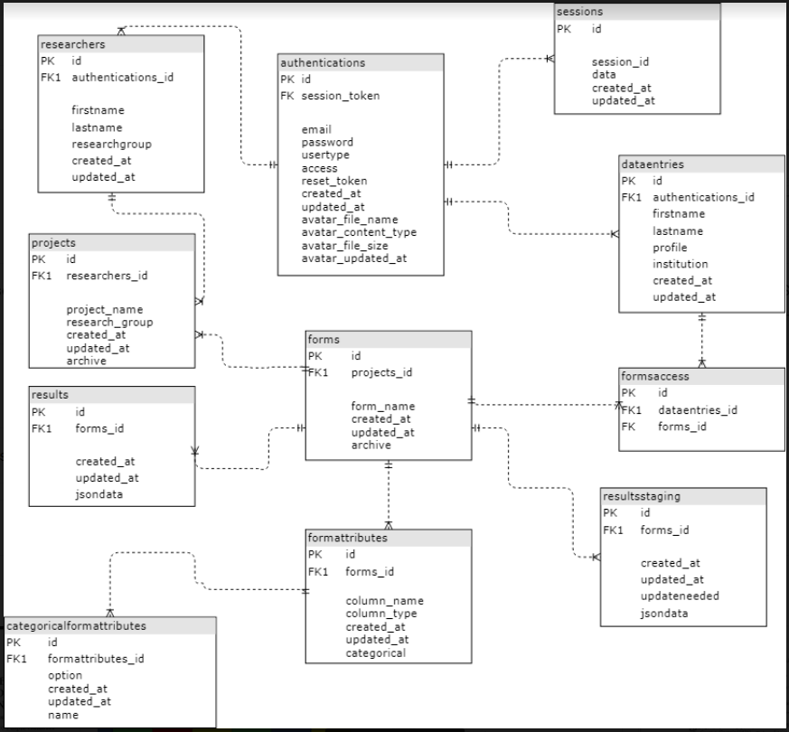
Implementation: Database Schema
Notes:
Database Schema
We made sure that the database schema is properly normalized.
Used Foreign keys in such a way as to maintain Database table Integrity.
We also used some specific PostGreSQL features such as storing and indexing data as JSON.

Slide 4
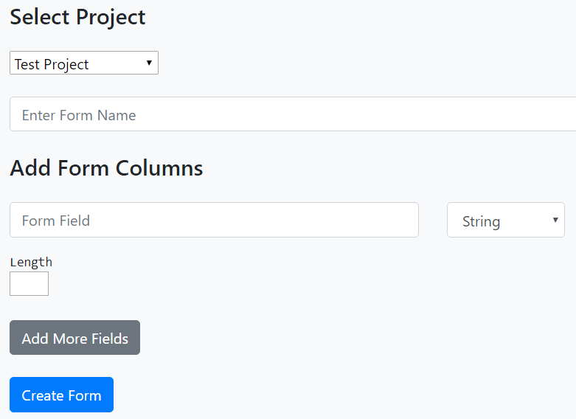
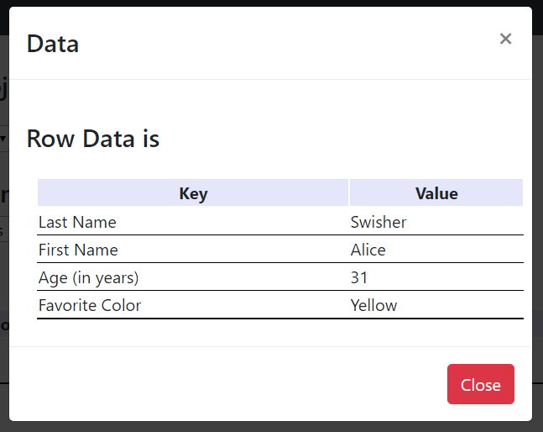
Implementation: Javascript
Dynamic Form Creation
Form Viewing
Data Viewing/Approval

Slide 5
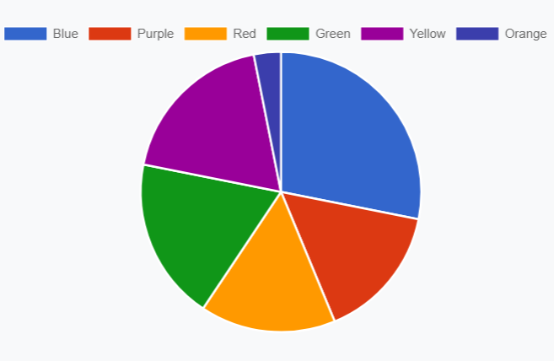
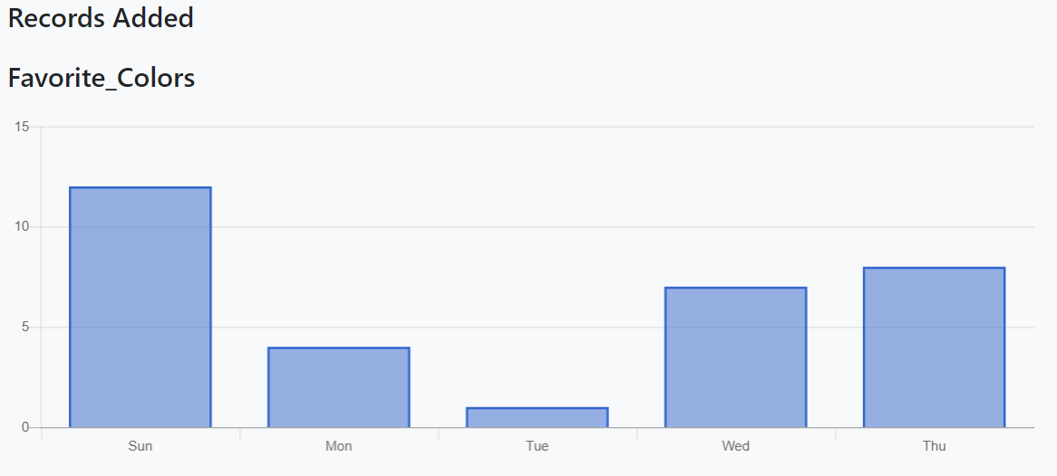
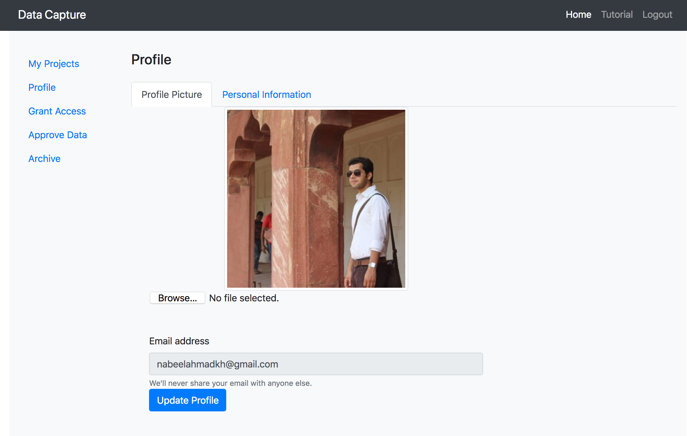
Implementation: Notable Gems
chartkick and groupdate
paperclip
aws-sdk-s3
responders
Notes:
Chartkick - Ruby gem for creating charts using a single line of Ruby code using ActiveRecord queries (pie charts, bar charts, etc.)
Groupdate - Groupdate interfaces with Chartkick to allow for the generation of charts that are time-based and group periods of time by day, week, year, etc.

Slide 6
Overall Process
Pivotal Tracker - Agile Project Management Tool
Held user stories that needed completion, bugs, and product owner final approval
Stories were assigned 1,2, or 3 points depending on difficulty
Running Velocity : 30 points
Sprint 1: 10 stories, 16 points
Sprint 2: 12 stories, 16 points
Sprint 3: 27 stories, 45 points
Slack - main messaging application
Used to schedule scrum meetings, notify group members of pending pull requests on Git, and mention when bugs were entered into pivotal tracker
Notes:
Pivotal tracker stories were entered in by the product owner based on their importance to making a minimum viable product for each sprint.
Current pivotal tracker icebox has 21 points worth of user stories waiting in it.
Pivotal Tracker for Agile Project Management.
Issue tracking

Slide 7
Overall Process
GitHub
Source Control
Feature Branching
Wiki for Documentation
Heroku
Deployment
New Relic Monitoring

Slide 8
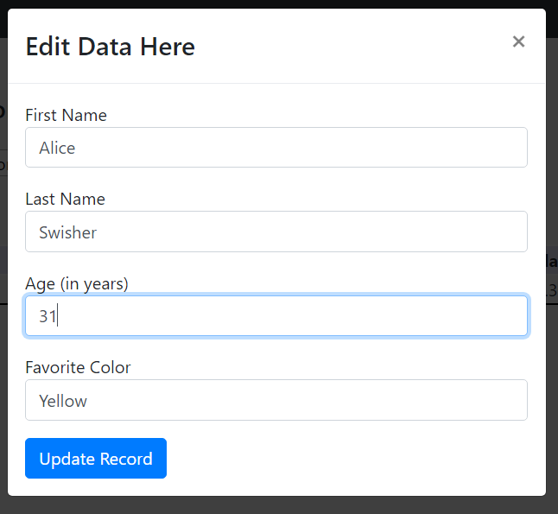
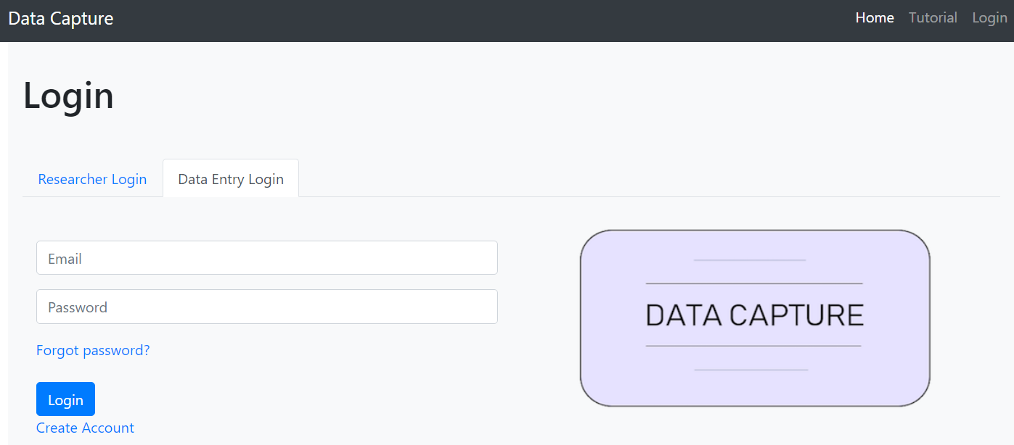
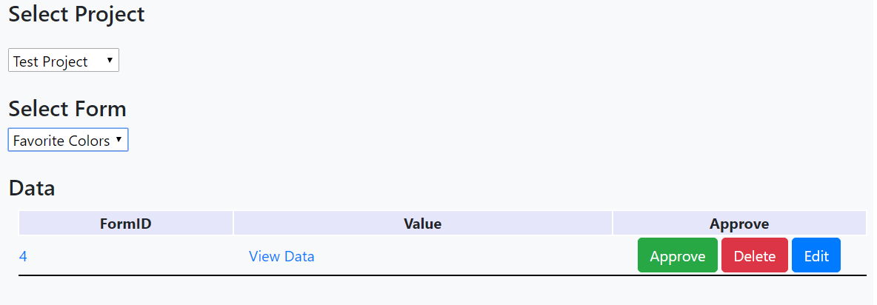
Functionality / Features
Sign Up/Log in
Project Creation
Dynamic Form Creation
Data Approval and Edit Requests
Basic Charting
Data Export
Form Archiving

Slide 9
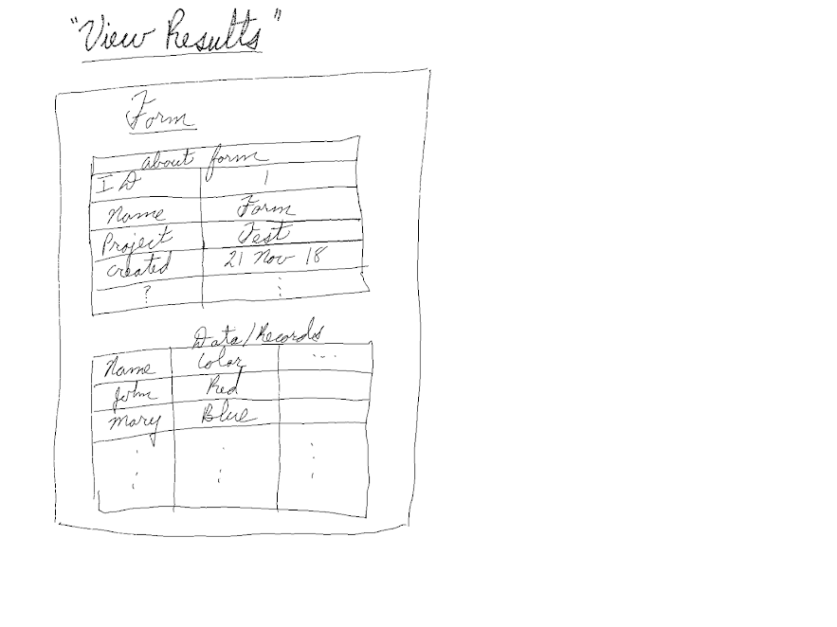
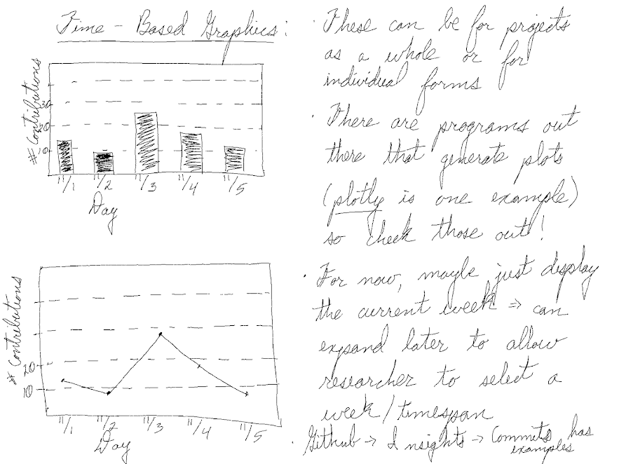
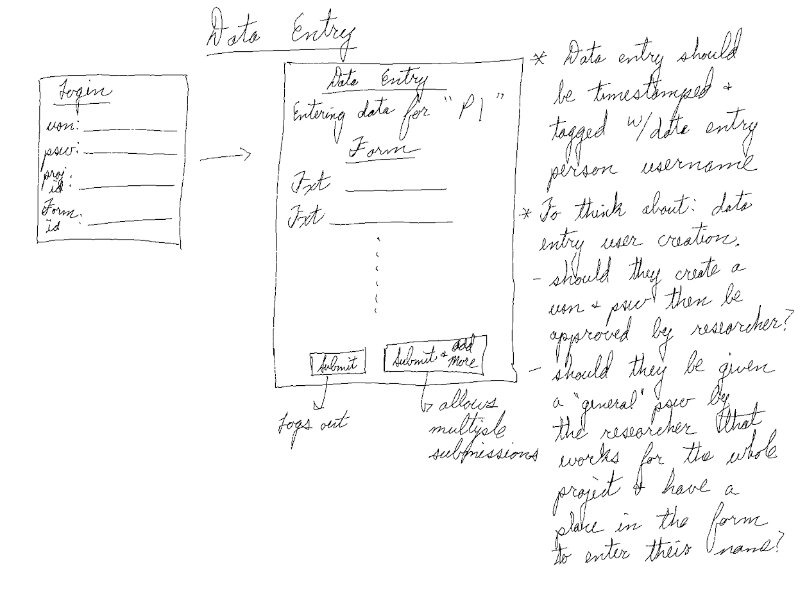
Behavior Driven Design
Notes:
In terms of testing, we most accurately followed BDD. At the beginning of each sprint, Lo-fi sketches were generated. They were often accompanied by notes that talked more about what the feature should do.

Slide 10
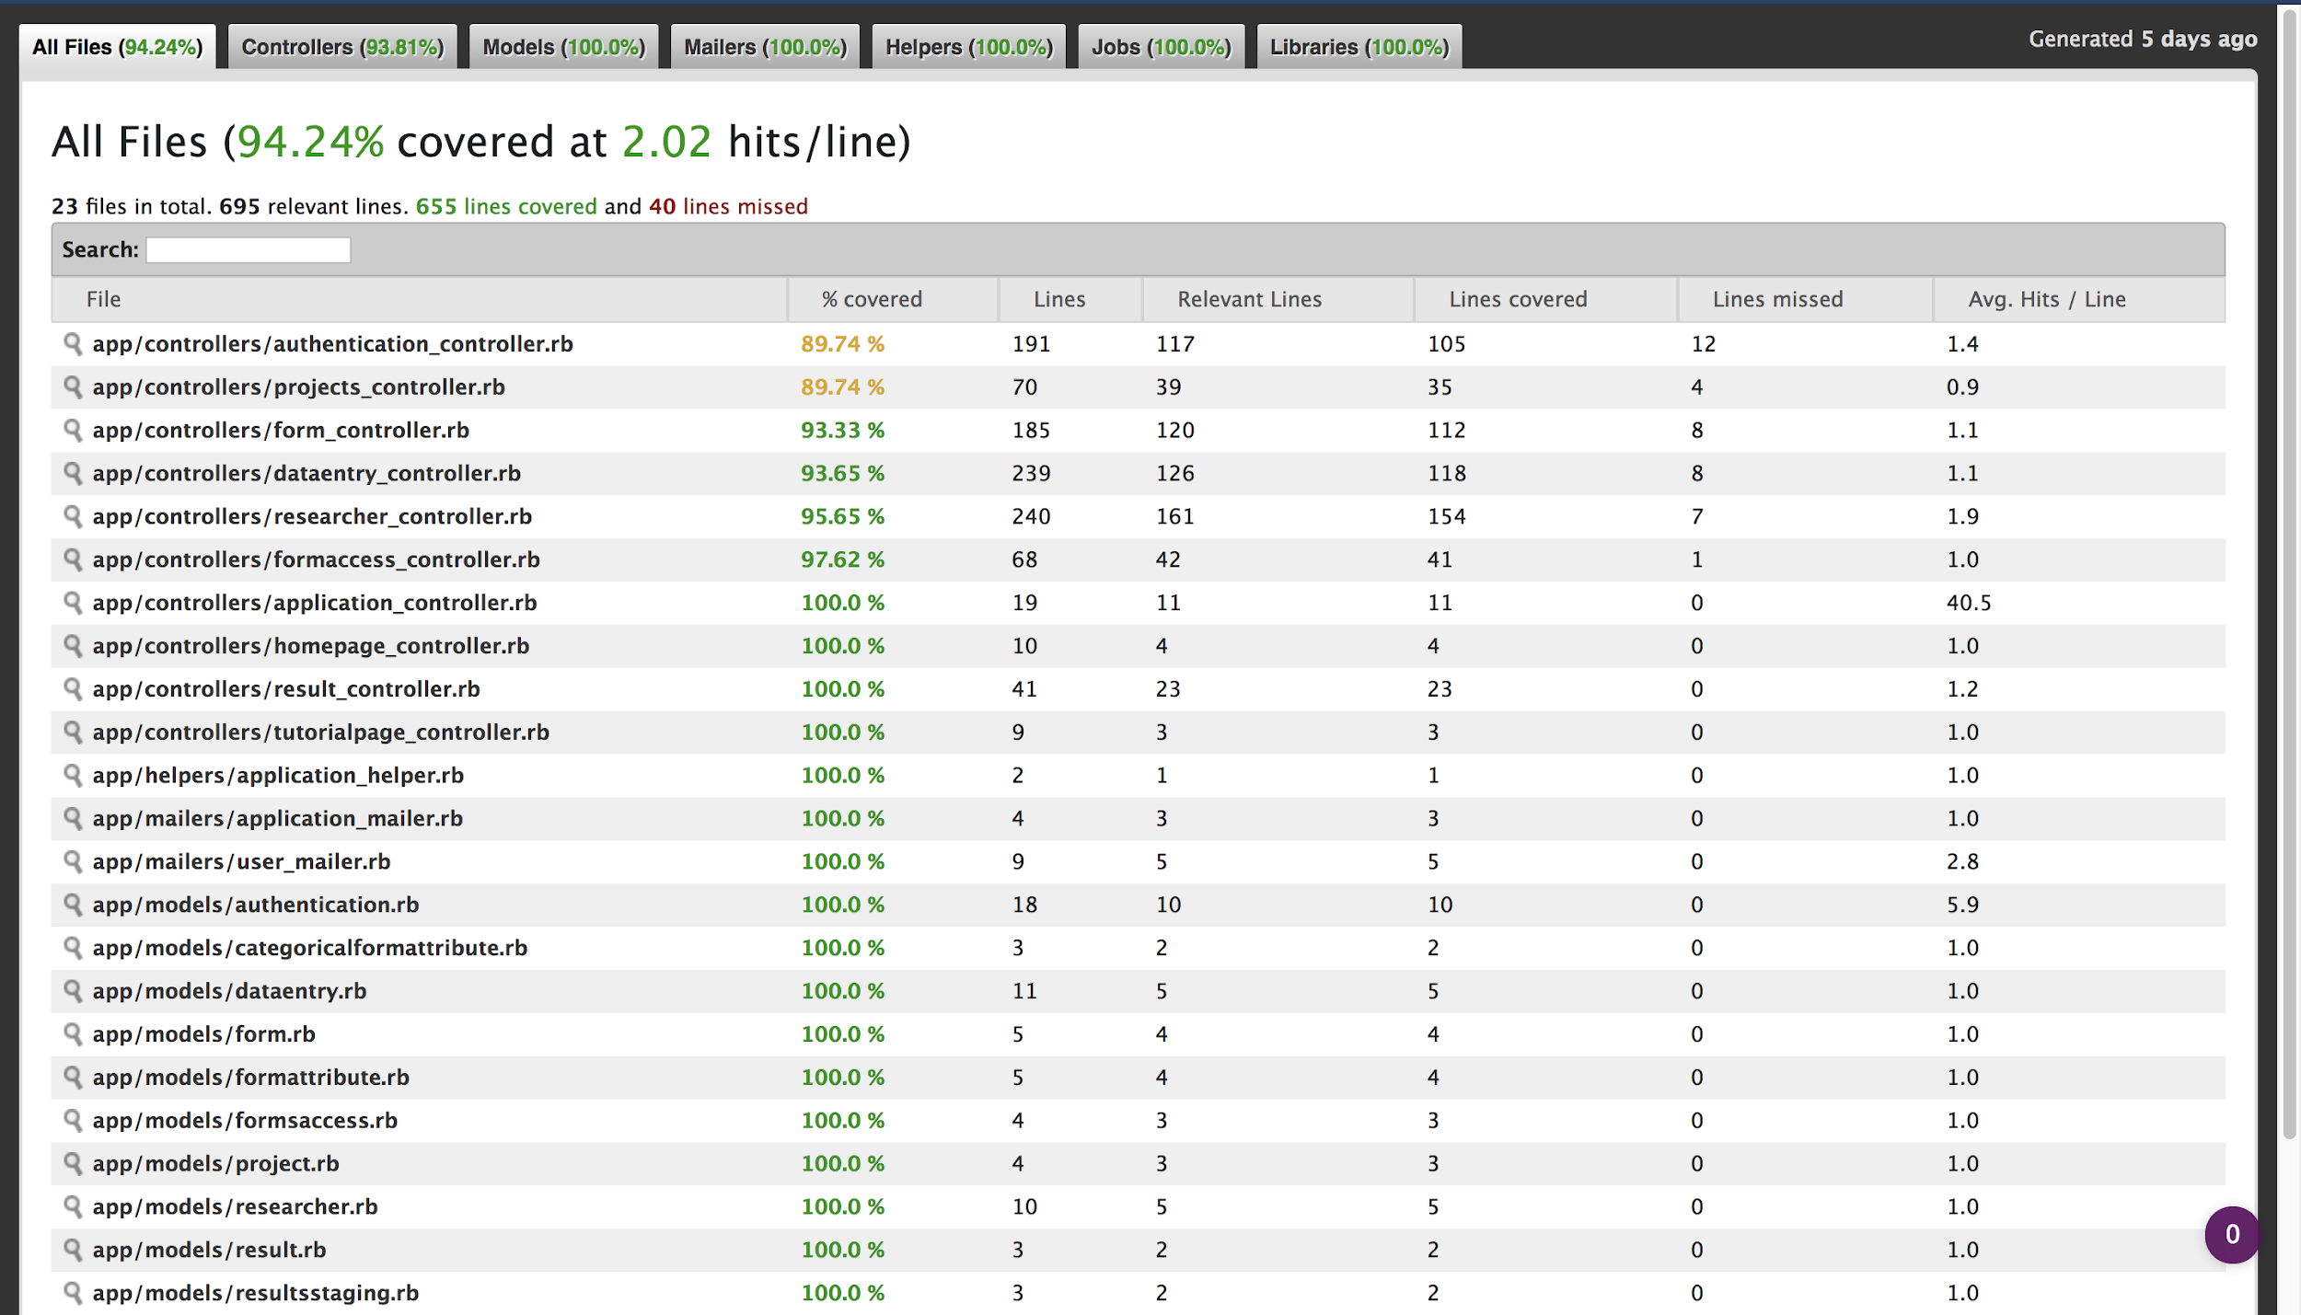
Other Testing
SimpleCov: Unit Testing
94.24% coverage
Cucumber: Functional Testing
15 scenarios, 89 steps tested and passed
Different browsers and OS
Notes:
For our unit testing, we reached a coverage of 94%
For our functional testing, the scenarios covered testing of user creation, login, project and form creation
We specifically tested the export data feature on different browsers and operatings systems to make sure data downloaded correctly

Slide 11
Lessons Learned
Efficiently using JSON objects in Relational Databases
Database design should be finalized at beginning
Working on Discrete Features
Team Communication
Unable to complete Jasmine Testing
Notes:
Data flow should be done in the design phase, before coding begins, to reduce development time
Each member working on their own model, view and controller was helpful in minimizing overlap and merge conflicts
Started testing javascript with Jasime, but we were unable to complete the all the testing

Slide 12
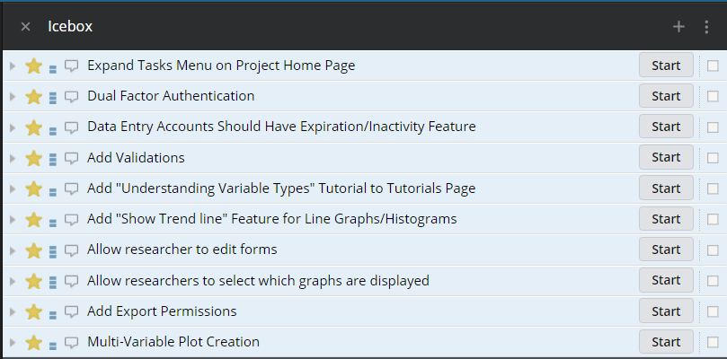
Future Work
Notes:
Dual Factor Authenication
Allowing researchers to edit forms

Slide 13
DEMO

