Slide 1
Sanjiv
India's Energy Resilience Command Center
Keep India's energy moving.
Observe > Detect > Simulate > Optimise > Approve > Monitor
Working prototype
Evidence-backed
Current UI | 212 tests | 3:55 submitted demo

Slide 2
A supply shock is a business decision, not just a data problem.
Energy teams need a shared, auditable path from a corridor signal to a decision they can defend.
What breaks in the operating model
What Sanjiv makes possible
A disruption hits continuity, exposure, inventory and procurement at once. Fragmented dashboards do not give teams a common decision package.
Under uncertainty, unsupported claims are as risky as missing data.
Test the no-action consequence.
Compare cost, continuity and concentration trade-offs.
Carry evidence and assumptions into approval.
Monitor the declared outcome after a decision.
6
3
4
100%
0
decision stages
procurement profiles
reserve policies
provenance target
autonomous orders
Sanjiv | ET AI Hackathon 2026
2/12

Slide 3
One workflow from signal to human decision
The same scenario powers risk, simulation, optimisation, evidence and approval.
Observe
Detect
Simulate
Optimise
Approve
Monitor
A live or replayed threat appears - or the user types a scenario.
The twin estimates which flows and assets are exposed.
Sanjiv compares no action, procurement and reserve response.
Human approval is blocked unless evidence, assumptions, solver and checker results all pass.
This is decision intelligence, not an autonomous trading or reserve-release system.
Sanjiv | ET AI Hackathon 2026
3/12

Slide 4
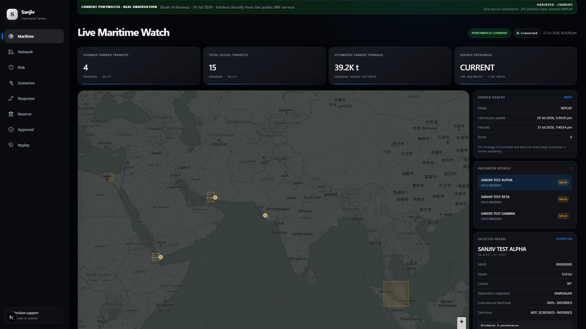
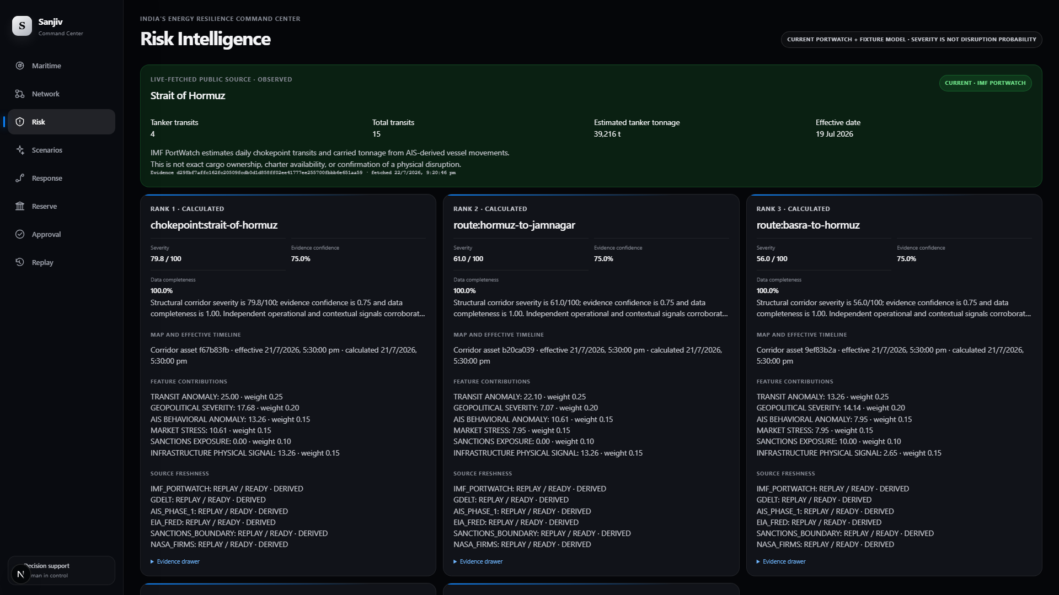
Observed data and replay remain visibly separate
A current public observation can strengthen the demo without becoming a false live-AIS or disruption claim.
Command Center - observed signal
Risk - observed card + fixture model
IMF PortWatch: 4 tanker transits, 15 total transits and 39,216 t estimated tanker tonnage for 19 Jul 2026. OBSERVED / CURRENT.
The observed card sits above the structural ranking. Severity remains fixture-based and is not disruption probability.
Sanjiv | ET AI Hackathon 2026
4/12

Slide 5
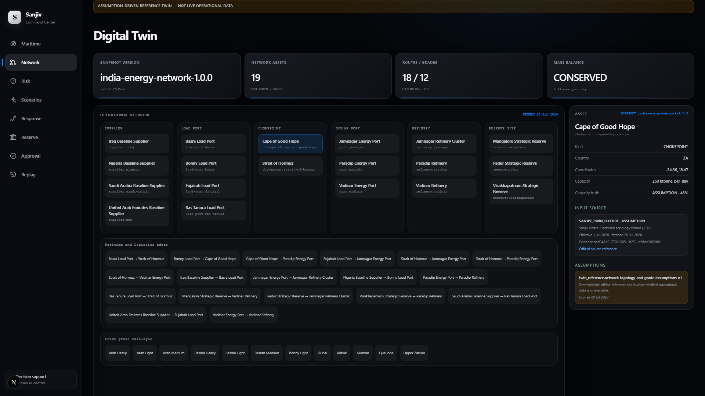
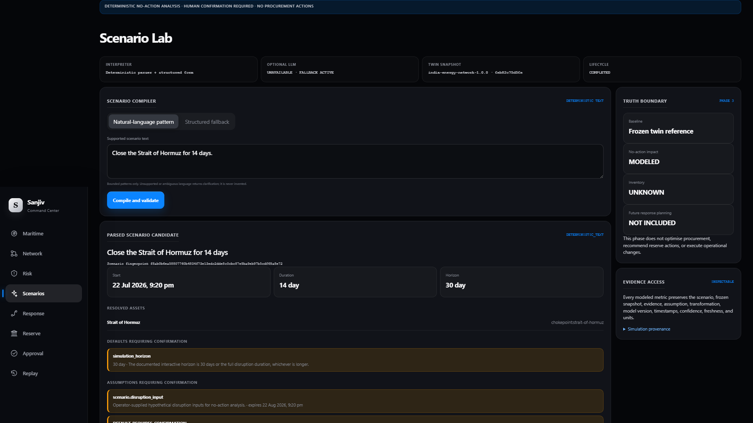
Freeze the network state before asking the model to reason
One frozen twin and scenario fingerprint carry into simulation, optimisation and audit.
Digital Twin - conserved reference state
Scenario Lab - compile, confirm, simulate
The reference twin is explicitly assumption-driven; mass balance must reconcile before a snapshot is usable.
A user confirms the parsed disruption before freeze. The no-action run is bounded sensitivity, not a probability forecast.
Sanjiv | ET AI Hackathon 2026
5/12

Slide 6
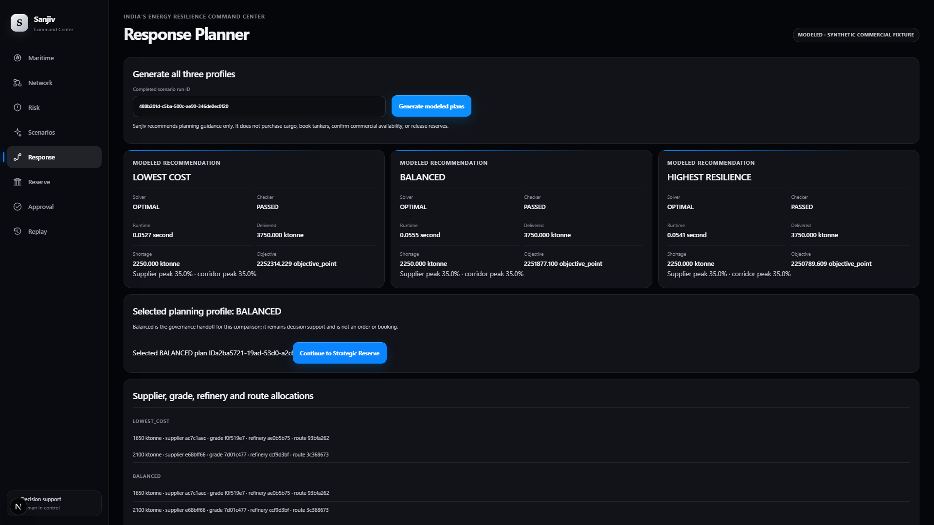
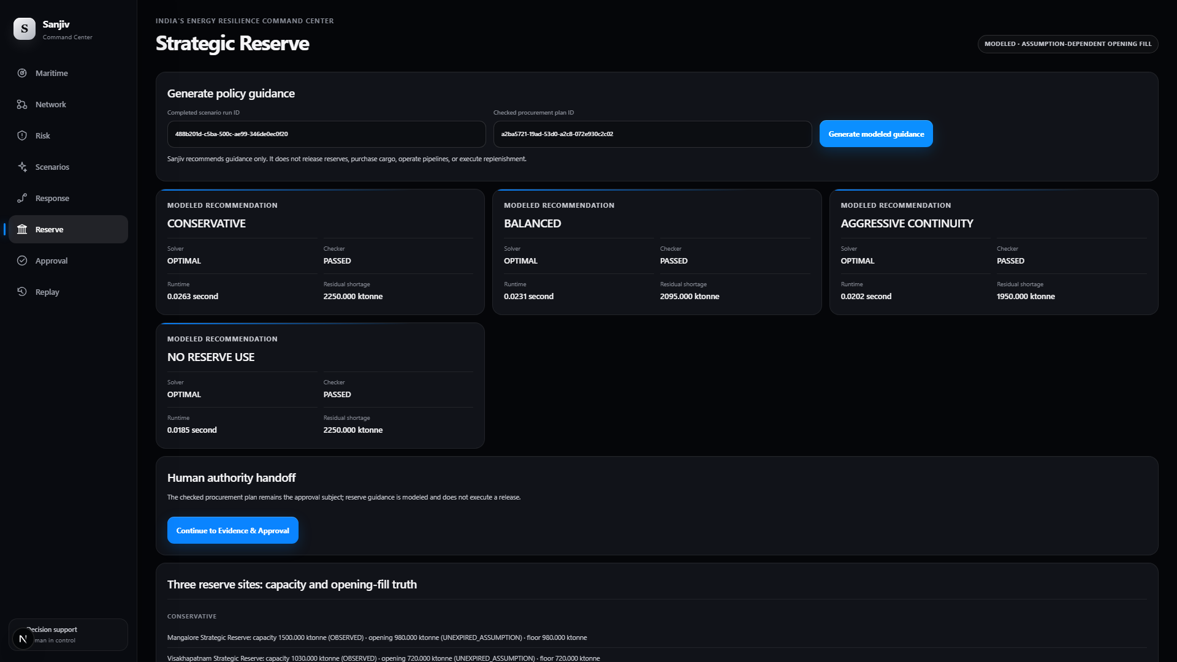
Checked choices beat one magic answer
Every candidate exposes the trade-off it makes; independent checkers must pass before the plan can move forward.
Response Planner - 3 profiles
Strategic Reserve - 4 policies
Lowest cost, balanced and highest resilience share hard constraints and expose modeled allocations, provenance and assumptions.
Public capacity is not current fill. Opening inventory remains an explicit assumption until an operator supplies verified data.
Sanjiv | ET AI Hackathon 2026
6/12

Slide 7
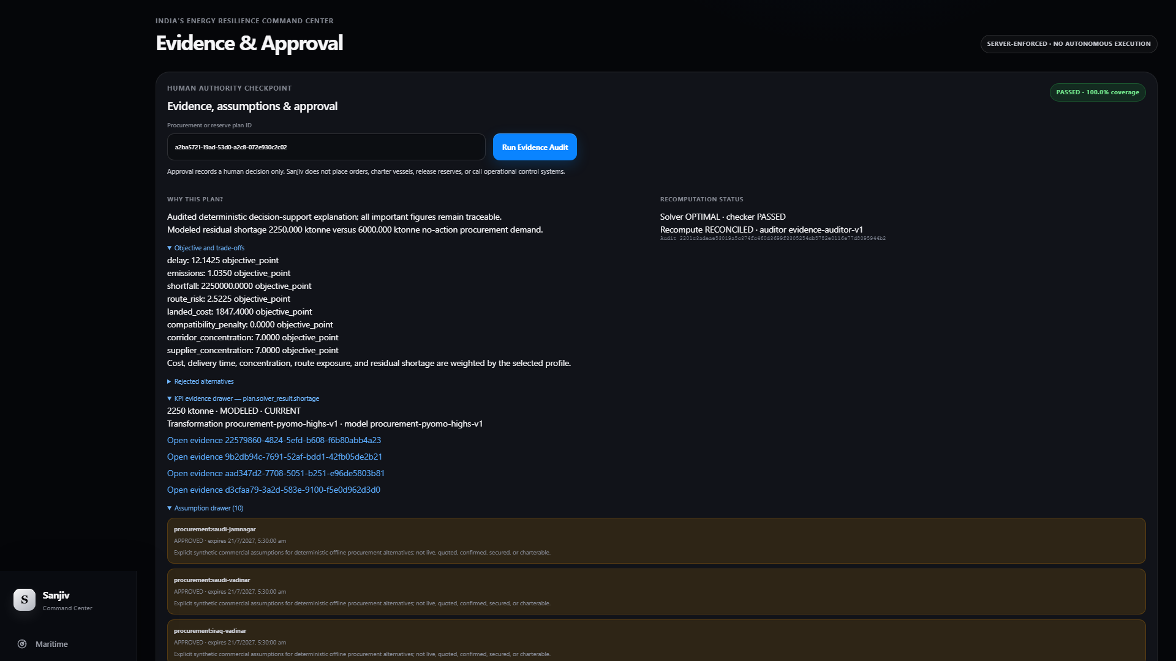
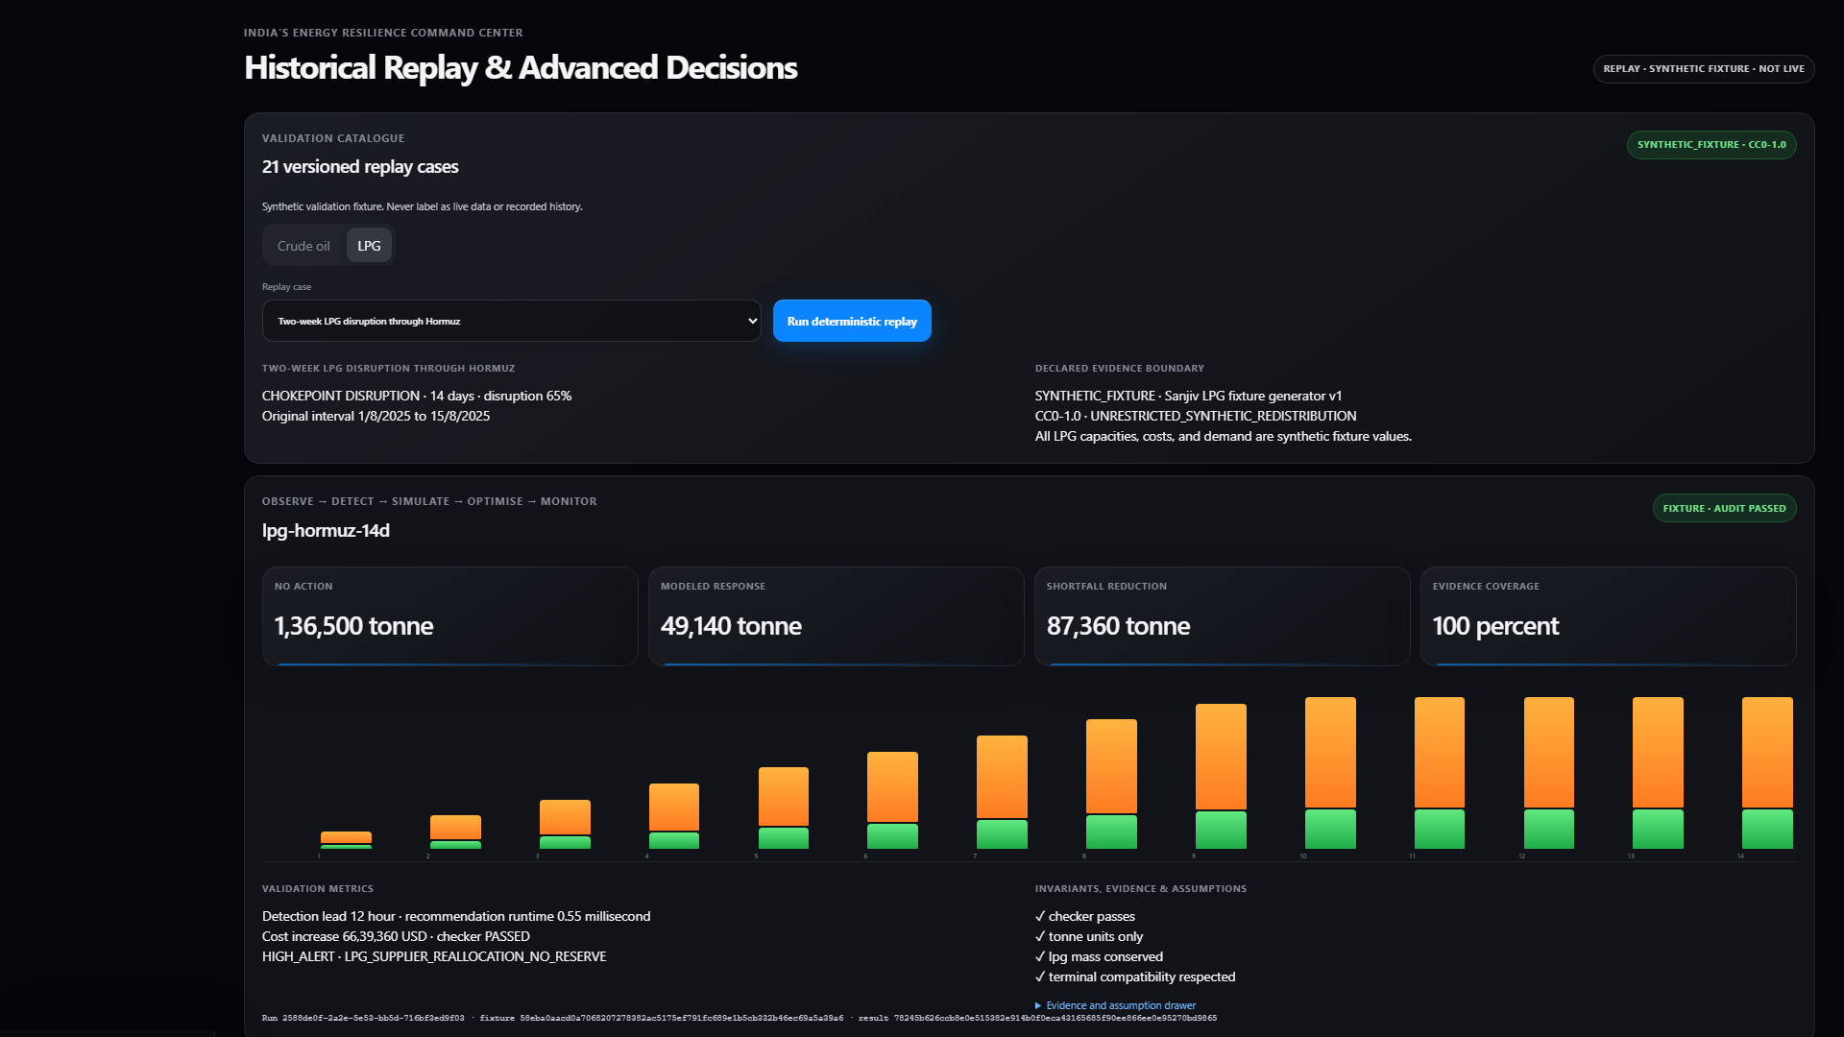
Trust requires evidence and a human signature
The interface preserves the full path from plan fingerprint to approval, replay, sensitivity and monitored export.
Evidence & Approval
Replay, sensitivity & export
The audit reports PASSED with 100.0% coverage and RECOMPUTE_RECONCILED. Approval records actor, role, comment and UTC time.
Twenty-one versioned synthetic cases keep regression evidence repeatable. Outputs remain audited decisions, not execution.
Sanjiv | ET AI Hackathon 2026
7/12

Slide 8
Evidence Auditor: the trust layer
Every decision KPI must explain where it came from and why the user should trust it.
A plan can be blocked by:
Approval requires:
missing or stale evidence
expired or superseded assumptions
metric recomputation mismatch
failed solver/checker result
unsupported claim language
changed plan fingerprint
authenticated role
unchanged scenario, simulation, twin and plan fingerprints
passed independent checker
passed Evidence Auditor
immutable actor, comment and UTC timestamp
Sanjiv recommends. People decide. Every decision remains auditable.
Sanjiv | ET AI Hackathon 2026
8/12

Slide 9
Validation is part of the product
Current repository evidence: 212 tests, two complete browser journeys, a clean committed benchmark and explicit security checks.
212
2 journeys
CLEAN
8 / 8
188 Python + 23 web + 1 contract
All 8 product screens; Observe to Monitor
benchmark source: CLEAN_COMMITTED
security checks passed; 0 failure names
Quality gates
Honest labels
212 tests: 188 Python / 23 web / 1 contract
lint + strict type checks + production build
contract drift clean
2 Playwright journeys / 8 real screenshots
clean benchmark at commit de5140a
PortWatch: OBSERVED / CURRENT
AIS position layer: REPLAY
risk model: FIXTURE
severity is not probability
commercial inputs: ASSUMPTION
reserve fill: never inferred
Sanjiv | ET AI Hackathon 2026
9/12

Slide 10
Architecture built to scale without losing truth
Provider-neutral adapters feed an evidence ledger; all decisions consume immutable fingerprints.
AIS / Replay
GDELT
PortWatch
OFAC
FIRMS
EIA / FRED
Evidence ledger
Source health
Assumption registry
Audit trail
Digital twin
Risk engine
Scenario compiler
Impact simulator
Procurement solver
Reserve solver
Independent checkers
Evidence auditor
Command UI
Replay
Exports
Monitoring
Sanjiv | ET AI Hackathon 2026
10/12

Slide 11
A 3 min 55 sec demo of a pilot-ready decision loop.
The submitted video turns an observed public signal into a governed response package; the pilot starts in shadow mode, without autonomous execution.
1.
Observe current PortWatch alongside replay context
2.
Inspect risk, confidence and data completeness
3.
Confirm one business disruption scenario
4.
See the no-action shortfall and impact
5.
Compare cost, continuity and concentration trade-offs
6.
Check reserve policy without inventing fill
7.
Open the evidence and decision rationale
8.
Record human review and approval
9.
Monitor the declared replay outcome
Submitted demo length: 3 min 55 sec. Business adoption begins with one corridor, one commodity and shadow-mode use alongside existing governance.
Sanjiv | ET AI Hackathon 2026
11/12

Slide 12
Sanjiv
A current public signal arrives - or an analyst defines a scenario. Sanjiv gives risk, procurement and reserve teams one common, auditable decision package: what is observed, what is modeled, and what needs human sign-off.
Keep India's energy moving.
Business value: explainable trade-offs, human authority and a monitored outcome.
GitHub | Demo | vivekyarra567@gmail.com
Observe
Detect
Simulate
Optimise
Approve
Monitor

