Slide 1

CHALKLINE
The board
stays with you.
Live blackboard lessons.
Built for weak connections.
YARRA VIVEK / INDIVIDUAL ENTRY
Snapdragon AI Lab Build & Present Challenge
PRODUCT PROPOSAL • AI-GENERATED CONCEPT VISUAL
Notes:
Imagine joining a maths lesson on a weak connection. You hear the explanation, but the equation on the board is unreadable. CHALKLINE proposes preserving the board as a versioned visual document, with audio, instead of treating the whole lesson as continuous motion. This is a proposal, not a deployed product. All photographs and interface imagery are AI-generated concepts; depicted hardware is illustrative. Intended deployment is a Snapdragon-powered HP PC.

Slide 2
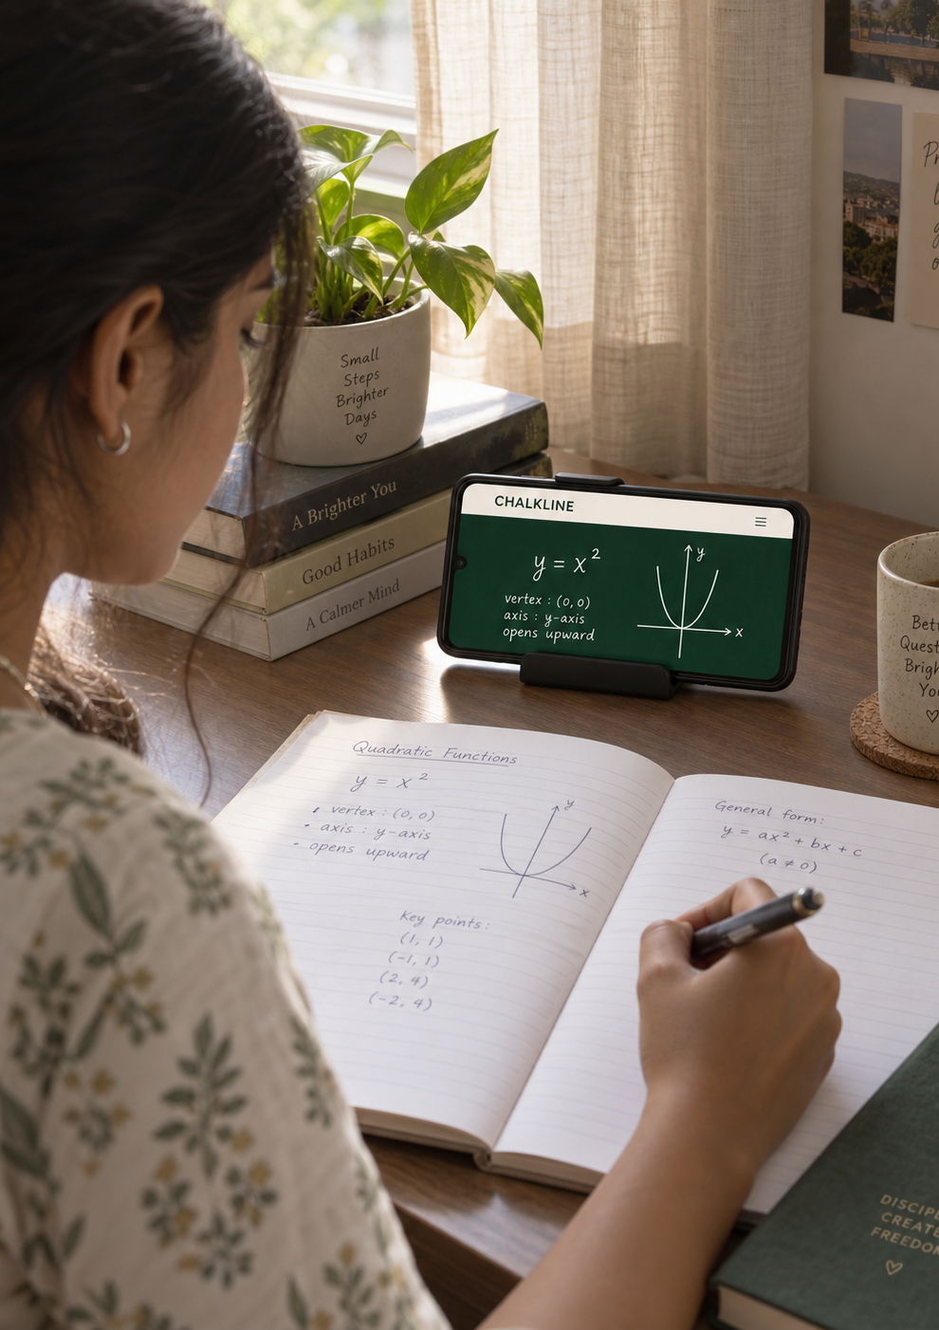
THE PROBLEM
A missed symbol.
A lost explanation.
A small minus sign matters more
than a smooth video frame.
When the connection stalls, a student
can lose the exact step the teacher
has already erased.
Keep the teaching style.
Change how the board travels.
Illustrative learner scenario; concept image.
Notes:
The initial user is a tutor or lecturer teaching with a physical chalkboard, with remote learners on constrained connections. This is a problem hypothesis to validate with teachers, not a claim of completed interviews. Teams network guidance shows that audio and video have different bandwidth requirements; it does not establish CHALKLINE performance. Source: https://learn.microsoft.com/en-us/microsoftteams/prepare-network

Slide 3
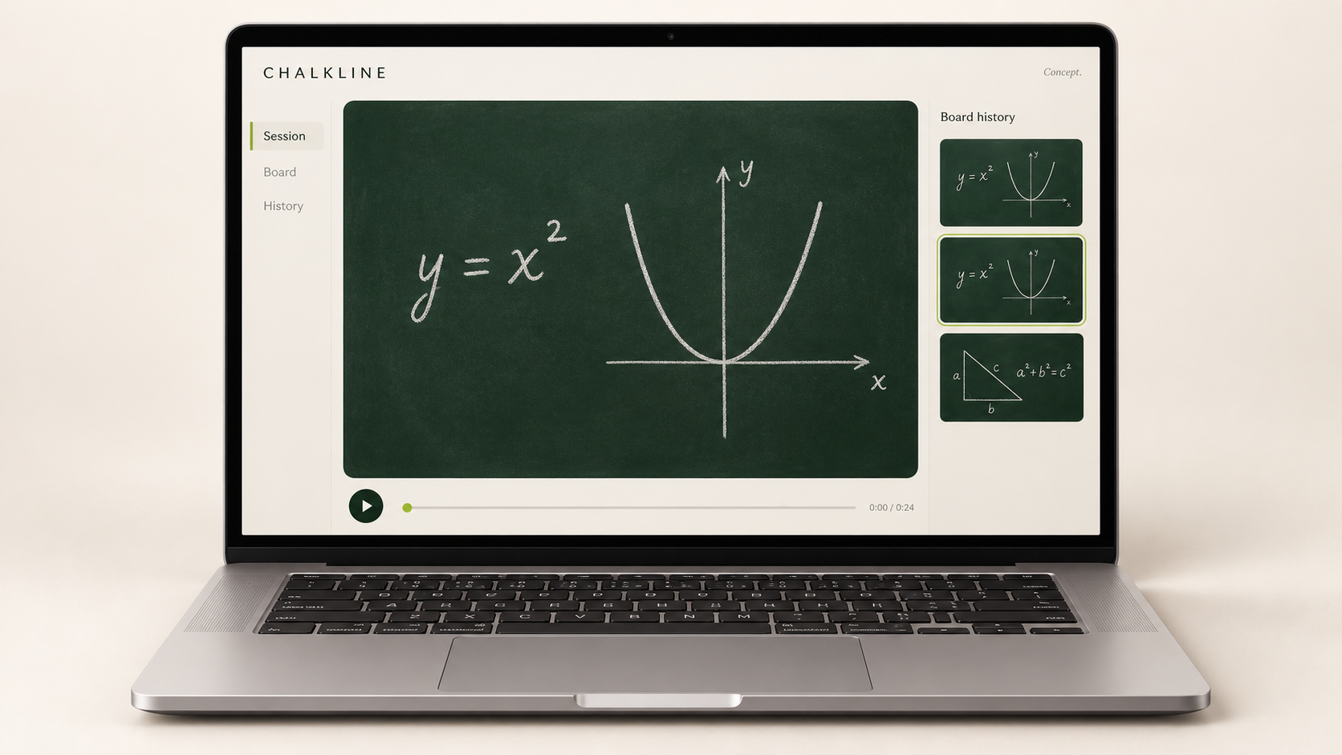
THE PROPOSED EXPERIENCE
A live board that remembers.
Read
Original handwriting.
No retyped equations.
Rewind
Return to an earlier
board state.
Recover
Catch up after
a connection drop.
AI-generated interface concept. Features are planned.
03
Notes:
The browser receives board patches and audio. It can reconstruct board versions and navigate history. A reconnect requests a valid checkpoint and missing changes, rather than quietly showing an obsolete board. The interface is a design concept; the application has not been implemented.

Slide 4
THE ENGINEERING TARGET
64
Proposed average allocation
24
kbps
Audio
32
Board
For the board, the voice,
and the transport.
8
Overhead
All values in kbps. Budget hypothesis;
bursts and recovery must fit the cap.
DESIGN TARGET — NOT A MEASURED RESULT
04
Notes:
64 kbps is the initial constrained-link design target per receiving client, including application, encryption and transport overhead; it is not an achieved benchmark. The planning split is 24 kbps audio, 32 kbps board updates and 8 kbps control/overhead. Packetization may require revising this split. Prioritize current audio, coalesce board changes and rate-limit checkpoints. If a full board cannot arrive promptly, show freshness and measure the delay. Remote lesson delivery still requires connectivity.

Slide 5
WHY SNAPDRAGON
Spend compute beside the teacher.
Save bandwidth for the learner.
01 Observe
02 Separate
LOCAL AI
USB camera → board crop
NPU segmentation identifies
Snapdragon X
Perspective alignment on CPU.
the presenter and occlusion.
HP PC
03 Preserve
04 Deliver
Candidate model:
DeepLabV3+MobileNet
CPU tracks observed pixels,
Changed regions + audio.
via ONNX Runtime QNN
erasures and board versions.
A browser rebuilds the board.
Proposed pipeline. Exact model compatibility and NPU execution must be verified. [1, 2]
05
Notes:
The candidate segmentation model and QNN execution path are documented by Qualcomm AI Hub and ONNX Runtime. Their availability is evidence for a plausible implementation route, not proof of performance on the entrant laptop. Start with CPU correctness, then validate model export, quantization if needed, supported operators and actual NPU execution. Do not claim NPU acceleration if fallback occurs. The browser does not need an AI model. Sources: https://aihub.qualcomm.com/models/deeplabv3_plus_mobilenet ; https://onnxruntime.ai/docs/execution-providers/QNN-ExecutionProvider.html

Slide 6
THE DIFFERENCE TO PROVE
Treat the board as a document
that changes over time.
PRESERVE WHAT WAS SEEN
The hardest failure
Hold the last observed board pixels.
A teacher covers a line.
Mark hidden or stale regions.
The system mistakes it
Never invent missing handwriting.
for an erasure.
RESPECT WHAT WAS ERASED
Conservative updates
and visible freshness
Confirm erasures across clear frames.
are part of the product.
Keep earlier versions available.
Camera enhancement already exists; blackboard support and constrained-link delivery need separate proof. [3]
06
Notes:
Novelty is a proposed combination: occlusion-aware board-state preservation, explicit erasure handling, versioned recovery and low-bandwidth delivery on a Snapdragon PC. Do not claim invention of interframe compression: ordinary video codecs already exploit temporal redundancy. Microsoft Teams already provides camera-based board enhancement; its support page states blackboards are not currently supported. This documented limitation does not establish that no other competitor supports blackboards. Source: https://support.microsoft.com/en-us/teams/meetings/share-whiteboards-and-documents-using-your-camera-in-microsoft-teams-meetings

Slide 7
THE DEMO IS THE TEST
One lesson. Three delivery methods.
The same constrained connection.
CHALKLINE
Tuned video
Snapshots
Board changes + audio
Low frame rate + audio
Periodic images + audio
WRITE → BLOCK → ERASE → DISCONNECT → REJOIN
Readability
Continuity
Recovery
Efficiency
Blind symbol
Audio intelligibility
Correct board after
Total bytes and
transcription
and board delay
a 10-second drop
CPU/NPU profile
Planned evaluation, not completed testing. Publish the same inputs, settings and failures.
07
Notes:
Record one fixed-camera, ten-minute lesson with a ground-truth board sequence. Run all three methods under matched 64/128/256 kbps link profiles and a forced ten-second interruption; record loss, latency and transport bytes. Tune both baselines rather than choosing weak defaults. Have readers transcribe predefined symbols without method labels and assess audio intelligibility. Report median and worst-case update/recovery delay, stale-region behavior and CPU/NPU execution. A 64 kbps claim is earned only if quality and full transport measurements support it. No results currently exist.

Slide 8
A FOCUSED FIRST RELEASE
One teacher laptop.
Any student browser.
Start with independent tutors and college lecturers
who already teach from a physical board.
BUILD
PROVE
PILOT
One camera. One board.
Readable symbols.
One teacher and
A ten-minute lesson.
Correct recovery.
5–10 adult learners.
CHALKLINE
The next line should reach everyone.
Notes:
These are proposed milestones, not completed pilots. First recruit one teacher and 5–10 adult learners with consent, and validate whether board continuity changes lesson comprehension. The first deployment is a Snapdragon-powered HP PC, one fixed USB camera and a browser viewer. Exclude multi-camera tracking, automatic transcription, translation, generative tutoring and LMS integrations from the MVP. Teacher or institution licensing is a commercial hypothesis to test after a successful pilot; no revenue or willingness-to-pay data is claimed.

Slide 9
REFERENCE NOTES
Evidence behind the proposal
1 Qualcomm AI Hub
DeepLabV3-Plus-MobileNet model catalog
2 ONNX Runtime
QNN execution provider for Qualcomm hardware
3 Microsoft Teams Support
Camera-based board enhancement; blackboards currently unsupported
4 Microsoft Learn
Teams network preparation and bandwidth guidance
5 Challenge listing
Snapdragon AI Lab Build & Present Challenge
Sources reviewed 8 September 2026. Full clickable references are in speaker notes and the project brief.
Concept-stage submission. All product imagery is AI-generated; no pilot, benchmark or deployment is claimed.
Notes:
1 Qualcomm AI Hub — DeepLabV3-Plus-MobileNet model catalog
https://aihub.qualcomm.com/models/deeplabv3_plus_mobilenet
2 ONNX Runtime — QNN execution provider for Qualcomm hardware
https://onnxruntime.ai/docs/execution-providers/QNN-ExecutionProvider.html
3 Microsoft Teams Support — Camera-based board enhancement; blackboards currently unsupported
https://support.microsoft.com/en-us/teams/meetings/share-whiteboards-and-documents-using-your-camera-in-microsoft-teams-meetings
4 Microsoft Learn — Teams network preparation and bandwidth guidance
https://learn.microsoft.com/en-us/microsoftteams/prepare-network
5 Challenge listing — Snapdragon AI Lab Build & Present Challenge
https://unstop.com/competitions/crp-snapdragon-ai-lab-build-present-challenge-qualcomm-1748893/amp

