Slide 1
Why Use Jenkin's Pipeline?
Jenkins is an open continuous integration server which has the ability to support the automation of software development processes. You can create multiple automation jobs with the help of use cases, and run them as a Jenkins pipeline.
Here are the reasons why you use should use Jenkins pipeline:
Jenkins pipeline is implemented as a code which allows multiple users to edit and execute the pipeline process.
Pipelines are robust. So if your server undergoes an unforeseen restart, the pipeline will be automatically resumed.
You can pause the pipeline process and make it wait to resume until there is an input from the user.
Jenkins Pipelines support big projects. You can run multiple jobs, and even use pipelines in a loop.

Slide 2
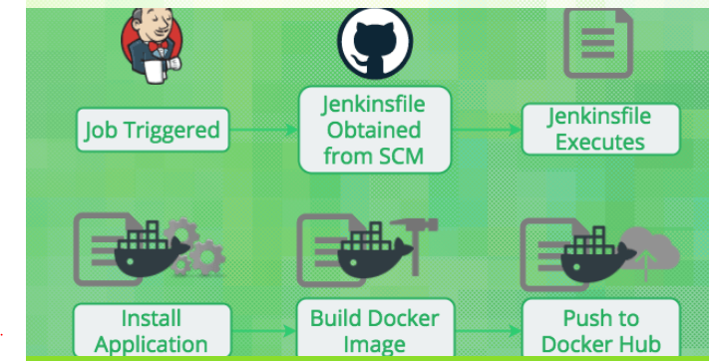
Jenkins - Job Triggered
Jenkins - Job Triggered
- Jenkisfile obtained from SCM
- Jenkinsfile Executes
- Install Applications
- Build Docker Image
- Push to Docker Hub

Slide 3
Jenkins is the most popular tool to do Continuous Integration and Continuous Delivery of your software:
It’s free and open source
It has a strong community with thousands of plugins you can use
Jenkins is used in a lot of companies, from startups to enterprises
This course will teach you how to use Jenkins using the Jenkins DSL and Jenkins Pipelines (Jenkinsfile). It's a new way of using Jenkins, rather than using freestyle projects. I call it using Jenkins, the DevOps way! I'll explain you about infrastructure as code and automation to make sure you understand how Jenkins Pipelines fits within this new way of thinking.
I'll show you how to integrate Jenkins Pipelines with popular software tools, like:
Docker
GitHub / Bitbucket
JFrog Artifactory
SonarQube
Onelogin (Using SAML)
If you’re looking for a job in the DevOps space, Jenkins is a must have skill.
A coupon to get $10 free credits on DigitalOcean is provided within this course. You can use this coupon to install Jenkins on a DigitalOcean droplet.

Slide 4
What is a JenkinsFile?
Jenkins pipelines can be defined using a text file called JenkinsFile. You can implement pipeline as code using JenkinsFile, and this can be defined by using a domain specific language (DSL). With JenkinsFile, you can write the steps needed for running a Jenkins pipeline.
The benefits of using JenkinsFile are:
You can create pipelines automatically for all branches and execute pull requests with just one JenkinsFile.
You can review your code on the pipeline
You can audit your Jenkins pipeline
This is the singular source for your pipeline and can be modified by multiple users.
JenkinsFile can be defined by either Web UI or with a JenkinsFile.
Declarative versus Scripted pipeline syntax:
There are two types of syntax used for defining your JenkinsFile.
Declarative
Scripted

Slide 5
Term | Description
Pipeline | The pipeline is a set of instructions given in the form of code for continuous delivery and consists of instructions needed for the entire build process. With pipeline, you can build, test, and deliver the application.
Node | The machine on which Jenkins runs is called a node. A node block is mainly used in scripted pipeline syntax.
Stage | A stage block contains a series of steps in a pipeline. That is, the build, test, and deploy processes all come together in a stage. Generally, a stage block is used to visualize the Jenkins pipeline process.
Step | A step is nothing but a single task that executes a specific process at a defined time. A pipeline involves a series of steps.

Slide 6
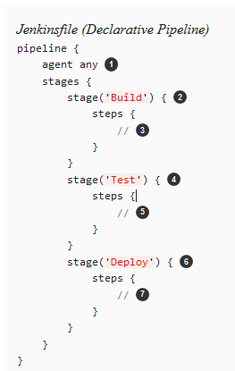
Declarative Pipeline fundamentals
 | 1.Execute this Pipeline or any of its stages, on any available agent.
 | 2. Defines the "Build" stage.
 | 3. Perform some steps related to the "Build" stage.
 | 4. Defines the "Test" stage.
 | 5. Perform some steps related to the "Test" stage.
 | 6. Defines the "Deploy" stage.
 | 7. Perform some steps related to the "Deploy" stage

Slide 7
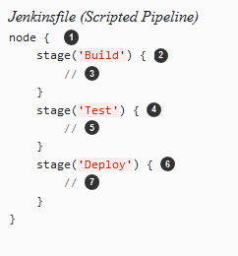
Scripted Pipeline fundamentals
 | 1. Execute this Pipeline or any of its stages, on any available agent.
 | 2. Defines the "Build" stage. stage blocks are optional in Scripted Pipeline syntax. However, implementing stage blocks in a Scripted Pipeline provides clearer visualization of each `stage’s subset of tasks/steps in the Jenkins UI.
 | 3. Perform some steps related to the "Build" stage.
 | 4. Defines the "Test" stage.
 | 5. Perform some steps related to the "Test" stage.
 | 6. Defines the "Deploy" stage.
 | 7. Perform some steps related to the "Deploy" stage.

Slide 8
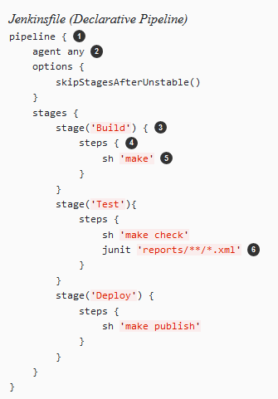
Pipeline example
 | pipeline is Declarative Pipeline-specific syntax that defines a "block" containing all content and instructions for executing the entire Pipeline.
 | agent is Declarative Pipeline-specific syntax that instructs Jenkins to allocate an executor (on a node) and workspace for the entire Pipeline.
 | stage is a syntax block that describes a stage of this Pipeline. Read more about stage blocks in Declarative Pipeline syntax on the Pipeline syntax page. As mentioned above, stage blocks are optional in Scripted Pipeline syntax.
 | steps is Declarative Pipeline-specific syntax that describes the steps to be run in this stage.
 | sh is a Pipeline step (provided by the Pipeline: Nodes and Processes plugin) that executes the given shell command.
 | junit is another a Pipeline step (provided by the JUnit plugin) for aggregating test reports.
 | node is Scripted Pipeline-specific syntax that instructs Jenkins to execute this Pipeline (and any stages contained within it), on any available agent/node. This is effectively equivalent to agent in Declarative Pipeline-specific syntax.

