Slide 1
PROJECT Presentation OF College Notes Gallery
By – Viven CSE, 11805470
Submitted to : Dr. Balwinder Kaur Dhaliwal

Slide 2
Introduction
College Notes is a web based notes sharing and management system which helps students and teachers to share their notes online effectively. It reduces the wasting of time in manually distributing notes to each individual. It greatly overcomes the lack of availability and converts the manual old school paperwork to a fully automated and managed online system.
College Notes Gallery allows users to securely register and log in to their accounts and create, read , update, delete notes according to their needs. It provides notes to everyone in a very secure manner. It is a very useful notes management system for Colleges, Schools and other Institutes to manage and share their notes in an secure, efficient and effective manner.

Slide 3
Objective
The objectives are:
To reduce time sharing and distribution.
Increased time efficiency
This system in useful for Students teaches and administrator

Slide 4
Tools used:
Php myadmin: phpMyAdmin is a free and open source administration tool for MYSQL and MariaDB. As a portable web applicationwritten primarily in PHP, it has become one of the most popular MySQL administration tools, especially for web hosting services. .
Languages: PHP, SQL, HTML, CSS, Javascript.

Slide 5
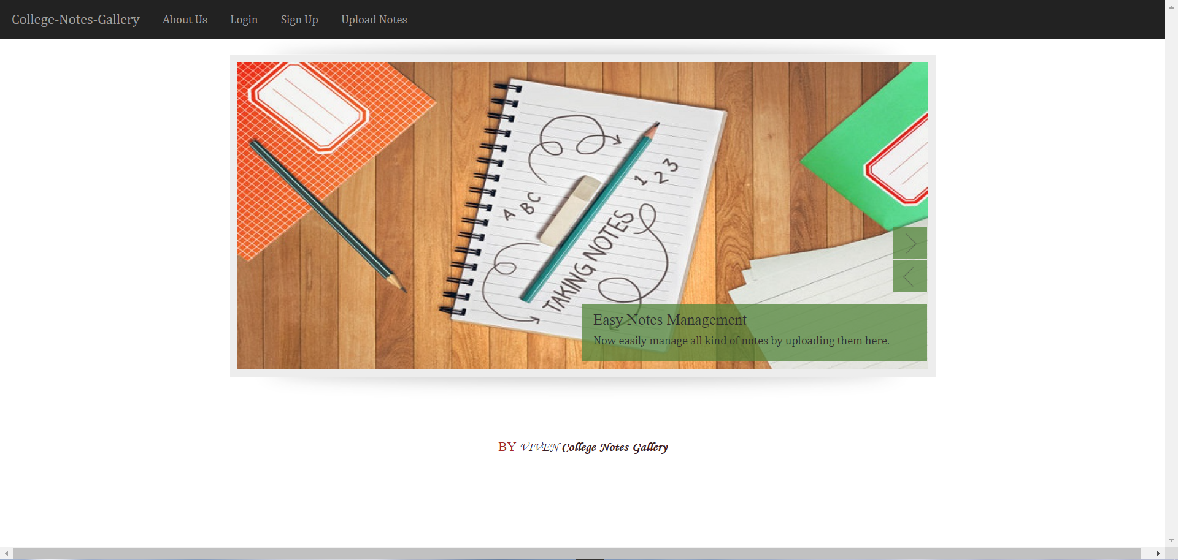
Screenshots:

Slide 6
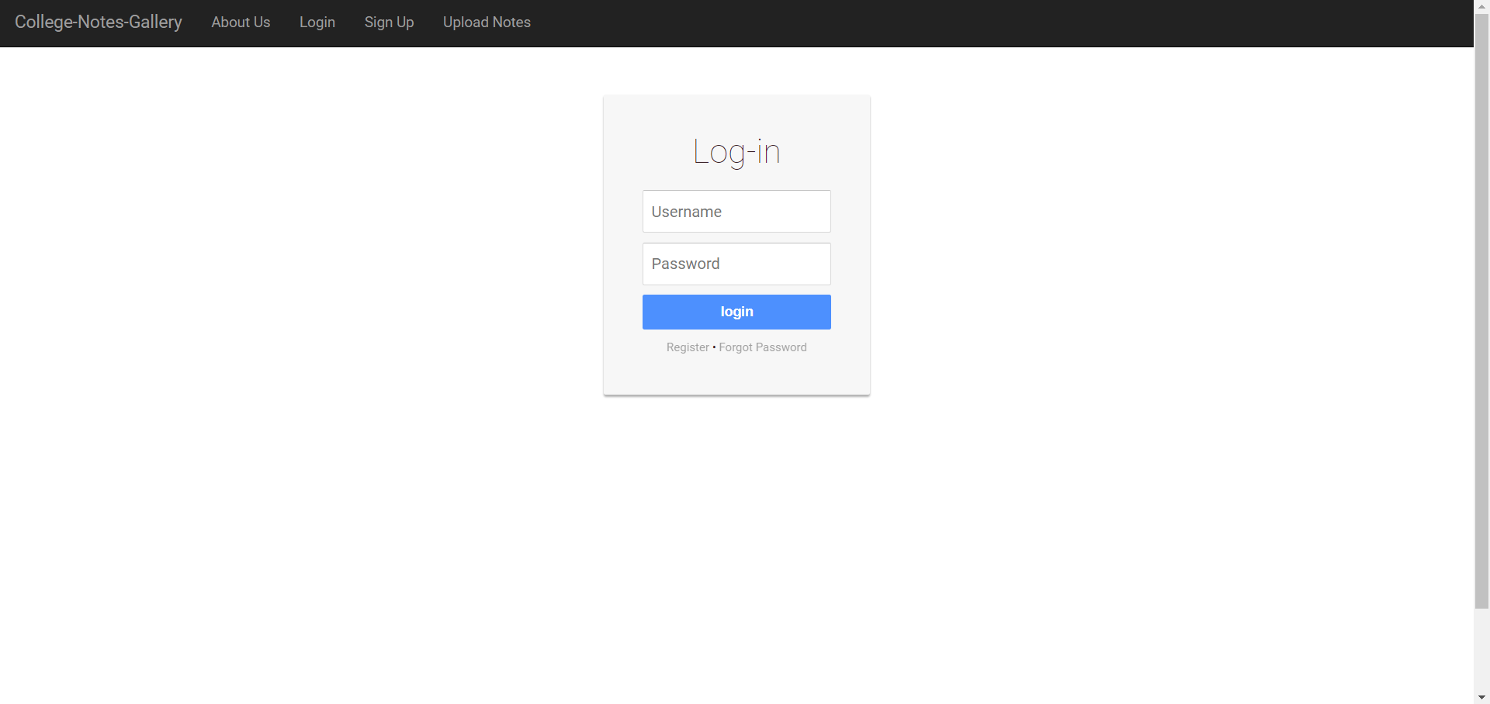

Slide 7
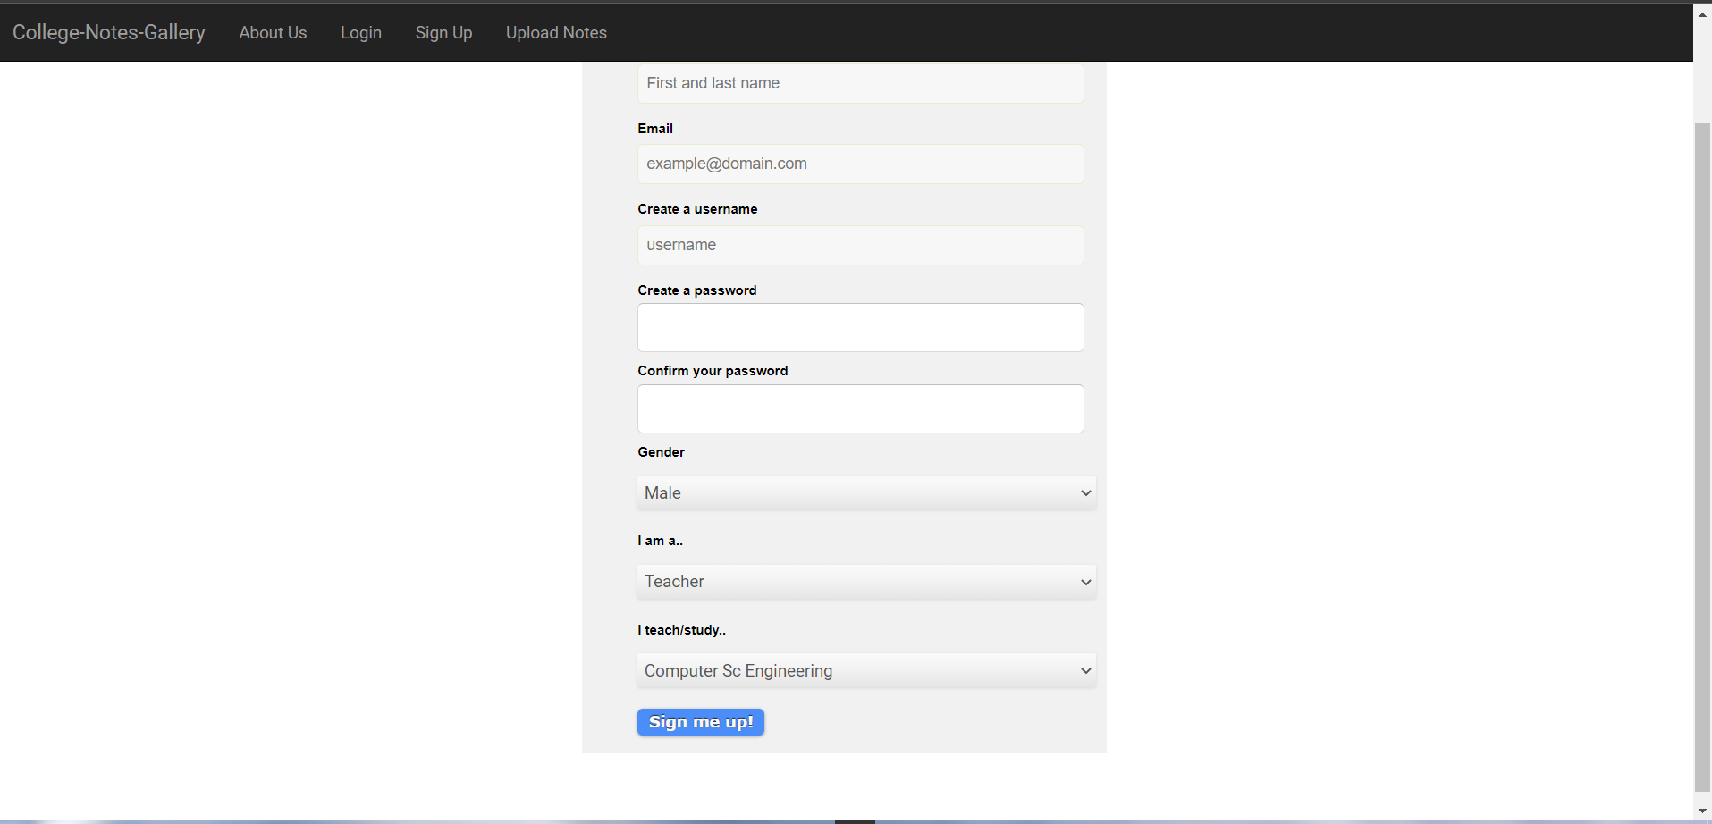

Slide 8
