Slide 1
Overview of Multi-agent Reinforcement Learning in Game Playing
Buciu Ștefan
2022

Slide 2
What is Multi-Agent Reinforcement Learning?
Multi-agent RL (MARL) defines a setting where multiple agents are trying to maximize their own long-term result by taking sequential decisions that interact with the environment and each other.
Notes:
MARL comes in different forms, but the most basic one is called independent RL (InRL). In this setting, agents have no knowledge of each other, thus treating all interactions as part of their (”localized”) environment.

Slide 3
MARL Settings
Cooperative
Competitive
Mixture
agents share the reward function
agents have different private reward functions, but have a long-term goal to maximize the team-average reward (Markov Teams)
zero-sum Markov Games
General-sum game setting
no restriction is imposed on the goal and relationship among agents
each agent is self-interested, whose reward may be conflicting with others’
Notes:
In general, MARL algorithms can be classified as fully cooperative, fully competitive, or a mix of the two.

Slide 4
MARL Challenges
Nonstationarity
Scalability
Partial observability
Multiple agents that interact with the environment
MDP properties are lost
Joint-action space
Exponential complexity
Full environment information is not available
Agents receive data from local observations
Agents receive data by communicating

Slide 5
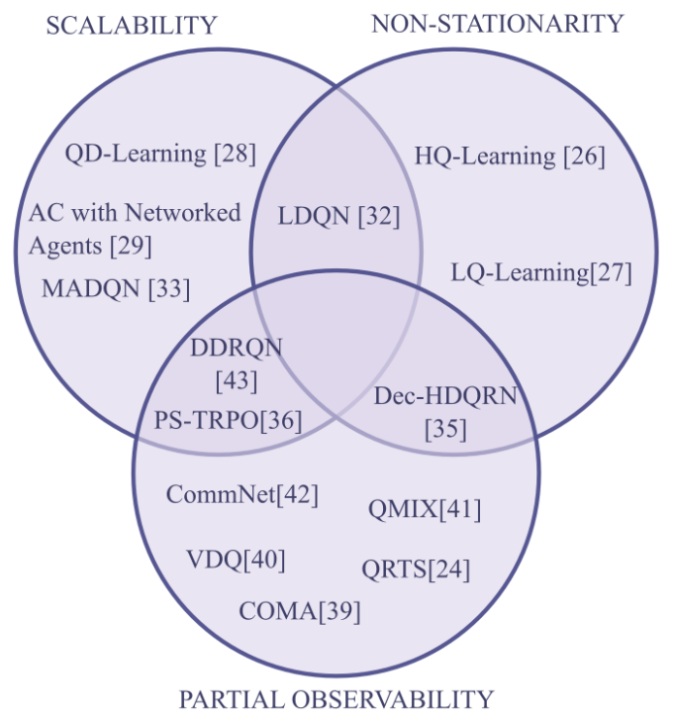
Canese, L., Cardarilli, G.C., Di Nunzio, L., Fazzolari, R., Giardino, D., Re, M., Spano, S., 2021. Multi-agent reinforcement learning: A review of challenges and applications. Applied Sciences 11, 4948

Slide 6
Some MARL Algorithms
Counterfactual multi-agent policy gradient (COMA)
Hysteretic Q-learning (HQ-learning)
Lenient Multi-Agent Deep Reinforcement Learning (LDQN)
Actor critic approach
Centralized training of decentralized policies paradigm
Counterfactual baseline
Improvement over optimistic agents
Uses a different learning rate for increasing and decreasing Q-values
No need for communication between agents
Deals with relative generalization
Uses a leniency factor to ignore sub-optimal actions

