Slide 1
Overview of Multi-agent Reinforcement Learning in Game Playing
Buciu Ștefan
2022

Slide 2
What is Multi-Agent Reinforcement Learning?
Multi-agent RL (MARL) defines a setting where multiple agents are trying to maximize their own long-term result by taking sequential decisions that interact with the environment and each other.
Notes:
MARL comes in different forms, but the most basic one is called independent RL (InRL). In this setting, agents have no knowledge of each other, thus treating all interactions as part of their (”localized”) environment.
In general, MARL algorithms can be classified as fully cooperative, fully competitive, or a mix of the two.

Slide 3
MARL Settings
Cooperative
Competitive
Mixture
agents share the reward function
agents have different private reward functions, but have a long-term goal to maximize the team-average reward (Markov Teams)
zero-sum Markov Games
General-sum game setting
no restriction is imposed on the goal and relationship among agents
each agent is self-interested, whose reward may be conflicting with others’

Slide 4
League training Marl
AlphaStar
An algorithm designed to play StarCraft, which achieved superhuman performance and attaining the title of grand-master
League Training
MARL algorithm used by AlphaStar
Self-play cycle training
Self-play algorithms, similar to those used in chess and Go, learn rapidly but may chase cycles (for example, where A defeats B, and B defeats C, but A loses to C) indefinitely without making progress.
Diversify strategies
This league of potential opponents includes a diverse range of agents, as well as their policies from both current and previous iterations. At each iteration, each agent plays games against opponents sampled from a mixture policy specific to that agent

Slide 5
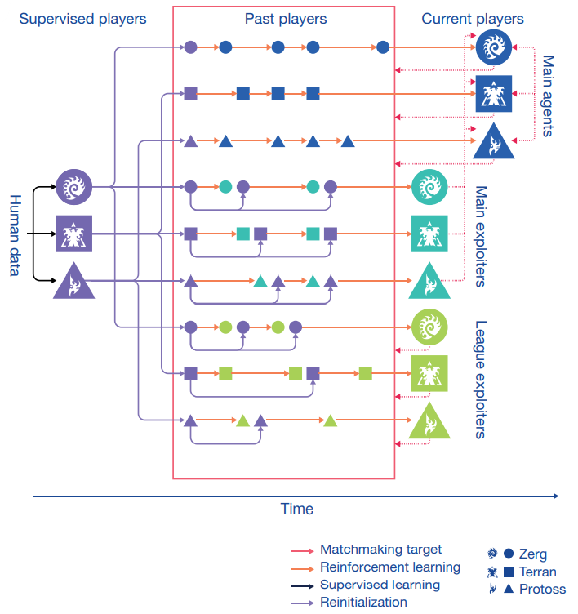
League training Marl
Three pools of agents, each initialized by supervised learning, were subsequently trained with reinforcement learning.
As they train, these agents intermittently add copies of themselves—”players” that are frozen at a specific point—to the league.
The main agents train against all of these past players, as well as themselves.
The league exploiters train against all past players.
The main exploiters train against the main agents.
Main exploiters and league exploiters can be reset to the supervised agent when they add a player to the league.

