Slide 1
Educational game 2
Nigel Belderbos
Sam De Wispelaere
Nikita Vandecasteele
Colin Bossuyt

Slide 2
How are we
Nigel Belderbos -programming
Sam De Wispelaere -programming -documentation -educational videos
Nikita Vandecasteele -programming -drawing strites
Colin Bossuyt - programming

Slide 3
About the game
educate about climate change fundamentals.
Target Audience: Kids aged 6 to 10.
Incorporates mini-games to teach about climate change issues.
Players address environmental problems through gameplay.
Educational video per minigame
Made in Godot

Slide 4
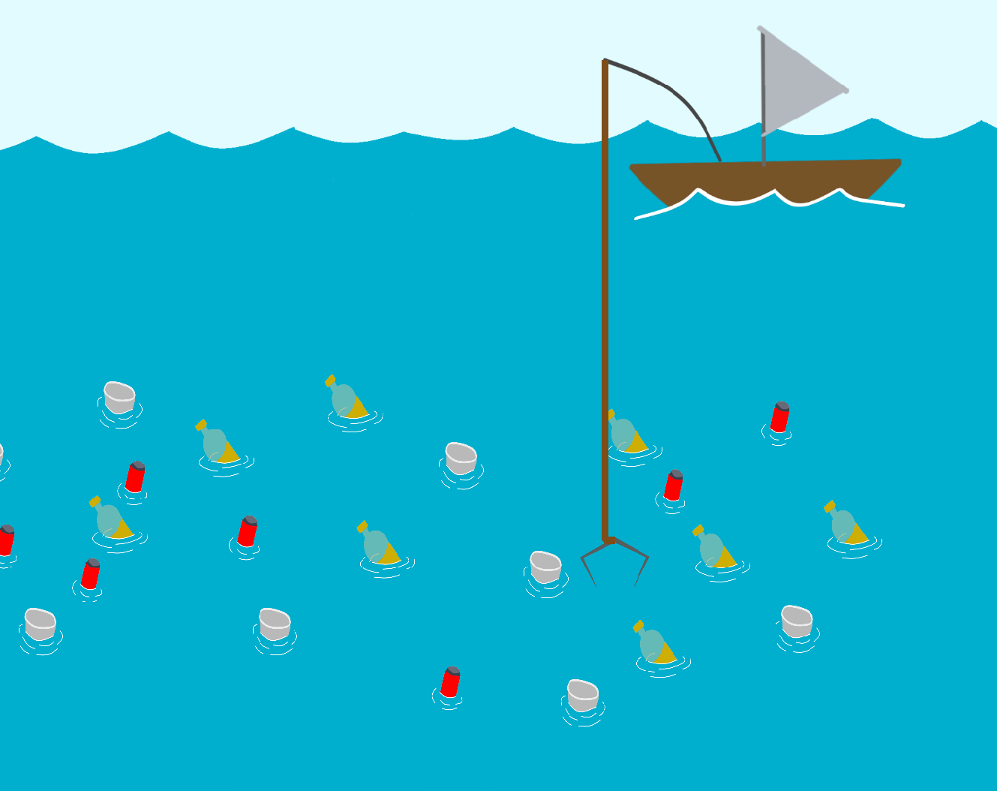
Plastic catch
Objective: Remove plastic from the ocean.
Danger: Plastic pollution harms marine life and ecosystems.

Slide 5
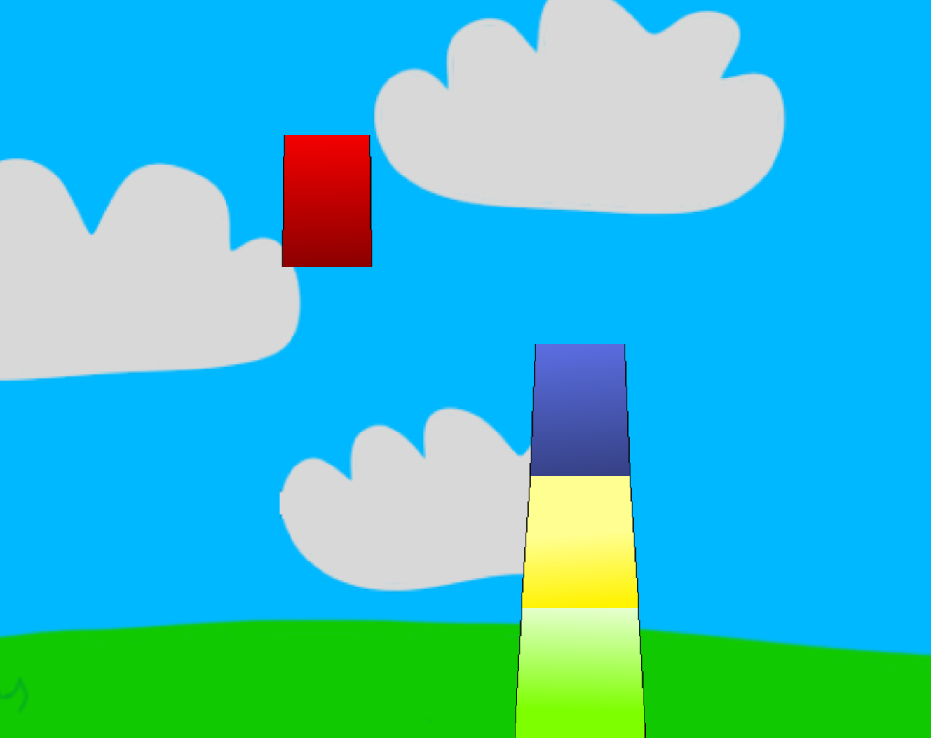
Stacking turbine
Objective: Build windmills to combat carbon emissions.
Benefits of windmills: Renewable energy source, clean energy production, energy independence.

Slide 6

Forest on fire
Objective: Navigate a bird through a burning forest.
Awareness: Illustrates the impact of wildfires.

Slide 7
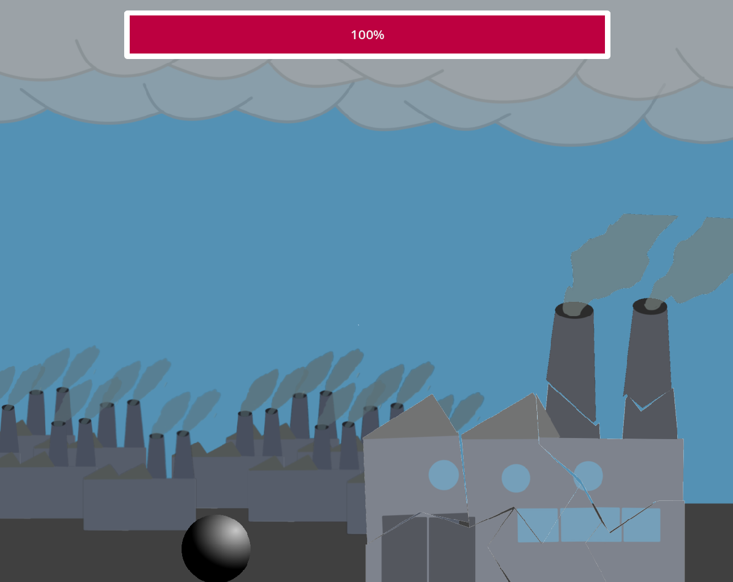
Factory wrecking
Objective: Destroy factories emitting carbon.
Awareness: Factories contribute to carbon emissions.

Slide 8
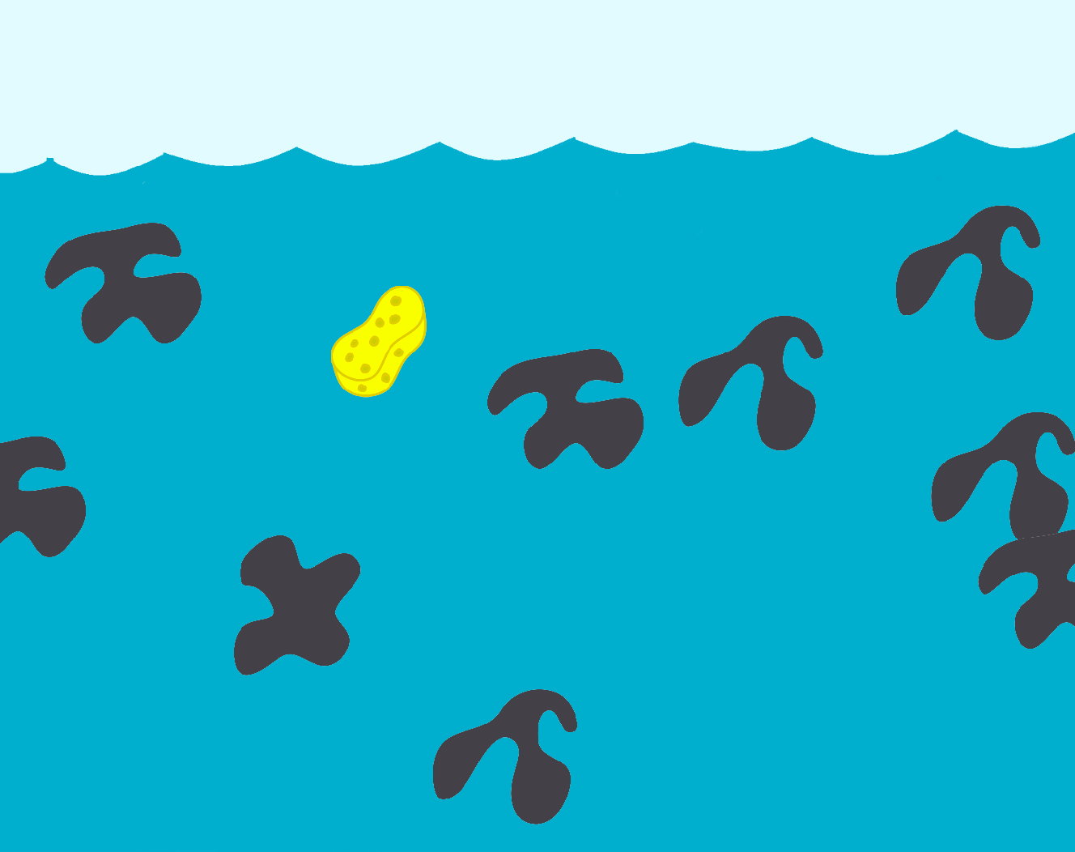
Oil clean up
Objective: Remove oil from the ocean using sorbents.
Issue: Oil pollution harms marine life.

Slide 9
Expansion
Integrating information about each problem.
Additional minigames

