Slide 1
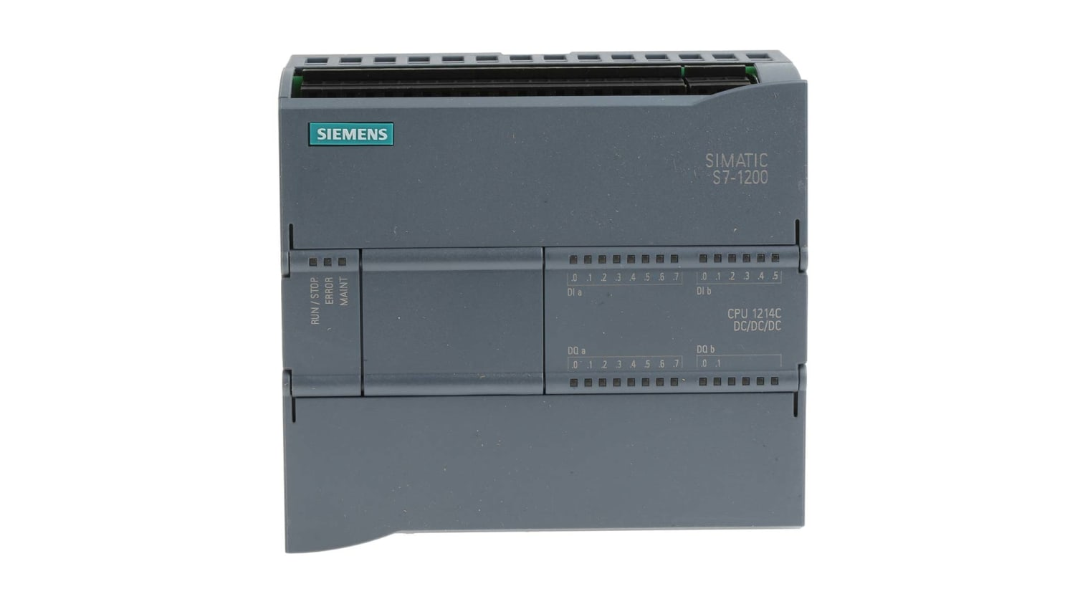
Mqtt-broker 172.16.12.22
Node-red
Profinet
Ethernet
UFW
Sensor
PLC
172.16.12.21
Router
Raspberry PI
Dashboard
Iot-> Node red
Dashboard
Netwerk -> node.js

