Slide 1
Let's Start with a Story...

Slide 2
Let's Start with a Story...
Long long ago.....

Slide 3






JINJIN
JAJA
JIJI
NINA
JOJO
JUJU

Slide 4
Our task is to find Nina’s Match…

Slide 5
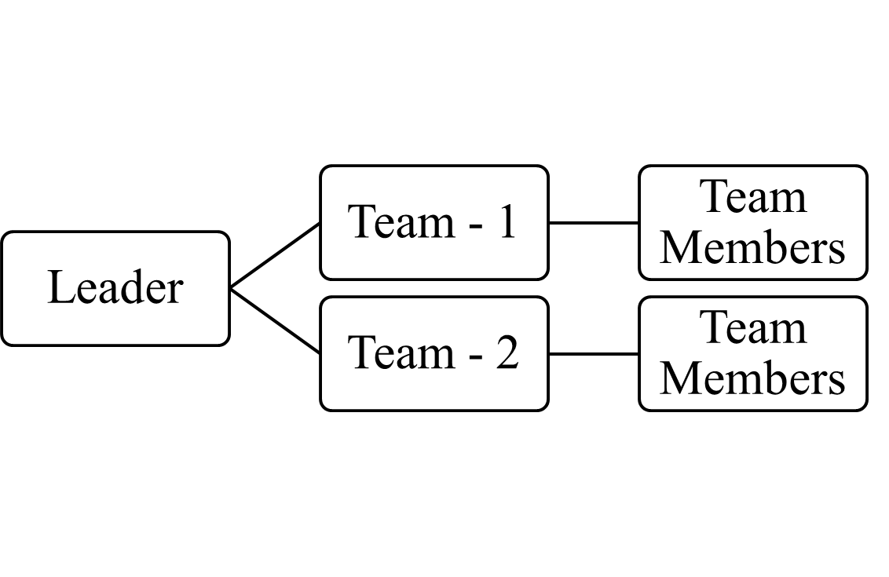
GROUP
TEAM - 1
TEAM - 2

Slide 6
Task - 1
JAJA
Jaja – 1
Jiji – 1
Jojo – 1
Jaja – 1
JIJI
JUJU
Write down the name of the person in photo and then a 1.
Two people in each photo ➔ 16 lines in your paper
IMPORTANT: All lines should have only “1” no other numbers
JOJO
JINJIN

Slide 7
Task - 2
JAJA
1
1
1
1
1
JAJA
JIJI
JUJU
Team leader should collect all the sheets
Give five sheets to any five people in the group.
Team leader should write one name on top of each sheet (jaja, jiji, juju, etc)
Team leader will read lines present in the two sheets of task-1
Team member (worker) has to write one ‘1’ whenever he hears to the name written on his sheet.
JOJO
JINJIN

Slide 8
Task - 3
JAJA
5
JAJA
JIJI
JUJU
Team leader should collect all the sheets
Give five sheets to any five people in the group.
Team member(worker) should add the 1s and write the number on back of sheet in bold letters, along with the name.
JOJO
JINJIN

