Slide 1
ATM SIMULATION
Nikhitha S (1BM24CS189)
Nikitha M N (1BM24CS190)
Panchami P (1BM24CS196)
Harsh Bafna (1BM24CS357)

Slide 2
PROBLEM STATEMENT
The problem is to design and develop a Java-based ATM Simulation System that mimics the working of a real ATM machine.
The system should provide a secure login mechanism using a PIN and allow the user to perform basic banking operations through a graphical interface.
The application must be user-friendly, reliable, and should handle invalid inputs gracefully without crashing.

Slide 3
INTRODUCTION
“ATM SIMULATION” is a graphical user interface (GUI) based application developed using Java Swing. It gives you real time visualization of fundamental operations of an ATM such as PIN authentication, balance inquiry, cash deposit, and withdrawal.
The project emphasizes the practical implementation of Object-Oriented Programming (OOP) concepts, event-driven programming, and exception handling in Java.
The main aim of this project is to provide hands-on experience in developing a real-world application using Java and to enhance understanding of GUI components and user interaction.

Slide 4
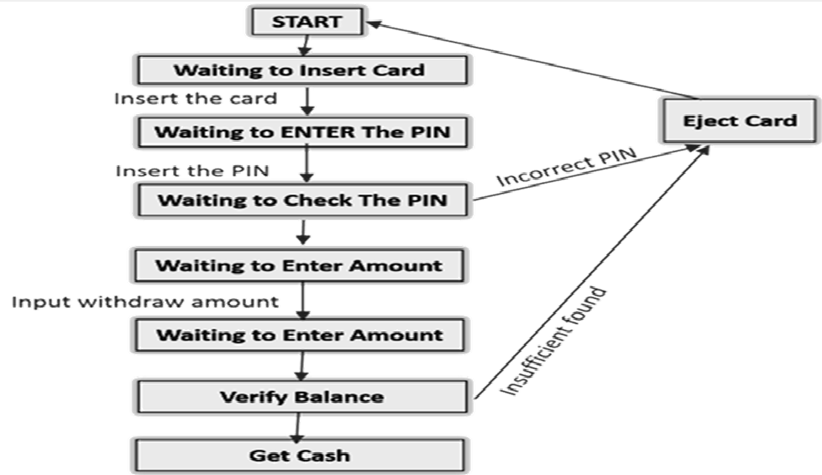
OVERVIEW OF THE PROJECT

Slide 5
TOOLS USED
Java (JDK) – Core programming language used for application logic
Java Swing – Used for creating graphical user interface components
AWT (Abstract Window Toolkit) – Used for layouts, events, and graphics
VS CODE Editor– Used for writing, compiling, and executing code
Windows Operating System – Platform used for development and testing

Slide 6
OOPS CONCEPTS FROM JAVA
Encapsulation: Encapsulation is achieved by declaring variables such as balance and PIN as private members of the class.
Inheritance: The main class ATMSimulation extends the JFrame class, inheriting properties of a window-based application.
Abstraction: The internal implementation details of ATM operations are hidden from the user. The user interacts only through buttons and dialogs.
Polymorphism: Method overriding is used in handling events such as actionPerformed() where different actions are performed based on the source of the event.

Slide 7
OOPS CONCEPTS FROM JAVA
Interfaces: The ActionListener interface is implemented to handle button click events.
Exception Handling: Try-catch blocks are used to handle invalid inputs such as non-numeric PINs or invalid transaction amounts, preventing application crashes.
Java Swing: Java Swing is a GUI toolkit used to create window-based applications.
Abstract Window Toolkit (AWT): AWT is a Java library that provides basic graphical components, layouts, and event handling mechanisms

Slide 8
OOPS CONCEPTS FROM JAVA
Java Event Handling: Event handling is a mechanism that controls user interactions such as button clicks.
Java Graphics (Graphics & Graphics2D): The Graphics and Graphics2D classes are used to create custom visual effects.
Java Layout Managers: Layout managers are used to control the arrangement of components in a window.
Java Swing Dialogs: This is used to display dialog boxes for user interaction.

Slide 9
IMPLEMENTATION
The ATM Simulation is implemented as a Java Swing application using event-driven programming. The main components include:
Login Screen using JPasswordField for secure PIN entry
Menu Screen with buttons for ATM operations
Dialog Boxes using JOptionPane to interact with the user
The application maintains the account balance internally and updates it based on deposit and withdrawal transactions.
Each user action triggers an event handled by the actionPerformed() method.

Slide 10
Conclusion
The ATM Simulation project successfully demonstrates the working of a real-time ATM system using Java.
Core banking operations such as PIN authentication, balance inquiry, deposit, and withdrawal were implemented effectively.
The project provided hands-on experience with Object-Oriented Programming concepts like encapsulation, inheritance, and polymorphism.
Java Swing and AWT were efficiently used to create a user-friendly and interactive graphical interface.
Overall, the project helped bridge the gap between theoretical Java concepts and practical application development.

Slide 11
Future Enhancements
Integration of a database to store user accounts, transaction history, and multiple user details.
Implementation of advanced security features such as OTP verification and PIN encryption.
Support for multiple bank accounts and card-based authentication.
Addition of features like mini statements, fund transfer, and PIN change options.
Development of a web-based or mobile version of the ATM system for real-world deployment

Slide 12
THANK YOU

