Slide 1

Credit Risk Analysis with Machine Learning
Maximizing loan acceptance with minimum default

Slide 2
Credit Risk Analysis with Machine Learning
Problem Undertanding
Model development
Business Strategy
Data Analysis
Notes:
Credit risk is associated with the possibility of a client failing to meet contractual obligations, such as mortgages, credit card debts, and other types of loans.
Minimizing the risk of default is a major concern for financial institutions. For this reason, commercial and investment banks, venture capital funds, asset management companies and insurance firms, to name a few, are increasingly relying on technology to predict which clients are more prone to not honoring their debts.
Machine Learning models have been helping these companies to improve the accuracy of their credit risk analysis, providing a scientific method to identify potential debtors in advance.

Slide 3



Credit Risk Analysis
Credit risk is associated with the possibility of a client failing to meet contractual obligations, such as mortgages, credit card debts, and other types of loans.
Acceptance Rate
Risk of Default
Bad Rate
The greater the number of contracted loans , the greater the company's profit
The profits from loan operations are only realized if the client honors with the payments.
The proportion of defaults of total loans accepted by the institution
21,82%
Current Bad Rate
Notes:
Credit risk is associated with the possibility of a client failing to meet contractual obligations, such as mortgages, credit card debts, and other types of loans.
Minimizing the risk of default is a major concern for financial institutions. For this reason, commercial and investment banks, venture capital funds, asset management companies and insurance firms, to name a few, are increasingly relying on technology to predict which clients are more prone to not honoring their debts.
Machine Learning models have been helping these companies to improve the accuracy of their credit risk analysis, providing a scientific method to identify potential debtors in advance.

Slide 4


Exploratory Data Analysis
The database contains 12 features for 32.581 clientes.
The features can be divided in two main categories: personal information (age, anual income etc.) and loan information (loan amount, interest rate etc).
loan_status is a binary feature and is the target variable used to predict probabilities of default.
22% of defaults – Unbalanced dataset.
Notes:
Credit risk is associated with the possibility of a client failing to meet contractual obligations, such as mortgages, credit card debts, and other types of loans.
Minimizing the risk of default is a major concern for financial institutions. For this reason, commercial and investment banks, venture capital funds, asset management companies and insurance firms, to name a few, are increasingly relying on technology to predict which clients are more prone to not honoring their debts.
Machine Learning models have been helping these companies to improve the accuracy of their credit risk analysis, providing a scientific method to identify potential debtors in advance.

Slide 5
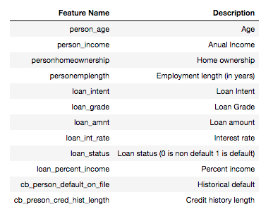
Exploratory Data Analysis
Features
Mix of numerical and categorical features.
Age, Income have long tails
Notes:
Credit risk is associated with the possibility of a client failing to meet contractual obligations, such as mortgages, credit card debts, and other types of loans.
Minimizing the risk of default is a major concern for financial institutions. For this reason, commercial and investment banks, venture capital funds, asset management companies and insurance firms, to name a few, are increasingly relying on technology to predict which clients are more prone to not honoring their debts.
Machine Learning models have been helping these companies to improve the accuracy of their credit risk analysis, providing a scientific method to identify potential debtors in advance.

Slide 6

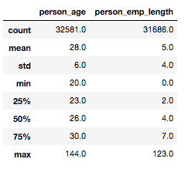
Exploratory Data Analysis
Outliars
The descritve statitiscs showed error in two variables
The age was simply truncated at 95 years.
For the employment length the ratio was taken
between it and age, since it is impossible someone
work for a longer time then they are alive.
All values >= 1 were deleted.
Notes:
Credit risk is associated with the possibility of a client failing to meet contractual obligations, such as mortgages, credit card debts, and other types of loans.
Minimizing the risk of default is a major concern for financial institutions. For this reason, commercial and investment banks, venture capital funds, asset management companies and insurance firms, to name a few, are increasingly relying on technology to predict which clients are more prone to not honoring their debts.
Machine Learning models have been helping these companies to improve the accuracy of their credit risk analysis, providing a scientific method to identify potential debtors in advance.

Slide 7



Exploratory Data Analysis
Missing Data
Drop NaN’s
Simple Mean/ Median Imputation
Mean Imputatation +
Mean Category Imputatation
Notes:
Credit risk is associated with the possibility of a client failing to meet contractual obligations, such as mortgages, credit card debts, and other types of loans.
Minimizing the risk of default is a major concern for financial institutions. For this reason, commercial and investment banks, venture capital funds, asset management companies and insurance firms, to name a few, are increasingly relying on technology to predict which clients are more prone to not honoring their debts.
Machine Learning models have been helping these companies to improve the accuracy of their credit risk analysis, providing a scientific method to identify potential debtors in advance.

Slide 8
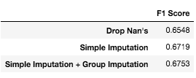


Exploratory Data Analysis
Missing Data
Evaluation Strategy
Random Forest scored using F1 Score
At this point the data set was dividided in train and validation to avoid data leakage, since an aggregated metric are being used.
Notes:
Credit risk is associated with the possibility of a client failing to meet contractual obligations, such as mortgages, credit card debts, and other types of loans.
Minimizing the risk of default is a major concern for financial institutions. For this reason, commercial and investment banks, venture capital funds, asset management companies and insurance firms, to name a few, are increasingly relying on technology to predict which clients are more prone to not honoring their debts.
Machine Learning models have been helping these companies to improve the accuracy of their credit risk analysis, providing a scientific method to identify potential debtors in advance.

Slide 9
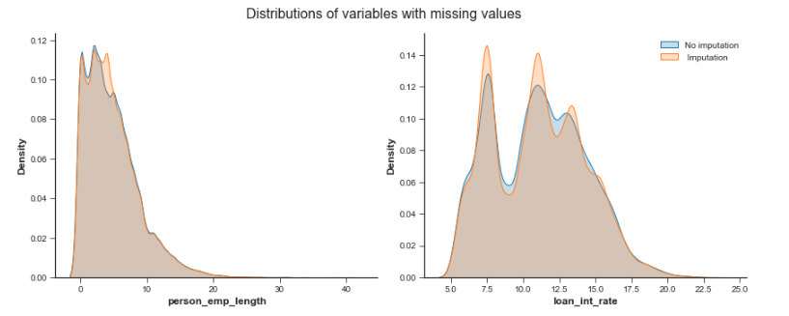
Exploratory Data Analysis
Missing Data
KS 2 Sample
Test statistic: 0.203
P-value: 7.121e-6
Notes:
https://docs.scipy.org/doc/scipy/reference/generated/scipy.stats.ks_2samp.html
Compute the Kolmogorov-Smirnov statistic on 2 samples.
This is a two-sided test for the null hypothesis that 2 independent samples are drawn from the same continuous distribution. The alternative hypothesis can be either ‘two-sided’ (default), ‘less’ or ‘greater’.
If the KS statistic is small or the p-value is high, then we cannot reject the hypothesis that the distributions of the two samples are the same.

Slide 10
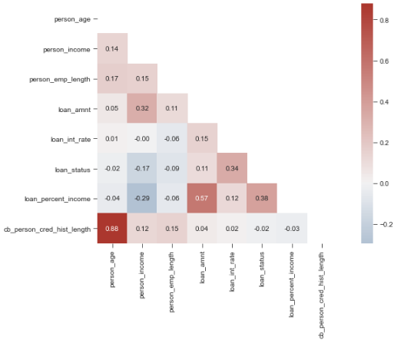
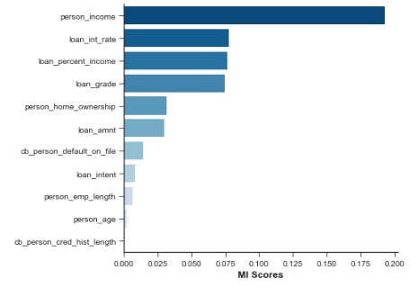
Exploratory Data Analysis
Correlation Scores & Mutual Information
Notes:
The mutual information (MI) between two quantities is a measure of the extent to which knowledge of one quantity reduces uncertainty about the other.
The least possible mutual information between quantities is 0.0. When MI is zero, the quantities are independent: neither can tell you anything about the other.
The scikit-learn algorithm for MI treats discrete features differently from continuous features.

Slide 11

Feature Engineering &
Model Selection
CatBoost is an algorithm is for gradiente boosting on decision trees, that have categorical feature support, this way there is one less step in pre-processing of the data.
It also requires minumum tuning.
Since the dataset is a mix of diffent types of features, CatBoost will be used to construct the model of probabilities of default.

Slide 12

Feature Engineering &
Model Selection
The comparison of the models at this stage will be done using a cross-validation statregy with 5 folds. ROC auc, F1 Score and Recall are the metrics chosen.
Spetial atention were paid to Recall, since the cost of a operation marked as false negative, meaning that the finantial company had lend a loan that will not be paid, resulting in loss.

Slide 13
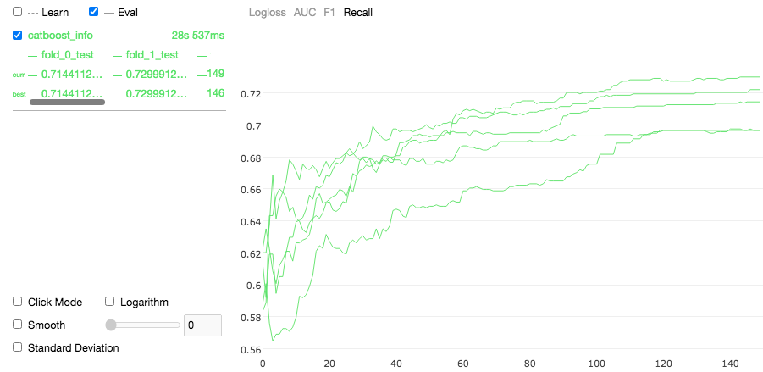

Feature Engineering &
Model Selection
After a few rounds the final cross-validation performance was:
And the final features to be used in the next stage of modeling
Dropped
Length of credit history
Created
Indicator of employment (Y or N)
Mean income by home ownership
Mean income by loan intente
Ratio of employment length by income
Difference betweenperson_income and loan_amnt

Slide 14
Hyperparameter Tuning
Using the overfitting detector, if the Recall metric doesn’t increase, on the validation set, in 25 rounds, then the training stops and the model use those best parameters.
For this dataset the best parameters were:
Number of Trees: 122
Learning Rate: 0.07

Slide 15
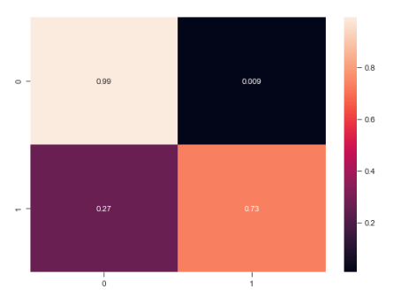
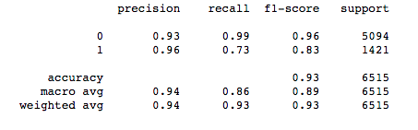
Hyperparameter Tuning
Metrics
Classification Report
Confusion Matrix

Slide 16
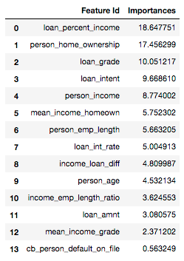
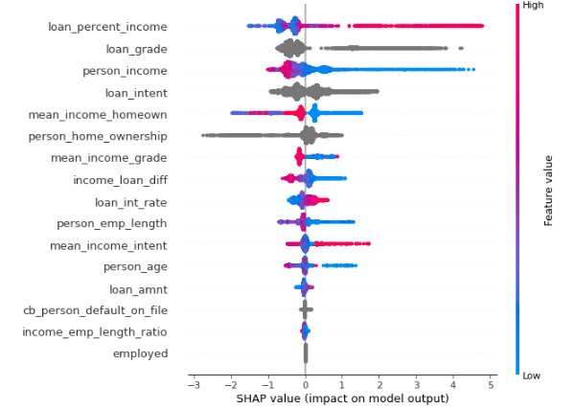
Model Interpretation
Feature Importance
Prediction Value Change
SHAP Summary Plot
Notes:
### PredictionValuesChange
For each feature, PredictionValuesChange shows how much on average the prediction changes if the feature value changes. The bigger the value of the importance the bigger on average is the change to the prediction value if this feature is changed.
The output is normalized, all the importances will add up to 100

Slide 17
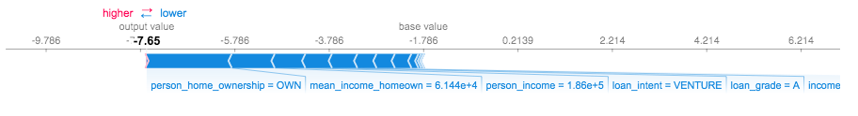
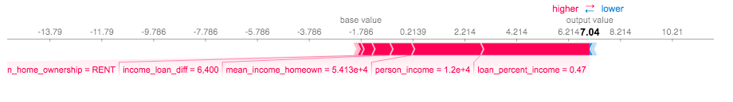
Model Interpretation
Feature Importance
It is also possible to see how a prediction was made for individual cases, this is spetial usefull for
Credit Risk since the finantial institution is legally required to explain the basis por each loan rejection.
Notes:
SHAP values interpret the impact of having a certain value for a given feature in comparison to the prediction we'd make if that feature took some baseline value.

Slide 18
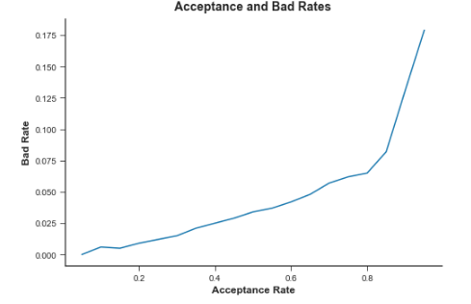
Choosing the Classification Threshold
The objective is to accept the highest possible number of operations with minimum default rate.
With acceptance rates higher than 80%
the bad rate grows very fast.

Slide 19
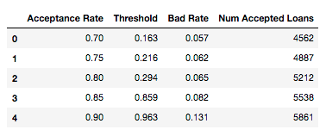

Choosing the Classification Threshold
The objective is to accept the highest possible number of operations with minimum default rate.
21,82%
39% decrease
8,2%
.

Slide 20

Improvement Points
New model with only the most important features;
Test with others classification algorithms;
Model Staking;
.

