Slide 1

Predicting the House Price
Math448 Project
Xingxin Ma

Slide 2

Contents
Project description
Data set
Data clean
Build models
Summary

Slide 3

Project description
For your future dream house, expected relax place, and a feasible payment plan, to estimate the house price ahead of time is helpful.
In this project the goal is to predict the house price. This is a regression problem.
There are a lot of variables of house price. I will try to build several statistical models to predict the numerical response(house price).

Slide 4

Slide 27

Slide 5
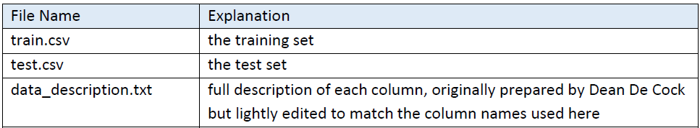
Data set
The first file train.csv has 1460 house sale records for training. And test.csv has 1459 house sale records for testing. The file train.csv has 1461 rows. The first row is the title, and below each row represents a house sale record. The file train.csv has 81 columns. The first column is Id. The last column is sale price----the output. And the rest columns represent 80 variables.
The data I used in this project is from Kaggle. The link is below:
https://www.kaggle.com/c/house-prices-advanced-regression-techniques/overview
The first file train.csv has 1460 house sale records for training. The file train.csv has 1461 rows. The first row is the title, and below each row represents a house sale record. The file train.csv has 81 columns. The first column is Id. The last column is sale price----the output. And the rest columns represent 80 variables. Test.csv is similar from train.csv, and has 1459 records without sale price. So I will split train.csv into training data set(75%) and test data set(25%). And use test data set to verify the models.

Slide 6
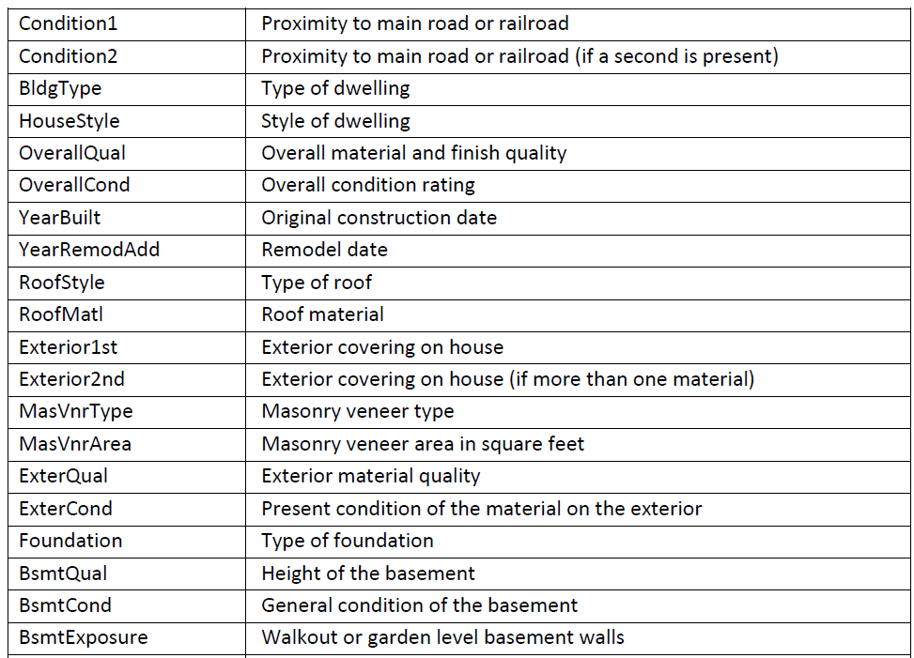
Data set
The first file train.csv has 1460 house sale records for training. And test.csv has 1459 house sale records for testing. The file train.csv has 1461 rows. The first row is the title, and below each row represents a house sale record. The file train.csv has 81 columns. The first column is Id. The last column is sale price----the output. And the rest columns represent 80 variables.
Screenshot of some variables name and variables explanation.

Slide 7
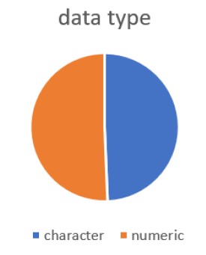
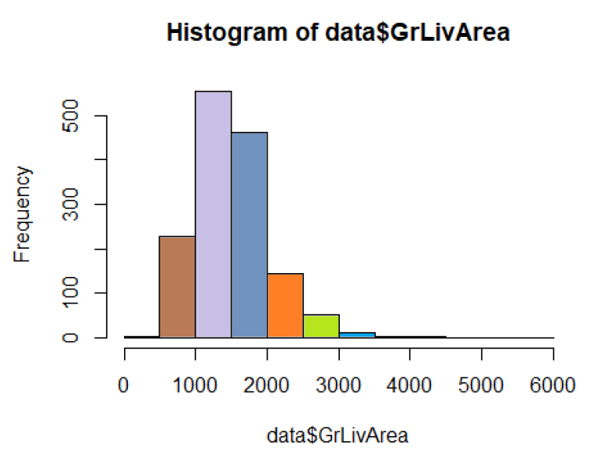
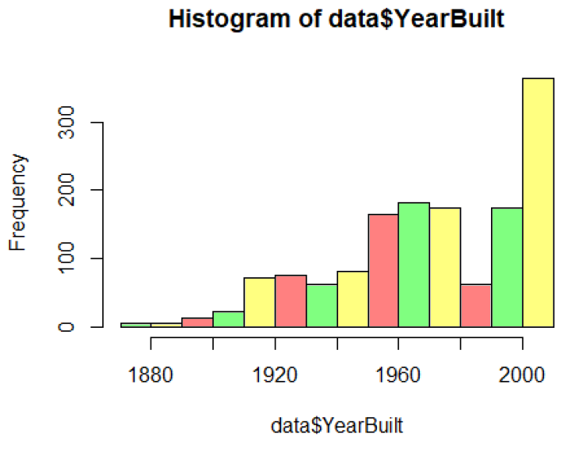
Data set
The first file train.csv has 1460 house sale records for training. And test.csv has 1459 house sale records for testing. The file train.csv has 1461 rows. The first row is the title, and below each row represents a house sale record. The file train.csv has 81 columns. The first column is Id. The last column is sale price----the output. And the rest columns represent 80 variables.
Variable type summary and some variables histograms.
categorical

Slide 8
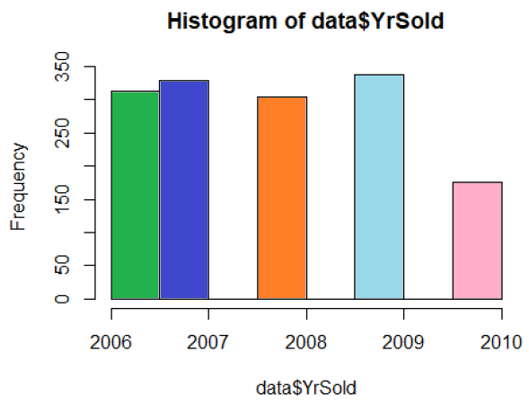
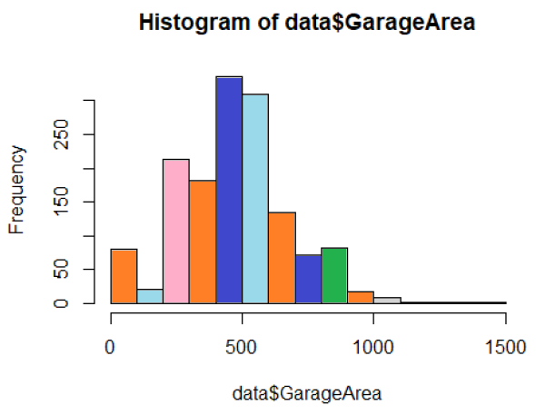
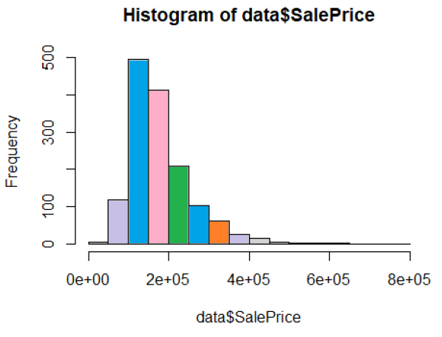
Data set
The first file train.csv has 1460 house sale records for training. And test.csv has 1459 house sale records for testing. The file train.csv has 1461 rows. The first row is the title, and below each row represents a house sale record. The file train.csv has 81 columns. The first column is Id. The last column is sale price----the output. And the rest columns represent 80 variables.
Some variables and response histograms.

Slide 9

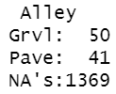
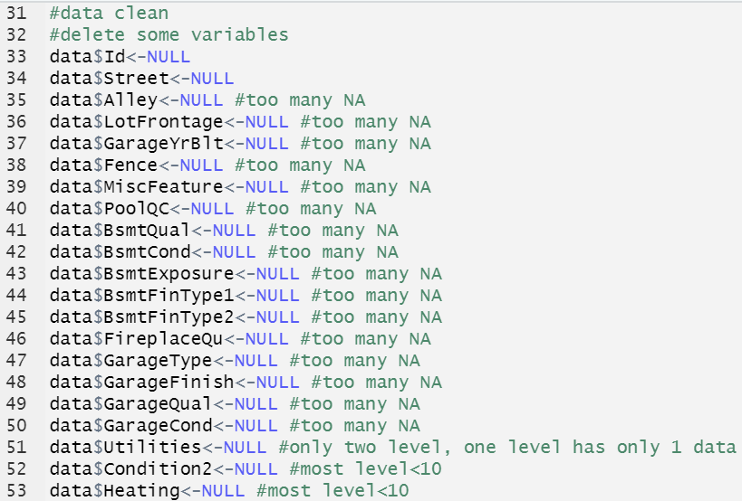
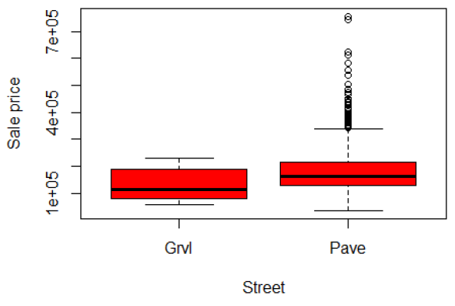
Data clean
The first file train.csv has 1460 house sale records for training. And test.csv has 1459 house sale records for testing. The file train.csv has 1461 rows. The first row is the title, and below each row represents a house sale record. The file train.csv has 81 columns. The first column is Id. The last column is sale price----the output. And the rest columns represent 80 variables.
I found some variables has only one level. Or some variables are almost all “NA”. Or some categorical variables has large percentage on one of the category, and small percentage on the others. And I checked the box plotting, there is not such a obviously difference between the categories. To avoid cannot found the minor category in training set error, I delete these categorical variables. For example, I deleted these variables:

Slide 10
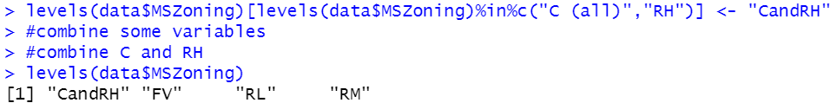
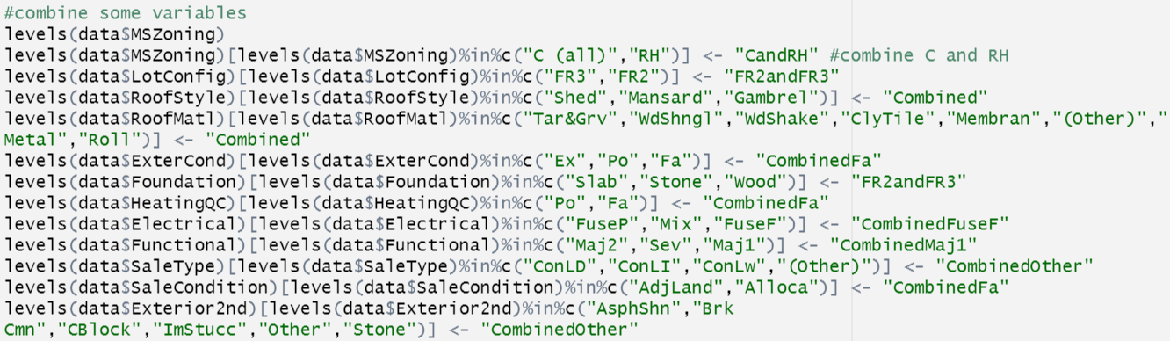
Data clean
The first file train.csv has 1460 house sale records for training. And test.csv has 1459 house sale records for testing. The file train.csv has 1461 rows. The first row is the title, and below each row represents a house sale record. The file train.csv has 81 columns. The first column is Id. The last column is sale price----the output. And the rest columns represent 80 variables.
I combined some categories(level<10) of some variables to avoid cannot found the minor category in training set error. For example:

Slide 11
Models used in this project
Linear regression
Multiple Linear Regression
K-Nearest Neighbors
Ridge
Lasso
(Forward Backward stepwise selection)

Slide 12
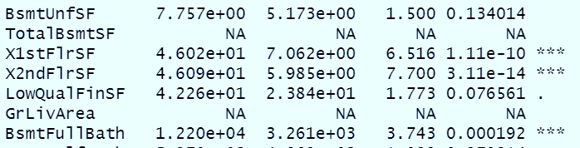
Linear regression
When I use summary(), I found some variable NA. I deleted these two variables: TotalBsmtSF and GrLivArea. (Because correlated with other variables). Deleting these variables will not cause R^2 or MSE change.
Using both quantitative and qualitative variables, I got R^2=0.56 and MAE=45654.

Slide 13
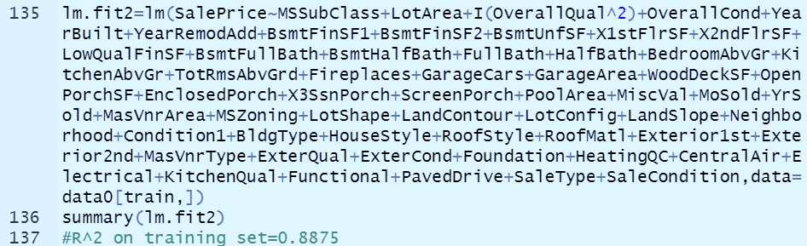
Multiple Linear Regression
I use both quantitative and qualitative variables in simple linear regression and only add OverallQual^2 and I got R^2=0.55 and MAE= 49096.

Slide 14
K-Nearest Neighbors
In KNN, I delete all categorical variables and only use quantitative variables to predict.
I tried k=1, k=3, k=5 to build model and predict.
I compared the predict and show it below. From the result, K=1 is the best model in KNN.
K | R^2 | MAE | MSE
1 | 0.998225 | 962.3829 | 11066609
3 | 0.9978133 | 1360.118 | 13633639
5 | 0.9973595 | 1579.264 | 16462835

Slide 15
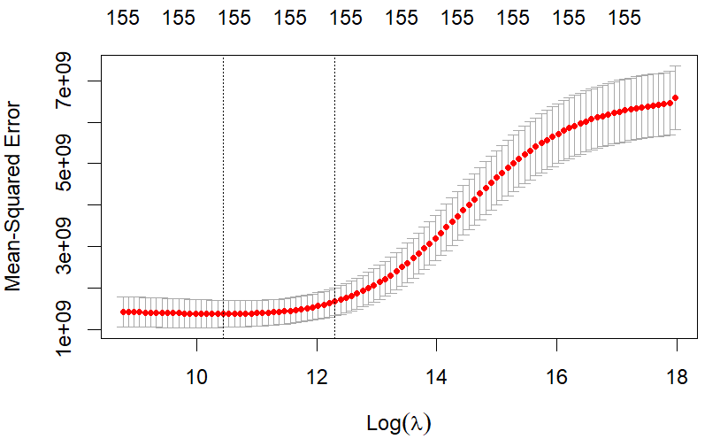
Ridge regression
In Ridge regression, I add all categorical variables to make model. Using cross validation to obtain the best λ=49678.66. Using the best λ I got R^2=0.8894993, MAE=16182.67.

Slide 16
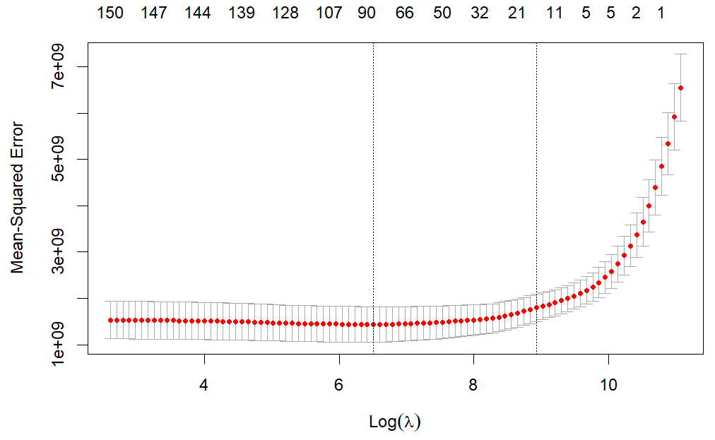
Lasso regression
In Lasso regression, I add all categorical variables to make model. Using cross validation to obtain the best λ= 672.1759. Using the best λ I got R^2=0.8894993, MAE= 17976.64.

Slide 17
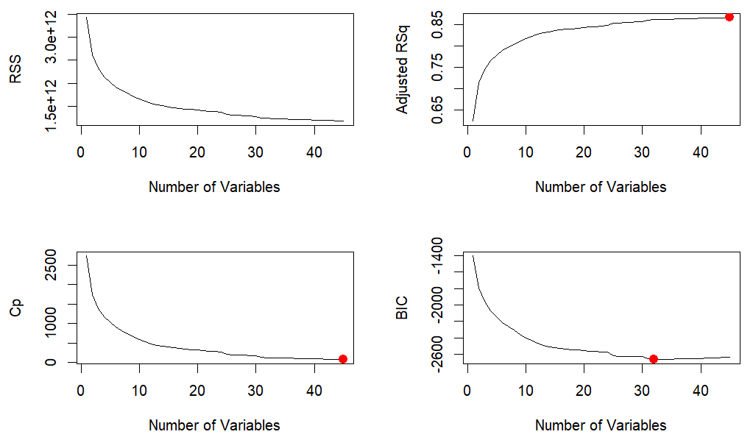
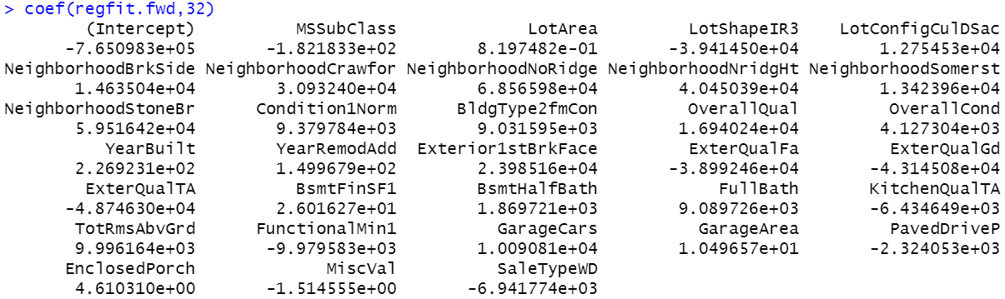
Forward Stepwise Selection

Slide 18
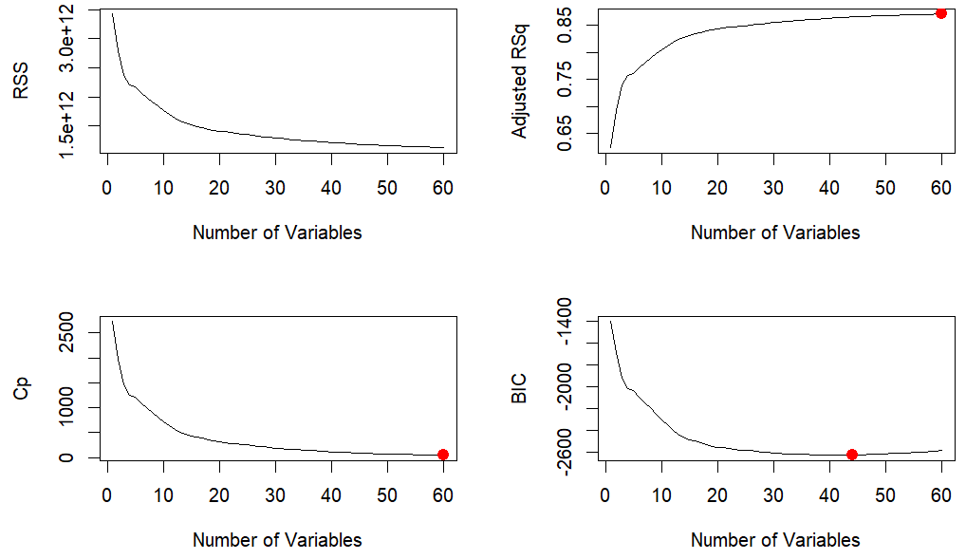
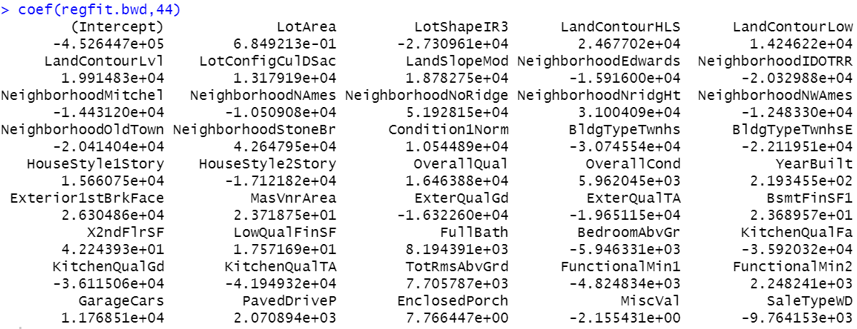
Backward Stepwise Selection

Slide 19
Summary
House price depends on a lot of variables.
Some predictors have positive relationship (positive coefficients) with SalePrice, such as OverallQual, OverallCond, LotArea, YearBuilt. In general words, this means, the bigger, better condition, more quality material, and new built would make a higher sale price.
From right form, KNN k=1 is the best model. It means: if you want to estimate a house’s sale price, try to find a sold house which is similar.
Model | MSE | MAE | R^2
Linear Regression | 3870487153 | 45654 | 0.56
Multiple Linear Regression | 3442170128 | 49096 | 0.55
KNN(k=1) | 11066609 | 962 | 0.99
KNN(k=3) | 13633639 | 1360 | 0.99
KNN(k=5) | 16462835 | 1579 | 0.99
Lasso Regression | 694366449 | 16182 | 0.87
Ridge Regression | 596698596 | 16182 | 0.89

Slide 20
Next
The first file train.csv has 1460 house sale records for training. And test.csv has 1459 house sale records for testing. The file train.csv has 1461 rows. The first row is the title, and below each row represents a house sale record. The file train.csv has 81 columns. The first column is Id. The last column is sale price----the output. And the rest columns represent 80 variables.
I will try some other models such like polynomial regression, bagging….
After comparing all the models I tried, I will select the best model and use all the training data set to make the model and do prediction on the test data set.
Thanks!

