Slide 1
行動電信網路 Project 3

Slide 2
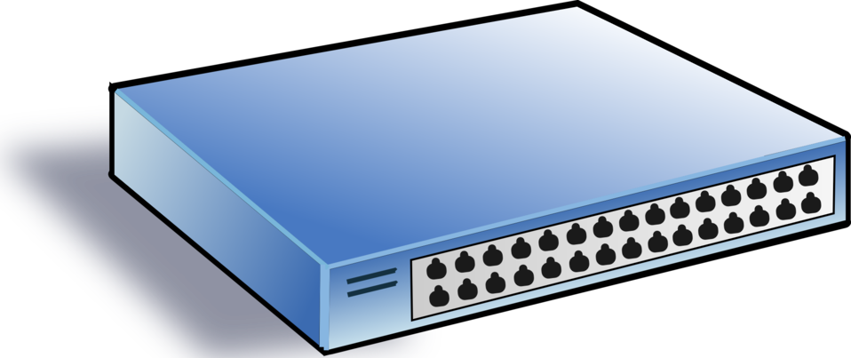

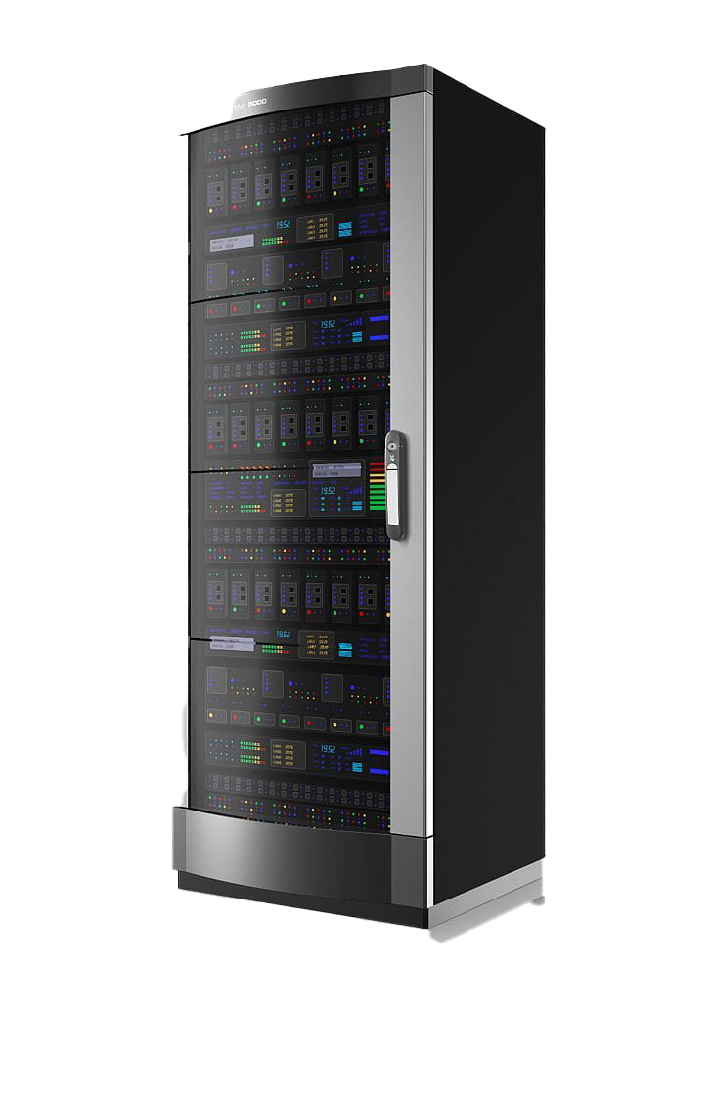
Goal
In project 3, we will use mininet and ONOS to:
Build a designated topology for the client-server scenario
Install several flow rules to control network flow
Achieve server load balancing
Client1
Client2
Server1
Server2

Slide 3
Introductions

Slide 4
To Learn
Build a custom topology with python
Connect the ONOS controller and mininet
Set flow rule on switches

Slide 5
To Learn
Build a custom topology with python
Connect the ONOS controller and mininet
Set flow rule on switches

Slide 6
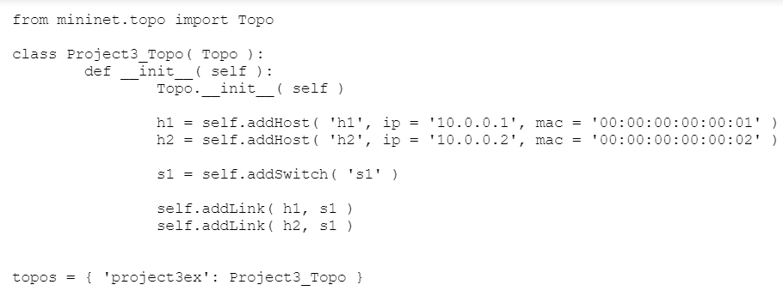
Customize a topology
To build a topology
You can write a topology in Python like the following one.
After that, start mininet with:
sudo mn --custom=“your_topology_file.py” --topo=“your_topology_name”
In this example, it will be
sudo mn --custom=“p3ex.py” --topo=“project3ex”
h1
s1
h2

Slide 7
To Learn
Build a custom topology with python
Connect the ONOS controller and mininet
Set flow rule on switches

Slide 8
Connect mininet and ONOS
We use mininet to simulate the data plane and ONOS as the control plane
In other words, the ONOS will be our SDN controller, and make us able to program our network.
How to do this?
To build the data plane, we use:
sudo mn --custom=“your_topology_file.py” --topo=“your_topology_name”
To use ONOS or another SDN controller to control mininet, use --controller.
sudo mn --custom=“your_topology_file.py” --topo=“your_topology_name” --controller=remote,ip=127.0.0.1:6653

Slide 9
To Learn
Build a custom topology with python
Connect the ONOS controller and mininet
Set flow rule on switches

Slide 10
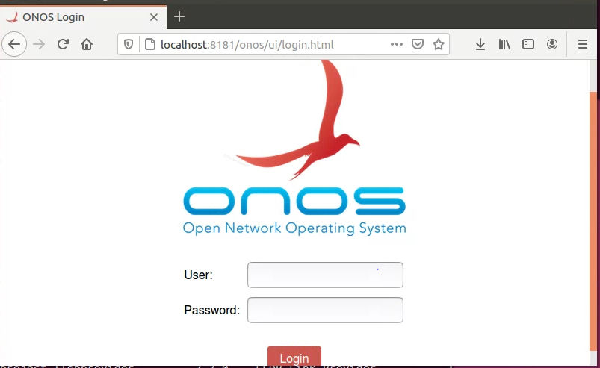
Set flow rules on switch (1/6) – Onos GUI
Now, we can see our topology in ONOS web GUI.
Open your browser, visit “http://localhost:8181/onos/ui
http://192.168.1.108:8181/onos/ui
user: onos/ password: rocks

Slide 11
Set flow rules on switch (2/6) – Onos GUI
If you want to see the hosts in network, the controller needs to receive some packet from them first.
Fortunately, ONOS has a default flow rule that will packet-in all arp packets, so we just need to let hosts ping or arping each other.
use “pingall”, each host will ping all other hosts.
or use “host1_name ping host2_name”, host1 will ping host2
if you just want to send arp packet , use “host1_name arping host2_name”
Ex. After host1 arping host2, press “H” key on Onos GUI, and you’ll see host1 on the Onos GUI

Slide 12
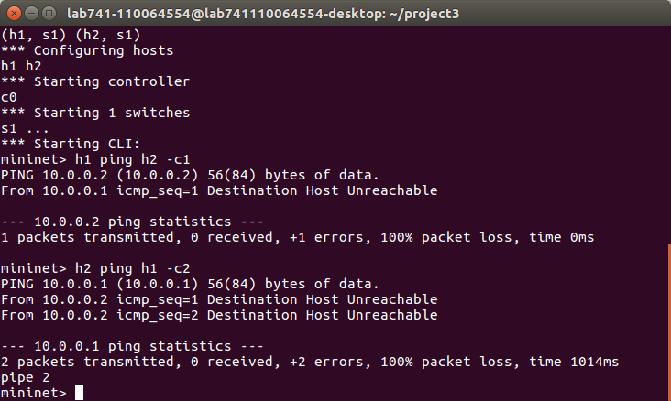
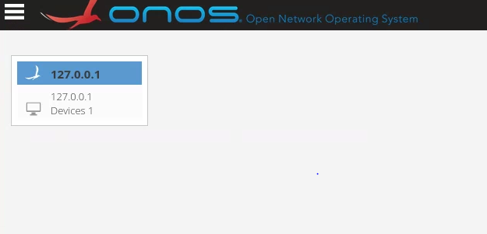
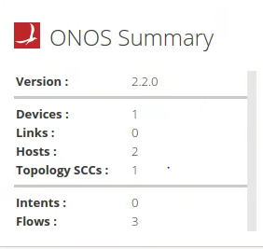
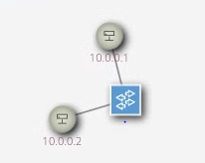
Set flow rules on switch (3/6) – Onos GUI
We can see the topology in the GUI
Before we set flow rules, the ping (ICMP requests) cannot reach its destination because the switch doesn’t know where it is.

Slide 13
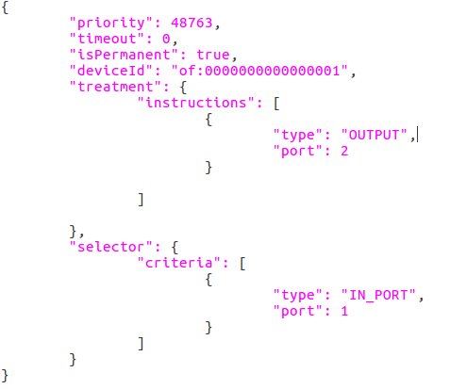
Set flow rules on switch (4/6) – Flow Rule
But how to set flow rules?
We can write flow rules in .json file, and use curl command to send them to the controller.
Remember, the network communication is “both-way”, so if we want to use “h1 ping h2” and get response, we need to set two flow rules: h1 to h2 and h2 to h1.
The .json flow rule is like follow:

Slide 14

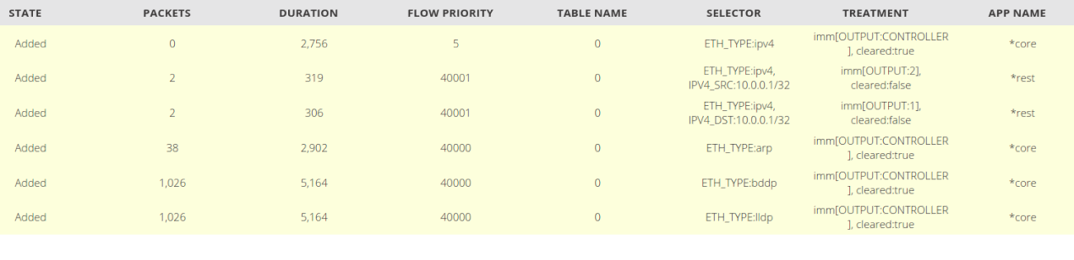
Set flow rules on switch (5/6) – Flow Rule
curl -u onos:rocks -X POST -H ‘Content-Type: application/json’ –d @switch1_1.json ‘http://localhost:8181/onos/v1/flows/of:0000000000000001’
We can observe the flow rules in the GUI like this:
Notes:
when no bug, no extra message

Slide 15
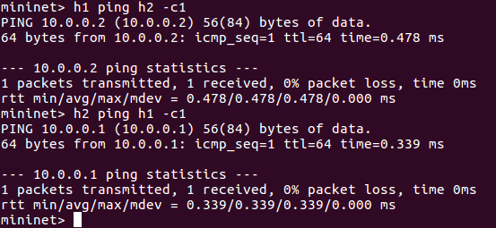
Set flow rules on switch (6/6) – Flow Rule
After installing the flow rules, the packet will execute the corresponding action when matching treatment

Slide 16
Requirements

Slide 17
To-Do
We divided this project into three parts:
1. Topology Creation
2. Ping Ability
3. Load Balance

Slide 18
Task_1 - Topology Creation (1/3)
Use the skills mentioned before to create a designated topology in mininet, the topology includes:
2 hosts for clients, 2 hosts for servers, 6 switches
It would look like:
Client1
Client2
Server1
Server2

Slide 19
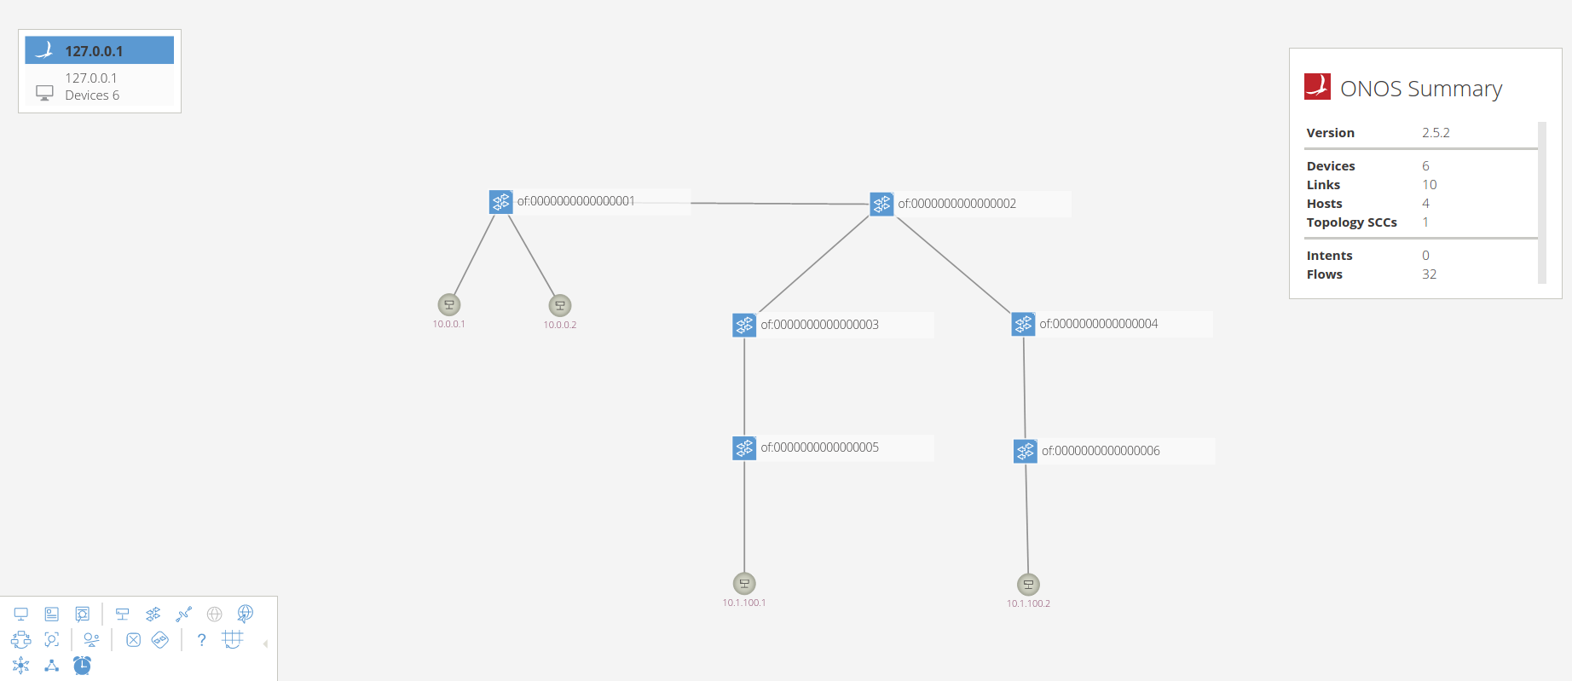
Task_1 - Topology Creation (2/3)
s1
s2
s3
s4
h1
h2
s5
s6
h3
h4

Slide 20
Task_1 - Topology Creation (3/3)
Because we don’t want the hosts to send ARP packets, use following command to start your mininet
sudo mn --custom=“your_topology_file.py” --topo=“your_topology_name” --controller=remote,ip=127.0.0.1:6653 --arp
(if you want to see your hosts in ONOS web, the pingall or ping command will not send ARP, so just use arping to send ARP and let the controller see your hosts.)

Slide 21
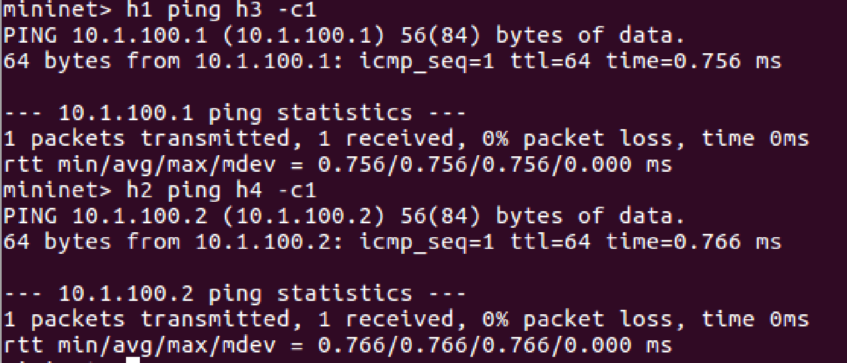
Task_2 - Ping Ability
Set some flow rules on your switches
Let h1 can ping h3, and h2 can ping h4

Slide 22
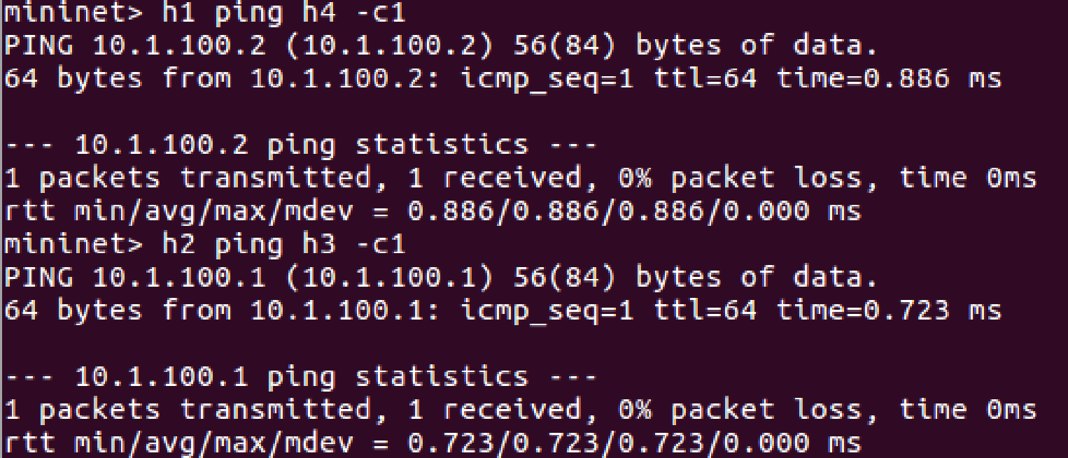
Task_3 - Load Balance (1/2)
In this section, we construct a scenario: when the path to a specific server is congested, we need to force the packets to pass through some other paths to another server.
In our topology, when you use h1 ping h4, let the ICMP request send to h3, similarly, when h2 ping h3, let the request send to h4.

Slide 23
Task_3 - Load Balance (2/2)
To do this, you need to use “L2MODIFICATION” and “L3MODIFICATION” rules to make the h1 to h4 packet become h1 to h3, and h3 to h1 become h4 to h1. (similar in h2 to h3 situation)
L2MODIFICATION parameter can be used to modify mac address
L3MODIFICATION parameter can be used to modify ip address
You can reference following documents
( https://wiki.onosproject.org/display/ONOS/Flow+Rules )

Slide 24
submission
You need to write a report (deadline : 12/20), including :
environment setup successfully (40%)
your topology file, which is a python file (20%)
screenshot of Task_2 ping successfully, like the picture in p.21 (20%)
screenshot of Task_3 ping successfully, like the picture in p.22 (10%)
all flow rule .json file, including Task_2 and Task_3 (10%)

Slide 25
Template Code
我們有提供 project3_template_code 供同學完成 project3
project3_template_code 的說明在 ppt “project3_template_code.pptx” 內
請根據 project3_template_code.pptx 內的指示步驟及註解，逐步完成 project3

