Slide 1
SDN Environment setup

Slide 2
VirtualBox

Slide 3
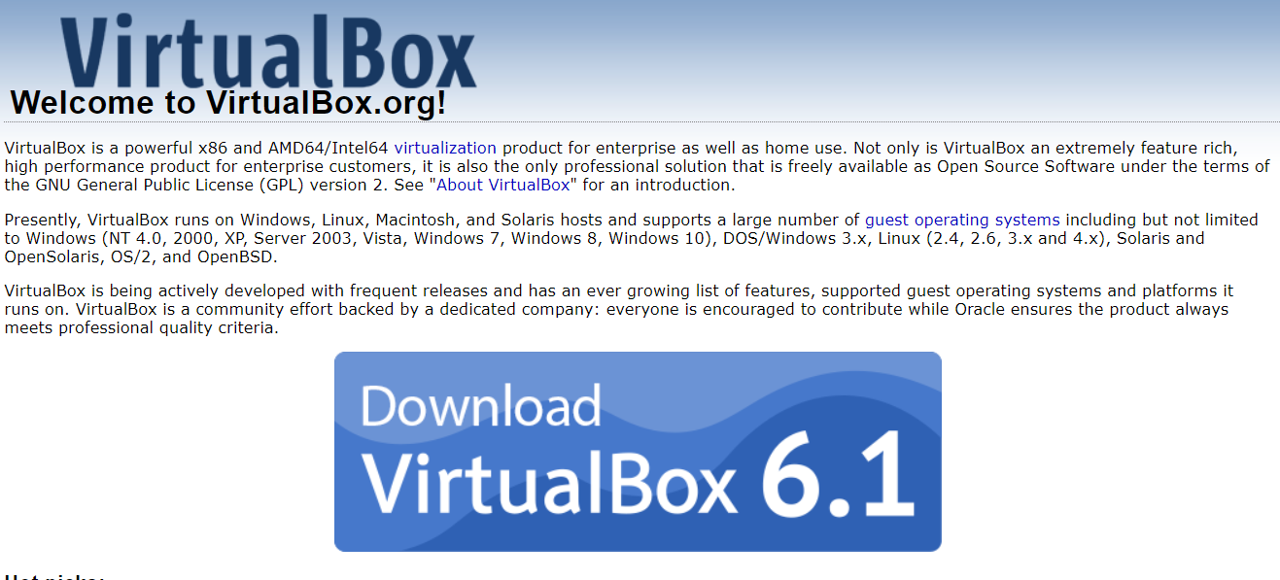
Install VirtualBox
https://www.virtualbox.org/

Slide 4
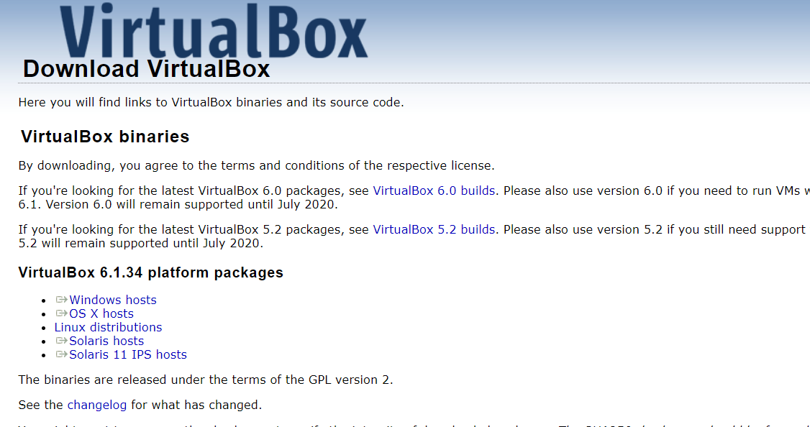
Install VirtualBox

Slide 5
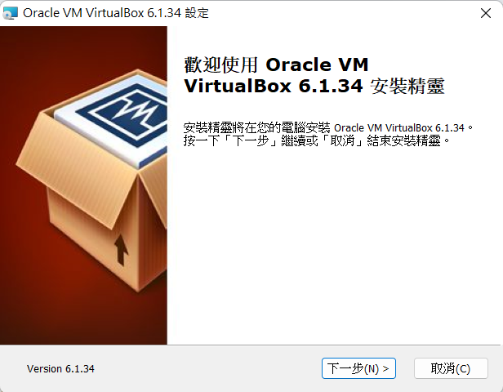
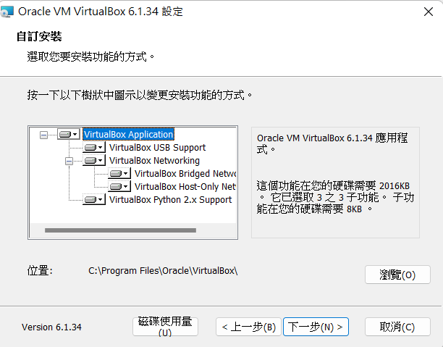
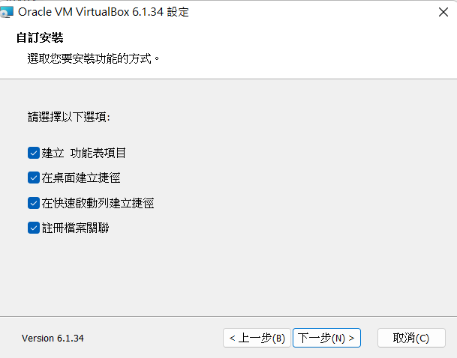
Install VirtualBox
1
2
3

Slide 6
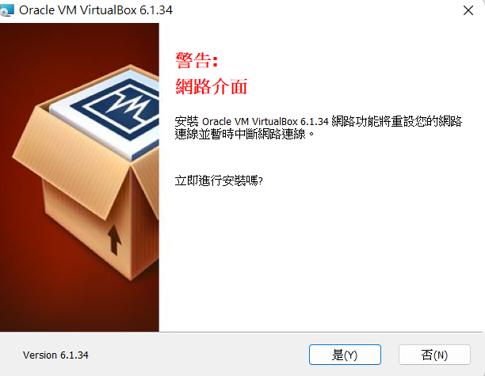
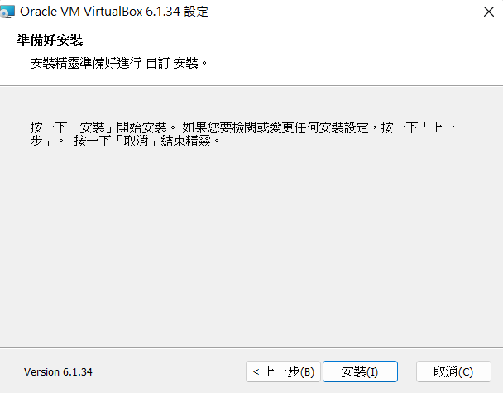
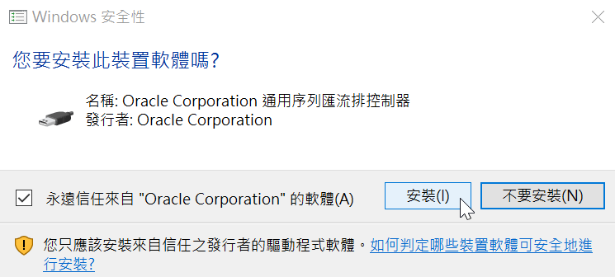
Install VirtualBox
1
2
3

Slide 7
Ubuntu 16.04

Slide 8
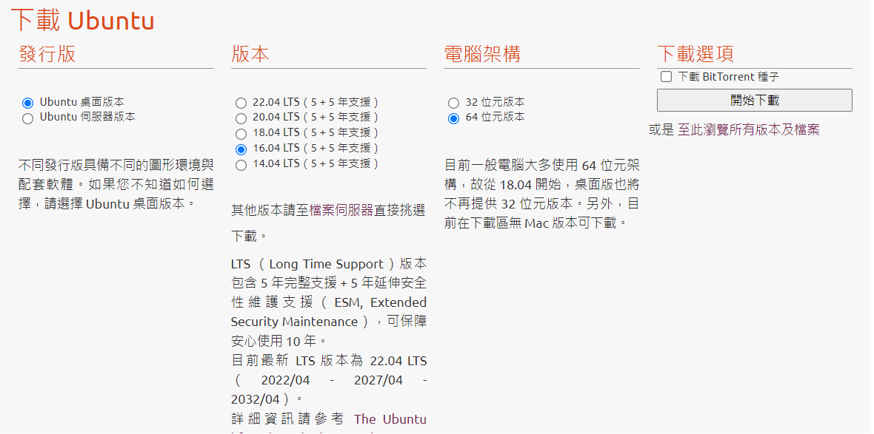
Install image
https://www.ubuntu-tw.org/modules/tinyd0/

Slide 9
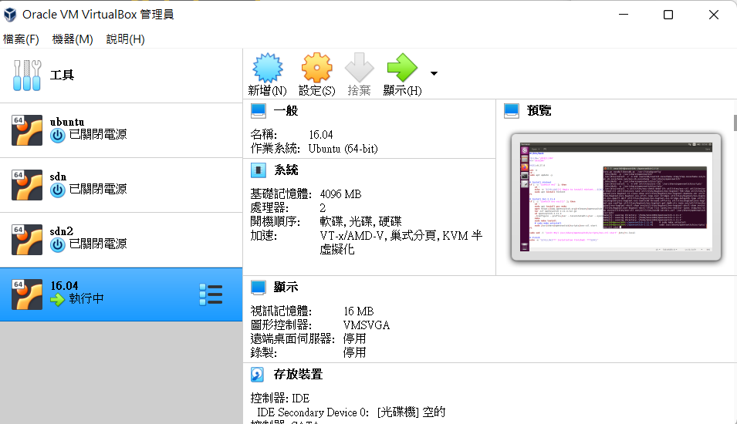
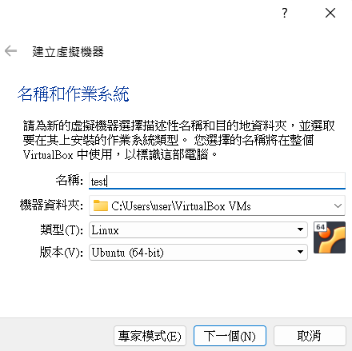
Create a VM
1
2

Slide 10
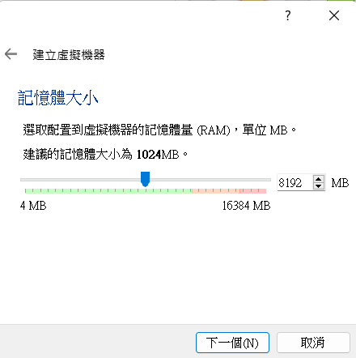
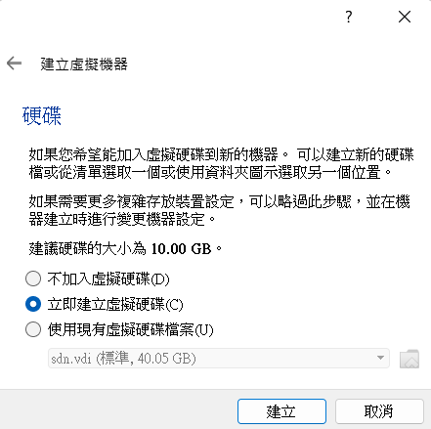
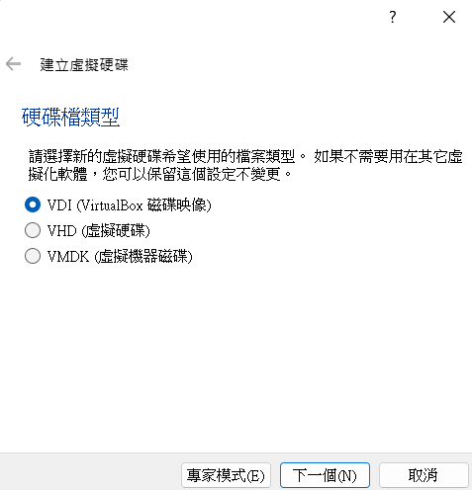
Create a VM
1
2
3

Slide 11
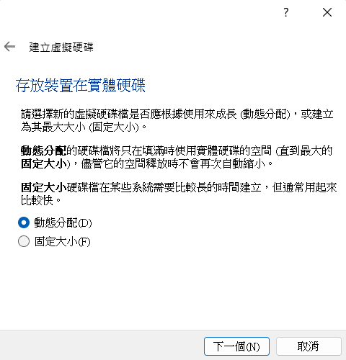
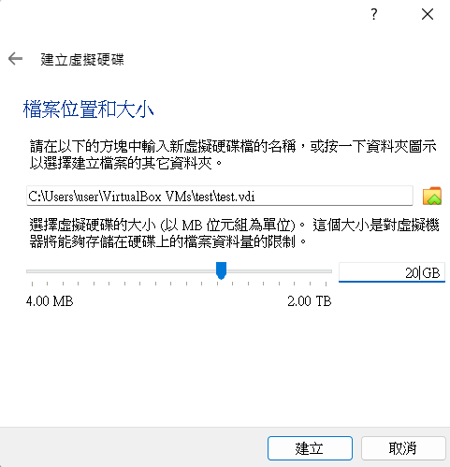
Create a VM
1
2

Slide 12
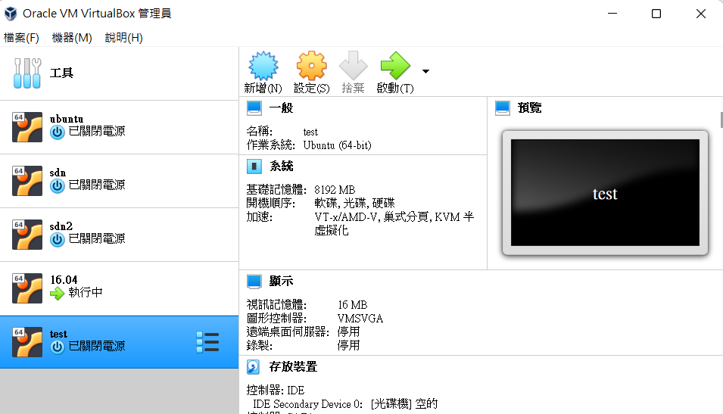
Create a VM

Slide 13
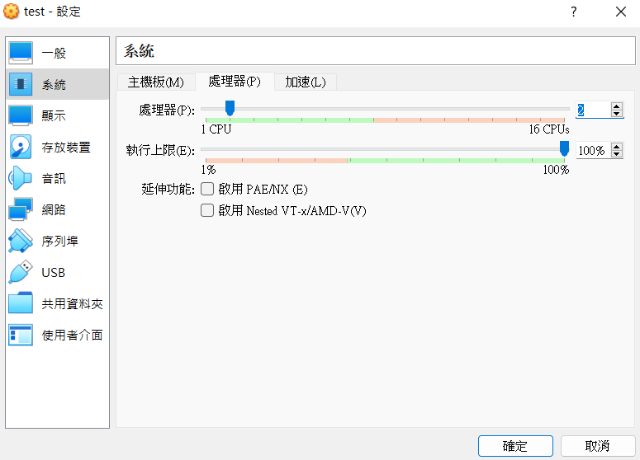
Create a VM

Slide 14
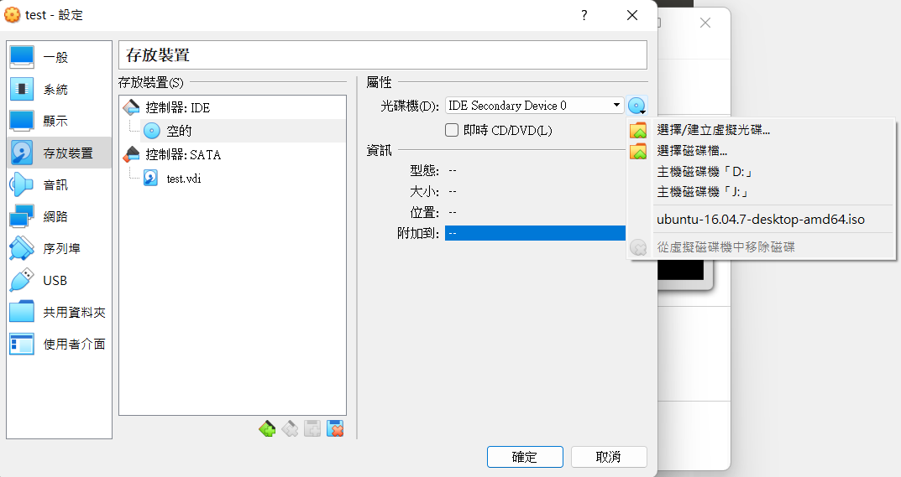
Create a VM

Slide 15
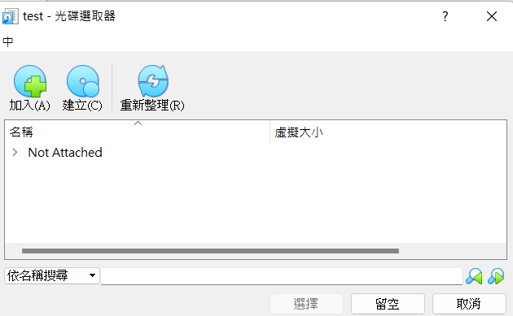
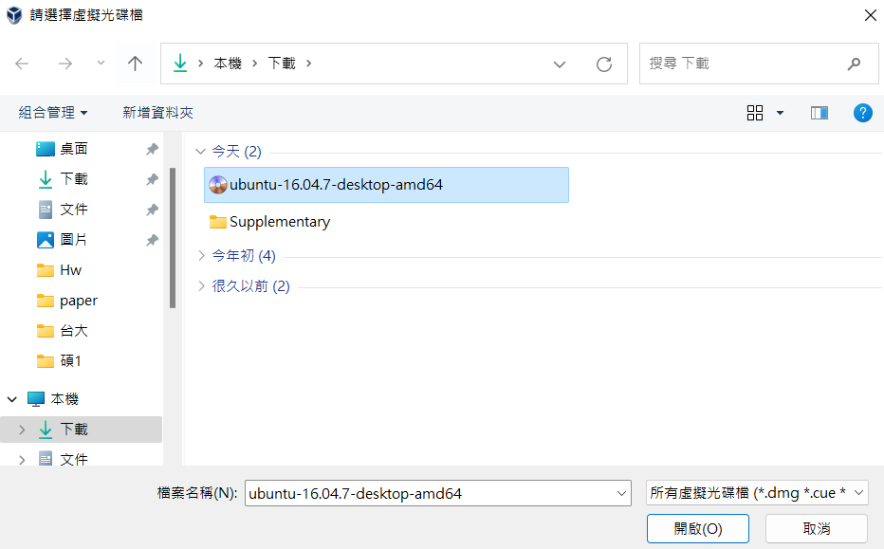
Create a VM
1
2

Slide 16
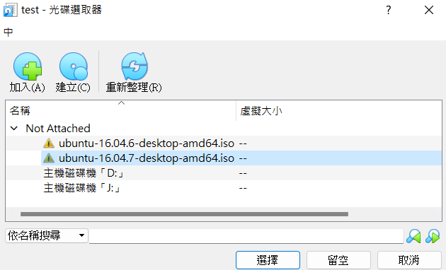
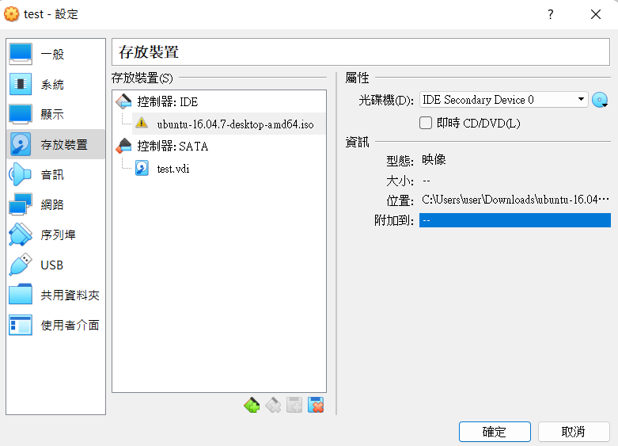
Create a VM
1
2

Slide 17
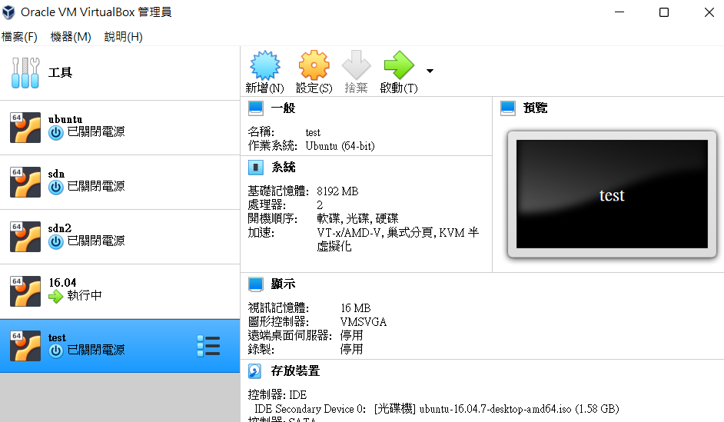
Create a VM

Slide 18
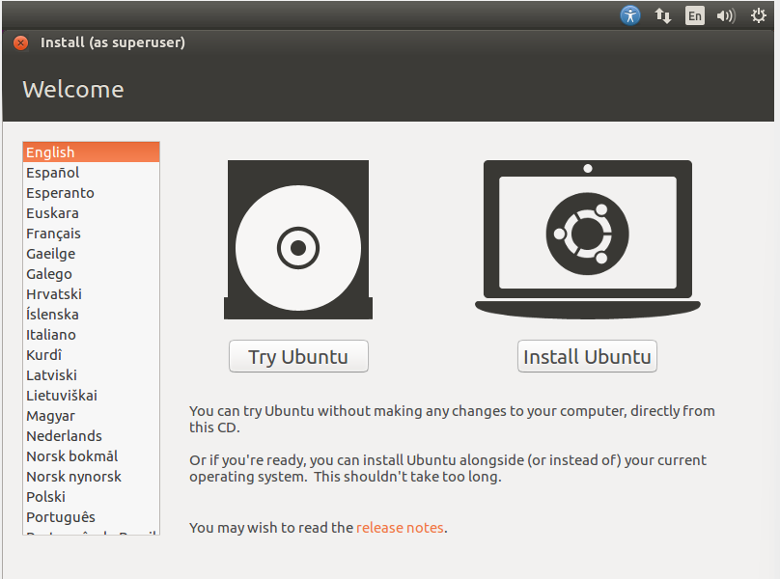
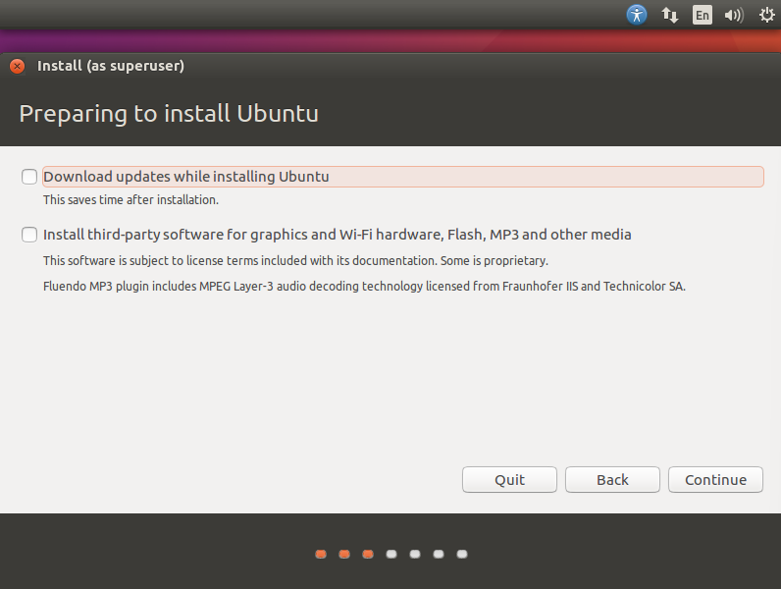
Create a VM
1
2

Slide 19
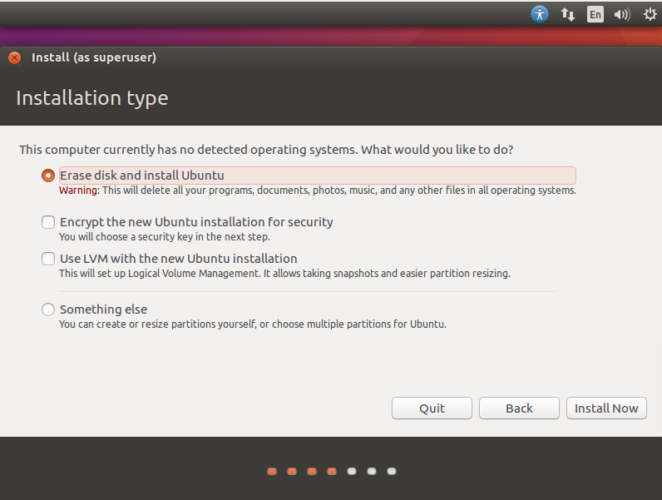
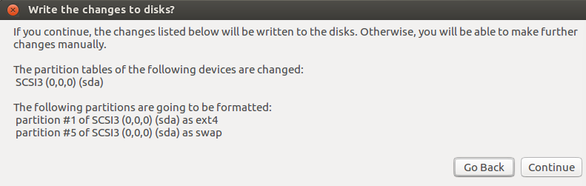
Create a VM
1
2

Slide 20
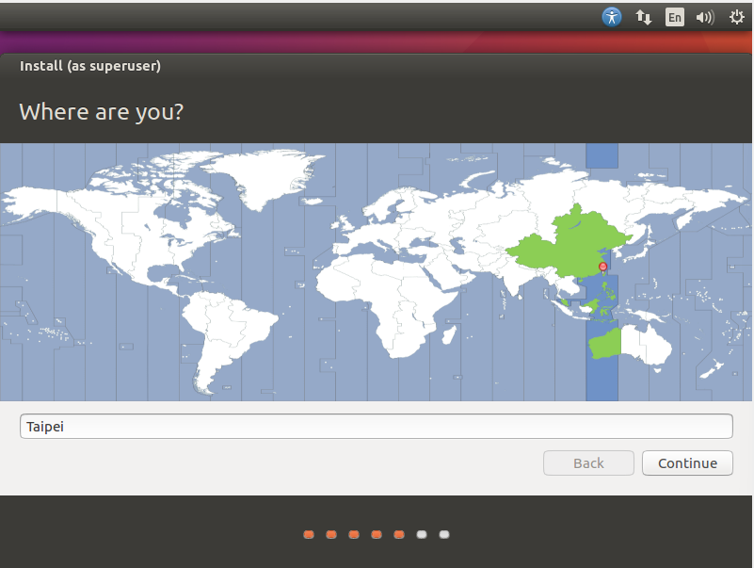
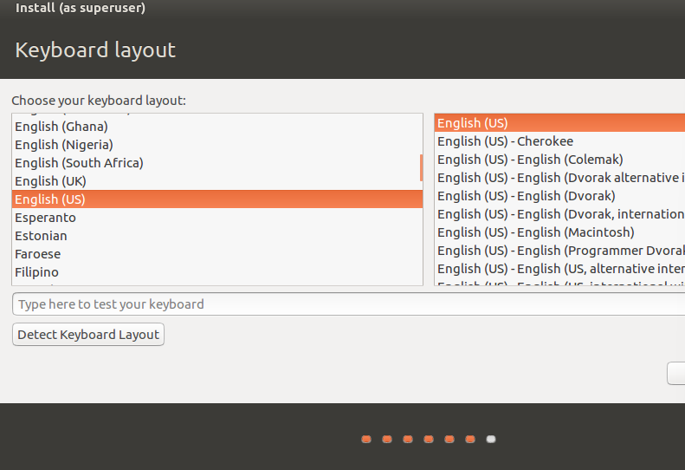
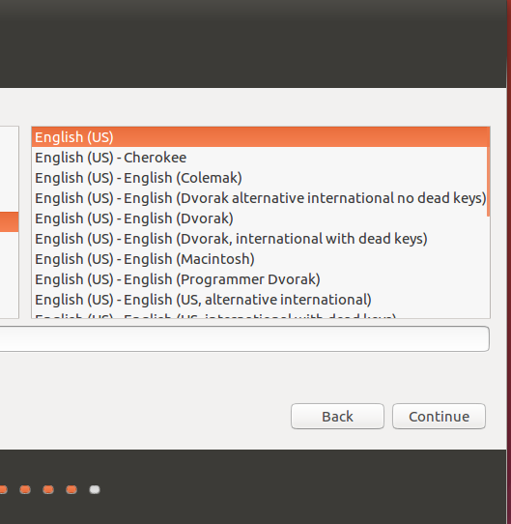
Create a VM

Slide 21
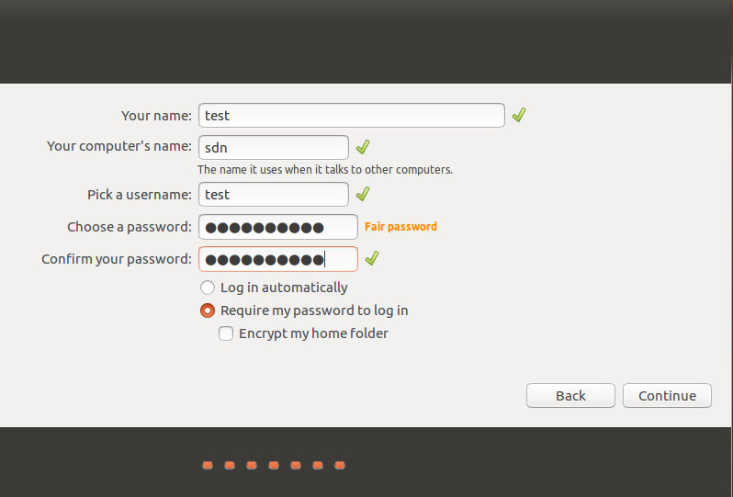
Create a VM

Slide 22
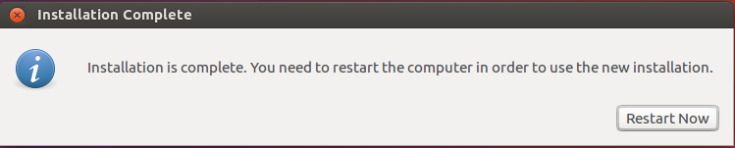
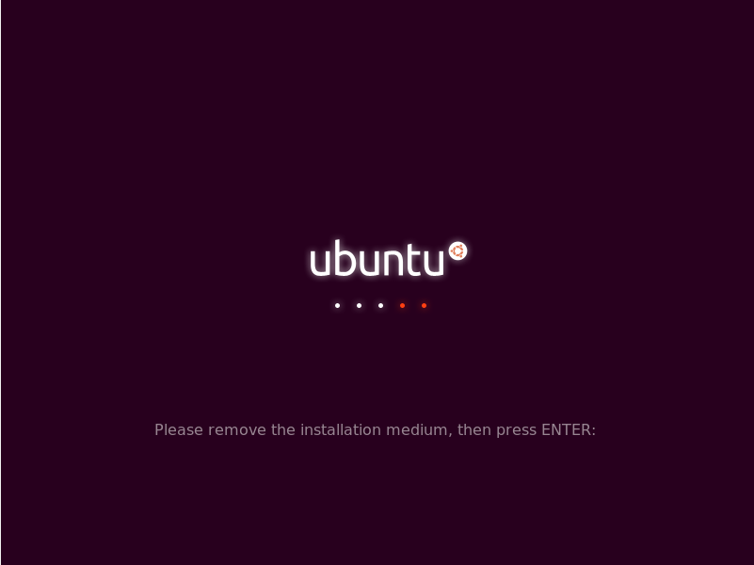
Create a VM

Slide 23
ONOS & mininet

Slide 24
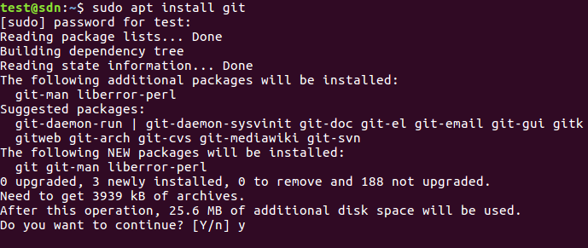
git

Slide 25
jdk
sudo add-apt-repository ppa:openjdk-r/ppa
sudo apt update
sudo apt install openjdk-11-jdk

Slide 26
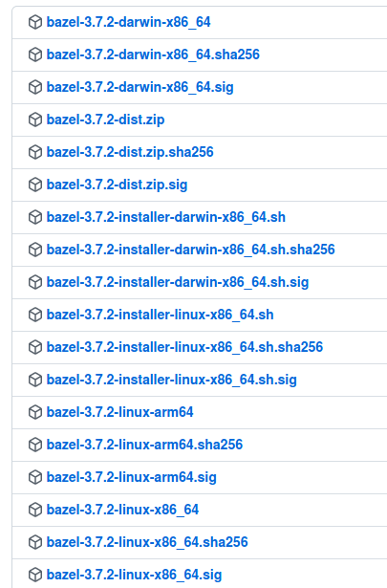
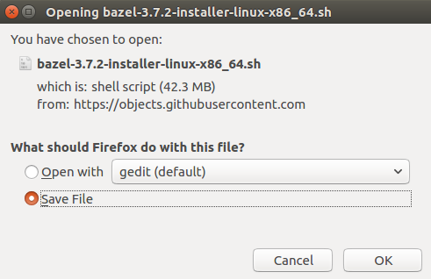
bazel
https://github.com/bazelbuild/bazel/releases/tag/3.7.2

Slide 27
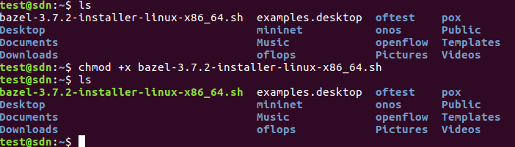
bazel

Slide 28

ONOS
export ONOS_ROOT=~/onos
source $ONOS_ROOT/tools/dev/bash_profile

Slide 29
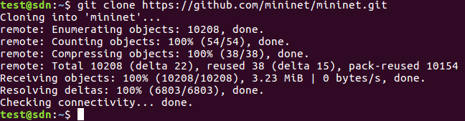
mininet

Slide 30
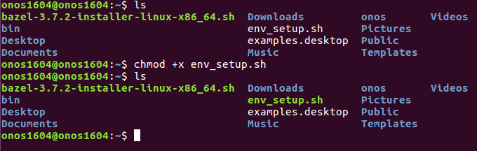
OVS

Slide 31
To run ONOS
get into ONOS folder (ex: cd ~/onos)
and run the following command :
bazel run onos-local -- clean debug

