Slide 1
Netty设备服务器Devtunnel

Slide 2
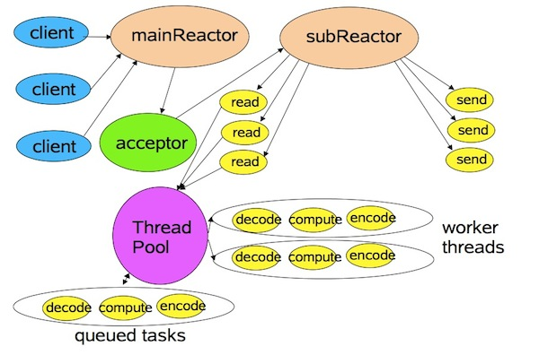
Netty模型
private final EventLoopGroup bossGroup = new NioEventLoopGroup(1);
private final EventLoopGroup workerGroup = new NioEventLoopGroup();

Slide 3
EventLoopGroup与线程对应关系
bossGroup
workerGroup
private final EventLoopGroup bossGroup = new NioEventLoopGroup(1);
private final EventLoopGroup workerGroup = new NioEventLoopGroup()
public NioEventLoopGroup() { this(0); }
protected MultithreadEventLoopGroup(int nThreads, Executor executor, Object... args) { super(nThreads == 0 ? DEFAULT_EVENT_LOOP_THREADS : nThreads, executor, args); }
DEFAULT_EVENT_LOOP_THREADS = Math.max(1, SystemPropertyUtil.getInt( "io.netty.eventLoopThreads", Runtime.getRuntime().availableProcessors() * 2));

Slide 4
protected MultithreadEventExecutorGroup(int nThreads, Executor executor, Object... args) { if (nThreads <= 0) { throw new IllegalArgumentException(String.format("nThreads: %d (expected: > 0)", nThreads)); } if (executor == null) { executor = new ThreadPerTaskExecutor(newDefaultThreadFactory()); } children = new EventExecutor[nThreads]; if (isPowerOfTwo(children.length)) { chooser = new PowerOfTwoEventExecutorChooser(); } else { chooser = new GenericEventExecutorChooser(); } for (int i = 0; i < nThreads; i ++) { boolean success = false; try { children[i] = newChild(executor, args); success = true; } catch (Exception e) {
…..
public class NioEventLoopGroup extends MultithreadEventLoopGroup {
@Override protected EventLoop newChild(Executor executor, Object... args) throws Exception { return new NioEventLoop(this, executor, (SelectorProvider) args[0], ((SelectStrategyFactory) args[1]).newSelectStrategy()); }
public final class NioEventLoop extends SingleThreadEventLoop {

Slide 5
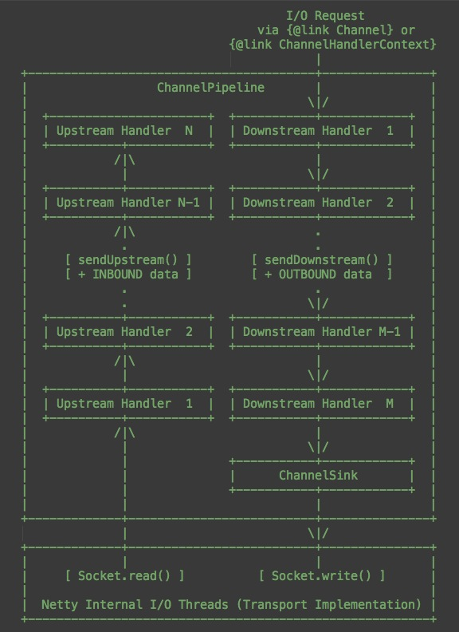
ChannelHandler

Slide 6
DevTunnel用来做什么
1、提供设备与App的命令推送，未来意在代替Push库，利用websocket实现异步的、语言级别的SDK，
不需要另外开一个Restful接口用于回调。
举例：现在的设备初始化过程调用了Push库，现在发送命令后等待用户的回调，默认6秒，超时会返回失败，但其实设备已经成功初始化。而利用Devtunnel可以避免这一缺陷。
2、作为Kurento Application Server的信令服务器
3、在Kurento方案未完善前，作为传输小容量二进制文件（语音等）的替代方案。

Slide 7
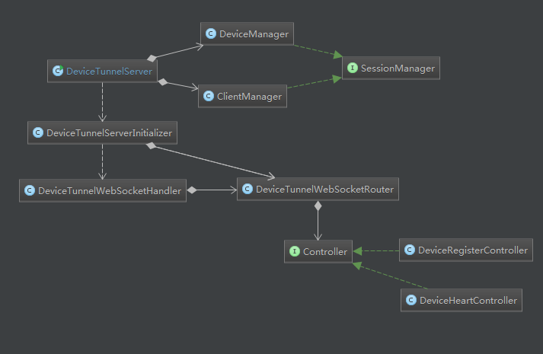
DevTunnel结构

