Slide 1

Prepared by Vivian Botros & Marsel Jaber
4girls-T1
From Image to UML: First Results of Image-Based
UML Diagram Generation using LLMs
Aaron Conrardy1,*, Jordi Cabot1,2
20 May, 2025

Slide 2
Key Terms:
Model-Driven Engineering (MDE)
Low-code
Visual LLM
Instead of building software by writing code, you first make a plan (a model), and the computer helps turn that into real working code.
Make apps with very little typing — you just drag, drop, and click most of it instead of writing a lot of code yourself.
LLM that uses pictures or diagrams with a smart AI (like ChatGPT) that can understand and talk about them.

Slide 3

so what is the problem?
UML diagrams are often hand-drawn during meetings.
But these sketches aren't usable in code or tools.
Manually converting them is boring, slow, and error-prone.

Slide 4


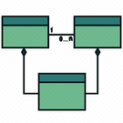
The Paper’s Proposal
How does it work?
what if we use LLM’S to take a look and generate a diagram?
Image
In this paper, the possibility of using visual LLMs to turn hand-drawn diagrams into formal diagrams is explored.
so how did they test it?
Tested LLM’s
LLM
GPT-4V
Gemini (Pro & Ultra)
CogVLM
🌱
PlantUML
Class Diagram

Slide 5

How Did They Test It?
Uml Class Diagram
Used Prompts
Testing and Mesurment
4 Hand drawn Class Diagrams
the first 3 were increasingly difficult and the 4th was logically incorrect.
Each model tested 3 times per prompt.
missing elements, and Hallucinations were considered as mistakes
syntax errors were considered as errors.
not generating a PlantUML code was considered a refusal.
3 Types of prompts
simple → detailed

Slide 6
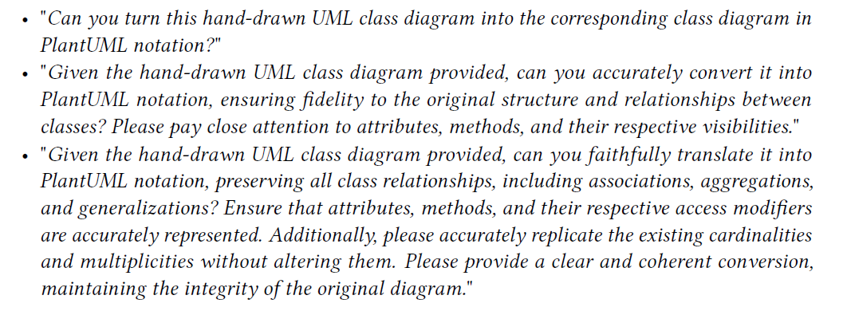
The used prompts:

Slide 7
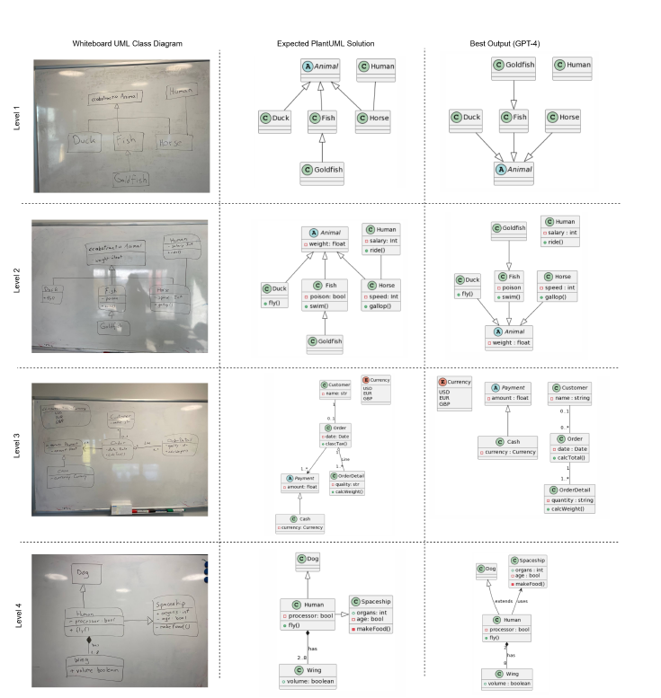
the results of using GPT-4:

Slide 8
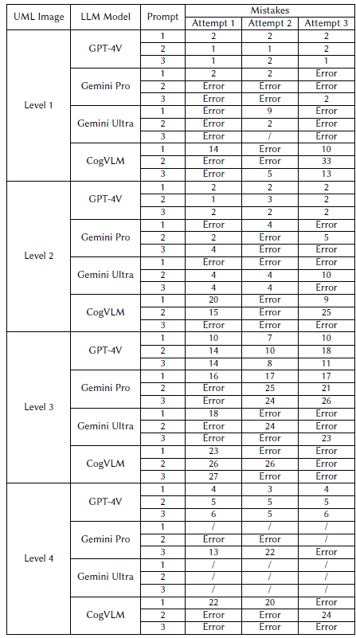
the results:
GPT-4V: fewest mistakes, no syntax errors
Gemini: syntax problems and some refusals
CogVLM: many mistakes and errors
Surprisingly: simpler prompts worked better!
“the Gemini models often had trouble with the notation to define inter-class
relationships. An example would be for inheritance, instead of the correct syntax "class Fish
extends Animal{...}" Gemini Pro would generate "class Fish <|– Animal{...}".
As for CogVLM,
simple class definitions such as "class Duck{}" would already cause problems as it would attempt
to define classes as "Duck{}".”

Slide 9
Conclusions & Limitations
Conclusions
Limitations
LLMs like GPT-4V can successfully turn UML images into models
Performance varies greatly between models
Simpler prompts often led to better results
A human is still needed to verify or correct the output ("human-in-the-loop")
Internal Validity (Method Issues)
The grading system treats all mistakes equally (missing a class = same weight as a missing attribute)
Diagrams used were small/simple — results might not apply to large, real-world systems
Prompt design might not have been optimal
“Results are promising, but imperfect — AI can assist, not replace, the modeler.”
External Validity (Generalization Issues)
Only tested 3 LLMs — results may not hold for others
LLMs are non-deterministic (answers can change)
Small sample size of test cases
only class diagrams were tested.

Slide 10
Thank you

Slide 11

Class Activity :)

