Slide 1
CS 3240
Advanced
Software Development Methods
Tom Horton
Room 402, Rice Hall
horton.uva@gmail.com

Slide 2
Course Foci
Excellence In Software Engineering
Avoid Engineering Mistakes
Face Engineering Realities
Learn From Excellent Artifacts
Enabling Technology
Software Engineering Technology Is The Key To Excellent Software

Slide 3
Course Information
Second Course Focusing On Software Development Methods
Outline of Topics:
  Software quality, including testing and inspections
  Project management, scheduling, planning, with an emphasis on the Scrum agile method
  Requirements elicitation, analysis and specification
  Architecture and design principles, when an emphasis on object-oriented design
  Programming and team-based development practices
  Security in software application development

Slide 4
Practices
Python etc
Basic web apps using Django
git and GitHub for configuration management
Multithreaded and multiprocessing programs
Some database and SQL
Testing and coverage tools

Slide 5
Course Information
Pre-requisite:
  CS2150 with a C-
  Enforced this term! (If you don’t have this, see me ASAP.)
  Why? The experience, but also
    UNIX experience
    Ability to learn new languages
    Data structures

Slide 6
Textbooks:
Little to buy but you can read things on Virgo:
  Kindle book by Laurie Williams (NCSU): $9.99
  Book by Tsui and Karam (Virgo)
  Other readings
Learning Python
  Two books (basic, advanced) on Virgo.
  Other on-line tutorials

Slide 7
Development Environment
Python 2.7 (not Python 3)
  You’ll learn this outside of lecture. (We’ll help, but…)
Ubuntu 14.04 LTS
  We’ll may test your code in this environment
  You may deploy your project in Ubuntu
  Feel free to develop in some other environment, but…
  Windows or Mac users:
    We’ll provide an account on a server
    Think about a virtualization environment (Parallels, VirtualBox). You did this in CS2150, so this is nothing new for you.

Slide 8
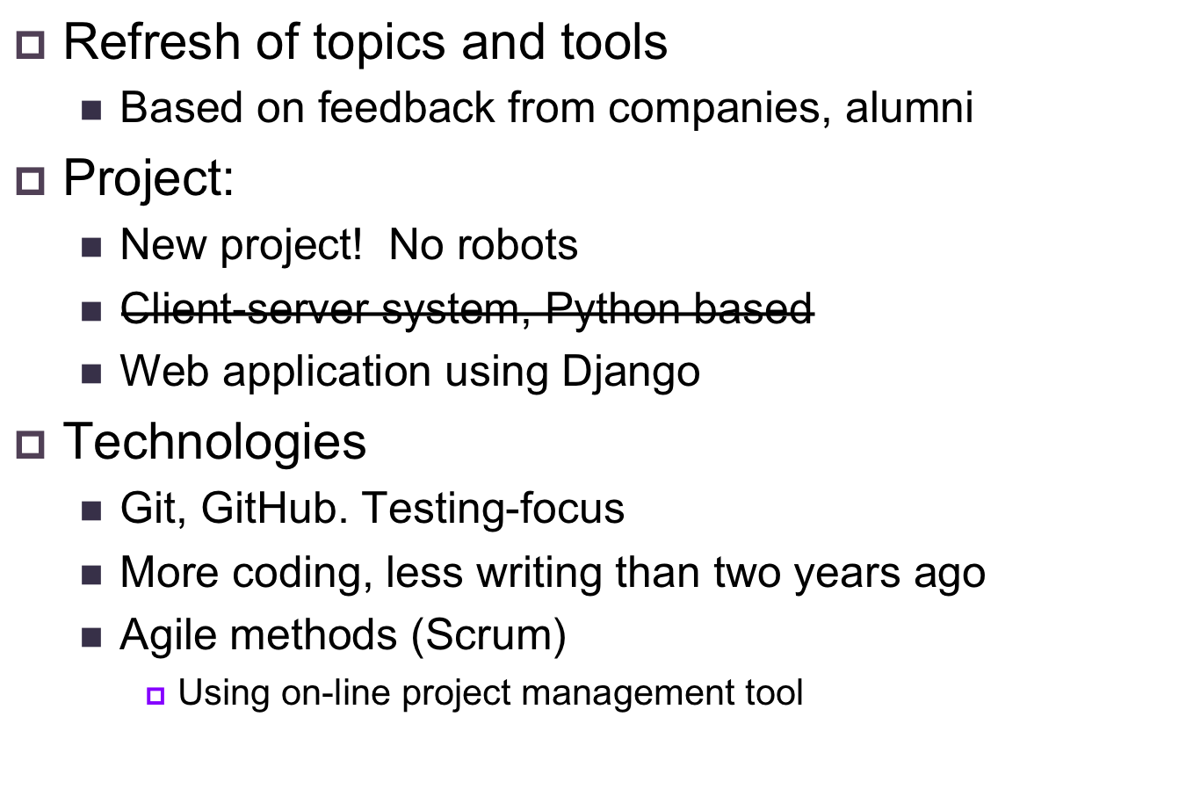
2014 Changes

Slide 9
Weekly Laboratories
You must be in a lab and come only to your lab.
You must bring a laptop with a Python development environment installed
  Try to have a charged battery!
Attendance Required!
Lab structure
  Early in term: demos, short lectures, hands-on learning
  During project (This might change!)
    Demos every two weeks
    Non-demo weeks: team meeting and/or exercise or activity
    Possible that teams will do some presentations (?)

Slide 10
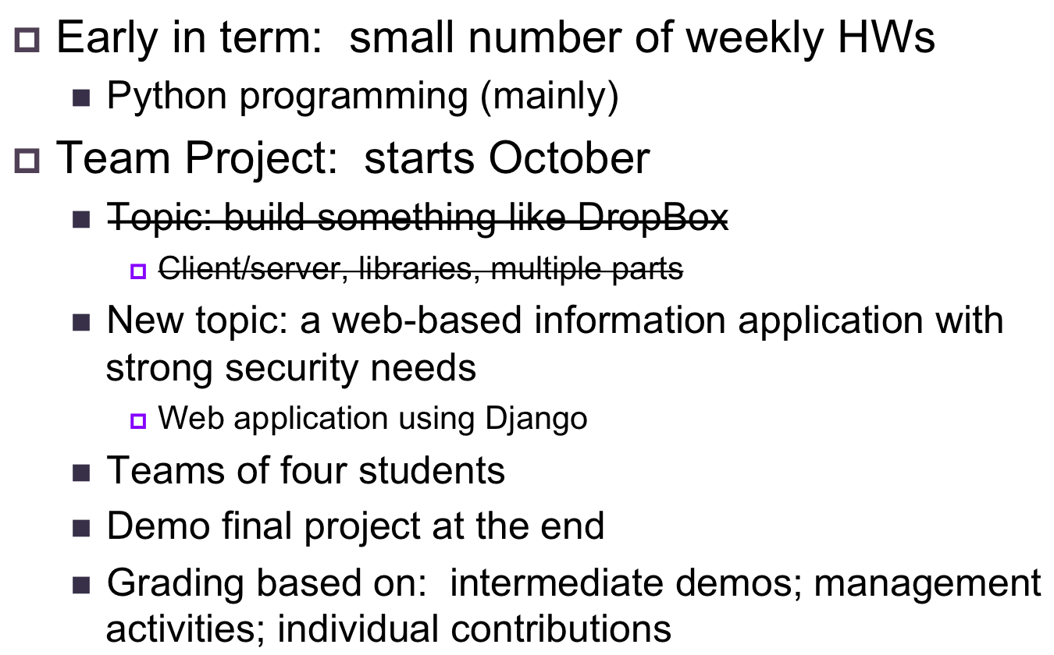
Homework and Projects

Slide 11
Homeworks
HW1: warm-up exercise
  Due next Tuesday night!
  Questions and updates: see Piazza discussion board (on Collab)
Later HWs: Python programs (individual)
  You’ll be learning a lot of Python on your own
  HWs will address:
    Basic OO coding in Python
    Use of 3rd party libraries
    Threading

Slide 12
Project Teams
Team Structure:
  Four Per Team
  We choose team members
  We’ll do this in mid February
Expectations
  Everyone codes
  Meetings: probably need two meetings a week
  Project time-commitment: significant!
In past years:
  Two teams paired to form one larger team
    Specification Exchange
    Work to same spec
    Combine to create complete system
  Not likely to do this exactly
    But maybe some inter-team interaction

Slide 13


Slide 14
Think and then Share
CS students do HWs and projects, but…
Have you ever:
  Written code as part of a team?
  Written code for a client or customer that was not you or not part of your team?
  Contributed code to an on-going project that had code before you joined and continued after you left?
What issues are more important than “student work” in these cases?
What different tools or techniques or practices were needed?
Think about these things. Then, talk to 2 or 3 neighbors. Compare notes and be prepared to share with all.

Slide 16
A Definition of Computer Science
Computer science is a discipline that involves the understanding and design of computers and computational processes. In its most general form it is concerned with the understanding of information transfer and transformation. Particular interest is placed on making processes efficient and endowing them with some form of intelligence.

Slide 17
A Definition of Engineering
…the systematic and regular application of scientific and mathematical knowledge to the design, construction, and operation of machines, systems, and so on of practical use and, hence, of economic value. Particular characteristic of engineers is that they take seriously their responsibility for correctness, suitability, and safety of the results of their efforts. In this regard they consider themselves to be responsible to their customer (including their employers where relevant), to the users of their machines and systems, and to the public at large

Slide 18
A Definition of Engineering
…the systematic and regular application of scientific and mathematical knowledge to the design, construction, and operation of machines, systems, and so on of practical use and, hence, of economic value. Particular characteristic of engineers is that they take seriously their responsibility for correctness, suitability, and safety of the results of their efforts. In this regard they consider themselves to be responsible to their customer (including their employers where relevant), to the users of their machines and systems, and to the public at large

Slide 19
Software Engineering
Term Coined At NATO Conference:
  Software Engineering
  Garmisch, Germany
  7 - 11 October, 1968.
Definitions Abound (E.g., Fairley):
    Software engineering is the technological and managerial discipline concerned with systematic production and maintenance of software products that are developed and modified on time and within cost estimates.

Slide 20
Engineering Practices
Other disciplines?
SW Engineering?

Slide 21
Some SE Practices
Quality assurance:
  Testing (various types), inspections, reviews, use of tools
Project Management:
  Estimation, staffing, tracking progress, tracking issues
Requirements:
  Getting them, documenting, specifying, correctness
Design:
  Correctness, modeling, quality
Development:
  Debugging, testing, version control, integration

Slide 22
Why is Building SW Different?

Slide 23
Why is Building SW Different?
Tractable medium (it’s “soft”, “thought-stuff”)
Changing requirements
Schedule Optimism, Pressure

Slide 24
So Is It Really Hard? A Problem?
First, SW Development is young and successful
But still…
  Cost overruns
  Late delivery
  Wrong requirements
  Delivered product not accepted by (potential) customers
Hardware changes and improvements affect the need for successful SW. Why?

Slide 25
Recall The Problem
Many Failures Attributed To Software:
  Shuttle Launch Anomaly
  Social Security Disaster
  Bank of New York Government Bond Trading System Failure
  Outages Of ATT Long Distance Switches
  Death And Injury From Therac 25
  Ariane V Explosion
  Mars Spacecraft
Cost Of Failure Becoming Very High:
  Financial
  Lost Of Life Or Lost Of Equipment
  Inconvenience

Slide 26
HealthCare.gov

Slide 27
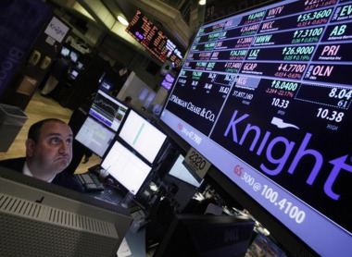
Knight Capital
Aug. 2012, Knight Capital launches new trading algorithm
After 1 hour’s use, lost $440M
Stock prices swung wildly
Knight stock fell 75%
Oops!
http://en.wikipedia.org/wiki/Knight_Capital_Group

Slide 28
Software Engineering
Building Software Is HARD, VERY HARD
But
Software Engineering Technology
and Practices are the
Key to Dealing With the Difficulties
With Good Software Engineering, We Win!!!!

Slide 29
Software Engineering
The Software Engineer:
Is An Engineer
Is a Professional
Rarely Works In Isolation
Is Responsible For His/Her Actions

Slide 30
Ethics and Professionalism
We Take Ethics Very Seriously.
If You Engage In Anything Unethical, You Will be Dismissed From The Class.
Always be professional.
Maintain the same attitude for CS3240 that you’d have for an important job.
(We’ll judge you on this in part.)

Slide 31
Ethics and Professionalism
What kinds of issues matter more in SW Engin.?

Slide 32
CS3240 Class Motto
We Will Strive to Become
Very Good
Software Engineers

