Slide 1
Comparing TCP implementation
Recreating the work of the paper ‘Simulation-based comparisons of Tahoe, Reno and New Reno TCP’ by Kevin Fall and Sally Floyd
by Bhargav Srinivasan, Om Kale, Vinish Chamrani, and Vivian Dsilva

Slide 2
TCP Congestion Control - Basics
Congestion could occur in router, creating dropped packets.
Retransmissions create even more congestion.
Nodes need to evaluate the capacity of the network link.
How do you solve this?

Slide 3
Congestion control
Three strategies:
Additive increase, multiplicative decrease of congestion window(AIMD)
Slow start
Fast-retransmit / Fast recovery

Slide 4
Additive increase/multiplicative decrease of congestion window(AIMD)
Incorporate a congestion window(cwin)
MaxWinSize = min(CongestionWindow, AdvertisedWindow)
When you receive a successful ACK, increment cwin
cwin is halved when a packet is dropped i.e. cwin = cwin/2
Increment = 1MSS per RTT

Slide 5
Slow Start
TCP enters slow start at the beginning of session and until timeout.
How?
Start with cwin = MSS
Double cwin at each ACK
Thus ramps of faster!

Slide 6
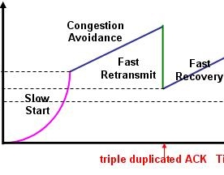
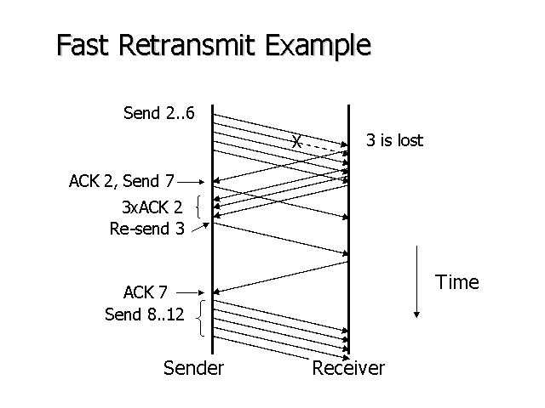
Fast-retransmit / Fast recovery
Fast Recovery:
Use ACKs to clock retransmission instead of reducing CongestionWindow to MSS and doing a slow start.
3 Duplicate ACKs (DupAcks) trigger retransmission.
The rx. sends a cumulative ACK

Slide 7
The paper speaks about
4 congestion control mechanisms
Tahoe
Reno
New Reno
SACK
Simulation based comparison of these protocols

Slide 8
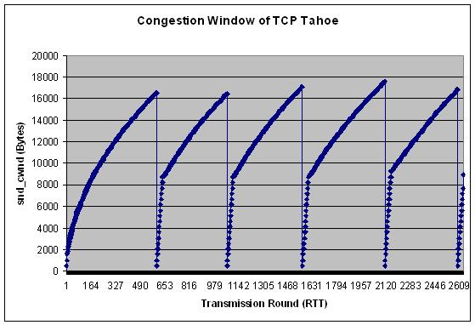
TCP Tahoe
Principle: Congestion Avoidance + fast-retransmit + slow start
Congestion control upon timeout OR 3 dup ACKs
Congestion window reduced to 1 MSS and slow start is triggered.
Drawbacks:
Congestion control too aggressive

Slide 9
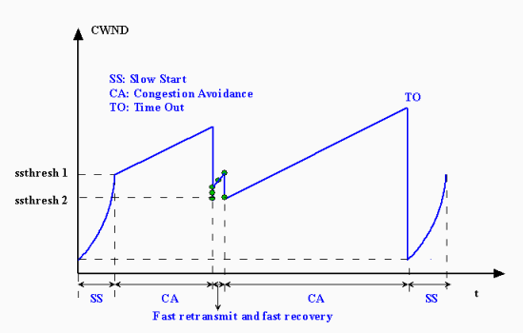
TCP Reno
Principle: TCP Tahoe + fast recovery
Congestion Control upon 3 dup ACKs
Divide Congestion Window by 2 and set ssthresh to the new value
Congestion control upon timeout
Congestion window reduced to 1 MSS and slow start is triggered
Advantages
TCP pipe does not become empty

Slide 10
TCP new Reno
Principle: TCP Reno + smarter recovery
TCP Reno goes out of fast recovery with first partial ACK
Reno times out when multiple burst losses occur
TCP new Reno partial ACK serves as an indicator for another lost packet in the fast recovery phase
Sender comes out of fast recovery only once all outstanding packets are ACKed
Advantages
Outperform TCP Reno at multiple loss packets

Slide 11
SACK (Selective ACK)
The paper discusses the intricacies of SACK
In a nutshell, a SACK can be sent by the data receiver to the sender that have been received.

Slide 12
Our experiment
while(<FH>){
$matchstring = $_;
if($matchstring =~ /^\+/){
$matchr = $';
$matchr =~ /\d+\.\d+|\d+/;
$acktime = $&;
print PH $acktime,"\t\t";
if($matchr =~ /ns3::TcpHeader\s.*/){
$ackcount = $&;
$ackcount =~ s/.*Ack=(\d+)\sWin=.*/$1/;
$ackcount = $ackcount / 512;
$ackcount = $ackcount % 60;
print PH $ackcount,"\n";
}
}
}
PERL scripts were used to extract the data from the trace file and the results were plotted using gnuplot.
#!/usr/bin/perl
use v5;
use strict;
use warnings;
open my $GP, '|-', 'gnuplot' or die "$! : Can't open .dat file";
print {$GP} <<'__GNUPLOT__';
set terminal png size 1280,640
set output "tahoe-1mod.png"
plot "ACKr.dat" using 1:2 title 'ACKs rx' with points, \
"SEQr.dat" using 1:2 title 'SEQs tx' with points, \
"cwndextract.dat" using 1:2 title 'Congestion Window' with linespoints
exit
__GNUPLOT__
close $GP;

Slide 13
One Packet Loss
Tahoe:
Slow start
ACKs from the receiver arrive increasing cwnd
One packet is dropped, 3 dup ACKs arrive, triggering a slow start.
Now, cwnd = 1 & ssthresh = CW/2
ACK for the lost packet arrives slow start continues
After ssthresh, congestion avoidance is activated and cwnd increases by 1 MSS per RTT
Reno:
3 dup ACKs arrive, triggering a retransmit of the lost packet
Fast recovery happens and newcwnd = cwnd/2; ssthresh= newcwnd
Exits Fast recovery after cumulative ACK
New Reno:
Same as Reno

Slide 14
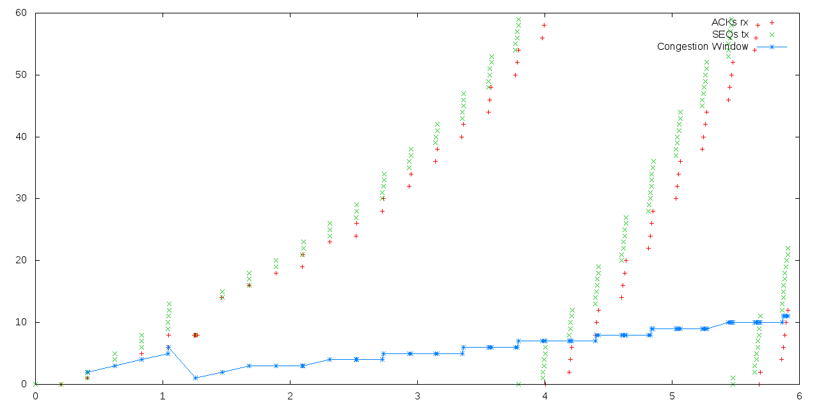
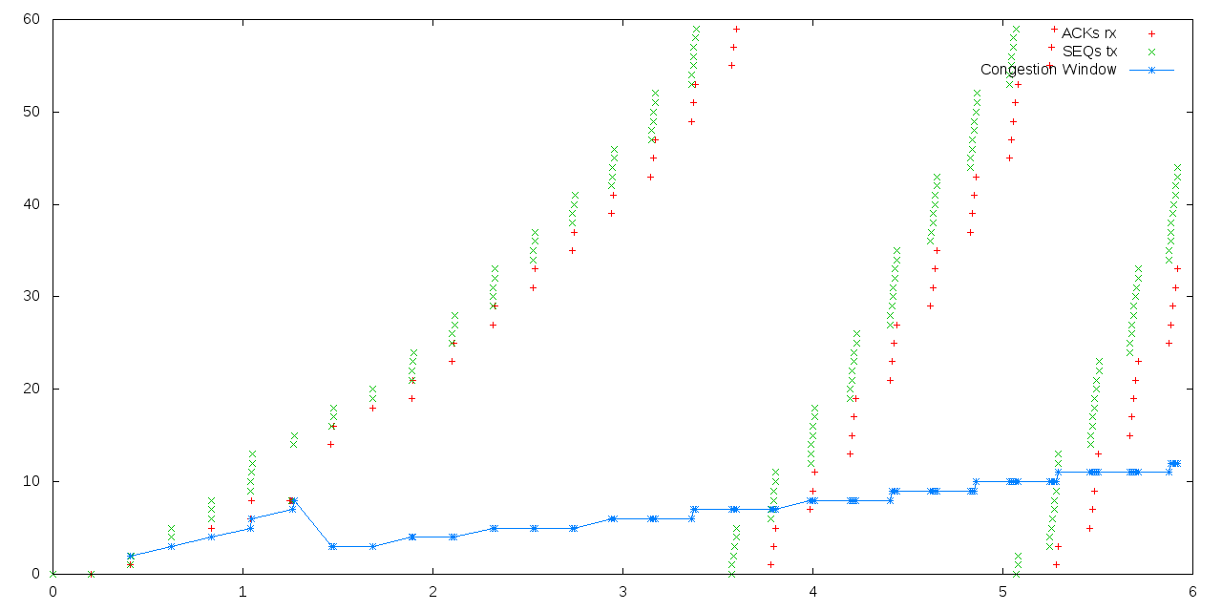
TCP Tahoe
TCP Reno

Slide 15
TCP New Reno

Slide 16
Two Packet Losses
Tahoe:
For one packet loss, its the same
The sender forgets that earlier packets were sent.
The sender goes into Slow-Start and once again transmits packets that were sent before
Switches to congestion Avoidance from Slow Start and continues
Reno:
Since, there is Fast recovery, the congestion window becomes half two times in two successive RTTs.
This slows down the connection considerably.
Operation similar to one drop case. (Fast retransmit and Fast recovery)
When second drop occurs, it halves the congestion window. Once, again Fast retransmit and Fast recovery
New Reno:
Similar to Reno, but with partial ACKs, the sender remains in fast Recovery

Slide 17
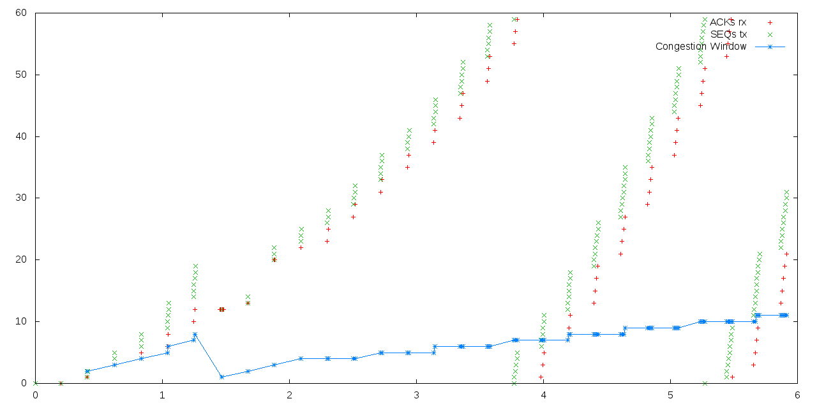
TCP Tahoe

Slide 18
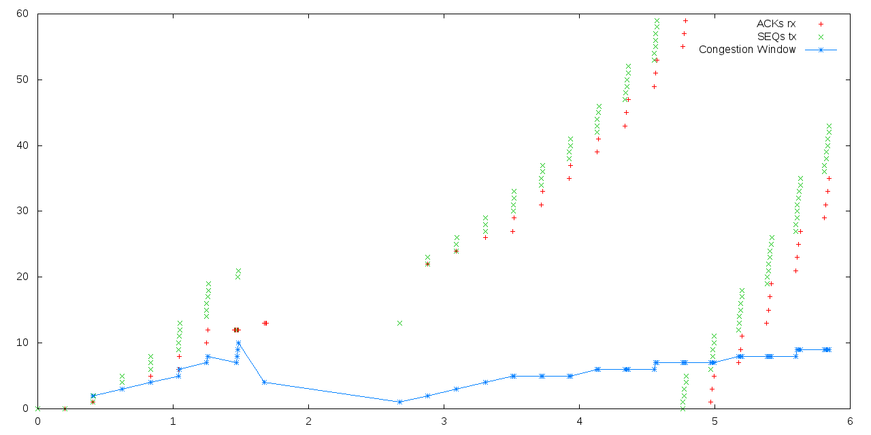
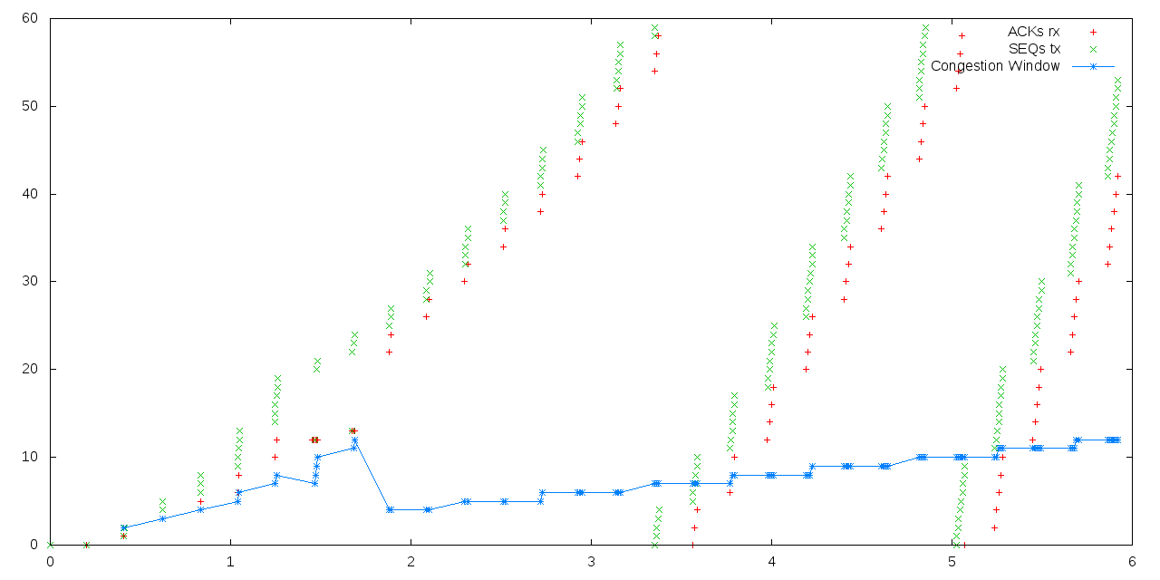
TCP Reno
TCP Reno
TCP New Reno

Slide 19
Three Packet Losses
Tahoe:
Response to first packet is same as in the one loss case
The cwnd is halved, causing retx of packets already sent
Thus, retrx. 2 packets
Remains in slow start
New Reno:
Similar to the two drop case.
The third packet drop causes the sender to stay in fast recovery and partial ACKs are received
The sender comes out of fast recovery after the cumulative ACK
Reno:
Similar to two drop case.
However, the additional packet loss in Reno causes the sender to wait for the expiration of the retransmit timer (RTO)

Slide 20
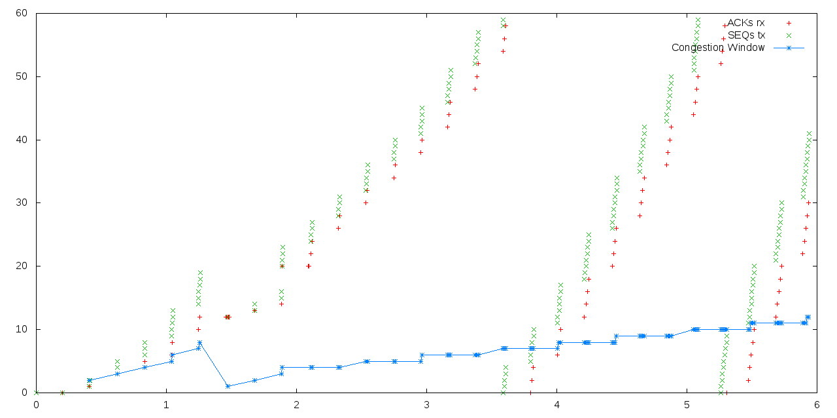
TCP tahoe
TCP Tahoe

Slide 21
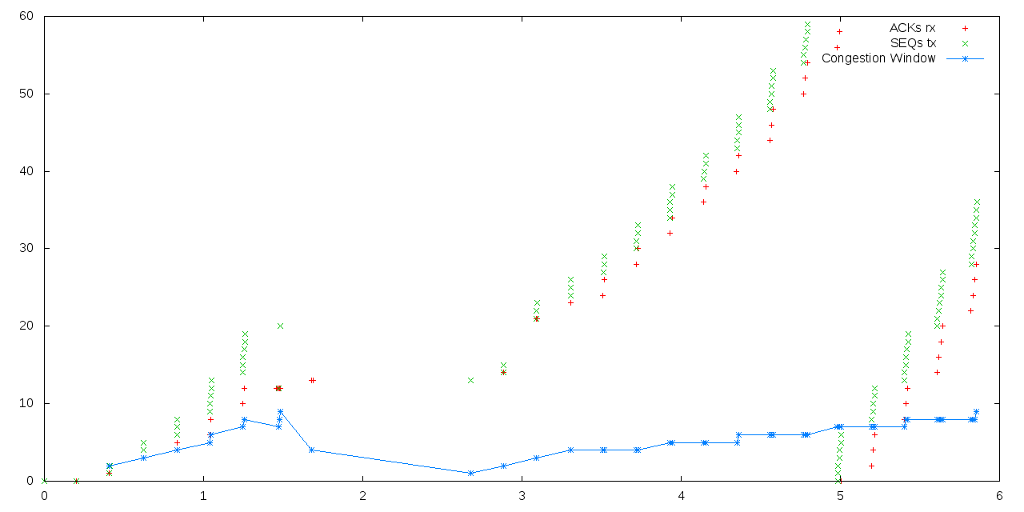
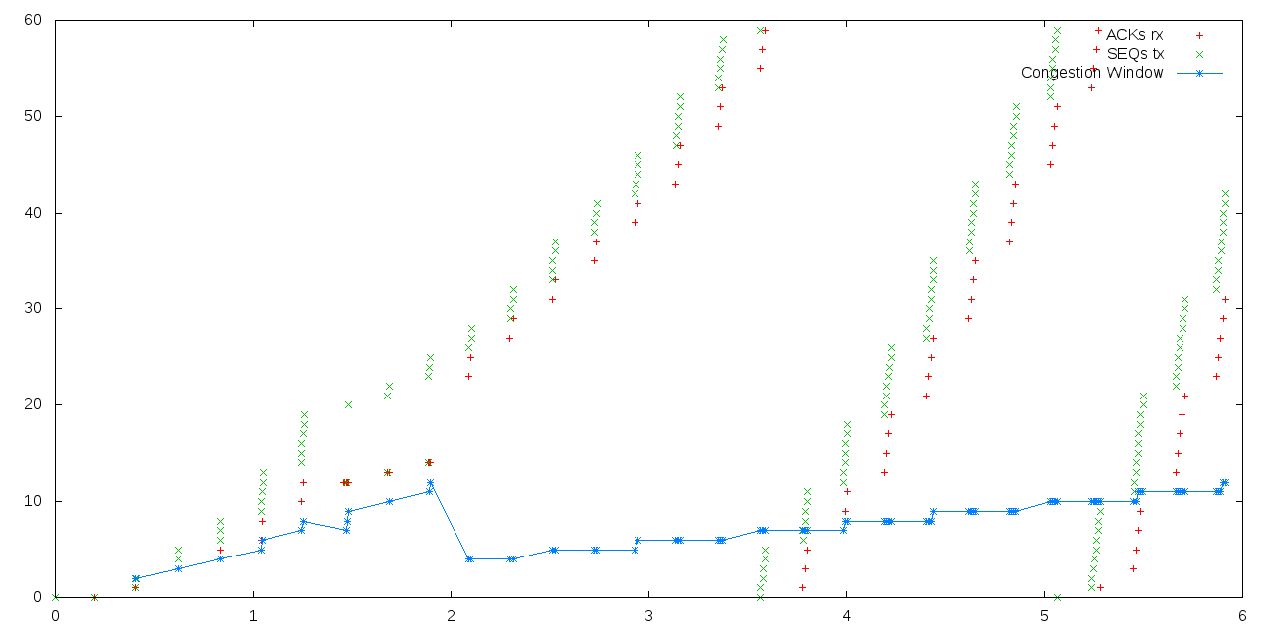
TCP Reno
TCP New Reno

Slide 22
Four Packet Losses
Reno:
The operation is similar to the two drop case and the sender initially goes into Fast retransmit/Fast Recovery.
The two additional losses trigger the expiration of the retransmit timer (RTO)
Tahoe:
Same as the three packet loss case.
Here it duplicates the effort, hence all the other three packets are retransmitted
New Reno:
Same as Reno
However partial ACKs are received which cause the sender to remain in fast recovery.
The cumulative ACK causes it to exit fast recovery.

Slide 23
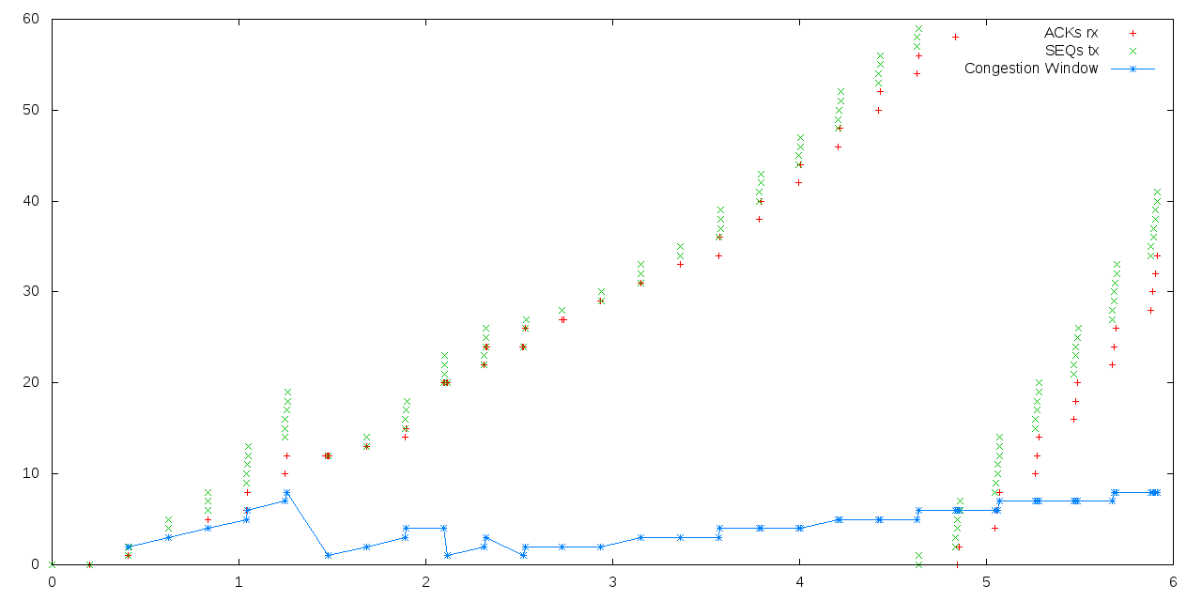
TCP Tahoe

Slide 24
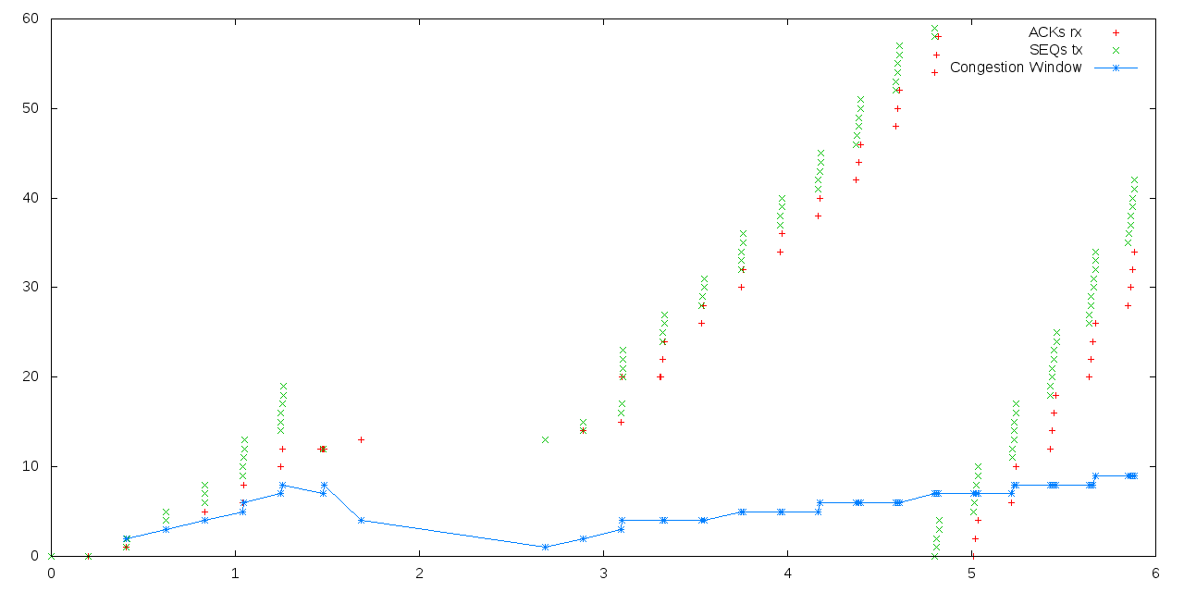
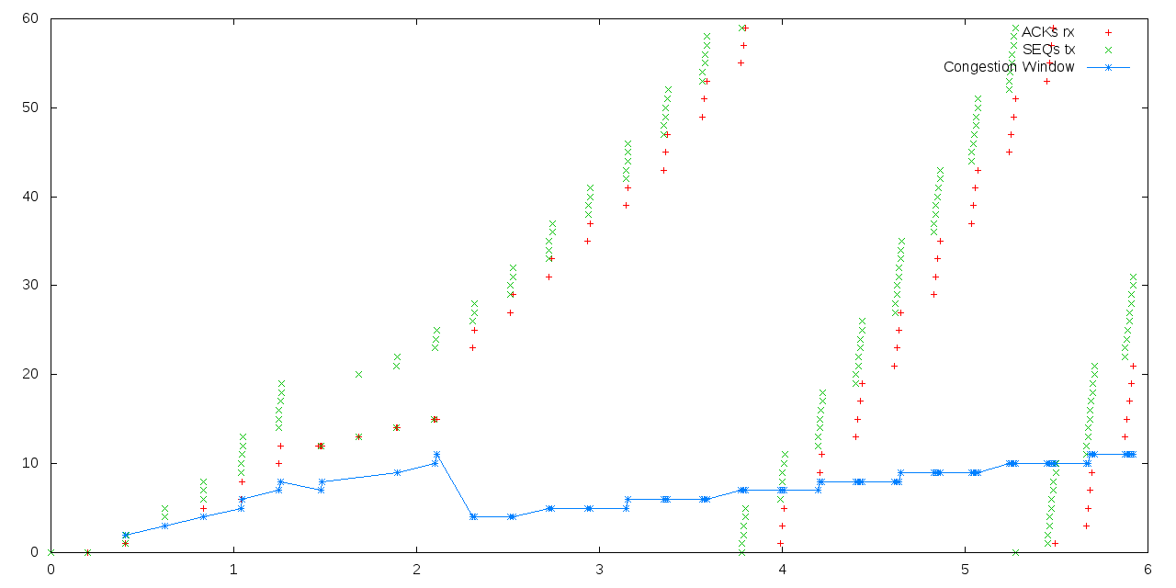
TCP Reno
TCP New Reno

Slide 25
NSNAM Tutorials. https://www.nsnam.org/docs/release/3.9/tutorial/tutorial_23.html
NSNAM Tutorials. https://www.nsnam.org/docs/release/3.7/tutorial/tutorial_32.html
NS3 Wiki. https://www.nsnam.org/wiki/New_TCP_Socket_Architecture#Result_from_tcp-loss-response
Gnuplot with PERL. http://www.misc-perl-info.com/perl-plotting.html
References:

Slide 26
THANK YOU!

