Slide 1
Test sample sequencing results

Slide 2
Processing pipeline
Shotgun whole metagenome DNA sequencing on MiSeq (paired end 150-bp reads)
Adapter trimming, and filtered for quality and read length with fastp
Taxonomic profiling with Kraken2 using standard RefSeq library (includes archaea, bacteria, viruses, human, plasmids)

Slide 3
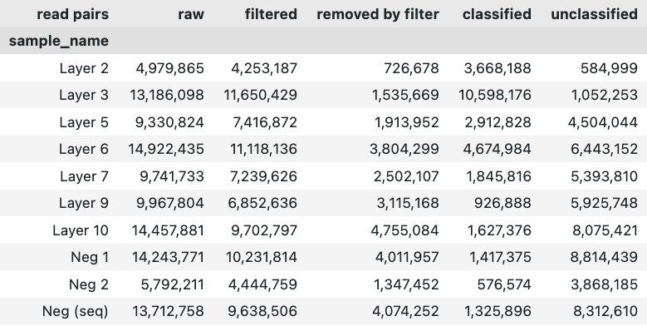
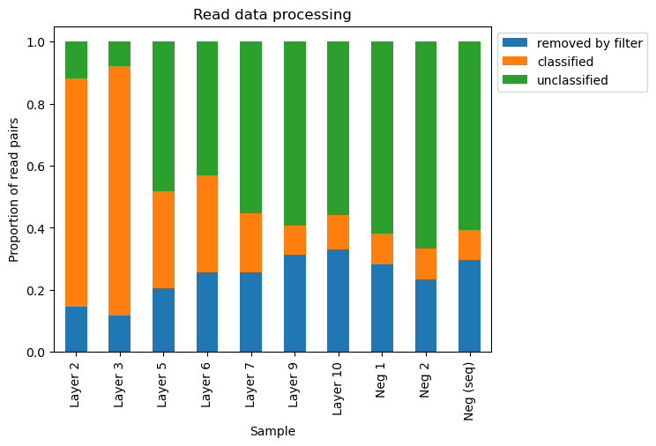
Read processing
Classified against standard RefSeq database

Slide 4
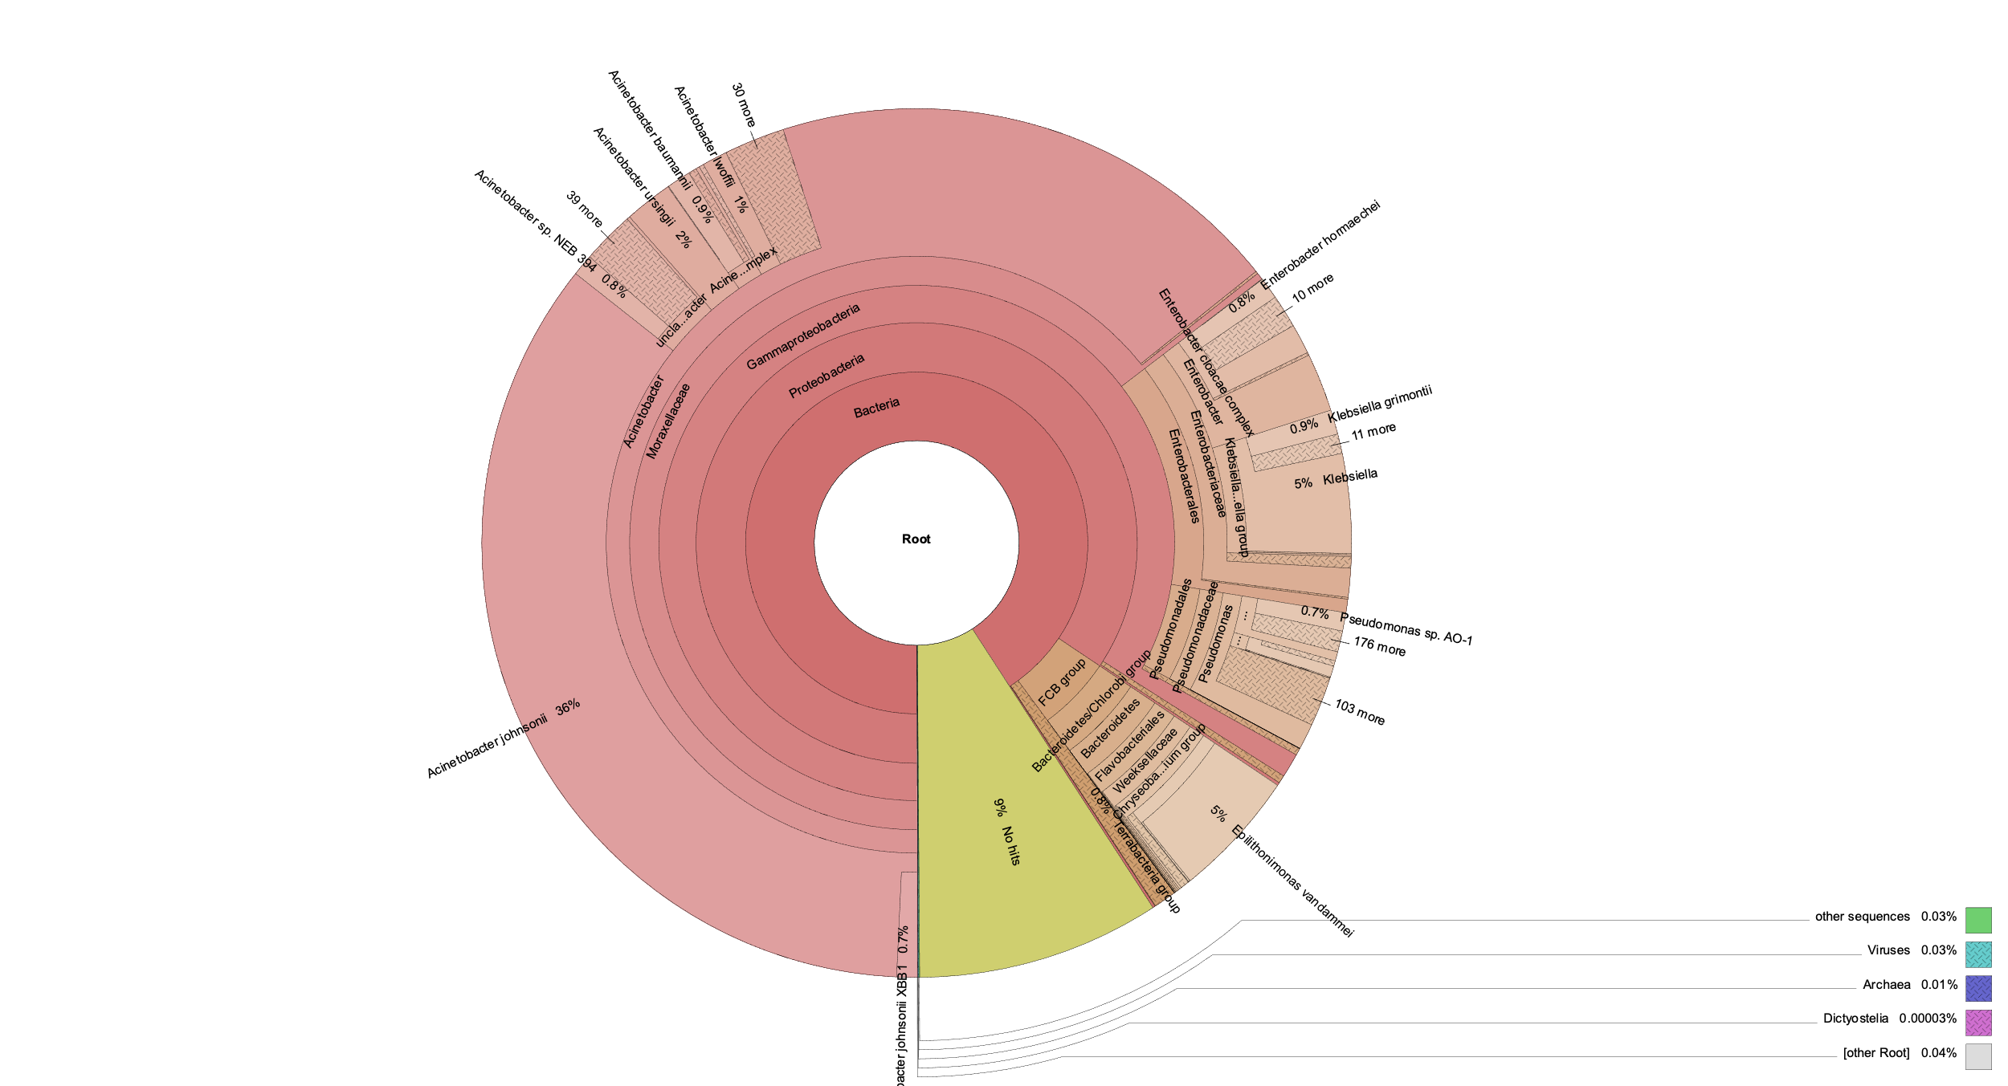
Test samples
Ice samples dominated by gamma-proteobacteria, particularly Acinetobacter johnsonii (and other Actinetobacter species)
Actinetobacter johnsonii found in many environments
Found in aquatic sources, human skin, animals. Can cause opportunistic infections (Castillo-Ramírez et al., 2020)
Previously found by a study of permafrost in Svalbard arctic (Singh et al, 2017)
Layer/Bottle 3
Castillo-Ramírez et al., mSphere, 2020
Singh et al., J. Basic Microbiol, 2017
Notes:
Layer 3

Slide 5
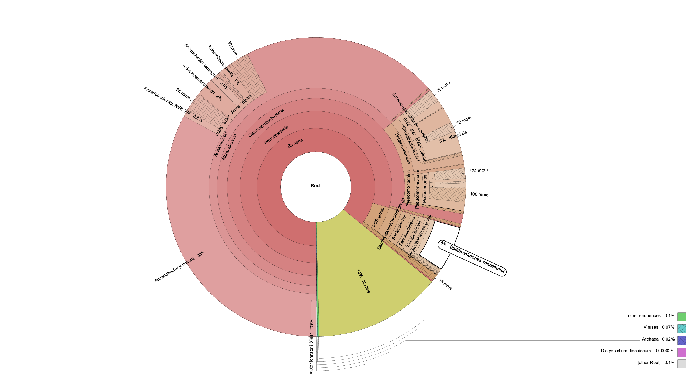
Test samples
Epilithonimonas vandammei (aka. Chryseobacterium hominis) found only in outer layers
Isolated from human clinical specimens, causes infections (Nicholson et al., 2020
Layer/Bottle 3
Castillo-Ramírez et al., mSphere, 2020
Singh et al., J. Basic Microbiol, 2017
Notes:
Layer 3
Blood, testicle, leg wound

Slide 6
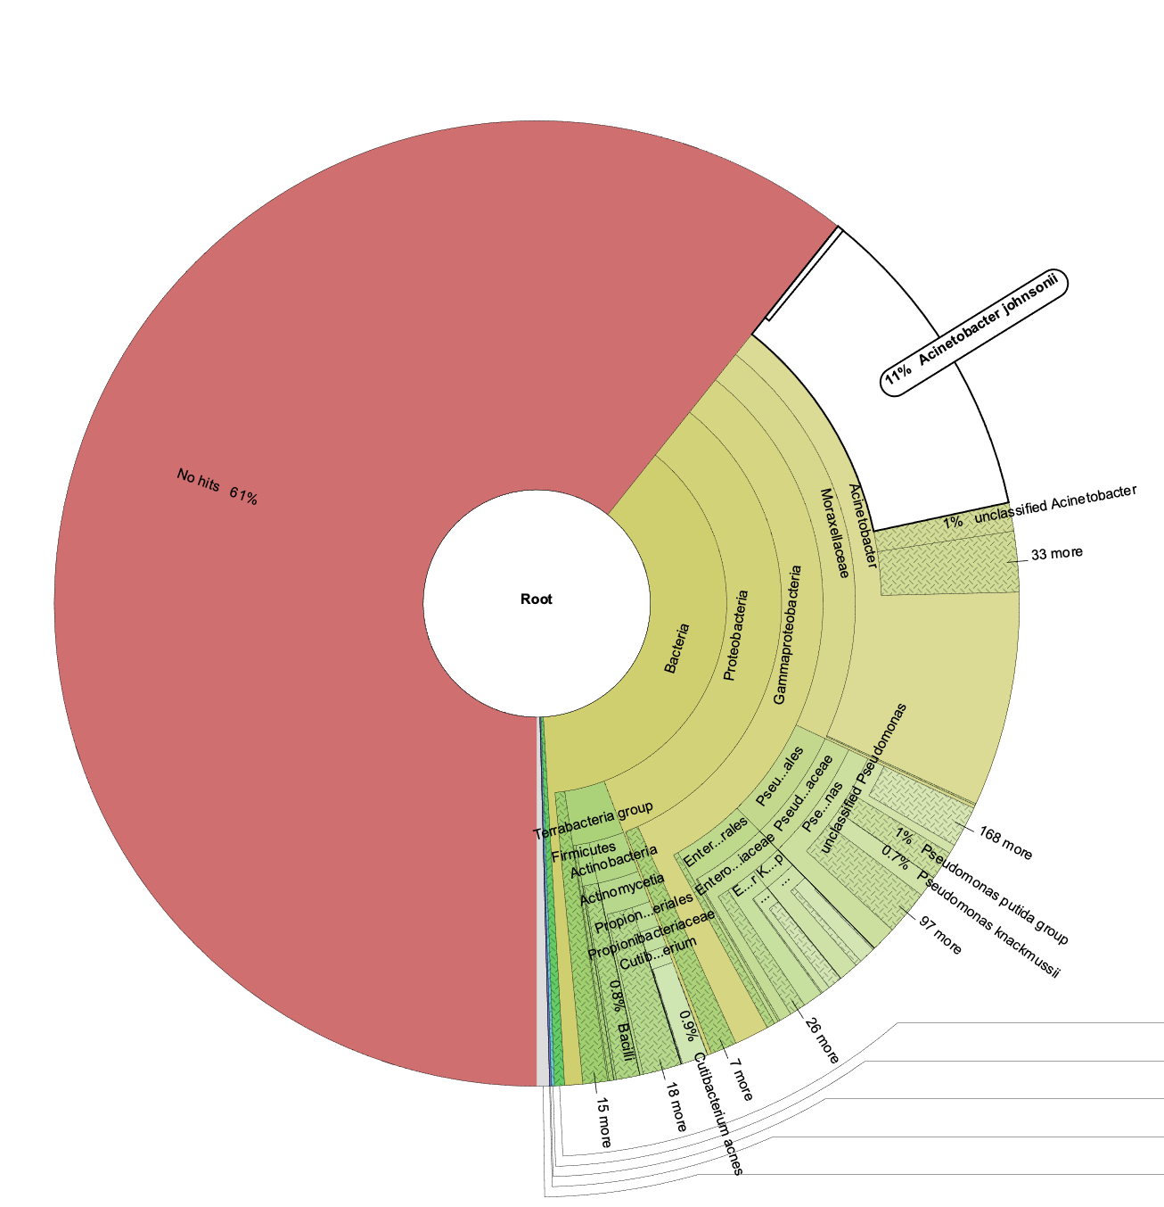
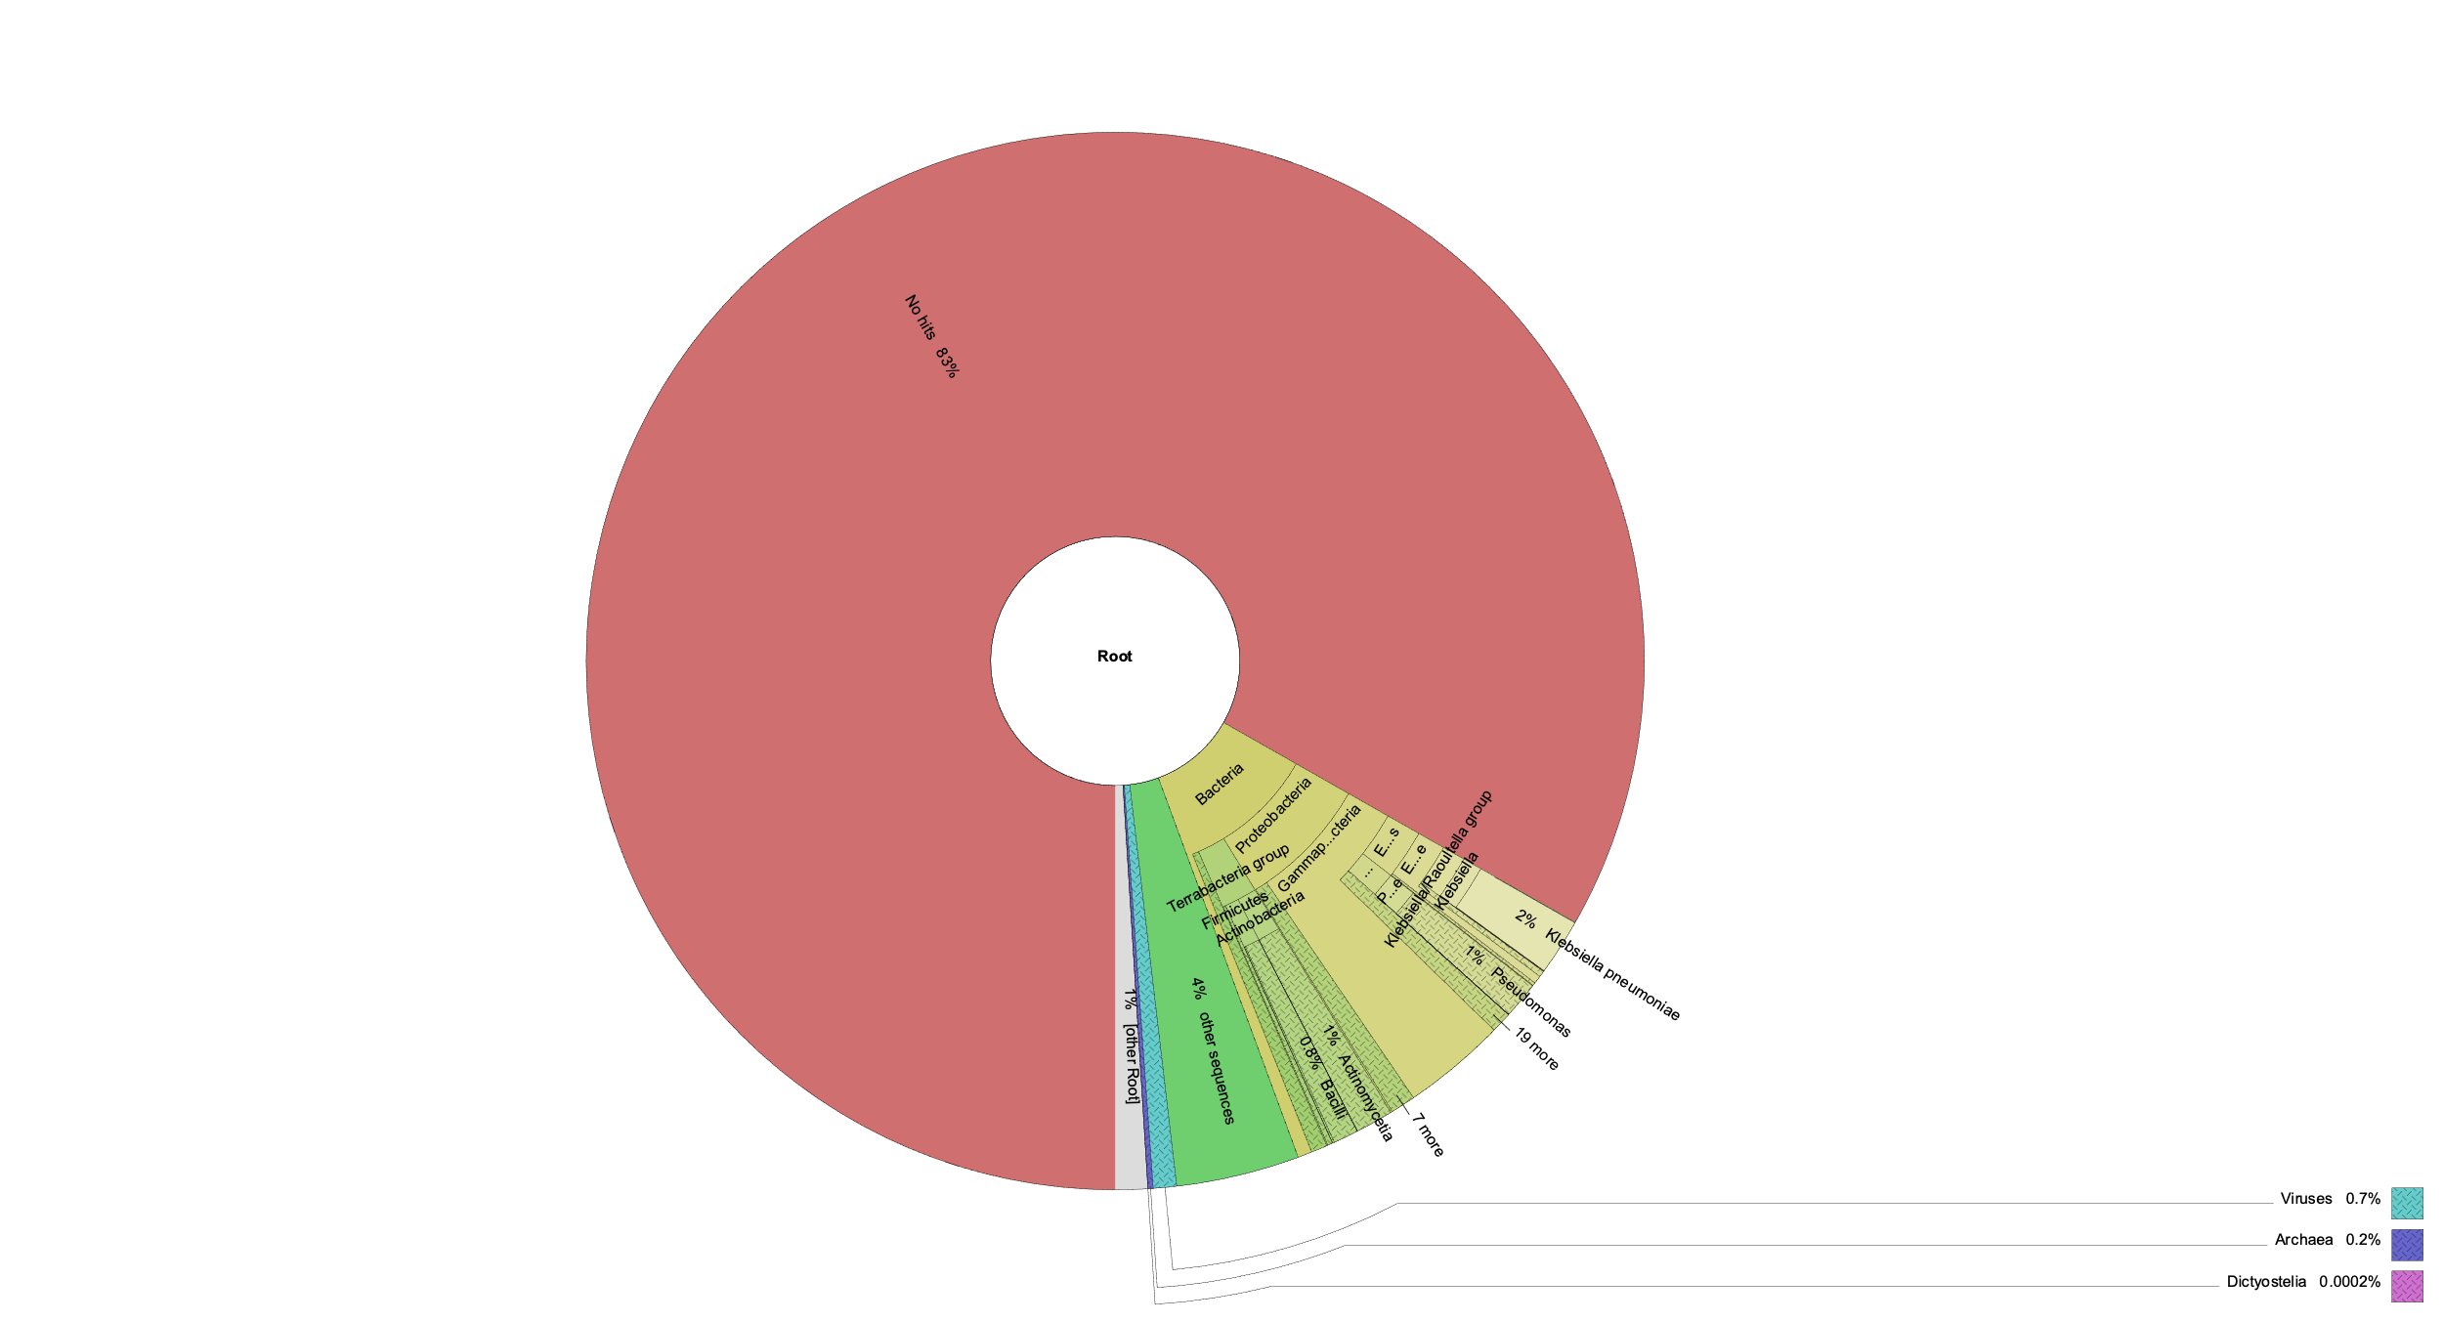
Gradient effect from outer to inner layers (from left to right: layers 3, 5, 10)

Slide 7
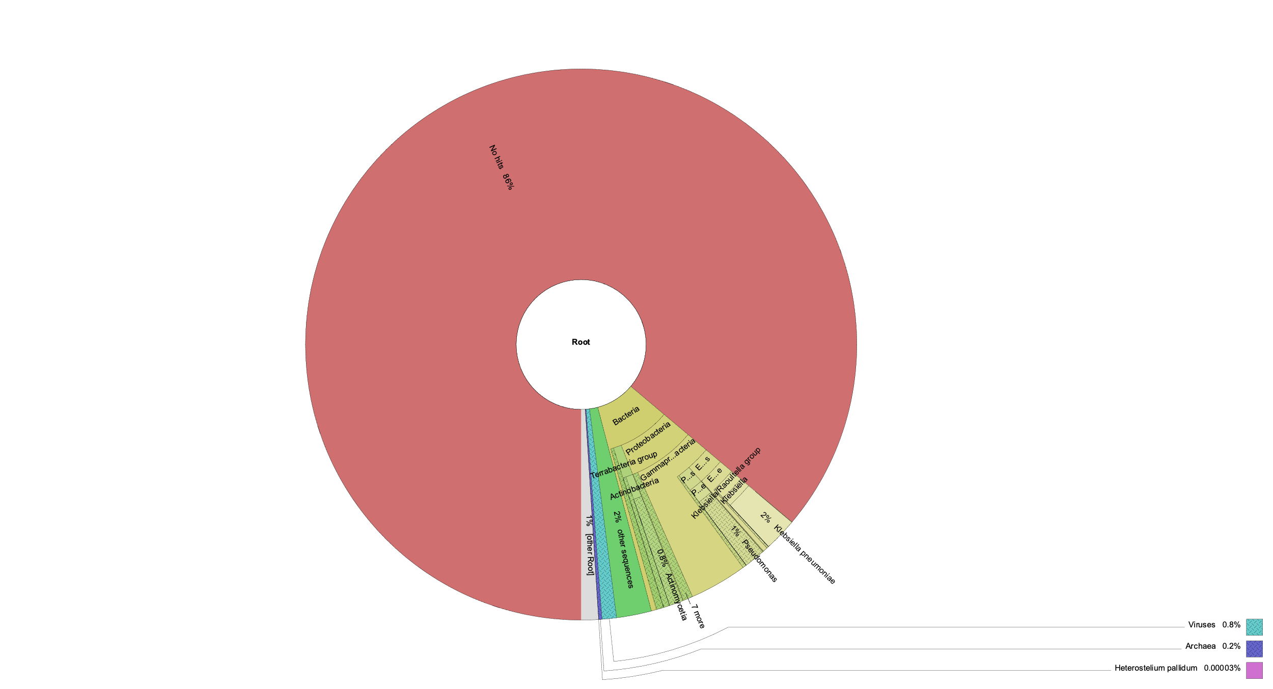
Negative samples
Large proportion of negative sample reads were unclassified
Classified majority from Klebsiella pneumoniae and some Pseudomonas species
Possible cross-contamination from other experiments during sequencing preparation
Negligible (<200 reads) A. johnsonii, likely from index hopping or sequencing artifact

