Slide 1
BARTi pipeline
2016-11-08

Slide 2
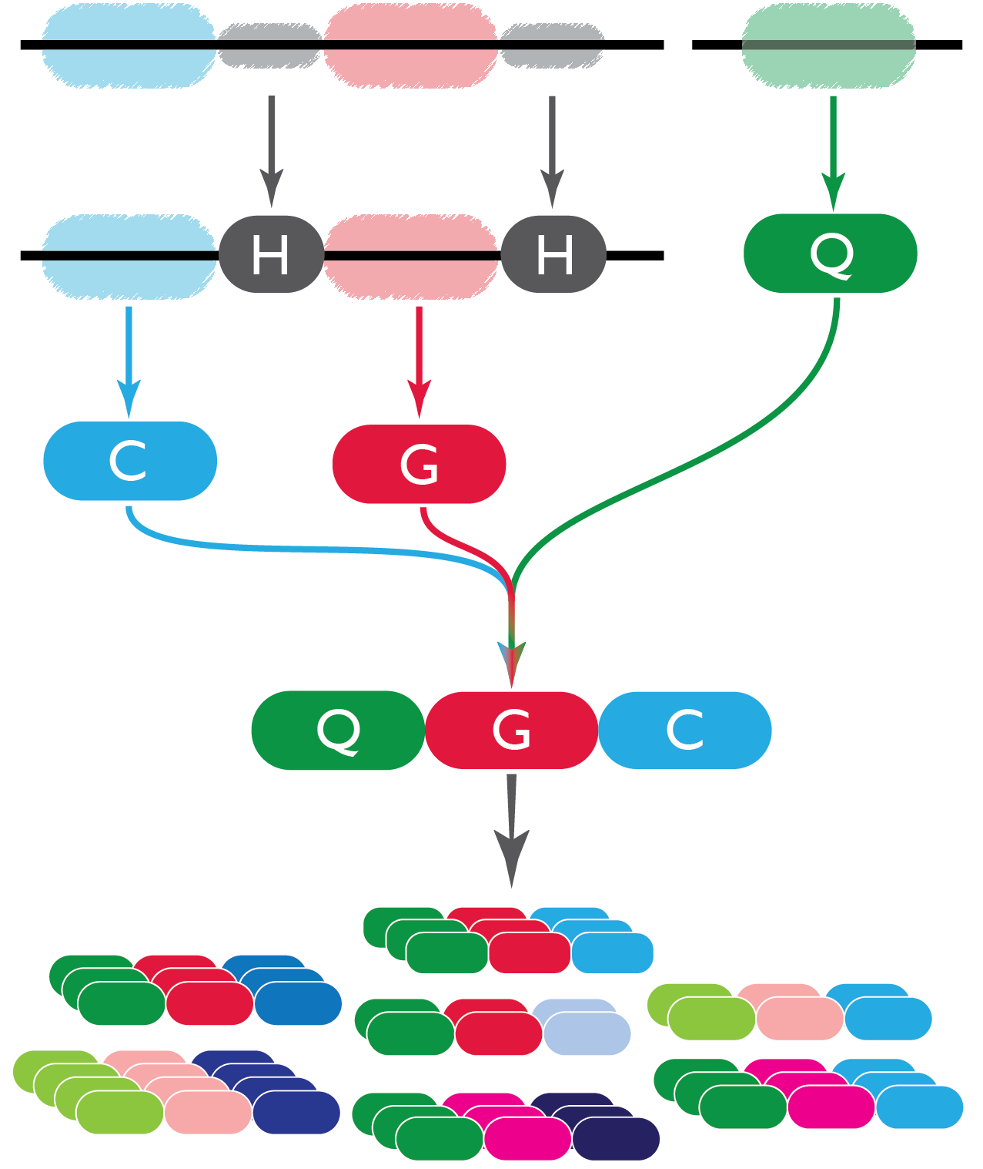
STEP 1: READ AND FIND LIB ID/BARCODE /COUNTER SEQUENCES
Read 1
Read 2
3.
Pair Reads 1 & 2.
Find Q-tag on Read 2.
Find constant handles on Read 1.
Select molecular counter and g-tag based on handles.
Bin QGC based on exact match.
4.
5.

Slide 3

STEP 2: QUALITY FILTER
For each read:
For each base in barcode region:
Is Q-Score > 30??
For each base, “is QS > 30?”
Case A.
························
All OK?
YES
KEEP
·············· ·········
Case B.
×
NO
DISCARD

Slide 4
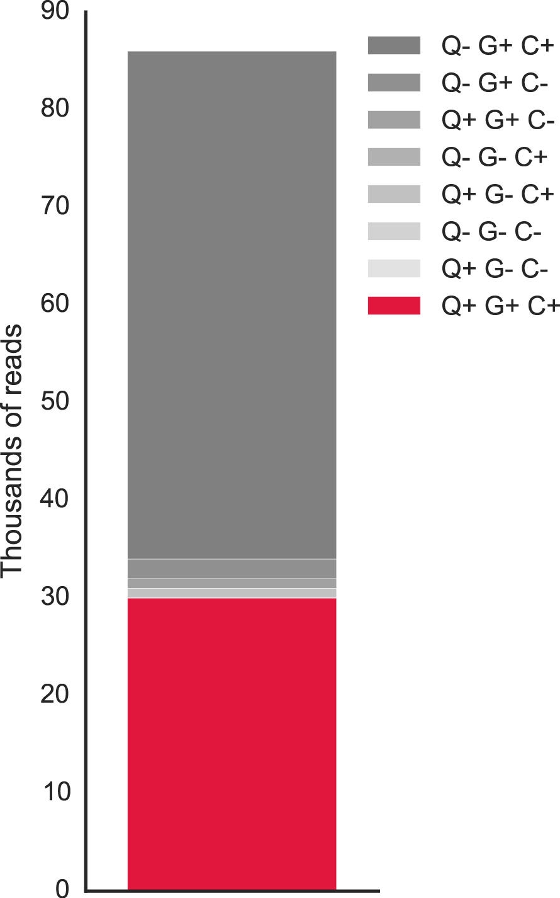
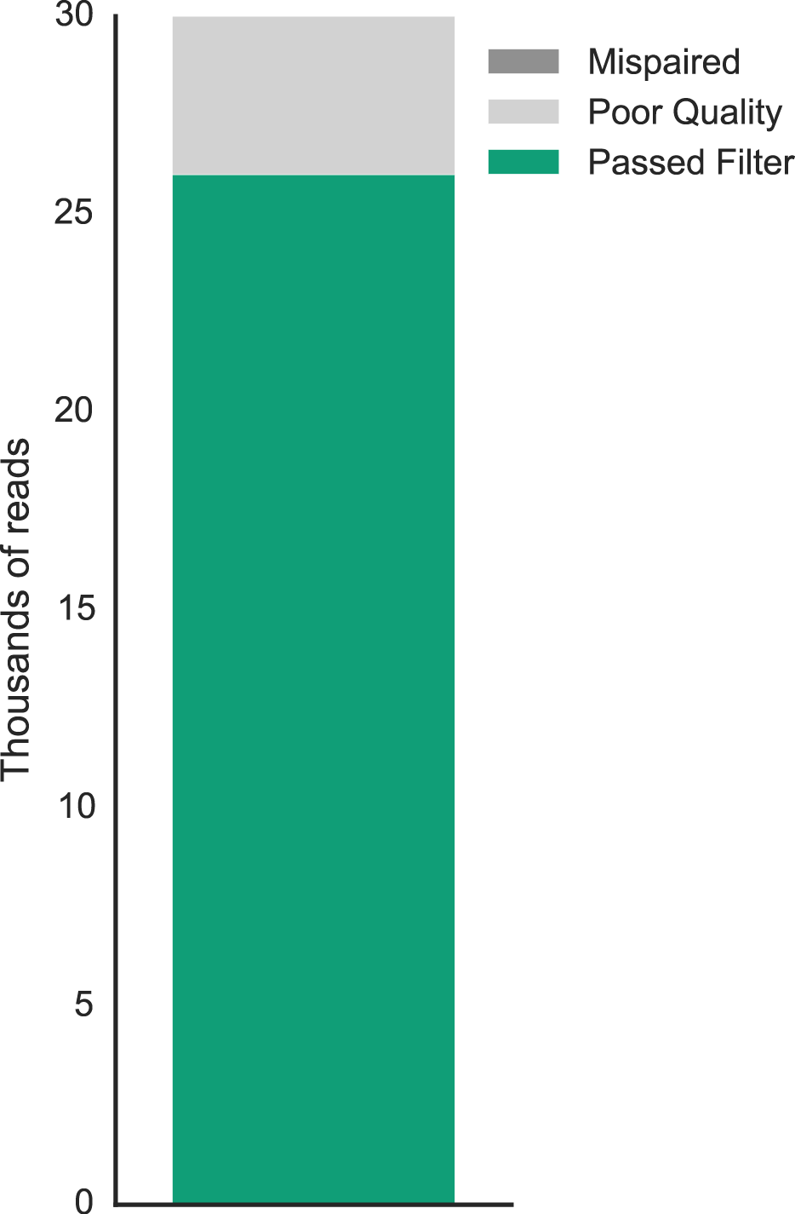
After Step 2 (Quality Filter)…

Slide 5
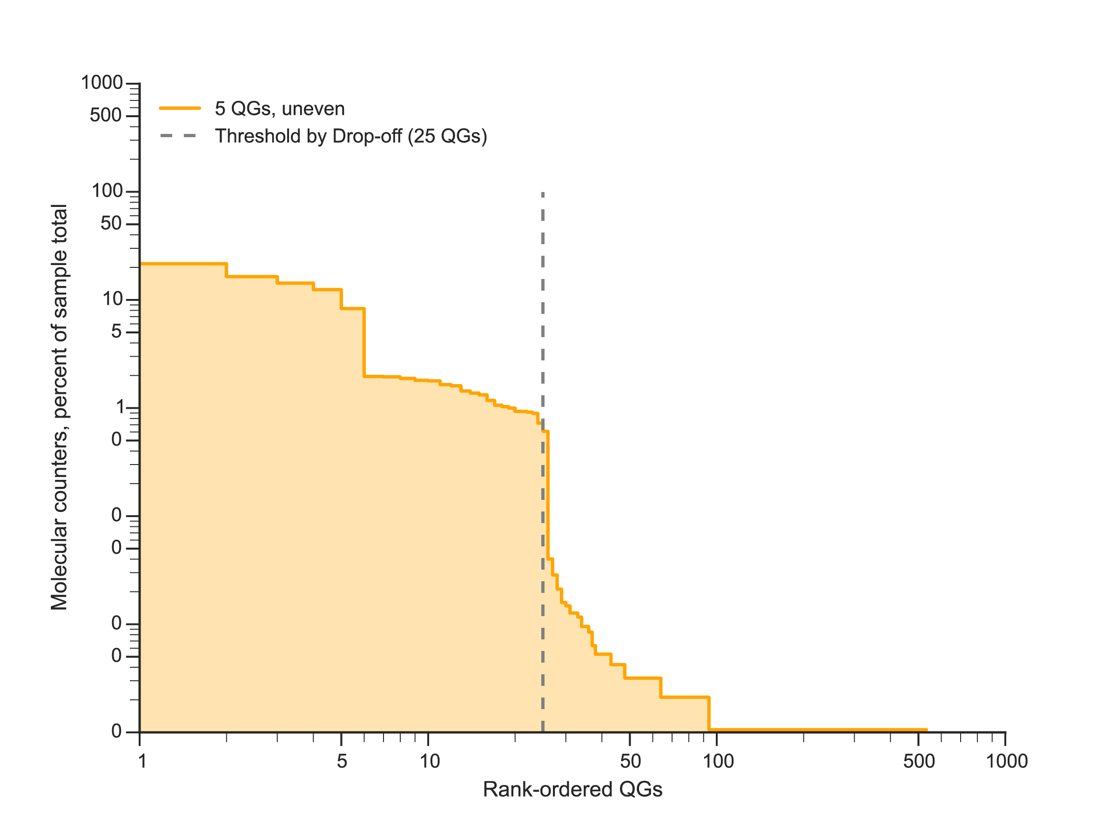
THRESHOLDING
Step 1: Rank order barcodes in descending abundance
Molecular counters (log scale)
Rank

Slide 6
THRESHOLDING
Step 2: Determine inflection point using a modified concavity function.
Our modified concavity function also considers the magnitude of first derivatives,
places more weight on segments with larger absolute differences
Thresholding does not rely on manual / arbitrary parameter
THIS IS AN INITIAL THRESHOLD
Molecular counters (log scale)
Rank

Slide 7
THRESHOLDING
Step 3: Eliminate less abundant, one-off barcodes .
The probability of drawing two barcodes (of 20, say) differing by at most 1 base (edit distance <=1) is very low (<1%).
Thus, in the elimination, we only consider edit distance <=1.

Slide 8
THRESHOLDING
Step 3: Eliminate less abundant, one-off barcodes .
For each barcode which passed the initial threshold,
We compare that lib ID/barcode to less abundant barcodes
If they differ by only one base, or have the same barcode but mismatched qtag, we eliminate that less-abundant barcode
Molecular counters (log scale)
Rank

Slide 9
THRESHOLDING
Step 3: Eliminate less abundant, one-off barcodes .
For each barcode which passed the initial threshold,
We compare that lib ID/barcode to less abundant barcodes
If they differ by only one base, or have the same barcode but mismatched qtag, we eliminate that less-abundant barcode
Molecular counters (log scale)
Rank

Slide 10
THRESHOLDING
Step 3: Eliminate / “clean” less abundant, one-off barcodes.
For each barcode which passed the initial threshold,
We compare that lib ID/barcode to less abundant barcodes
If they differ by only one base, or have the same barcode but mismatched qtag, we eliminate that less-abundant barcode
Molecular counters (log scale)

Slide 11
THRESHOLDING
Step 4: Rethreshold “cleaned” barcode set
If the new threshold is different from the previous, we repeat elimination, and then threshold again.
When the previous and new thresholds are the same, we use that to separate “true” and erroneous barcodes.
Molecular counters (log scale)
Rank

Slide 12
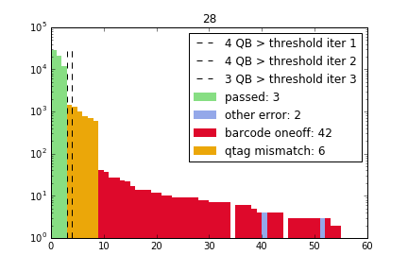
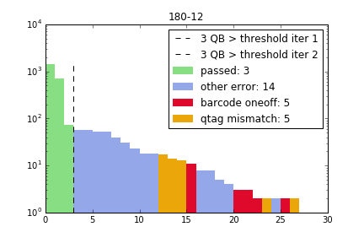
Examples from re-infection monkey 18014 scrapates
Molecular counters (log scale)
Rank

Slide 13
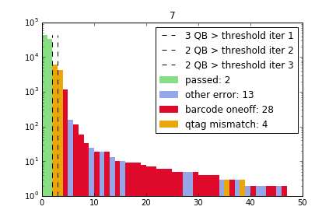
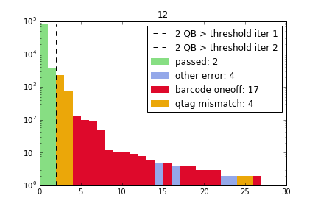
Examples from ratio data
(7): 2 barcodes, 50:50
(12): 2 barcodes, 99:1

Slide 14
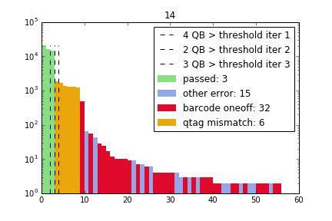
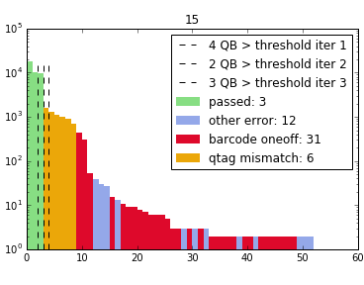
Examples from ratio data
(14): 3 barcodes, 33:33:33
(15): 3 barcodes, 50:25:25

