Slide 1
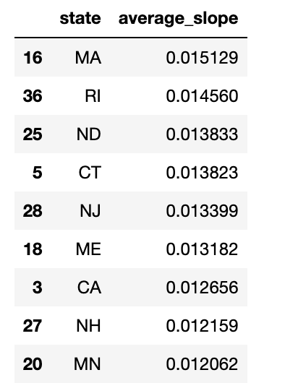
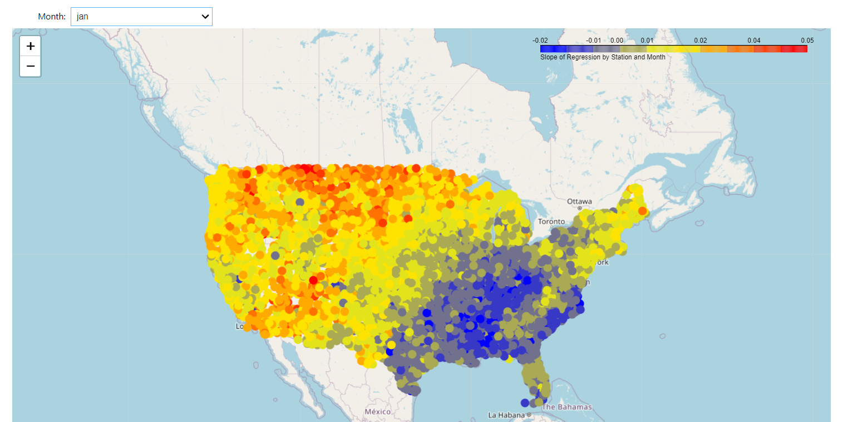
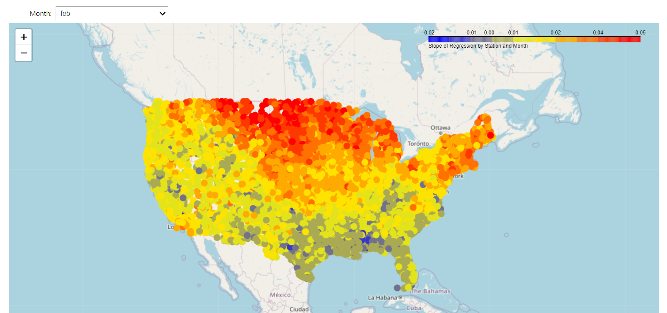
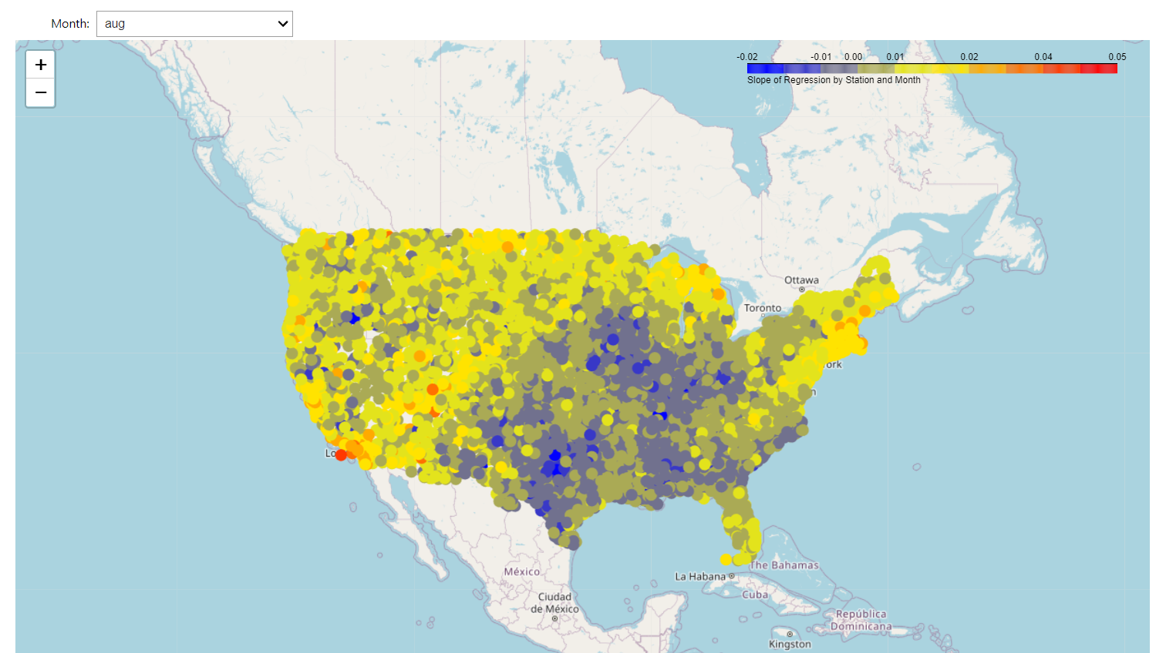
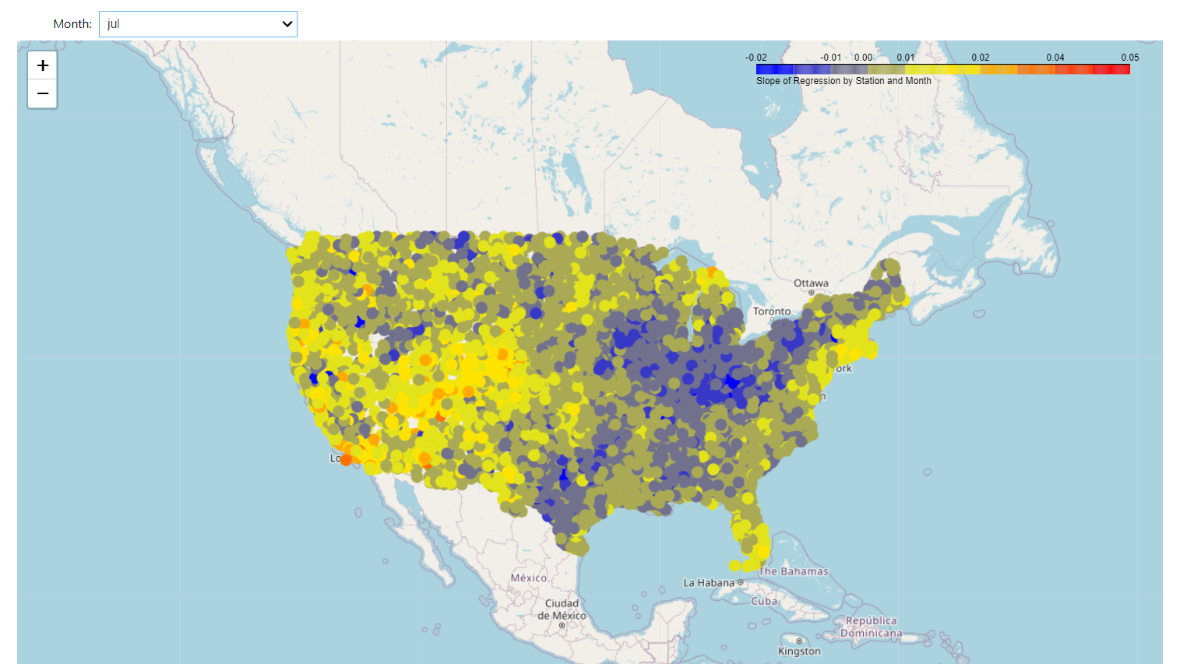
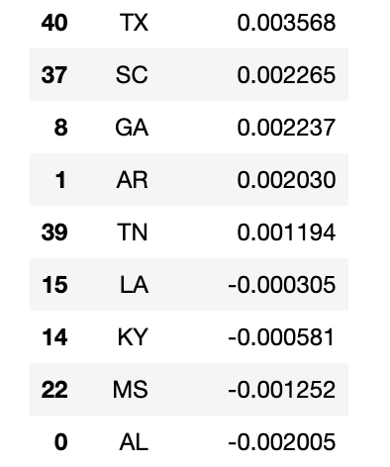
Temperature Trends and Climate Change (1920-2010)
By: Daniel Veretenov, Vivian Li, Gianna Saw, Khushi Shah
Top 9 states with the highest temperature regression value
Main Research Question: How has the climate temperature in the United States change during the past decades?
Folium Heatmap of Jan vs Feb and June vs July Regression Values
Jan
Feb
As shown above, there is a significant average temperature change between January and February despite them being only one month apart within the same season. The South region experienced colder temperatures during the month of January, but witnessed a warming trend in February. The Midwest region experienced a drastic increase in temperature during February, as indicated by the bright red color. In contrast, the temperature change during June and July is relatively small, as displayed below. It is evident that several regions around the Midwest, Northeast, and the South experience cooler temperatures in July compared to June. Meanwhile, the West region and certain parts around Massachusetts and New York remained warm during this period.
Top 9 states with the lowest temperature regression value
June
July
Notes:
Open up: talking about our goals & motivation for this research
People dont believe in climate change
Weird temp
Boston cold rn
Cali - reservoir water level was low
Forest fire
Venice sinking
Main problem: —
What method we used & what trials & problems occurs:
Time analysis graph - line plot
Started w/ plotting stations temp = too messy
Changed to average temp of all past years
Did folium of the average temp to see temp of different areas
Our overall results:
Looking at june & july - generally the same regression slope changes (more on blue and green – cooler colors)
Looking at jan & feb (feb has more red values – meaning more changes in regression slope despite jan and feb being 1 month apart)
Blue means negative regression slope (temp getting cooler) and red means positive slope (temp getting warmer)
Some places got cooler and some got warmer

