Slide 1


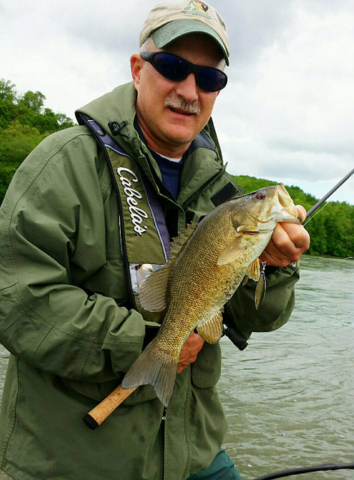
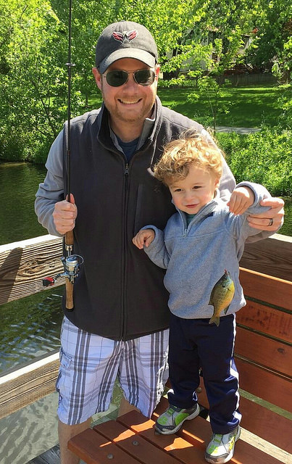
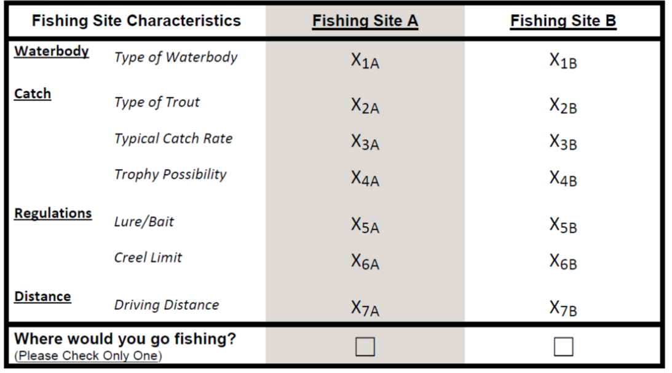
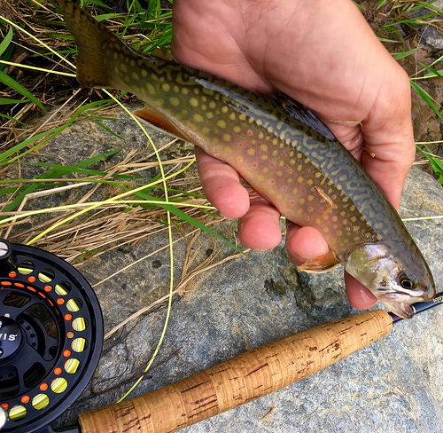
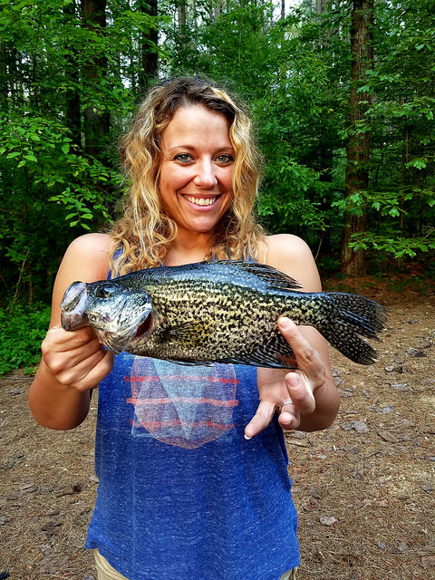
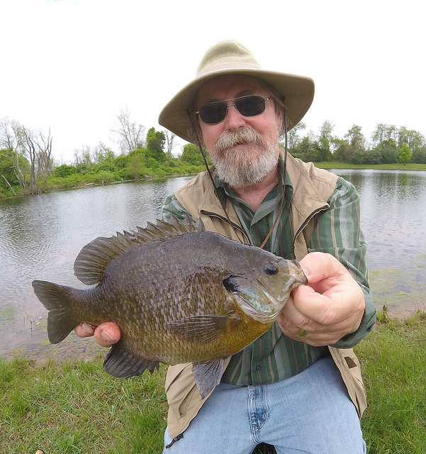
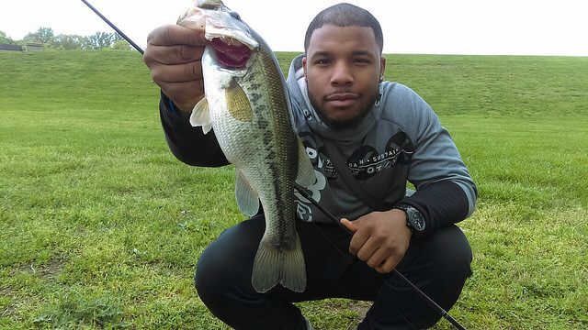
Maryland Non-Tidal Angler Preference Survey
Scott Knoche, Researcher, Morgan State University PEARL; Han Zhou, Intern, Morgan State University PEARL;
Susan Rivers, Maryland Department of Natural Resources Fisheries Service
Introduction
Maryland freshwater fishing in 2011: 227,000 anglers; 2.5 million fishing trips; $400 million in expenditures
Up-to-date information on angler participation, preferences, and expenditures is lacking
This inhibits the effective management of public fishery resources for anglers and other stakeholders
Our survey and analysis will enable fisheries managers to create, maintain and enhance the fisheries resources most valued by stakeholders
Survey Focus and Questions
Fishing Effort
Examine fishing trip frequency,
location, methods used, and
species targeted
Fishing Trip Expenditures
Estimate statewide &
regional trip expenditures
Stated Choice Experiment
Each respondent faces 4
trout fishing site choice
scenarios
Site characteristic levels (X’s)
vary within & across surveys
Statistical model developed
which relates fishing site
choice to site characteristics
Identify determinants of
fishing site selection and
tradeoffs
For example: Are anglers
willing to drive further to
catch more/bigger trout?
Survey Methods
Mailing 1
Letter w/ survey website (N = 4,300)
Mailing 2
Small Postcard
w/ survey website
Mailing 3
Large Postcard
w/ survey website
Mailing 4
Hard Copy of Survey w/ return envelope

