Slide 1

Image Generation and Enhancement using Generative Adversarial Network
National Institute of Technology Puducherry
Karaikal - 609609
Second Phase First Review
Date: 15/03/2021
Submitted by: Guided by:
S. Hariviknesh (EC17B1043) Dr. G Lakshmi Sutha
V Aman Babu (EC17B1057) HOD, ECE
Vivian Roshan A (EC17B1061)

Slide 2
Motivation
Objectives
The accuracy and performance of Artificial Neural Networks is limited by number of training samples.
It is highly impossible to manually categorize/ label/ tag large no of samples manually to train these networks, limiting their possibilities.
Generative Adversarial Network (GAN) aims to solve these by generating large no of samples close to real-world dataset.
Images captured digitally (ex: satellite images, video calls) have limited resolution due to network bandwidth,hardware limitations etc.
GANs are capable of increasing the resolution making it highly useful in research.
To explore in depth about Generative Adversarial Network (GAN), their implementation and use-cases from the literature.
To discover different architectures and training methods, identify metrics for evaluation and compare different GANs to implement an optimal GAN.
To develop a GAN that would generate Artificial samples (dataset) which is highly indistinguishable from real dataset.

Slide 3
Introduction
Generative Adversarial Network (GAN) consists of 2 competing Neural Networks (ie) Generator and Discriminator.
The Generator when fed with a random input (Noise) generates an image after the random noise is passed through sequence of neurons.
The Discriminator is responsible for correctly distinguishing original samples and fake samples generated by Generator.
Generator and Discriminator are trained alternatively trying to fool each other.

Slide 4
Work done till Phase 1
Used a real-world satellite image dataset of water bodies.
Implemented weight clipping technique (based on [3]) to force the weights of convolutional filter kernels to lie between - 0.01 to 0.01.
Trained the model using 3 different architecture.
Wasserstein GAN achieved the better stability in the three architectures.

Slide 5
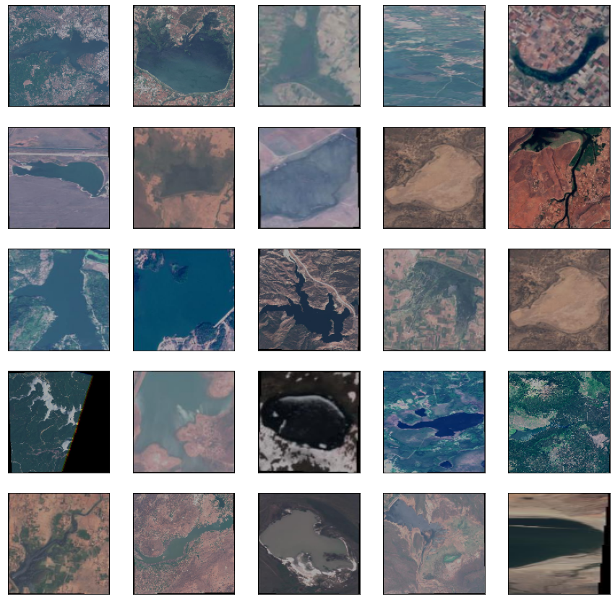
Dataset Details
Open source Satellite Images of Water Bodies taken from Kaggle (franciscoescobar/satellite-images-of-water-bodies)
2,481 samples
656x657 resolution
RGB Images
Training with batch size of 100

Slide 6
Results
Neural network Architecture | Epochs | Type of Neural network | Accuracy | Cross-entropy Loss | Wasserstein Loss
CGAN | 100 | Generator | - | 0.106053 | -
 |  | Discriminator | 86.62% | 0.244365 | -
DCGAN | 100 | Generator | - | 0.0856 | -
 |  | Discriminator | 88.80% | 0.130959 | -
WGAN | 100 | Generator | - | - | -250000
 |  | Discriminator | 74.6 % | - | -400

Slide 7
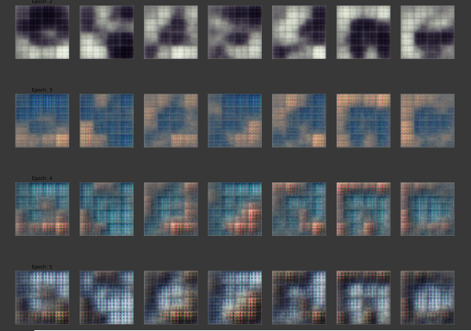
Generator Output

Slide 8

Work done Phase 2
Gradient Penalty
Mild errors while training having significant impact on further training - Exploding and Vanishing Gradients , causing Instability.
Gradient Penalty
Technique to solve this problem
Add magnitude of Gradient (Weights) to loss function
Defined Mathematically as

Slide 9
Training Details
Optimised dataset processing steps using low level libraries like tensorflow to speed up training.
Trained the model for 10,000 epochs using Sentinel-2 Satellite image dataset.
Penalty Coefficient (λ) = 10
No Batch Normalization layer in the discriminator.
Two sided penalty; The norm of the gradient should go towards 1 (two-sided penalty) instead of just staying below 1 (one-sided penalty).Optimal WGAN critic has gradients with norm 1.

Slide 10
Architecture
We added 4 additional Convolution layer in both generator and discriminator.
The input given to the generator is 100 normalized noise samples.
The input to the discriminator is 64, 64, 3 array.
Generator’s output is 64, 64, 3 array.

Slide 11

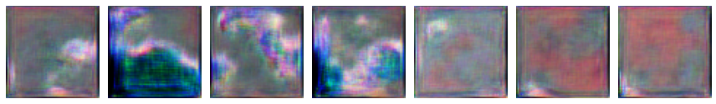
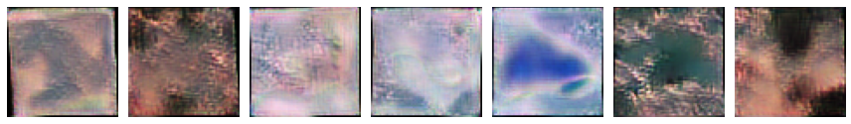
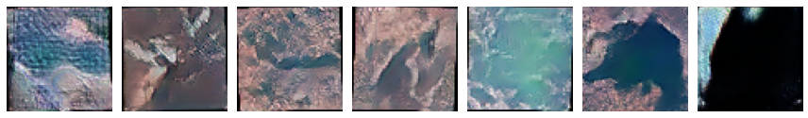
Results
Epoch 1:
Epoch 100:
Epoch 1000:
Epoch 10000:

Slide 12
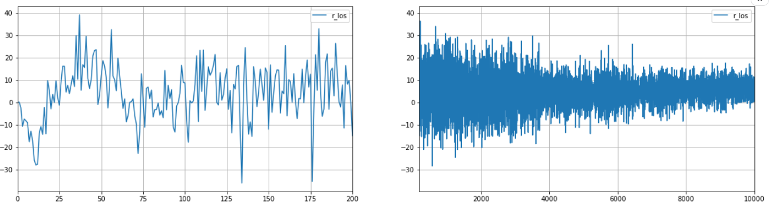
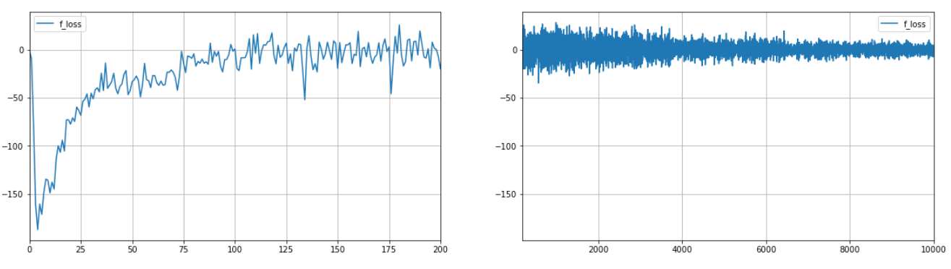
Loss
Loss
Epoch
Epoch
Loss
Loss
Epoch
Epoch

Slide 13
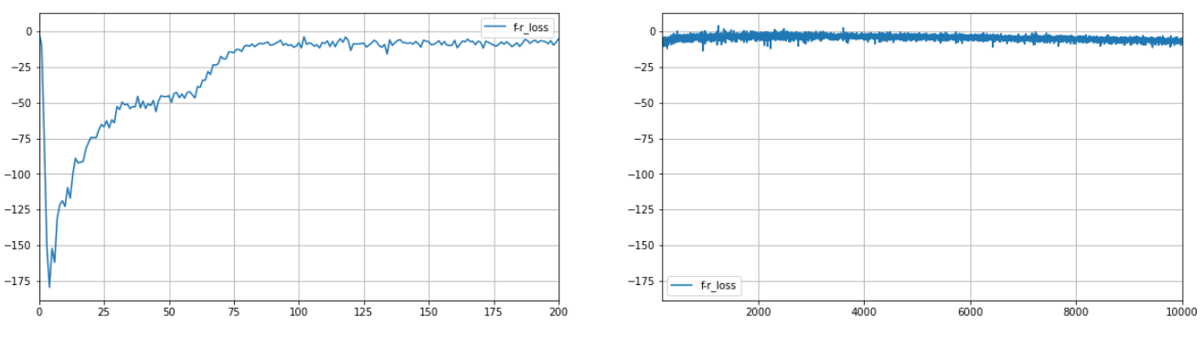
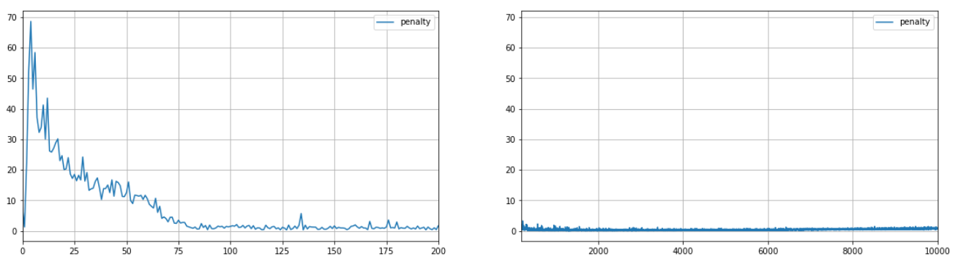
Loss
Loss
Epoch
Epoch
Loss
Loss
Epoch
Epoch

Slide 14
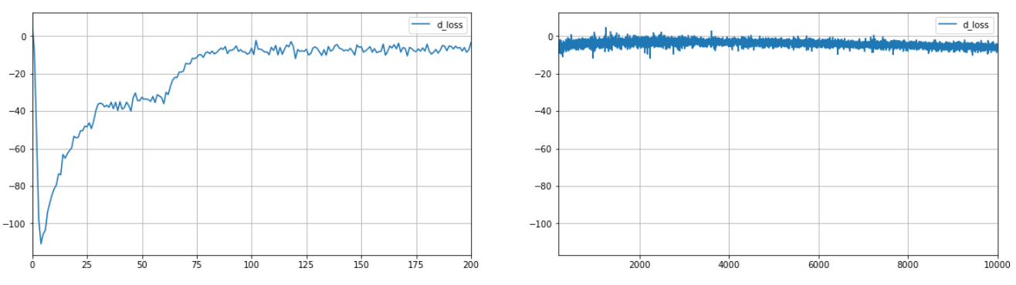
Loss
Loss
Epoch
Epoch

Slide 15
Summary
We had re-designed our GAN architecture proposed in phase 1 by altering the dimensions and incorporating additional convolutional layers.
Optimised training and data processing mechanisms.
Studied in-depth about discriminator’s penalty in WGAN.
Incorporated Gradient penalty on our architecture by modifying loss functions and activation functions.
Generated images which are close to the real world images.

Slide 16
Future works
Train 3 classifier networks to distinguish between land and water bodies; Using true satellite image dataset; Using dataset generated using GAN; Using both original and generated dataset together.
Train the GAN for Indian water bodies dataset.
Comparison of different image classification techniques against the ones augmented with GAN.

Slide 17
References
Wei Han, Lizhe Wanga, Ruyi Feng, Lang Gao, Xiaodao Chen, Ze Deng & Jia Chen, Peng Liu c, “Sample generation based on a supervised Wasserstein Generative Adversarial Network for high-resolution remote-sensing scene classification”, Information Sciences 539 (2020) 177–194, https://doi.org/10.1016/j.ins.2020.06.018
Martin Arjovsky, Soumith Chintala, and L´eon Bottou: Courant Institute of Mathematical Sciences, Facebook AI Research, “Wasserstein GAN”, arXiv:1701.07875v3 [stat.ML], 6 Dec 2017
Pegah Salehi, Abdolah Chalechale, Maryam Taghizadeh, “Generative Adversarial Networks (GANs): An Overview of Theoretical Model, Evaluation Metrics, and Recent Developments”, arXiv:2005.13178 [cs.CV]
Ishaan Gulrajani, Faruk Ahmed, Martin Arjovsky, Vincent Dumoulin, Aaron Courville, “Improved Training of Wasserstein GANs”, arXiv:1704.00028v3 [cs.LG] 25 Dec 2017

Slide 18
THANK YOU

