Slide 1

Capstone Project
The Battle of Neighborhoods
By Vivian Tavares de Andrade

Slide 2
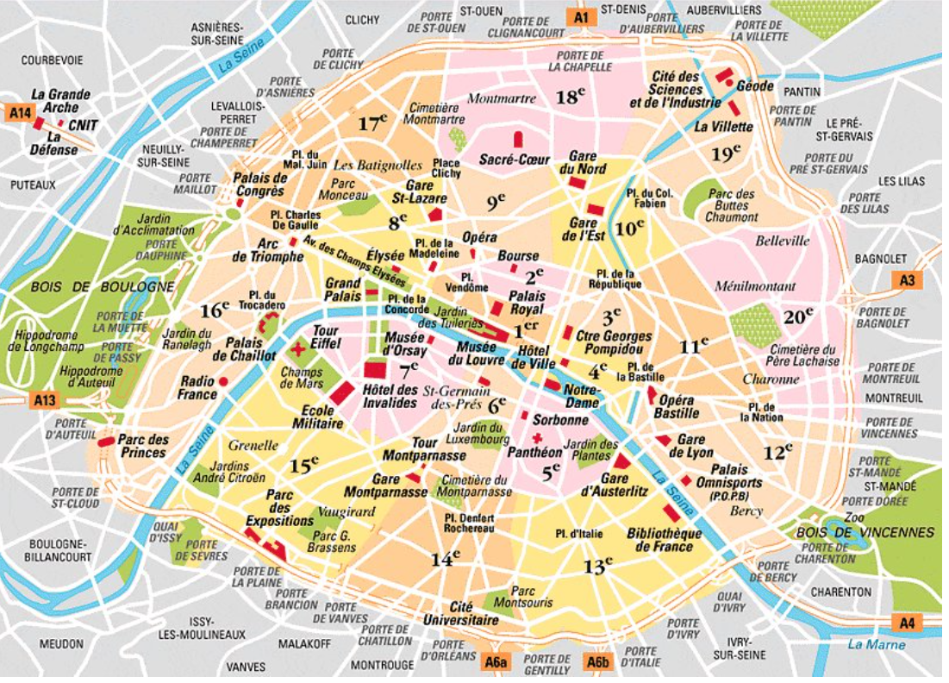
1. Business Problem
What is the best place to open a food and beverage business in Paris, France?

Slide 3
2. Data Acquisition
List of neighborhoods in Central Paris
Geo-coordinates of the neighborhoods in Paris
Restaurants by categories, Bakery, Salad Place, Café, Pastry Shop, Pizza Place, Bistro, Coffee Shop, Wine Bar, among other places that sell prepared food and beverages in these neighborhoods in Paris.

Slide 4
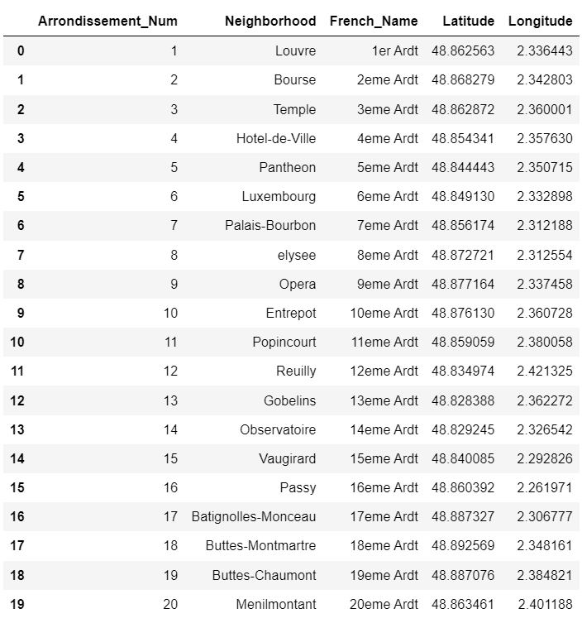
3. Methodology
Fig. 1: Arrondissements/
Neighbohoods of Paris.

Slide 5
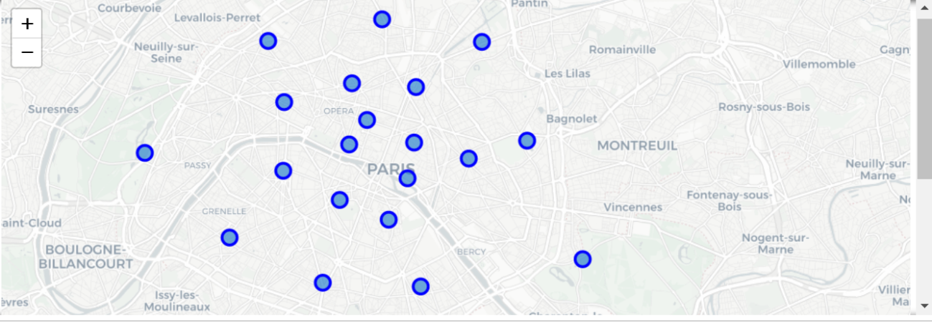
3. Methodology
Fig. 2: Map of Paris with 20 neighborhoods superimposed on top.

Slide 6
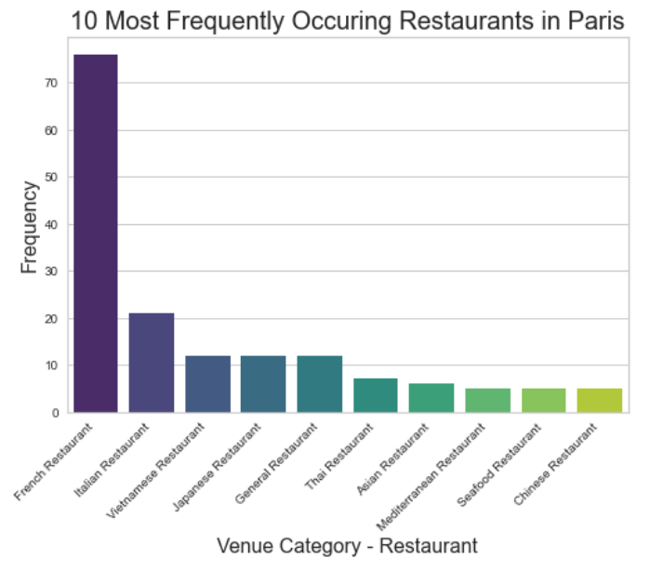
Top 10 restaurants types in Paris
Fig. 3: 10 most frequently occuring restaurants in Paris

Slide 7
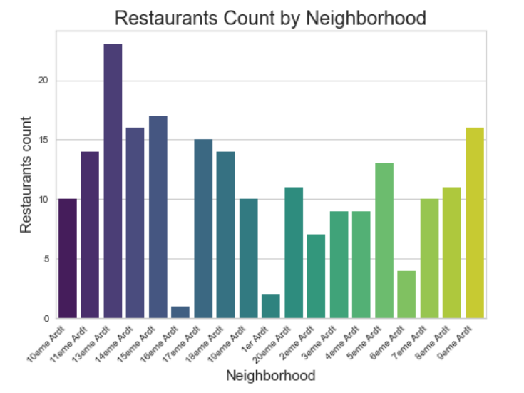
Restaurants Count by neighborhood
Fig. 4: Restaurants Count by neighborhood

Slide 8
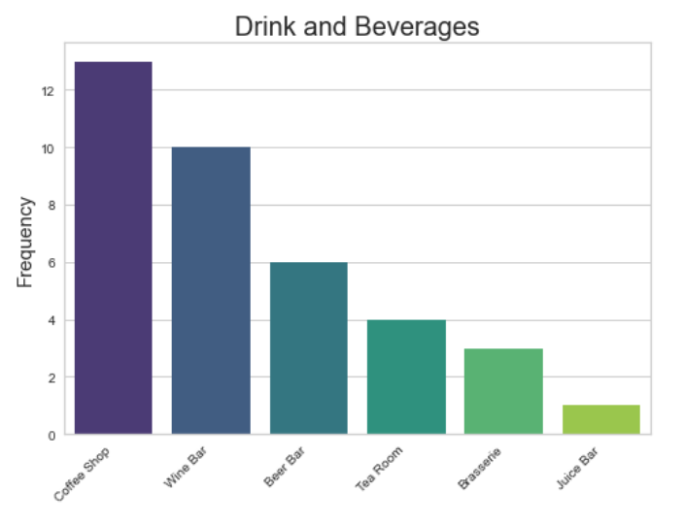
Food and beverage frequency
Fig. 5: Number of different venues for food and beverage in Paris.

Slide 9
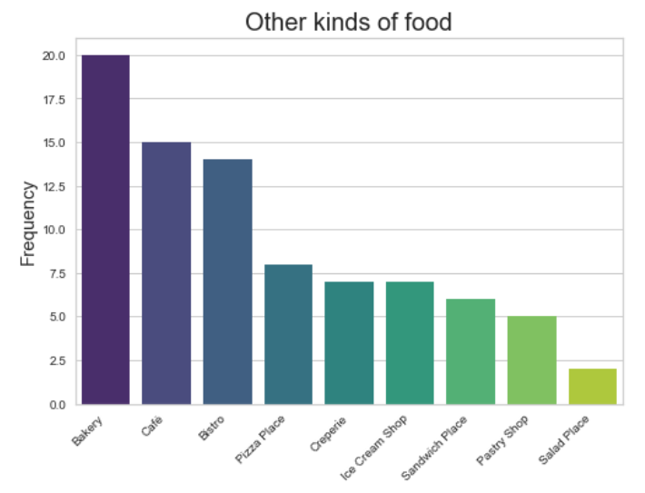
Others kinds of food frequency
Fig. 6: Number of different Bakery, Café, Bistro, Pizza Place, Creperie, Ice Cream Shop, Sandwich Place, Pastry Shop and Salad Place in Paris.

Slide 10
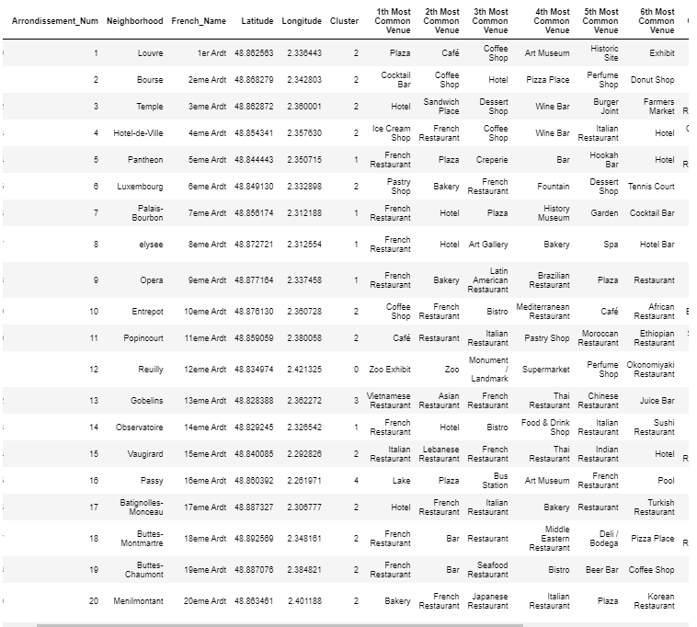
Clustering Neighborhood

Slide 11
Clustering Neighborhood
– Cluster 0 : Arrondissement_Num 12 (Red)
– Cluster 1 : Arrondissement_Num 5, 7, 8, 9 e 14 (Purple)
– Cluster 2 : Arrondissement_Num 1, 2 , 3 , 4, 6, 10, 11, 15, 17, 18, 19 e 20 (Blue)
– Cluster 3 : Arrondissement_Num 13 (Green)
– Cluster 4: Arrondissement_Num 16 (Orange)

Slide 12
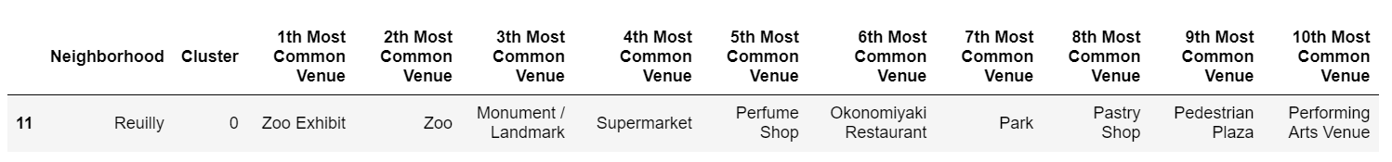
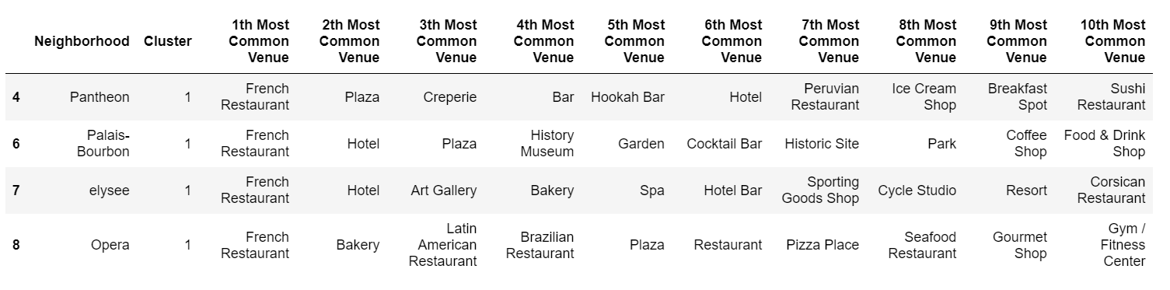
Cluster 0 e 1

Slide 13
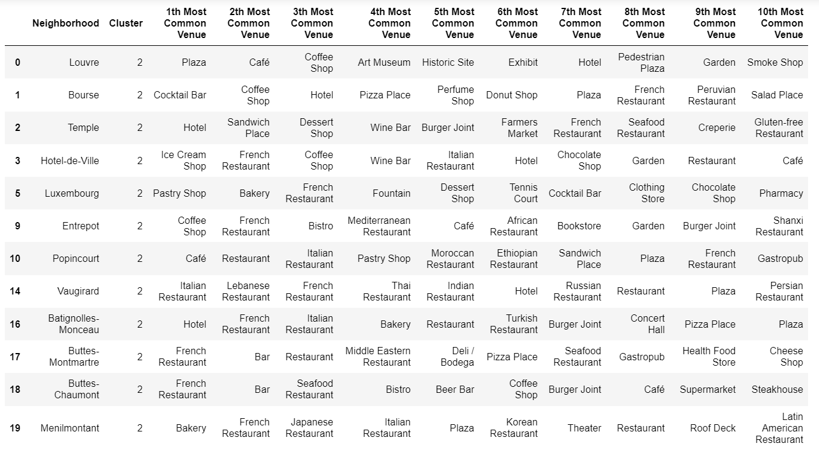
Cluster 2

Slide 14
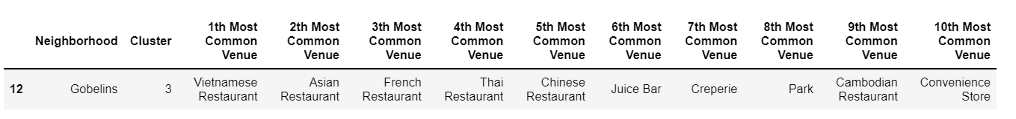
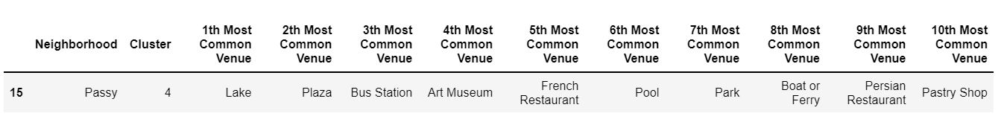
Clusters 3 e 4

Slide 15
Conclusão
- The opening of a restaurant in this cluster 1 and 2 are quite reasonable.
- The 13eme Ardt (Gobelins) has the highest number of top-rated restaurants. 8, therefore, I believe that this region presents a greater risk due to high competition.

Slide 16
- This analysis within this project is quite superficial, it shows the basic methods and opportunities. But, from this study, the stakeholders can refine your search criteria and improve your analysis for specific businesses.
- I hope this preliminary analysis will be helpful in your decision making. The clustering has revealed characteristic groups of areas on which it is possible to concentrate more specifically.
- So, for further consideration, I would choose the clusters 1 and 2.
Conclusão

