Slide 1
Bank Marketing Data Analysis
Yujia Wang & Ji Li

Slide 2
Outline
Introduction
Exploratory Data Analysis
Attempted ML Methods
Results and Conclusions

Slide 3
Background
Marketing selling campaigns is an important strategy to enhance business. There are different ways that can help to determine whether a marketing campaign will be successful or not.
A term deposit is a major source of income for a bank.
Definition: “A term deposit is a fixed-term investment that includes the deposit of money into an account at a financial institution. Term deposit investments usually carry short-term maturities ranging from one month to a few years and will have varying levels of required minimum deposits.”

Slide 4
Motivation
For companies to promote services through mass campaigns, directed marketing is an effective strategy that is targeting a specific set of contacts.
However, it requires lots of investment and may trigger a negative attitude towards banks due to the intrusion of privacy.
Data analytics helps finance teams gather the information needed to gain a clear view of customers’ needs.

Slide 5
Project Goal
To find the best machine learning model to predict if a customer will subscribe (yes/no) to a term deposit based on the existing record from a Portuguese banking institution.

Slide 6
Dataset Description
The dataset is from a Portuguese bank that used its own contact-center to do directed marketing campaigns which are mainly phone calls but sometimes with an auxiliary use of the Internet online banking.
There are a total of 4521 observations and 17 variables.
Personal Client Information: Age, Job, Marital, Education
Bank Client Information: Default, Balance, Housing, Loan
Last Contact of the current campaign: Contact, Day, Month, Duration
Other Information: Campaign, Pdays, Previous, Poutcome
Outcome y : Has the client subscribed to a term deposit? (binary: "yes","no")

Slide 7
Exploratory Data Analysis

Slide 8
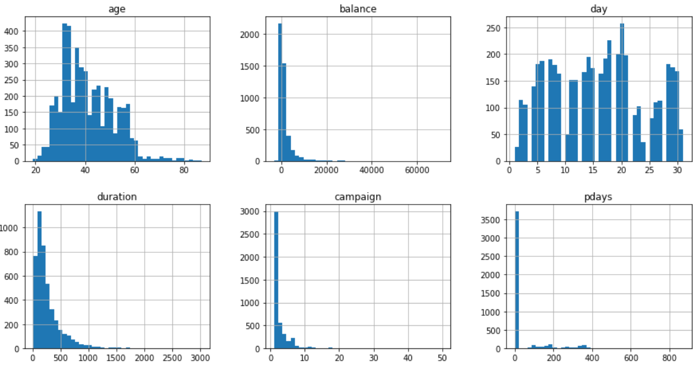
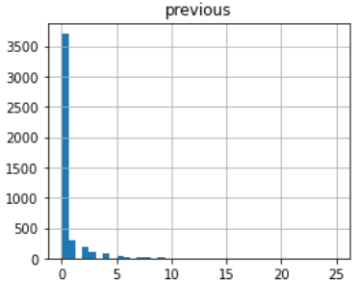
Exploratory Analysis of Continuous Variables

Slide 9
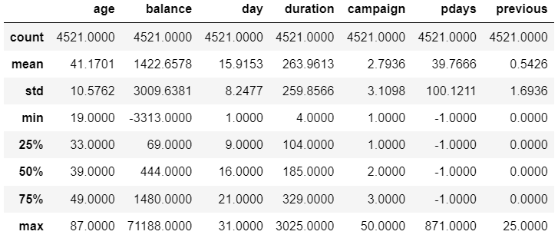
Summary Statistics of Continuous Variables

Slide 10
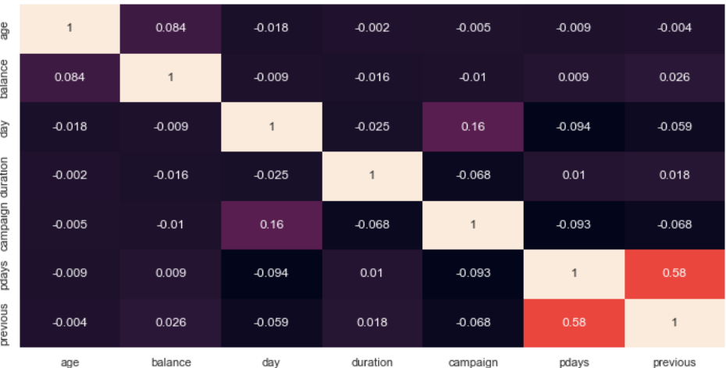
Correlation Coefficient Matrix

Slide 11
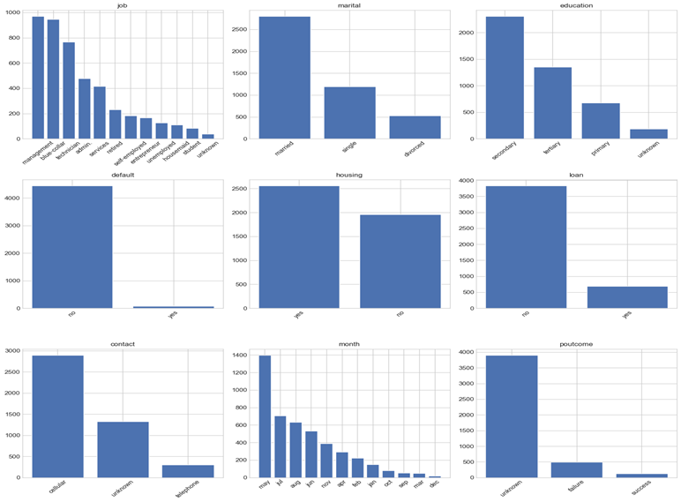
Explanatory Analysis of Categorical Variables

Slide 12
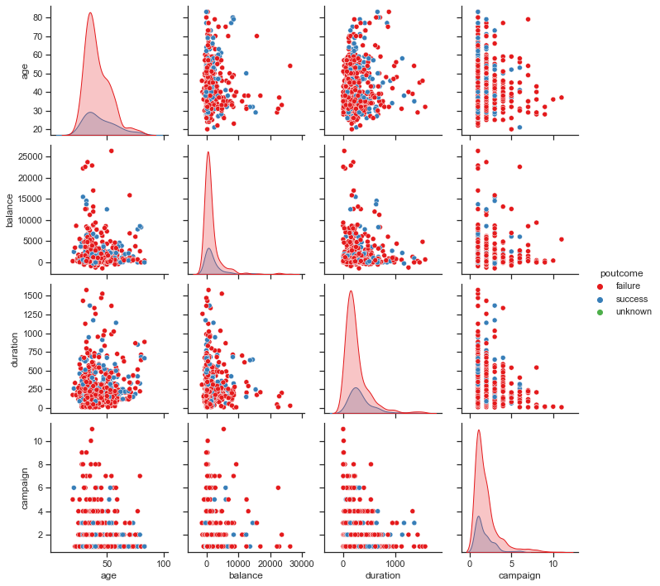
The “poutcome” Variable vs Continuous Variables

Slide 13
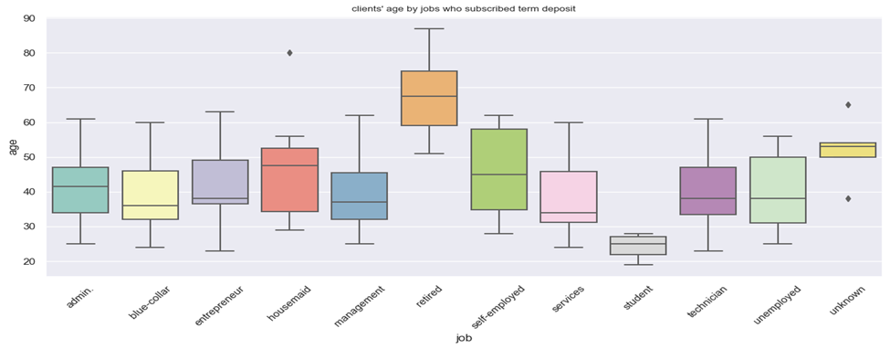
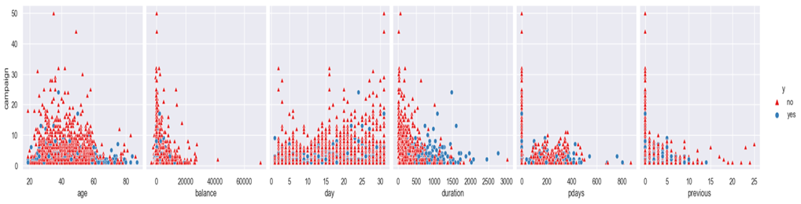
Exploratory Analysis of Categorical Variables
Boxplot of clients’ age by jobs who subscribed to the term deposit
Distributions of variables v.s the outcome

Slide 14
Data Pre-preparation
Label encoding
Many machine learning algorithms cannot operate on categorical data directly. They require all input variables and output variables to be numeric.
LabelEncoder is a utility class to help normalize labels such that they contain only values between 0 and n_classes-1.
Standardization
Some machine learning algorithms are sensitive to the scale of data.
For example, k-nearest neighbor, this algorithm only depends on computing the distances of data points.
To make the effects of features less sensitive to its scale and unit, one technique that we applied here is standardization.

Slide 15
Attempted Machine Learning Method

Slide 16

Logistic Regression
Logistic regression is a discriminative classifier. Unlike the linear regression that models the response Y directly, the logistic regression models the probability of response Y belonging to a particular category.
Using the logistic regression algorithm to the data, we have
Training accuracy: 88.90%
Test accuracy: 88.29%

Slide 17

Perceptron
Perceptron is an on-line algorithm. It is similar to the logistic regression method. We assume y ∈ {−1, +1}. In this case, our prediction becomes a sign function:
At each step, with a negative sign indicating an error, then we update the weight vector by adding on the gradient.
Using the perceptron algorithm to the data, we have
Training accuracy: 82.23 %
Test accuracy: 82.98%.

Slide 18
Shrinkage Methods
Using the least squares method to fit a model that contains all ‘p’ predictors, we can apply a technique that regularizes/shrinks the coefficient estimates.
By doing so, the variance of coefficient estimates are significantly reduced. The two most popular shrinkage methods are ridge regression and lasso regression.
Using the lasso regression algorithm to the data, we have
Training accuracy: 90.55 %
Test accuracy: 89.46%.
Using the ridge regression algorithm to the data, we have
Training accuracy: 90.49 %
Test accuracy: 89.68%.

Slide 19
Naive Bayes
The Naive Bayes algorithm is a generative classifier. Unlike the discriminative classifier using a conditional distribution, we use the joint distribution to generate the data. In a nutshell, Naive Bayes algorithm is based on Bayes rule and a set of conditional independence assumptions.
Using the Naive Bayes algorithm to the data, we have
Training accuracy: 85.48 %
Test accuracy: 84.97 %.

Slide 20
Support Vector Machine
In the case of support vector machines, a data point is viewed as a p - dimensional vector, and the classifier separates such points with a (p − 1) - dimensional hyperplane. This is called a “linear classifier”. The support vectors are p - dimensional vector vectors that support the maximal margin hyperplane that can correctly classify the data.
Using the SVM algorithm to the data, we have
Training accuracy: 88.83 %
Test accuracy: 87.18 %.

Slide 21
K-Nearest Neighbor
The k-nearest neighbors algorithm is based on the assumption that similar inputs have similar outputs. The key idea of the classification rule is to assign the most common labels among its most similar neighbors.
Using the KNN algorithm to the data, we have
Training accuracy: 92.39 %
Test accuracy: 86.19 %.

Slide 22
Random Forests
Step 1: In Random forest n number of random records are taken from the data set having k number of records.
Step 2: Individual decision trees are constructed for each sample.
Step 3: Each decision tree will generate an output.
Step 4: Final output is considered based on Majority Voting or Averaging for Classification and regression respectively.
Using the Random Forests algorithm to the data, we have
Training accuracy: 96.99 %
Test accuracy: 87.62 %.

Slide 23
Gradient Boosting
The main idea behind this algorithm is to build models sequentially and these subsequent models try to reduce the errors of the previous model.
The objective of Gradient Boosting Classifier is to minimize a loss function by adding weak learners using gradient descent.
For classification, we will have loss functions such as log-likelihood.
Using the Gradient Boosting algorithm to the data, we have
Training accuracy: 90.63 %
Test accuracy: 89.06 %.

Slide 24
Results and Conclusion

Slide 25
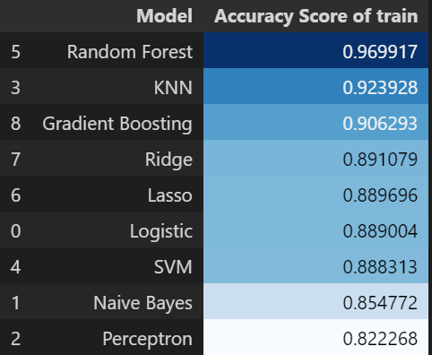
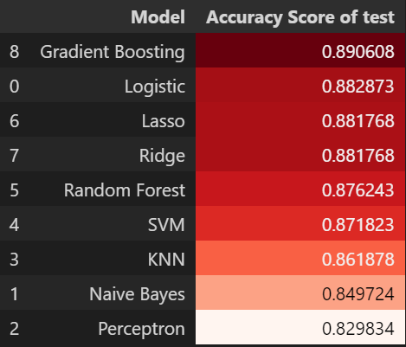
Results and Conclusion
Accuracy of 9 models of the training and testing data

Slide 26
Feature Selection
Mutual Information Gain
Mutual Information gain calculates the reduction in entropy from the transformation of a dataset.
It can be used for feature selection by evaluating the Information gain of each variable in the context of the target variable.
Features Importance with Random Forest
The tree-based strategies used by random forests naturally rank by how well they improve the purity of the node.
Nodes with the greatest decrease in impurity (Gini impurity) happen at the start of the trees, while notes with the least decrease in impurity occur at the end of trees.
By pruning trees below a particular node, we can create a subset of the most important features.

Slide 27
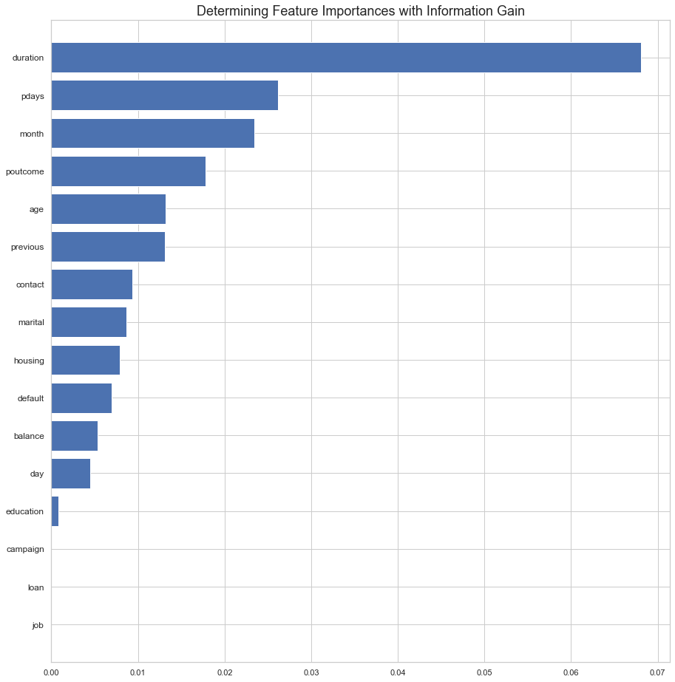
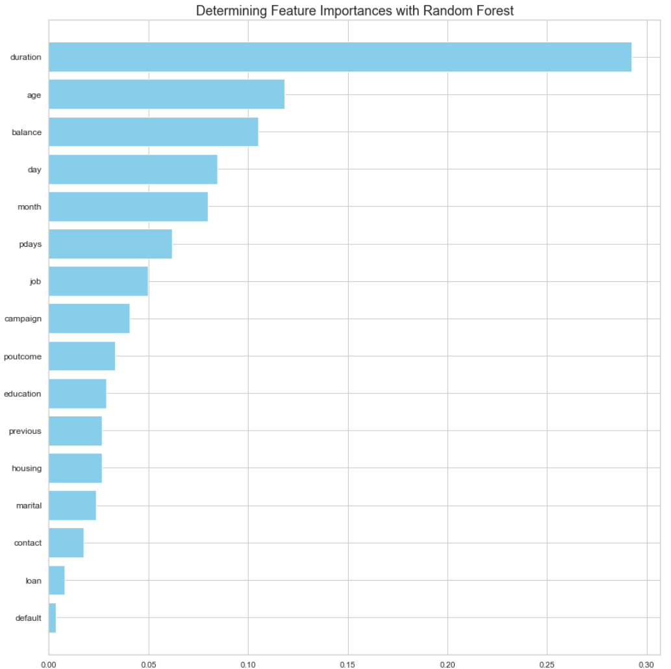
Feature Selection

Slide 28
Feature Selection
From the mutual information gain selection algorithm, we have the ‘duration’, ‘pdays’, ‘month’, ‘poutcome’, ‘age’, etc. as top ranking variables.
From the feature importance with random forest algorithm, we have the ‘duration’, ‘age’, ‘balance’, ‘day’, ‘month’, etc. as top ranking variables.
Both algorithms suggest to us that the “duration” feature is very important for modeling a customer’s decision of subscribing to a term account.

Slide 29
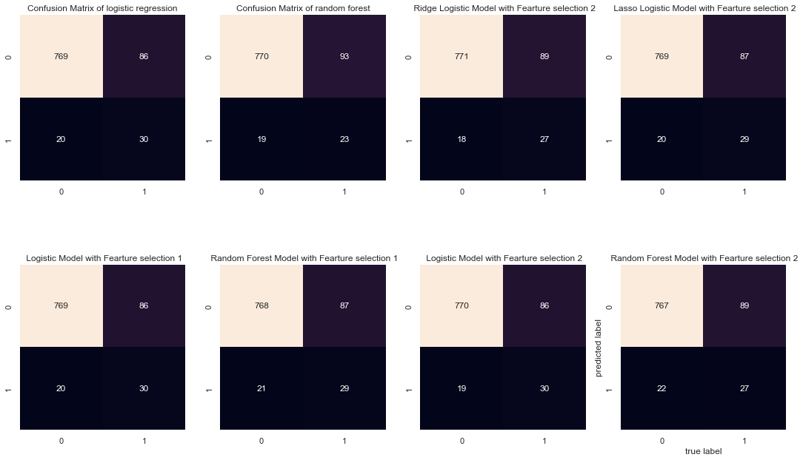
Feature Selection
Logistic regression with feature
selection 2 has the best prediction.

Slide 30
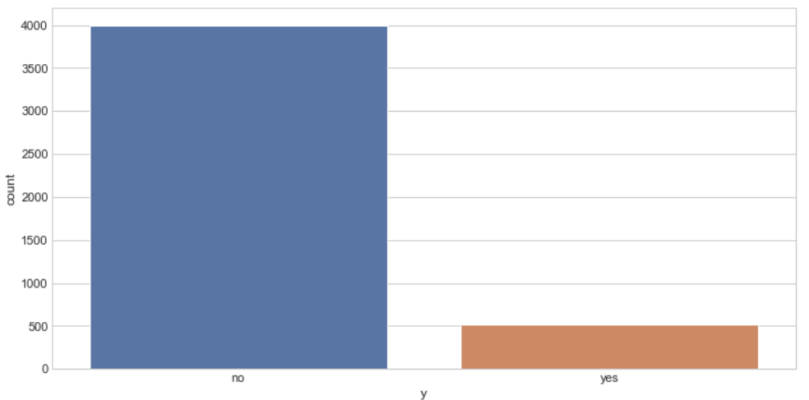
Imbalanced Classification
A classification data set with skewed class proportions is called imbalanced.
For the whole dataset, there were 521 successes and 4000 failures, about 11.52% success rate.

Slide 31


Imbalanced Classification
The usual multiple regression estimator is
The weighted regression estimator is
where W is a diagonal matrix, with weights on the diagonal.
We used repeated cross-validation to evaluate the model, with 2 repeats of 10-fold cross-validation. The model performance will be reported using the mean ROC area under curve (ROC AUC) averaged over repeats and all folds.

Slide 32
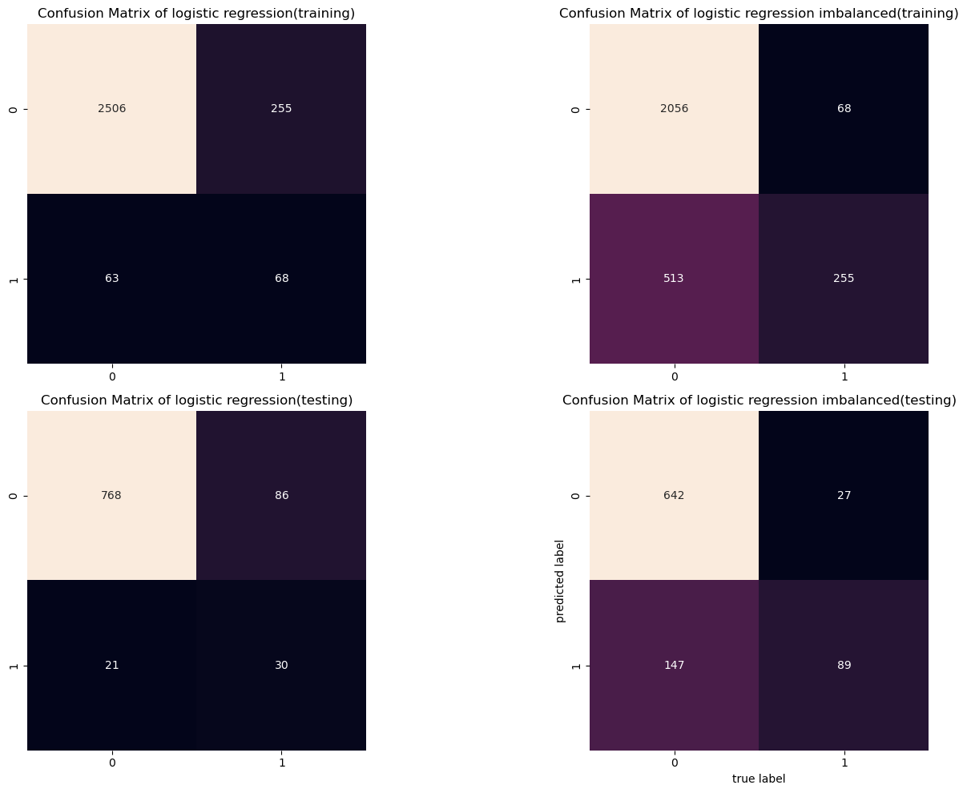
Imbalanced Classification
The overall performances are similar.
Weighted logistic model performs
better when the true outcome=1.
Mean ROC AUC of logistic training: 0.859
Mean ROC AUC of logistic testing: 0.866
Mean ROC AUC of weighted logistic training: 0.860
Mean ROC AUC of weighted logistic testing: 0.865

