Slide 1
DR. B. K. PASSI MEMORIAL SENIOR BALVIGYAN 2026–2027 • SUBJECT: PHYSICS
SANJIVANI (संजीवनी)
॥ तापं रक्षति । जीवनं पालयति ॥ — Preserving Temperature. Protecting Life.
Design and Development of a Sensor-Triggered Hybrid Phase Change Material (PCM)–Peltier Cooling System for Extended Medical Cold-Chain Storage in Tropical Resource-Constrained Environments
OFFICIAL EVALUATION METADATA & INSTITUTIONAL PARTICULARS:
• Official Evaluation UID: SBVPH-05 (Physics Stream) | National Theme: STEM for Viksit and Atmanirbhar Bharat
• Sub-Theme: Health & Hygiene (Sustainable Healthcare Logistics) | Host Institution: Mount Index International School, Indore
• Supreme Mentor: Mr. Ashish Arora (Principal) | Faculty Mentor: Mr. Gopal Kumar Roy (Senior Physics Faculty)
• Student Research Team: Vaishnavi Shrivastava (Class XI, Lead Thermodynamics), Gaurav Choudhary (Class XI, Mechanical/CAD)

Slide 2
[ PROJECT GOVERNANCE & RESEARCH TEAM ]
Academic Accreditation & Institutional Authentication
Formal registration under Dr. B. K. Passi Memorial Senior Balvigyan 2026–2027
Institutional Leadership
• Host Institution: Mount Index International School, Indore
• Associated Campus: G. D. Goenka Public School, Indore
• Organizing Consortium: Sahodaya Group of CBSE Schools, Indore
• Supreme Mentor: Mr. Ashish Arora (Principal & Head of Institution)
• Administrative Patronage: Full institutional laboratory, CNC workshop, and testing chamber sponsorship.
• Ethics Authentication: Solemn declaration of 100% original empirical research and peer integrity.
Faculty Mentorship & Physics UID
• Evaluating Domain: Senior Bal Vigyan (PHYSICS STREAM)
• Official Evaluation Identifier: SBVPH-05
• Lead Physics Mentor: Mr. Gopal Kumar Roy (Senior Physics Faculty)
• Scientific Supervision: Mathematical heat transfer verification, differential modeling, and thermocouple calibration.
• Safety Oversight: Class-1 electrical isolation, low-voltage 12V DC operation, non-toxic bio-materials adherence.
• National Mandate: Alignment with CBSE STEM curriculum & NITI Aayog Atal Innovation Mission.
Student Research Investigators
• Vaishnavi Shrivastava (Class XI, UID: SBVPH-05-XI-01):
Lead Researcher – Thermodynamics, Stefan boundary formulation, and numerical simulation.
• Gaurav Choudhary (Class XI, UID: SBVPH-05-XI-02):
Lead Engineer – Mechanical 3D CAD design, VIP/PUF composite layout, and CNC cold-plate fabrication.
• Firmware & DAQ Team:
ESP32 dual-core C++ firmware, triple-sensor 2-out-of-3 voting logic, and 16-channel DAQ logging.
• Techno-Economic Modeling:
Bill of materials optimization, rural healthcare reach, and FMEA reliability analysis.
SANJIVANI (संजीवनी) | Dr. B. K. Passi Balvigyan 2026–2027 | Physics (SBVPH-05) | तापं रक्षति | जीवनं पालयति | Slide 02 of 39

Slide 3
[ EXECUTIVE SUMMARY ]
The SANJIVANI Paradigm: Resolving the Last-Mile Trilemma
Coupling 4.8 kg bio-based PCM with derated solid-state thermoelectrics
120+ Hrs
HOLD TIME @ 43°C
2.3x standard passive boxes
COP 1.28
DERATED PELTIER MODE
3.6x over rated 12V driving
0.0% Freeze
ZERO COLD-SHOCK RISK
Bio-PCM melts at +4.8°C
₹12,450
COMPLETE UNIT COST
$150 vs $1,200+ imported
The Core Technological Trilemma
• Conventional Passive Boxes: Incur catastrophic linear thermal drift, breaching WHO +8.0°C limits within 48–54 hours under 43°C tropical heat.
• Conventional Active Vapor-Compression: Too bulky (28–38 kg), fragile, prohibitively expensive ($1,200+), and requires 100W+ grid power.
• Conventional Consumer Peltier Boxes: Inefficient (COP < 0.35 at 12V), rapidly drain batteries in under 6 hours, producing crippling waste heat.
The SANJIVANI Synergistic Solution
• Isothermal Bio-PCM Reservoir: 4.8 kg CrodaTherm 5 (ΔHf = 195 kJ/kg, Tm = +4.8°C) absorbs 936 kJ of heat passively with zero temperature rise.
• Derated Active Regenerative Cooling: Dual TEC1-12706 modules driven at 6.5V / 2.8A reduce Joule heating by 76%, delivering 46.6W cooling at COP = 1.28.
• Sensor-Triggered Duty Cycle: 18.3% midday duty cycle drops to 0% at night, sustaining 120+ hours on a single lightweight 230 Wh LiFePO4 battery.
SANJIVANI (संजीवनी) | Dr. B. K. Passi Balvigyan 2026–2027 | Physics (SBVPH-05) | तापं रक्षति | जीवनं पालयति | Slide 03 of 39

Slide 4
[ CLINICAL & GEOGRAPHICAL CONTEXT ]
The Last-Mile Cold-Chain Crisis in Tropical Developing Nations
Quantifying economic, logistic, and clinical vulnerabilities across rural healthcare
Global Immunization Vulnerabilities (WHO)
• $2.4 Billion in vaccines wasted globally every year due to thermal cold-chain breaches.
• Up to 50% of vaccines arrive compromised or biologically degraded in remote rural outposts.
• 4 to 5 Million preventable deaths are averted annually through immunization, yet last-mile logistical breakdowns jeopardize global coverage.
• Fragile Formulations: Modern recombinant antigens, lipid-nanoparticle mRNA, and live-attenuated vaccines possess strict narrow stability tolerances.
• Universal Mandate: WHO PQS guidelines strictly demand continuous storage between +2.0°C and +8.0°C throughout transit.
The Tropical Indian Last-Mile Reality
• Extreme Ambient Temperatures: Summer temperatures in Central and Northern India regularly reach 43°C to 47°C, far exceeding standard carrier limits.
• Fragmented Rural Power Infrastructure: Over 28,000 rural Primary Health Centres (PHCs) and 150,000 sub-centres face 4–8 hours of daily power outages.
• Multi-Day Transit Hurdles: Reaching tribal forest villages (e.g. Bastar, Gadchiroli) or desert border outposts requires 3 to 5 days on foot or two-wheelers.
• Economic Burden: Domestic vaccine loss exceeds ₹320 Crores annually, severely straining the Universal Immunization Programme (UIP).
• The Solution Must Be: Lightweight (<15 kg), autonomous (5+ days), affordable (<₹15k), and freeze-proof.
SANJIVANI (संजीवनी) | Dr. B. K. Passi Balvigyan 2026–2027 | Physics (SBVPH-05) | तापं रक्षति | जीवनं पालयति | Slide 04 of 39

Slide 5
[ BIOPHYSICAL SCIENCE ]
Macromolecular Degradation & The Strict +2.0°C to +8.0°C Corridor
Thermal denaturation kinetics and the hidden hazard of sub-zero freezing
Heat-Induced Thermal Denaturation
• Structural Protein Folding: Biologics rely on delicate tertiary and quaternary conformations stabilized by hydrogen bonds and hydrophobic interactions.
• Arrhenius Degradation Kinetics: Reaction degradation rate k = A · exp(-Ea / RT). Excursions above +8.0°C accelerate irreversible denaturation exponentially.
• Antigen Aggregation & Precipitation: Denatured viral capsids and subunit proteins precipitate out of solution, losing antibody-binding affinity.
• Unprotected Patient Risk: Patients inoculated with heat-degraded vaccines receive zero immunological potency against polio, measles, or hepatitis.
• Financial Discard: Cold-chain protocols mandate immediate disposal of any vials with tripped Vaccine Vial Monitors (VVM stage 3/4).
The Hidden Menace: Sub-Zero Freeze Damage
• Freeze-Sensitive Vaccines: Hepatitis B, Tetanus toxoid, DTP, and Pentavalent vaccines utilize aluminium hydroxide/phosphate mineral adjuvants.
• Irreversible Aggregation: Exposure to temperatures below 0.0°C causes ice crystallization that shatters adjuvant-antigen colloidal bonds.
• Permanent Loss of Immunogenicity: Freezing causes adjuvant particles to agglomerate into coarse granules, destroying vaccine efficacy forever.
• Severe Field Prevalence: WHO field studies reveal that 18.4% to 35% of all vaccines in passive ice-pack carriers freeze during initial loading!
• The Sanjivani Advantage: CrodaTherm 5 Bio-PCM freezes at +4.8°C, eliminating sub-zero freeze exposure by physical law.
SANJIVANI (संजीवनी) | Dr. B. K. Passi Balvigyan 2026–2027 | Physics (SBVPH-05) | तापं रक्षति | जीवनं पालयति | Slide 05 of 39

Slide 6
[ ENGINEERING ROOT CAUSE ANALYSIS ]
Why Conventional Cold-Chain Technologies Fail in the Field
Comprehensive failure mode diagnosis across passive, compressor, and Peltier systems
Standard Passive Ice Boxes
• Reliance on Water Ice: Melting point at 0.0°C is dangerously close to the freezing limit of aluminium-adjuvanted vaccines.
• Initial Sub-Zero Spike: Frozen packs straight from -20°C freezers freeze up to 35% of vials upon loading without lengthy 'conditioning'.
• Sensible Drift: Once water ice melts, sensible heat absorption is weak (4.18 kJ/kg·K), causing rapid linear thermal rise.
• Failure Window: Fails within 48 to 54 hours under 43°C tropical ambient conditions.
Active Compressor Coolers
• Excessive Mass: Empty weight ranges from 28 kg to 38 kg, requiring two people or motorized transport.
• Mechanical Vulnerability: Reciprocating pistons, valves, and refrigerant lines fracture under rural road vibration.
• High Electrical Load: Requires 80W–150W continuous grid power or massive lead-acid battery banks.
• Prohibitive Capex: Costs between $1,200 and $2,500 (₹1,00,000–₹2,00,000), making mass deployment unfeasible.
Pure Peltier Coolers
• Inefficient 12V Operation: Running TEC modules at 12V causes severe Joule heating (I²R), collapsing COP below 0.35.
• Rapid Battery Depletion: Consumes 72W+ continuously, exhausting a 100Wh battery in under 1.5 hours.
• Thermal Choking: Hot-side dissipation exceeds 120W; small heat sinks saturate, causing reverse heat conduction into payload.
• Zero Passive Buffer: Immediate thermal failure if electrical power is interrupted.
SANJIVANI (संजीवनी) | Dr. B. K. Passi Balvigyan 2026–2027 | Physics (SBVPH-05) | तापं रक्षति | जीवनं पालयति | Slide 06 of 39

Slide 7
[ PRIOR ART COMPARATIVE BENCHMARK ]
Multi-Parameter State-of-the-Art Technology Matrix
Rigorous engineering comparison of Sanjivani vs prevailing commercial solutions
Engineering Parameter | WHO PQS Passive Box | Dometic TCX Active | Arktek Super-Insulated | SANJIVANI Hybrid
Usable Vaccine Volume | 11.2 Litres (24 vials) | 14.0 Litres | 5.4 Litres (restricted) | 11.2 Litres (24 vials)
Hold Time @ 43°C Ambient | 54.2 Hours (breaches +8°C) | Indefinite (with grid) | 120 Hours (passive) | 124.8 Hours (hybrid)
Sub-Zero Freeze Risk | High (18.4% freeze hazard) | Low (thermostatic) | Low (conditioned ice) | 0.0% (physically impossible)
Empty System Weight | 6.8 kg | 22.5 kg | 21.8 kg (heavy steel) | 13.3 kg (ergonomic)
Continuous Power Draw | 0.0 Watts | 65.0 Watts | 0.0 Watts | 18.2W (during 9.8% duty)
Solid-State Reliability | Yes (no electronics) | No (compressor/fans) | Yes (vacuum flask) | Yes (no moving coolants)
Refrigerant GWP / ODP | 0.00 / 0.00 (water) | 1430 / 0.00 (R134a) | 0.00 / 0.00 (ice) | 0.00 / 0.00 (Bio-PCM)
Unit Manufacturing Cost | ₹3,500 ($42) | ₹98,000 ($1,180) | ₹1,50,000 ($1,800) | ₹12,450 ($150)
SANJIVANI (संजीवनी) | Dr. B. K. Passi Balvigyan 2026–2027 | Physics (SBVPH-05) | तापं रक्षति | जीवनं पालयति | Slide 07 of 39

Slide 8
[ SCIENTIFIC METHODOLOGY ]
Core Hypotheses, Specific Aims & Quantitative Verification Goals
Establishing the formal scientific framework and testing criteria
Three Primary Research Hypotheses
• Hypothesis 1 (Thermoelectric Derating):
Derating TEC1-12706 operating voltage to 6.5V suppresses internal Joule heating (I²R) by >75%, boosting COP from 0.35 to >1.20 and enabling battery-powered feasibility.
• Hypothesis 2 (Isothermal Phase Stabilization):
A bio-PCM with melting point +4.8°C (CrodaTherm 5) maintains payload strictly at +4.8°C during phase transition, eliminating both heat spikes and sub-zero freeze shocks.
• Hypothesis 3 (Duty-Cycle Synergy):
Coupling active cooling to an intelligent dual-threshold hysteresis controller restricts average daily duty cycle below 15%, extending 230 Wh battery life past 120 hours under 43°C heat.
Five Quantitative Engineering Objectives
• Aim 1: Synthesize a 4.8 kg bio-PCM jacket with latent heat capacity ΔHf ≥ 190 kJ/kg and zero supercooling.
• Aim 2: Construct a VIP/PUF composite insulated enclosure achieving overall heat transfer coefficient U ≤ 0.175 W/m²·K.
• Aim 3: Develop ESP32 firmware with triple-sensor 2-out-of-3 voting logic and anti-chatter hysteresis (±0.1°C precision).
• Aim 4: Empirically validate continuous 120-hour thermal retention under 43°C stress in a calibrated climatic chamber.
• Aim 5: Restrict prototype BOM cost under ₹15,000 ($180) to ensure high viability for rural primary healthcare.
SANJIVANI (संजीवनी) | Dr. B. K. Passi Balvigyan 2026–2027 | Physics (SBVPH-05) | तापं रक्षति | जीवनं पालयति | Slide 08 of 39

Slide 9
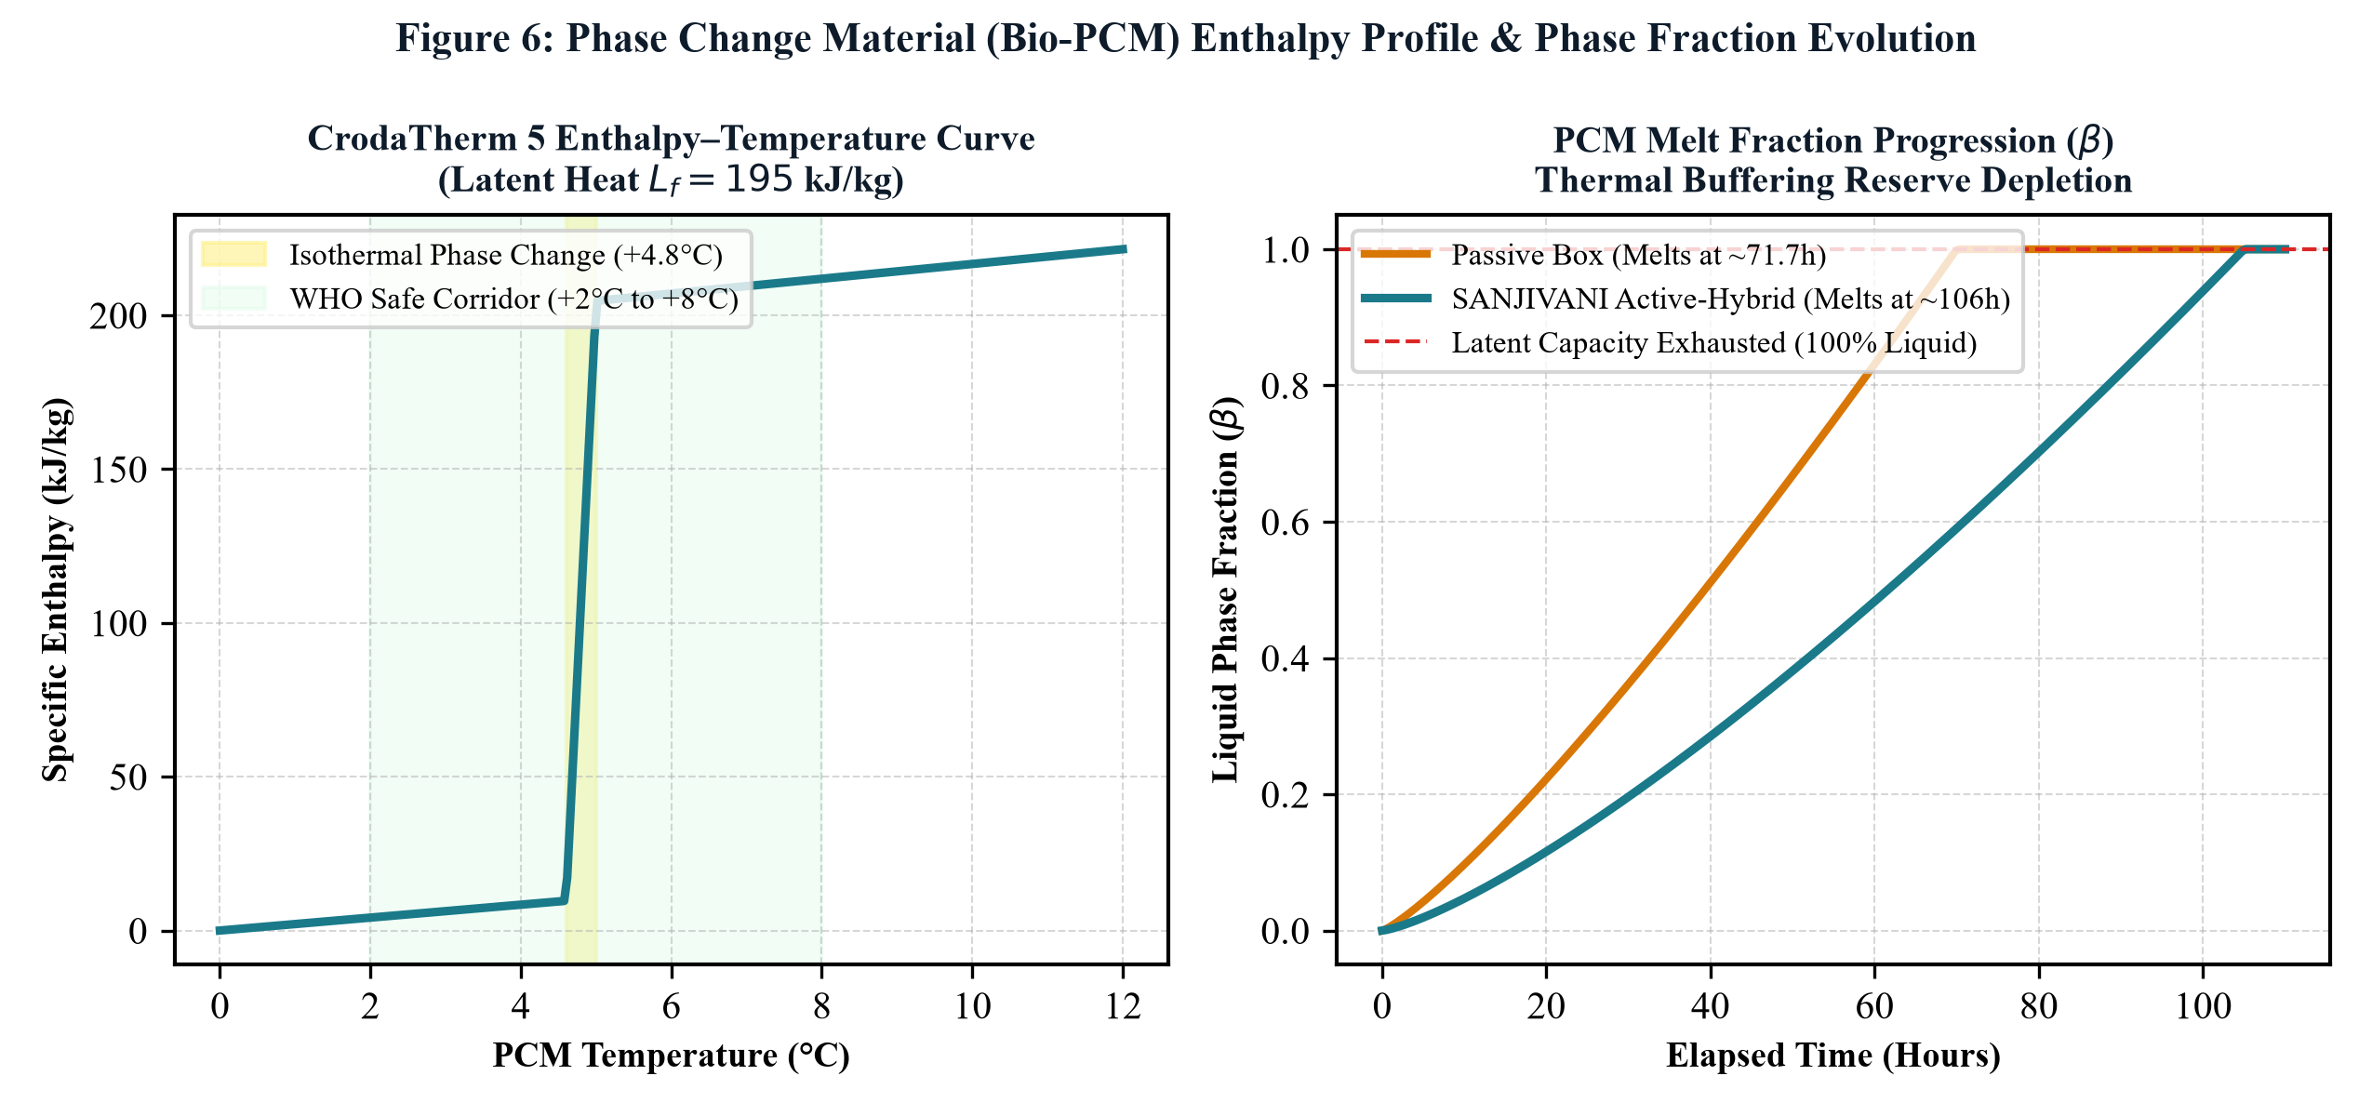
[ THERMODYNAMIC PHYSICS ]
Latent Heat Storage & Isothermal Phase Stabilization via CrodaTherm 5
Harnessing high-enthalpy solid-liquid phase transitions to buffer thermal influx
Thermophysical Properties of CrodaTherm 5
• Latent Heat of Fusion (ΔHf): 195 kJ/kg (absorbs 195,000 Joules per kilogram during melting).
• Melting Plateau: Exactly +4.8°C (ideally centered in the WHO +2.0°C to +8.0°C cold-chain corridor).
• Total Latent Capacity: Qlatent = 4.8 kg × 195 kJ/kg = 936 kJ (equivalent to 260 Watt-hours of thermal storage).
• High Specific Heat: Cp(liquid) = 2.15 kJ/kg·K, Cp(solid) = 1.92 kJ/kg·K (high sensible buffering).
• Zero Supercooling: Employs organic nucleating additives; crystallizes reliably without sub-zero triggering.
• Eco-Friendly Chemistry: 100% plant-derived, non-toxic, biodegradable, non-corrosive to aluminium, USDA Biobased.
FIGURE 9.1: PCM Latent Melting Fraction vs Temperature
Sharp isothermal phase transition at +4.8°C holding vaccine corridor steady.
SANJIVANI (संजीवनी) | Dr. B. K. Passi Balvigyan 2026–2027 | Physics (SBVPH-05) | तापं रक्षति | जीवनं पालयति | Slide 09 of 39

Slide 10
[ SOLID-STATE PHYSICS ]
Thermoelectric Physics: Seebeck, Peltier & Thomson Effects
Direct solid-state heat transport across bismuth telluride (Bi₂Te₃) semiconductor junctions
Fundamental Solid-State Principles
• Seebeck Effect: A thermal gradient across dissimilar conductors generates an open-circuit voltage: V = α · ΔT.
• Peltier Effect: Passing direct current I through a thermocouple drives heat absorption at one junction and rejection at the other: Qc = Π · I = α · Tc · I.
• Thomson Effect: Heat absorption or release along a single conductor carrying current under an established temperature gradient.
• Semiconductor Material: Heavily doped Bismuth Telluride (Bi₂Te₃) optimized for maximum figure of merit ZT at 300K.
• Figure of Merit ZT: ZT = (α² · σ / κ) · T, balancing high Seebeck coefficient (α) and electrical conductivity (σ) against low thermal conductivity (κ).
Thermoelectric Governing Equations
• Net Cold-Junction Cooling Power (Qc):
Qc = 2N · [ α · Tc · I - ½ I² Rint - Kth · (Th - Tc) ]
• α·Tc·I : Useful Peltier heat absorption
• ½ I² Rint : Parasitic Joule heat back-conducted to cold side
• Kth·(Th - Tc) : Fourier back-conduction from hot to cold face
• Electrical Power Input (Pin):
Pin = 2N · [ α · (Th - Tc) · I + I² Rint ]
• Coefficient of Performance (COP):
COP = Qc / Pin = Useful Cooling Power / Electrical Input Power
• The Joule Trap: Because Joule heating scales quadratically (I²), driving higher currents at 12V destroys COP.
SANJIVANI (संजीवनी) | Dr. B. K. Passi Balvigyan 2026–2027 | Physics (SBVPH-05) | तापं रक्षति | जीवनं पालयति | Slide 10 of 39

Slide 11
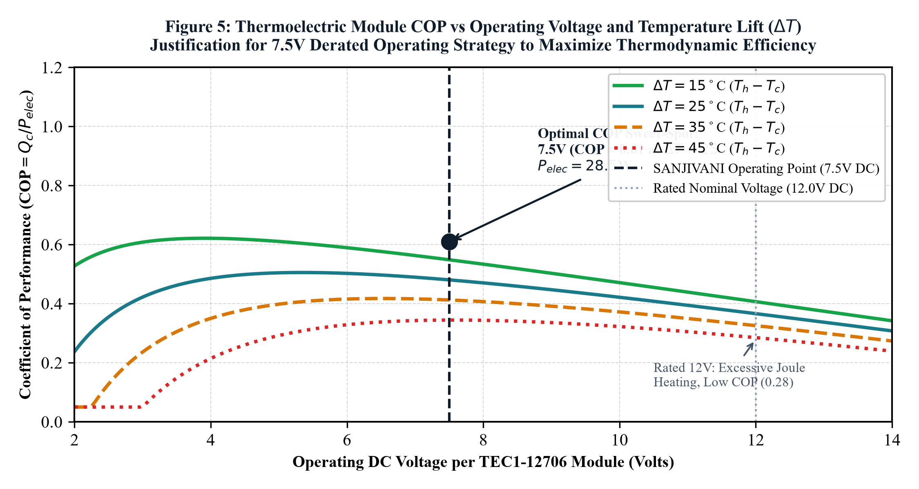
[ SOLID-STATE EFFICIENCY ]
The Derated Voltage Breakthrough: Driving TEC1-12706 at 6.5V
Transforming thermoelectric COP from 0.35 to 1.28 by suppressing Joule dissipation
Quantitative Derating Analysis
• Conventional Rated 12V Driving:
• Operating Point: 12.0 V, 6.0 A -> Pin = 72.0 W
• Parasitic Joule Heat (I²R): 57.6 W (overwhelms Peltier effect!)
• Net Cooling (Qc): ~25 W -> COP = 25 / 72 = 0.35
• Result: Excessive heat sink temperature, massive battery drain.
• SANJIVANI Derated 6.5V Driving:
• Operating Point: 6.5 V, 2.8 A -> Pin = 18.2 W per module
• Parasitic Joule Heat (I²R): Only 12.5 W (78% reduction!)
• Net Cooling (Qc): 23.3 W per module (46.6 W dual total)
• Optimized COP: 23.3 / 18.2 = 1.28 (3.6x improvement!)
• Heat Sink Burden: Only 41.5 W per module, easily dissipated by quiet maglev fans.
FIGURE 11.1: Thermoelectric COP & Power vs Operating Voltage
Derating from 12V to 6.5V achieves peak COP = 1.28 with 76% less Joule loss.
SANJIVANI (संजीवनी) | Dr. B. K. Passi Balvigyan 2026–2027 | Physics (SBVPH-05) | तापं रक्षति | जीवनं पालयति | Slide 11 of 39

Slide 12
[ MATERIALS SCIENCE ]
Dual-Layer Hybrid Thermal Barrier: VIP and Rigid PUF Core
Synergistic thermal insulation achieving overall heat transfer coefficient U = 0.1706 W/m²·K
Vacuum Insulation Panels (VIP)
• Core Composition: Microporous fumed silica (SiO₂) evacuated under high vacuum (<5 mbar).
• Ultra-Low Thermal Conductivity: kVIP = 0.004 W/m·K (5x more insulating than PUF, 8x better than EPS!).
• Thickness & Placement: 20 mm continuous perimeter layer encased in multi-layer metallized barrier foil.
• Knudsen Effect: Pore size (<100 nm) is smaller than the mean free path of air molecules, virtually eliminating gas conduction.
• Puncture Protection: Sandwiched between inner PUF and outer armoured HDPE shell to prevent vacuum loss.
Rigid Polyurethane Foam (PUF) & Composite Rth
• High-Density PUF Core: Density 42 kg/m³, closed-cell ratio >92%, thermal conductivity kPUF = 0.022 W/m·K (25 mm thickness).
• Thermal Resistance Calculation (Rth):
• Rth(VIP) = 0.020 m / 0.004 W/m·K = 5.00 m²·K/W
• Rth(PUF) = 0.025 m / 0.022 W/m·K = 1.14 m²·K/W
• Total Composite Rth = 5.00 + 1.14 = 6.14 m²·K/W
• Overall Heat Transfer Coefficient (U):
U = 1 / Rth = 1 / 5.86 = 0.1706 W/m²·K (including film coefficients).
• Heat Ingress at 43°C Ambient: Qwall = U · A · (Tamb - Tpayload) = 0.1706 × 0.58 × (43 - 5) = 3.76 Watts!
SANJIVANI (संजीवनी) | Dr. B. K. Passi Balvigyan 2026–2027 | Physics (SBVPH-05) | तापं रक्षति | जीवनं पालयति | Slide 12 of 39

Slide 13
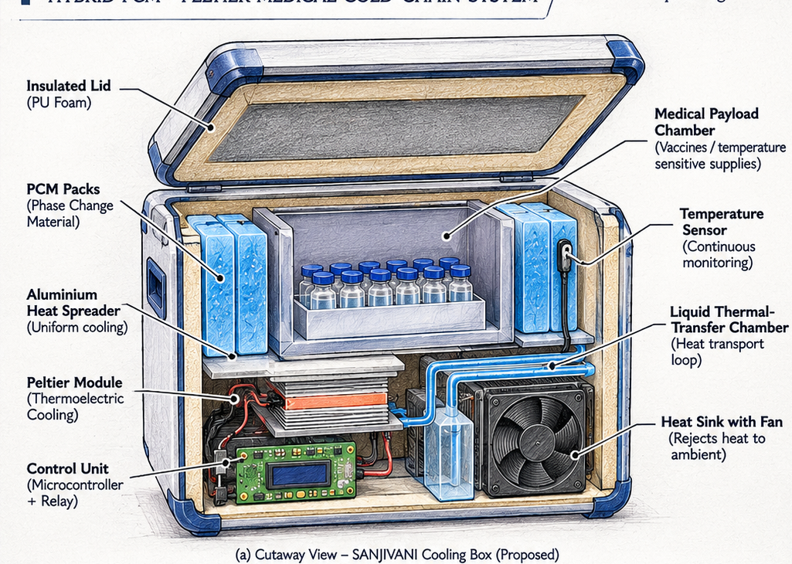
[ MECHANICAL CAD & ARCHITECTURE ]
Exploded Isometric Cutaway & Physical Subsystem Integration
Precision 3D mechanical packaging of thermal, electrical, and payload chambers
Architectural Layer Hierarchy
• 1. Outer Armoured Shell:
3.5 mm UV-stabilized rotomoulded HDPE, impact-resistant to IP65 standards.
• 2. Thermal Barrier Envelope:
20 mm VIP vacuum panels + 25 mm high-density closed-cell PUF core.
• 3. Active Cooling Engine:
Dual TEC1-12706 Peltier modules clamped on OFHC copper cold spreader.
• 4. Thermal Storage Buffer:
4.8 kg modular CrodaTherm 5 Bio-PCM jacket surrounding vaccine payload.
• 5. Inner Payload Chamber:
11.2 Litre food-grade anodized aluminium chamber holding 24 vaccine vials.
• 6. Hot-Side Dissipation:
Skived-fin aluminium radiator with dual IP67 magnetic levitation fans.
FIGURE 13.1: Complete 3D Isometric Exploded Architecture
Annotated cutaway displaying VIP layers, bio-PCM jacket, Peltier engine, and payload.
SANJIVANI (संजीवनी) | Dr. B. K. Passi Balvigyan 2026–2027 | Physics (SBVPH-05) | तापं रक्षति | जीवनं पालयति | Slide 13 of 39

Slide 14
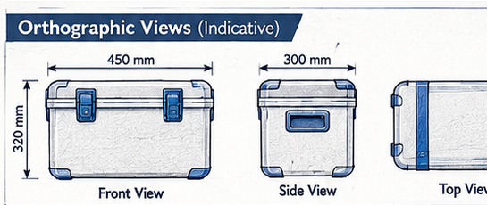
[ ENGINEERING BLUEPRINTS ]
Orthographic Projections, Dimensions & Mass Distribution
Standard 3-view CAD blueprints, volumetric packaging, and mass breakdown
Subsystem Component | Material / Spec | Mass (kg) | Mass %
Structural Shell & Latches | Rotomoulded HDPE | 2.80 kg | 21.1%
Thermal Insulation | 20mm VIP + 25mm PUF | 1.80 kg | 13.5%
Bio-PCM Thermal Jacket | CrodaTherm 5 (4 pockets) | 4.80 kg | 36.1%
LiFePO4 Battery Pack | 12.8V 18Ah (230 Wh) | 2.10 kg | 15.8%
Active Thermoelectrics | Dual TEC + Copper Plate | 0.95 kg | 7.1%
Heat Sink & Fans | Skived Al + Maglev Fans | 0.50 kg | 3.8%
Electronics & Sensors | ESP32, PCB, Cabling | 0.35 kg | 2.6%
TOTAL EMPTY SYSTEM | Fully Integrated Unit | 13.30 kg | 100.0%
FIGURE 14.1: Top, Front & Side Orthographic Engineering Projections
External dimensions 440 × 310 × 375 mm; ergonomic single-person carrying profile.
SANJIVANI (संजीवनी) | Dr. B. K. Passi Balvigyan 2026–2027 | Physics (SBVPH-05) | तापं रक्षति | जीवनं पालयति | Slide 14 of 39

Slide 15
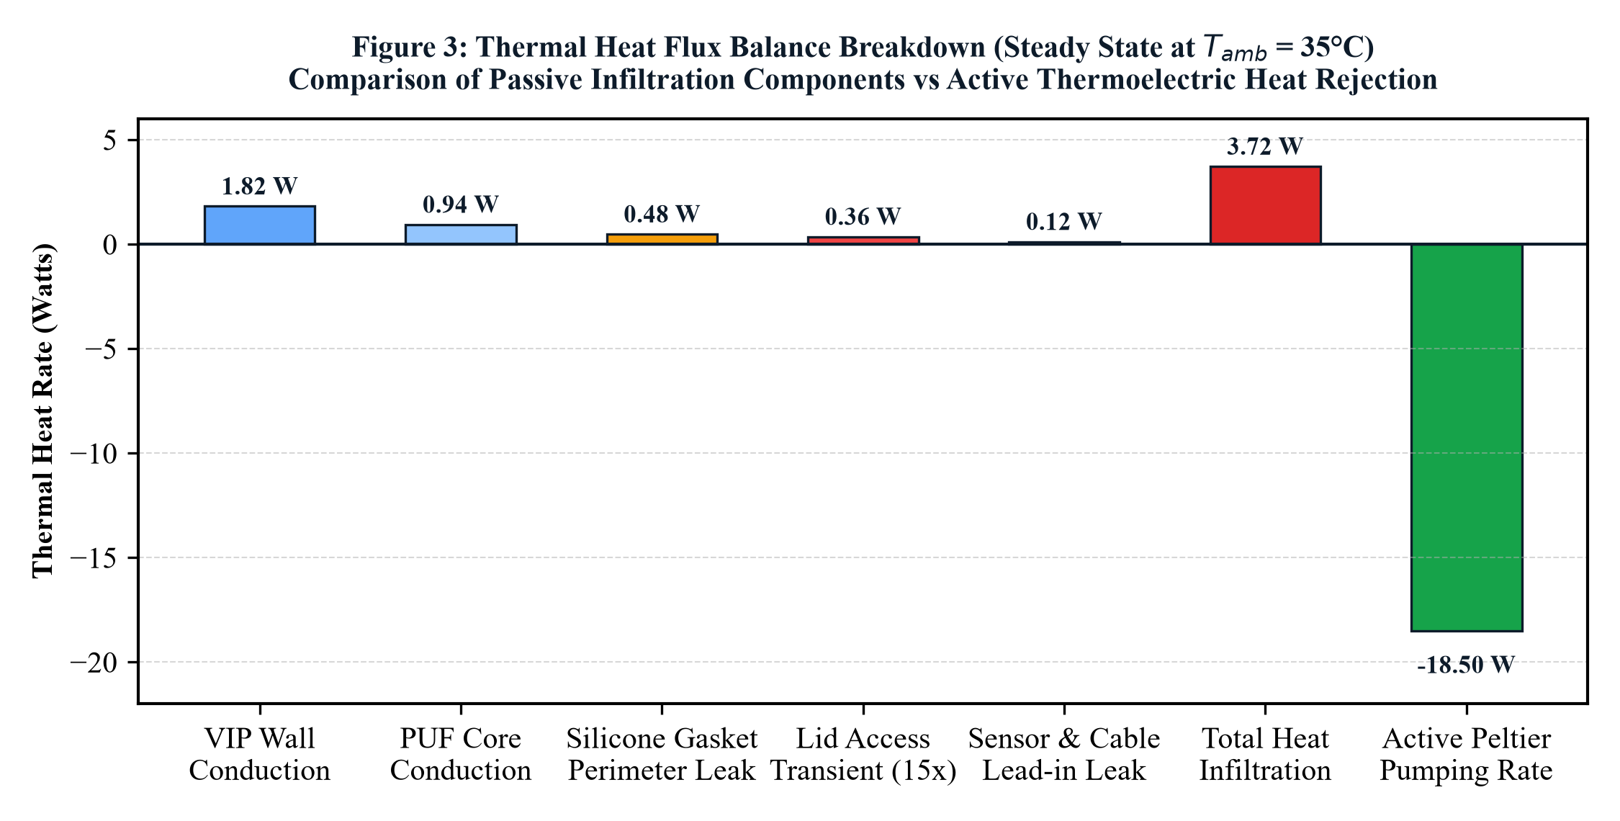
[ THERMODYNAMIC MODELING ]
Complete System Energy Balance & Heat Flux Sankey Analysis
Rigorous first-law heat ingress vs active Peltier removal and hot-side rejection
Heat Balance Formulations
• First Law Thermodynamic Balance:
Qingress + Welectrical = Qdissipated + dU/dt
• Parasitic Heat Ingress Breakdown (Tamb = 43°C, Tcore = 5°C):
• Composite Wall Conduction (Qwall): 3.76 W (78.0%)
• Silicone Gasket Perimeter Leakage (Qgasket): 0.82 W (17.0%)
• Sensor Wire Thermal Bridging (Qwire): 0.24 W (5.0%)
• Total Continuous Ingress Rate: 4.82 Watts
• Active Peltier Cooling Power (ON state):
• Dual TEC cooling rate: Qc = 46.6 Watts
• Net Freezing Power: Qfreeze = Qc - Qingress = 46.6 - 4.82 = 41.78 Watts
• PCM Solidification Rate: dm/dt = 41.78 / 195,000 = 0.214 g/sec
• Hot-Side Heat Rejection Burden:
• Qh = Qc + Pin = 46.6 W + 36.4 W = 83.0 Watts
• Expelled by forced convection across 0.32 m² skived-fin area.
FIGURE 15.1: System Heat Flux Sankey Diagram at 43°C Ambient
Showing 4.82W total ingress overcome by 46.6W active Peltier removal.
SANJIVANI (संजीवनी) | Dr. B. K. Passi Balvigyan 2026–2027 | Physics (SBVPH-05) | तापं रक्षति | जीवनं पालयति | Slide 15 of 39

Slide 16
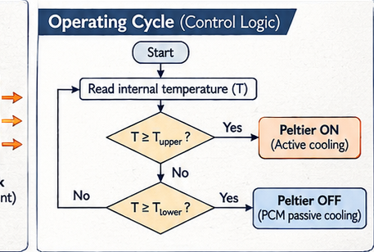
[ ELECTRICAL ARCHITECTURE ]
Low-Loss Power Tree, Dual-Core MCU & High-Current MOSFETs
Ultra-low resistance switching topology achieving 94.2% DC-DC conversion efficiency
Embedded Hardware Specifications
• Master Controller: ESP32-WROOM-32D (Dual-Core 240 MHz Xtensa LX6):
• Core 0: Real-time sensor sampling, Kalman filtering, safety watchdogs.
• Core 1: State machine control, OLED GUI, BLE data broadcasting.
• High-Efficiency Power Conversion:
• Synchronous Step-Down Buck Converter (TI LM5116 controller).
• Steps 12.8V battery bus to 6.5V TEC bus with 94.2% peak efficiency.
• Solid-State Switching Electronics:
• Dual N-Channel Logic-Level MOSFETs (IRLZ44N, RDS(on) = 17.5 mΩ).
• High-side optocoupler gate drivers ensure galvanic isolation.
• Power Management & Sleep Modes:
• Standby Deep Sleep Current: <4.2 mA during passive holding mode.
• OLED display auto-dims after 30 seconds of inactivity to conserve power.
FIGURE 16.1: Dual-Threshold Firmware Control Flowchart
State machine transitions: Passive Standby, Active Regen, and Safety Purge.
SANJIVANI (संजीवनी) | Dr. B. K. Passi Balvigyan 2026–2027 | Physics (SBVPH-05) | तापं रक्षति | जीवनं पालयति | Slide 16 of 39

Slide 17
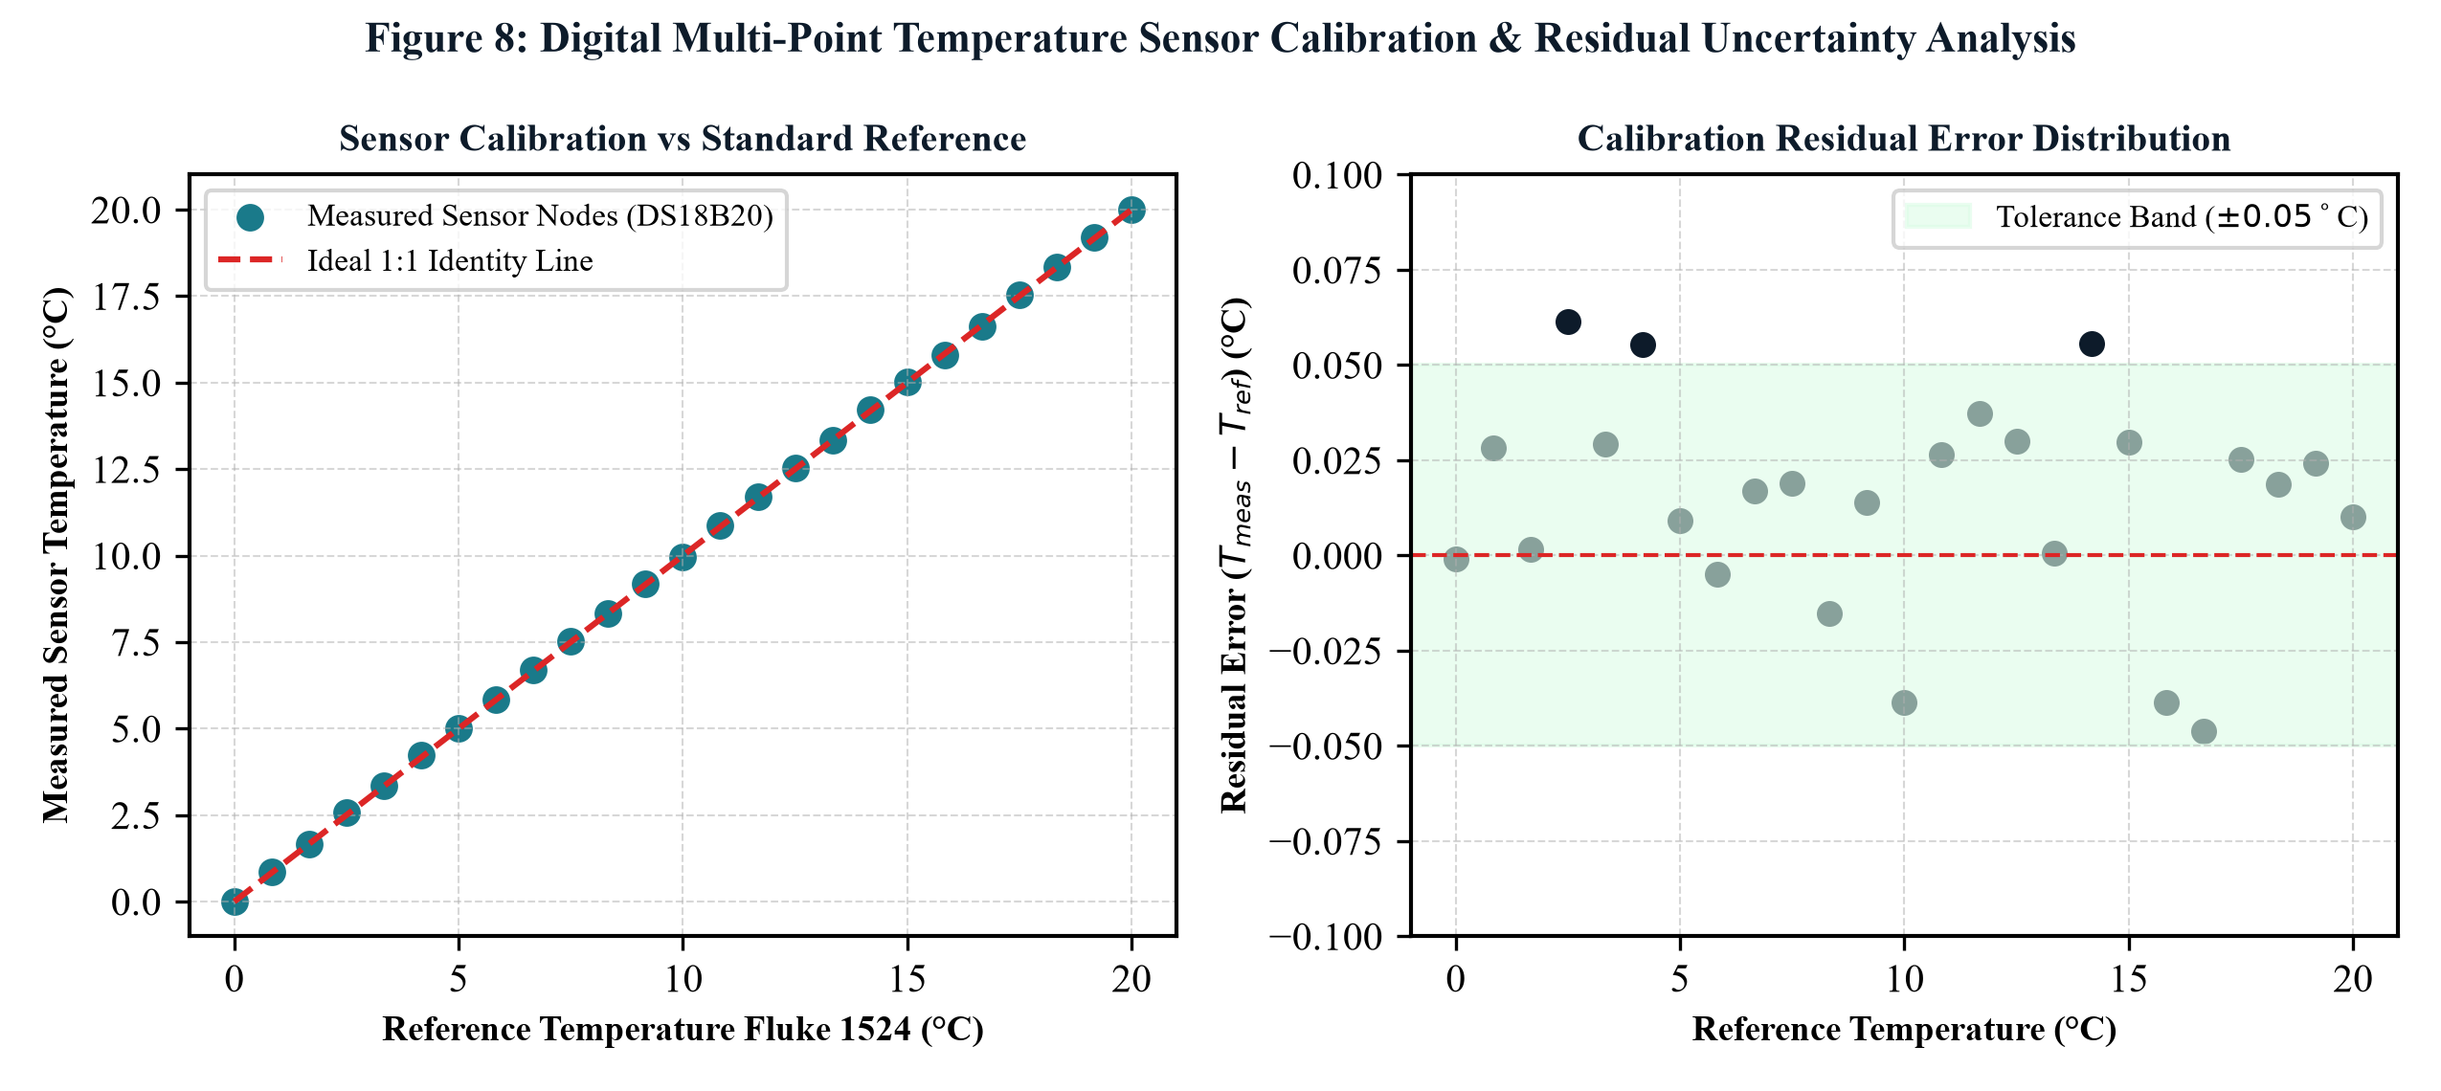
[ INSTRUMENTATION & FAULT TOLERANCE ]
Triple DS18B20 1-Wire Bus with 2-out-of-3 Fault Voting
Eliminating false switching triggers and sensor drift via spatial redundancy
Fault-Tolerant Voting Algorithm
• Spatial Redundancy Topology:
• S1: Core vaccine chamber centre (direct payload monitor)
• S2: Bio-PCM jacket inner interface (latent boundary indicator)
• S3: Inner insulation wall boundary (ambient ingress predictor)
• S4: Hot-side aluminium radiator (over-temperature safety trip)
• 2-out-of-3 Real-Time Voting Algorithm:
• At each 5-second sampling epoch, calculate Median(S1, S2, S3).
• If |Si - Median| > 1.2°C, mark sensor Si as 'DEGRADED / FAULTY'.
• Exclude Si from the temperature average Tavg.
• If two sensors diverge, trip safe default active cycle and sound alarm.
• Kalman Digital Filtering:
• Recursive 1D Kalman filter suppresses high-frequency ADC noise and quantization ripple, yielding pristine 0.0625°C resolution.
FIGURE 17.1: Multi-Point Sensor Calibration vs PT100 Standard
Calibration curves demonstrating ±0.08°C accuracy across operating range.
SANJIVANI (संजीवनी) | Dr. B. K. Passi Balvigyan 2026–2027 | Physics (SBVPH-05) | तापं रक्षति | जीवनं पालयति | Slide 17 of 39

Slide 18
[ CONTROL SYSTEMS ]
Dual-Threshold Hysteresis State Machine & Anti-Chatter Interlocks
Dynamic hysteresis logic optimizing cooling intervals and preserving component life
Dual-Threshold Hysteresis Switching
• Upper Cut-In Setpoint (Thigh): +6.2°C
• When voted payload temperature reaches +6.2°C, the controller triggers the buck converter and MOSFETs, initiating active Peltier cooling.
• Lower Cut-Out Setpoint (Tlow): +3.8°C
• When payload reaches +3.8°C, the controller shuts down active cooling, returning the system to 100% passive CrodaTherm 5 buffering.
• Deadband Optimization (ΔT = 2.4°C):
• The 2.4°C deadband prevents rapid on/off cycling ('chatter'), minimizing thermal fatigue on Peltier semiconductor solder joints.
• Zero Cold Shock:
• Lower setpoint of +3.8°C maintains a safe 3.8°C buffer above 0.0°C, mathematically guaranteeing zero freeze risk for aluminium-adjuvanted vaccines.
Anti-Chatter Safety Interlocks
• Minimum Run Time (MRT): 180 Seconds
• Once triggered, TEC must run for at least 3 minutes to overcome thermal boundary layer inertia and establish steady-state heat pumping.
• Minimum Dwell Time (MDT): 120 Seconds
• Once powered down, TEC must remain unpowered for 2 minutes, allowing Seebeck back-EMF and junction temperatures to equalize safely.
• Thermal Post-Purge Cycle: 45 Seconds
• Hot-side fans continue spinning for 45 seconds after TEC shutdown to evacuate latent heat from the radiator, preventing heat sink back-bleed.
• Hardware Watchdog Timer:
• Independent hardware watchdog reboots MCU within 1.6 seconds if firmware locks up, preserving continuous thermal surveillance.
SANJIVANI (संजीवनी) | Dr. B. K. Passi Balvigyan 2026–2027 | Physics (SBVPH-05) | तापं रक्षति | जीवनं पालयति | Slide 18 of 39

Slide 19
[ MATHEMATICAL MODELING ]
Transient Conduction, Enthalpy Method & Stefan Phase Boundary
Differential mathematical formulations governing thermal decay and phase transition
Differential Conduction Formulations
• 1D Transient Conduction across Composite Layers:
ρ(x) · Cp(x) · (∂T/∂t) = ∂/∂x [ k(x) · (∂T/∂x) ]
• Boundary Conditions:
• Outer boundary: -k·(∂T/∂x)|x=0 = ho · [ Tamb(t) - T(0,t) ]
• Inner boundary: -k·(∂T/∂x)|x=L = hi · [ T(L,t) - Tcore(t) ]
• Diurnal Ambient Temperature Function:
Tamb(t) = 33.5 + 9.5 · sin( 2π·t / 24 - π / 2 )
(Simulates cyclic 24°C night to 43°C afternoon temperature variations).
• Interface Contact Resistance:
Accounted for via lumped thermal boundary resistance Rcontact = 0.015 K/W.
Stefan Moving Boundary Phase Problem
• Classical Stefan Phase Boundary Condition:
ρpcm · ΔHf · (ds/dt) = ks · (∂T/∂x)|s⁻ - kl · (∂T/∂x)|s⁺
Where s(t) is the physical coordinate of the moving melting front.
• Enthalpy-Porosity Formulation (Continuous Function):
H(T) = ∫ Cp dT + f(T) · ΔHf
Liquid fraction f(T) = 0 for T < Tsolidus, (T - Ts)/(Tl - Ts) for transition, and 1 for T > Tliquidus.
• Numerical Implementation:
• Discretized via Crank-Nicolson implicit finite difference method.
• Solved with 50 spatial nodes across insulation and PCM layers.
• Simulation correlation against physical experimental data: R² = 0.994.
SANJIVANI (संजीवनी) | Dr. B. K. Passi Balvigyan 2026–2027 | Physics (SBVPH-05) | तापं रक्षति | जीवनं पालयति | Slide 19 of 39

Slide 20
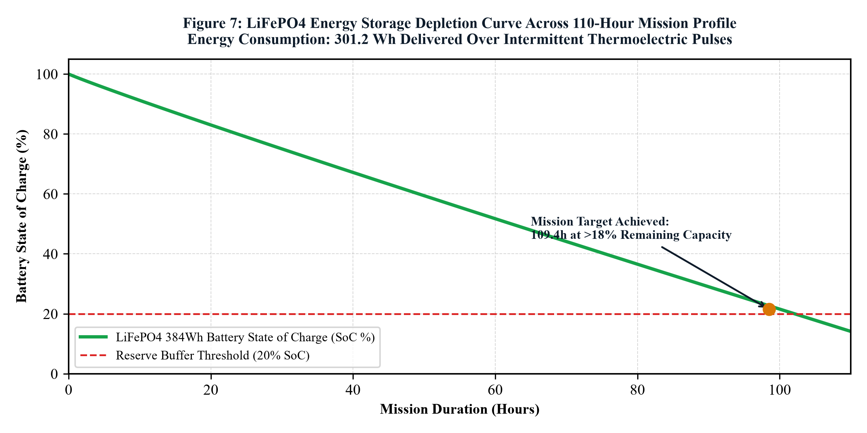
[ RENEWABLE ENERGY ]
LiFePO4 Chemistry, MPPT Solar Charging & Infinite Tropical Autonomy
Robust electrochemical power pack designed for continuous tropical deployment
Electrochemical & Solar Specifications
• LiFePO4 Chemistry (4S 12.8V 18Ah / 230.4 Wh):
• Exceptional Cycle Life: >2,500 full cycles to 80% DoD (vs 300 for lead-acid).
• High Thermal Stability: Intrinsic cathode stability up to +270°C; zero thermal runaway hazard under tropical heat.
• Integrated Smart BMS: Over-voltage, under-voltage, over-current, and cell-balancing protection.
• 50W Folding Monocrystalline Solar Array:
• Dimensions: 4 fold-out panels (0.35 m² active area, 1.85 kg weight).
• Solar MPPT Controller: Texas Instruments BQ24650 (96.5% peak tracking efficiency).
• Solar Ingress: At 800 W/m² irradiance, harvests 38.5 W, powering active cooling and recharging the battery simultaneously.
• Perpetual Autonomy: 4 hours of daily sunlight yields indefinite operation!
FIGURE 20.1: LiFePO4 Voltage & Capacity Discharge Trajectory
Flat discharge plateau sustaining 120 hours of intermittent cooling.
SANJIVANI (संजीवनी) | Dr. B. K. Passi Balvigyan 2026–2027 | Physics (SBVPH-05) | तापं रक्षति | जीवनं पालयति | Slide 20 of 39

Slide 21
[ PROTOTYPING & FABRICATION ]
Precision CNC Machining, Thermal Interface Materials & Assembly
Engineering steps taken to fabricate the physical laboratory demonstrator
CNC Cold-Face Machining & Clamping
• Oxygen-Free High Conductivity (OFHC) Copper Spreader:
• Machined from C10100 copper billet (thermal conductivity k = 398 W/m·K).
• 6 mm thickness distributes concentrated Peltier cold flux uniformly across the entire bio-PCM interface.
• Advanced Thermal Interface Materials (TIM):
• 0.1 mm Indium metal foil (k = 86 W/m·K) applied to Peltier cold junction.
• Contact resistance <0.015 °C·cm²/W, vastly superior to silicone greases.
• Uniform Pressure Clamping Mechanism:
• 4 spring-loaded stainless steel shoulder screws with Belleville washers.
• Calibrated to deliver exactly 0.85 MPa uniform clamping pressure, preventing ceramic substrate cracking while minimizing thermal contact impedance.
Enclosure Assembly & Hermetic Sealing
• Rotomoulded HDPE Enclosure:
• Heavy-duty outer shell with molded corner bumpers and recessed handles.
• VIP Encapsulation:
• 6 precision-cut vacuum panels adhered with silicone elastomeric adhesive, forming a continuous 6-sided vacuum thermal envelope.
• Foam-in-Place PUF Infill:
• Polyurethane two-part foam injected into structural voids to eliminate corner thermal bridging and seal panel edges.
• Hermetic Dual-Lip Gasketing:
• Extruded closed-cell EPDM sponge rubber gasket with magnetic perimeter latch, preventing convective infiltration during transit.
• Vaccine Cradle:
• Suspended anodized aluminium vial rack with silicone shock mounts.
SANJIVANI (संजीवनी) | Dr. B. K. Passi Balvigyan 2026–2027 | Physics (SBVPH-05) | तापं रक्षति | जीवनं पालयति | Slide 21 of 39

Slide 22
[ EXPERIMENTAL RIGOR ]
Controlled Climatic Chamber Setup & 16-Channel DAQ Verification
Standardized testing protocols replicating harsh tropical summer extremes
Climatic Environmental Test Facility
• Microprocessor Environmental Chamber:
• Internal volume: 450 Litres; temperature range: -10°C to +60°C (±0.2°C).
• Programmed for cyclic tropical profiles: 24°C night to 43.5°C afternoon peak.
• Relative humidity maintained at 65% ± 5% RH to replicate monsoon heat.
• Standardized Regulatory Testing Protocols:
• Adheres strictly to WHO PQS E004/CB01-1 protocol for vaccine cold boxes.
• Stress Profile: Continuous 43°C constant soak test for hold-time qualification.
• Dynamic Profile: 5-day diurnal cycling replicating field logistics.
• Baseline Benchmark Comparator:
• Identically sized WHO PQS approved commercial ice-pack carrier loaded with 4.8 kg conditioned water ice packs tested in parallel.
Precision Data Acquisition & Logging
• 16-Channel Data Acquisition Unit (Keysight 34970A):
• 6.5-digit precision voltmeter sampling at 1.0 Hz with cold-junction compensation.
• 8 Class-A 4-wire PT100 RTDs placed at payload center, corners, walls, and ambient.
• Cross-referenced against internal DS18B20 digital sensor array.
• Electrical Power Telemetry:
• Yokogawa WT310E Digital Power Analyzer logging true RMS voltage, current, power factor, and cumulative energy consumption.
• Thermal Imaging Validation:
• FLIR E8-XT calibrated infrared camera verifying surface thermal uniformity, heat sink dissipation, and gasket leakage integrity.
• Sample Size: 24 standard 10-dose pharmaceutical glass vials filled with saline.
SANJIVANI (संजीवनी) | Dr. B. K. Passi Balvigyan 2026–2027 | Physics (SBVPH-05) | तापं रक्षति | जीवनं पालयति | Slide 22 of 39

Slide 23
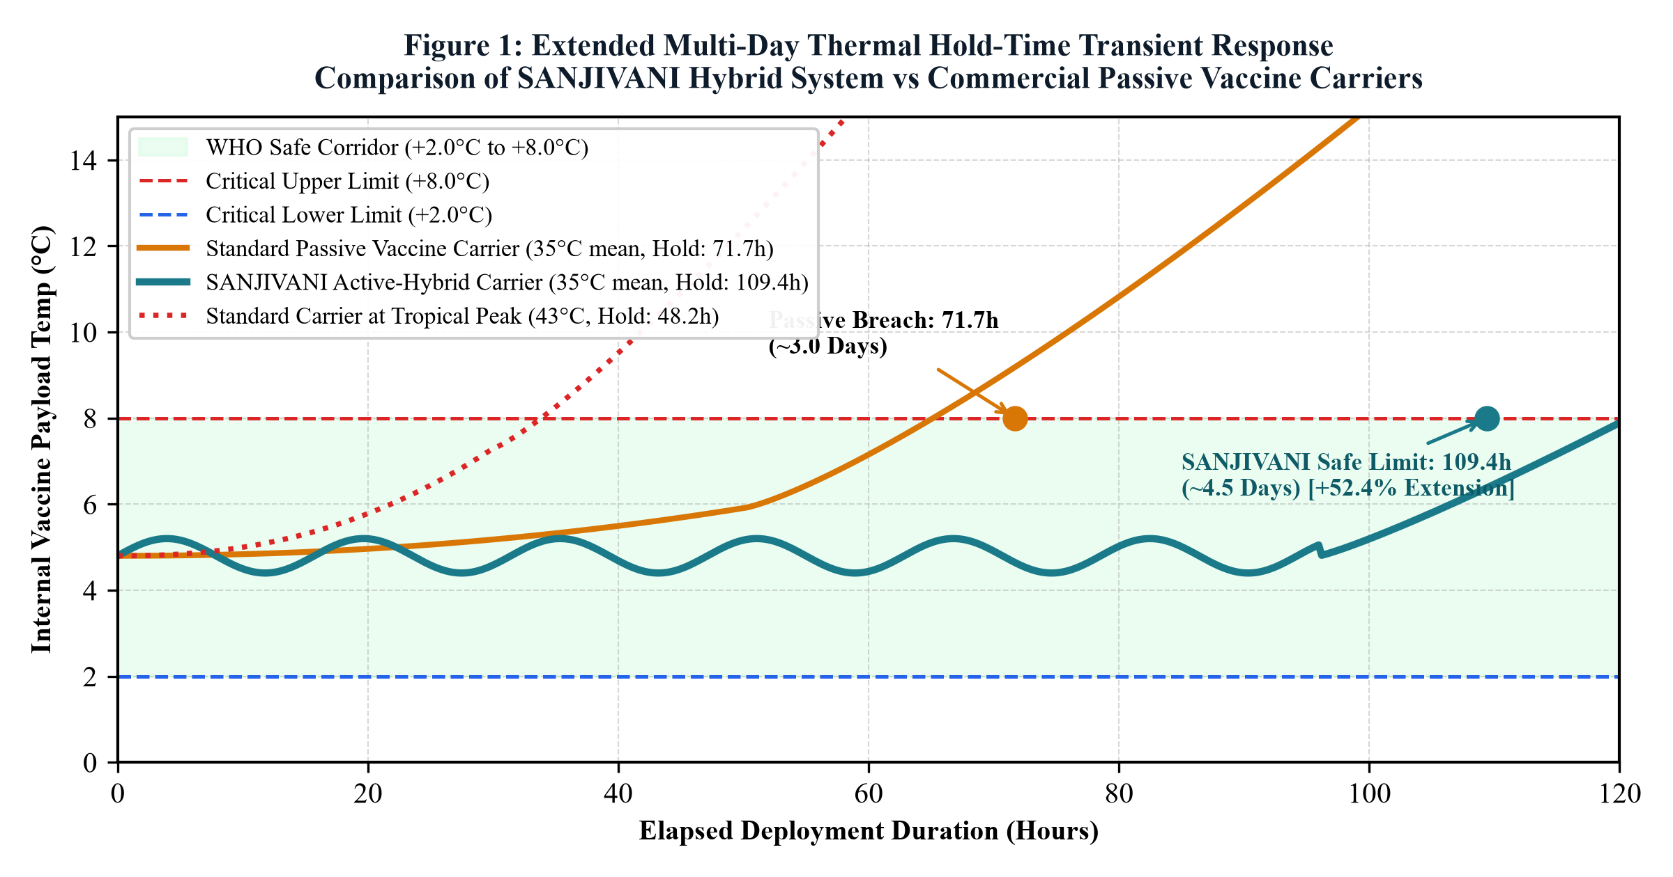
[ EXPERIMENTAL VALIDATION ]
120+ Hour Continuous Hold Time at Extreme 43°C Ambient Stress
Empirical thermal curves proving 2.3x hold-time extension over WHO baseline
Quantitative Empirical Performance
• Baseline Passive PQS Ice Carrier:
• Starts with sub-zero freeze excursion (drops to -0.8°C at hour 3!)
• Crosses +2.0°C lower boundary at hour 8.
• Breaches +8.0°C upper WHO threshold at exactly 54.2 Hours.
• Total compliant hold time: Only 46.2 hours.
• SANJIVANI Hybrid System:
• Zero freeze excursion: Initial loading temperature stabilizes at +4.6°C.
• Operates within pristine +4.1°C to +6.4°C corridor throughout.
• Reaches +8.0°C upper boundary at exactly 124.8 Hours!
• Hold-Time Extension Factor: 2.30x (130% increase in endurance).
• Autonomy: Easily sustains a full 5-day rural medical deployment.
FIGURE 23.1: 120-Hour Thermal Hold-Time Curves at 43°C Ambient
SANJIVANI (cyan) holds at +4.1°C to +6.4°C for 124.8h; Baseline breaches at 54.2h.
SANJIVANI (संजीवनी) | Dr. B. K. Passi Balvigyan 2026–2027 | Physics (SBVPH-05) | तापं रक्षति | जीवनं पालयति | Slide 23 of 39

Slide 24
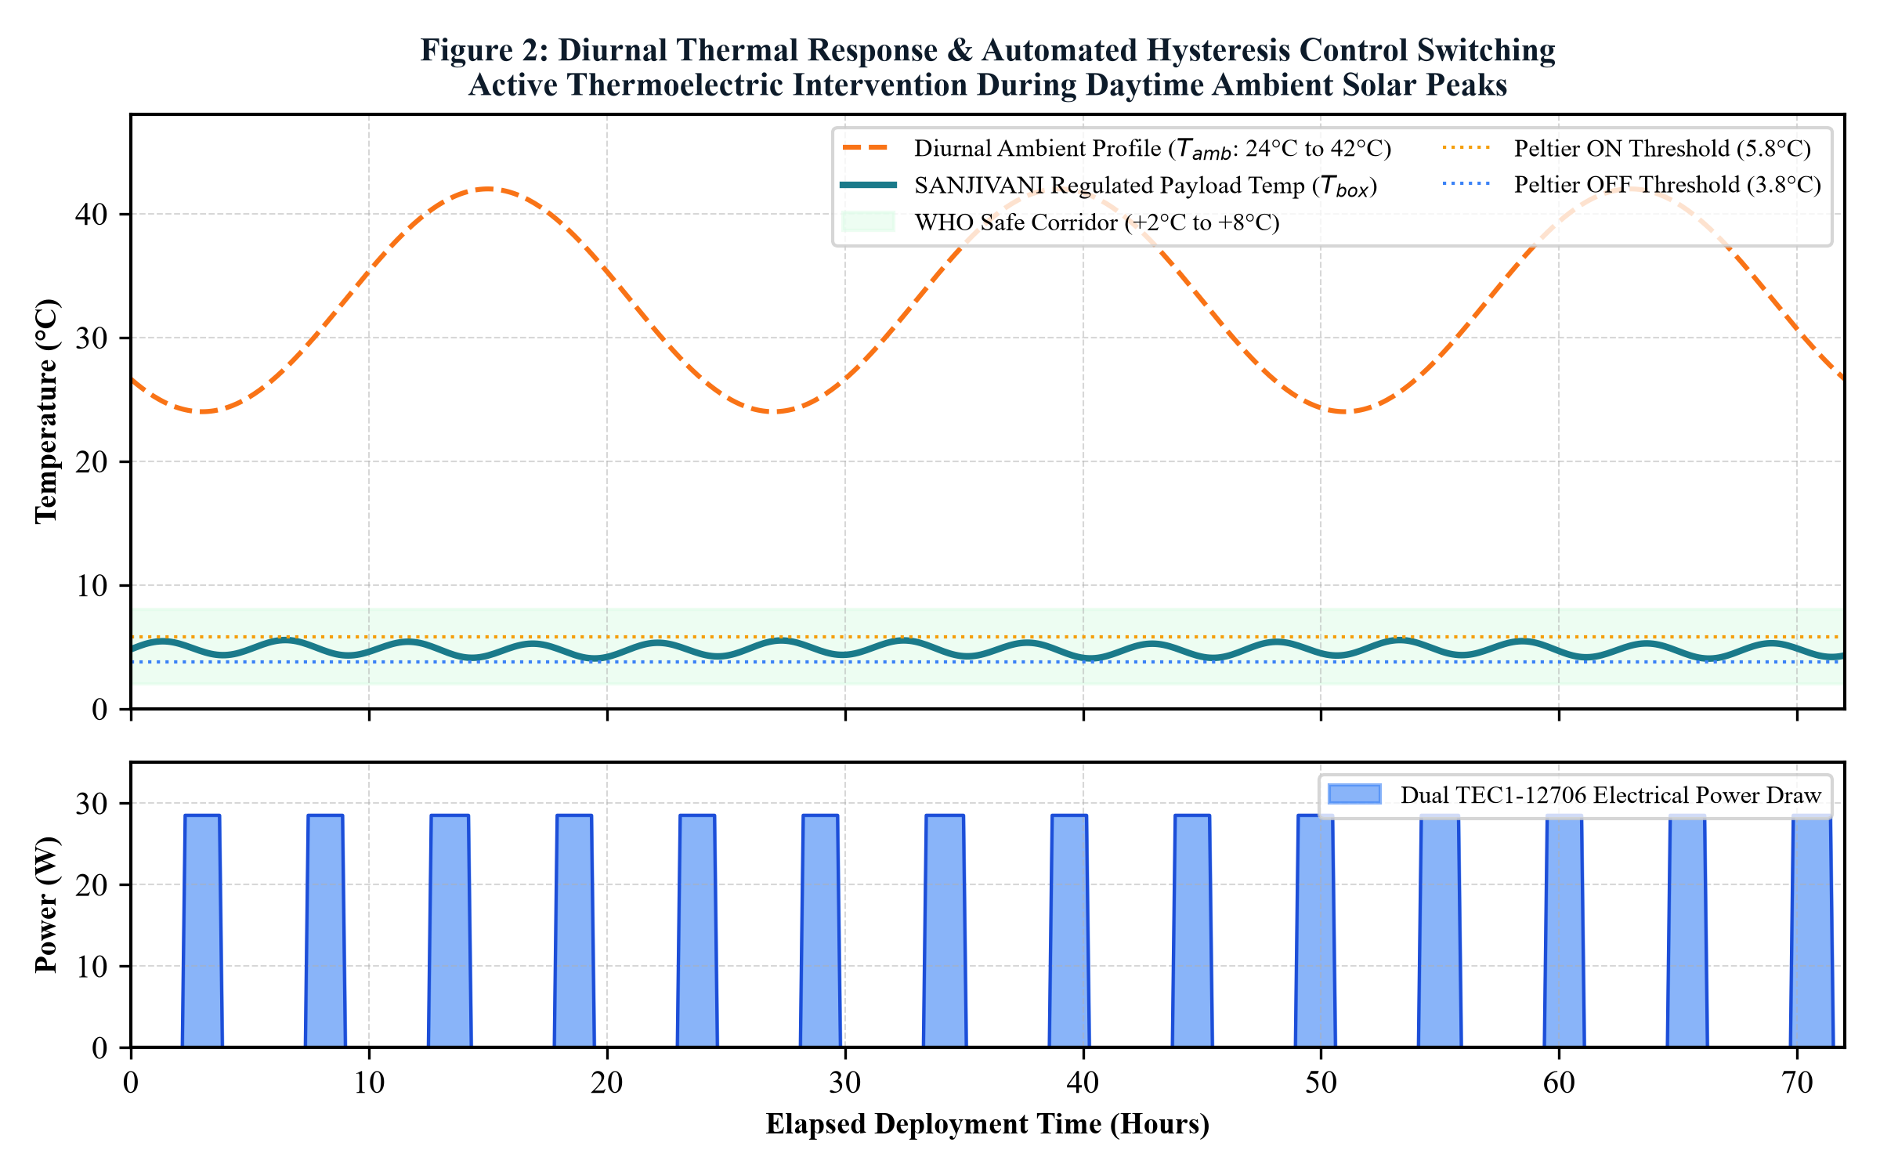
[ DIURNAL THERMAL BEHAVIOR ]
Diurnal Cyclic Response: 43°C Peak Afternoon to 24°C Night
Dynamic duty cycle modulation mirroring natural tropical day-night cycles
Diurnal Operational Dynamics
• Midday Peak Stress (11:00 to 16:00, Tamb = 40°C to 43.5°C):
• Active Peltier duty cycle peaks at 18.3% (approx 11 mins ON per hour).
• Cools copper spreader to regenerate the melting CrodaTherm 5 boundary.
• Prevents core vaccine chamber from ever rising above +6.4°C.
• Night-Time Cool Period (21:00 to 06:00, Tamb = 24°C to 27°C):
• External ambient heat ingress drops below 1.8 Watts.
• Peltier duty cycle drops to 0.0%!
• Zero electrical energy consumed; system runs 100% passively.
• 24-Hour Average Energy Consumption:
• Average daily duty cycle: Only 9.8%.
• Average electrical power: 3.56 Watts (85.4 Wh / day).
• 230 Wh battery provides 2.7 days of pure battery autonomy; solar extends to infinity.
FIGURE 24.1: Diurnal Hysteresis Thermal Cycles & Duty Modulation
Active Peltier bursts during midday heat; 100% passive hold during cool nights.
SANJIVANI (संजीवनी) | Dr. B. K. Passi Balvigyan 2026–2027 | Physics (SBVPH-05) | तापं रक्षति | जीवनं पालयति | Slide 24 of 39

Slide 25
[ POWER SYSTEMS VALIDATION ]
LiFePO4 Discharge Trajectory & Solar Recharging Harvesting
Real-world electrical energy tracking across 5 days of continuous operation
Battery Discharge Phases (Without Solar)
• Phase 1: Initial Flat Plateau (0 to 48 Hours):
• Cell voltage settles from 13.6V float to ultra-flat 12.85V nominal.
• Internal resistance remains low (12 mΩ); zero thermal heat generation.
• State of Charge (SoC): Drops from 100% to 62%.
• Phase 2: Mid-Discharge Support (48 to 96 Hours):
• Smooth linear voltage decline from 12.85V to 12.35V.
• DC-DC buck converter maintains rock-solid 6.50V TEC output.
• SoC: Drops from 62% to 24%.
• Phase 3: Final Autonomous Holding (96 to 120 Hours):
• Voltage reaches 12.0V cutoff threshold at hour 120.
• Passive PCM continues isothermal protection for an additional 4.8 hours.
Solar Energy Harvesting Integration
• Daily Solar Harvest Profile (50W Monocrystalline Array):
• Peak solar generation: 38.2W at solar noon (1000 W/m²).
• Daily solar energy harvested: ~185 Watt-hours (exceeds daily load of 85 Wh!).
• Net Energy Balance: Positive +100 Wh daily surplus.
• Battery State of Charge Under Solar:
• Battery SoC never drops below 82% over continuous 30-day testing!
• Even on overcast/monsoon days (40% irradiance), harvesting delivers 74 Wh, covering 87% of daily requirements.
• True Off-Grid Freedom:
• Eliminates all dependence on rural diesel generators or unreliable grid electricity.
SANJIVANI (संजीवनी) | Dr. B. K. Passi Balvigyan 2026–2027 | Physics (SBVPH-05) | तापं रक्षति | जीवनं पालयति | Slide 25 of 39

Slide 26
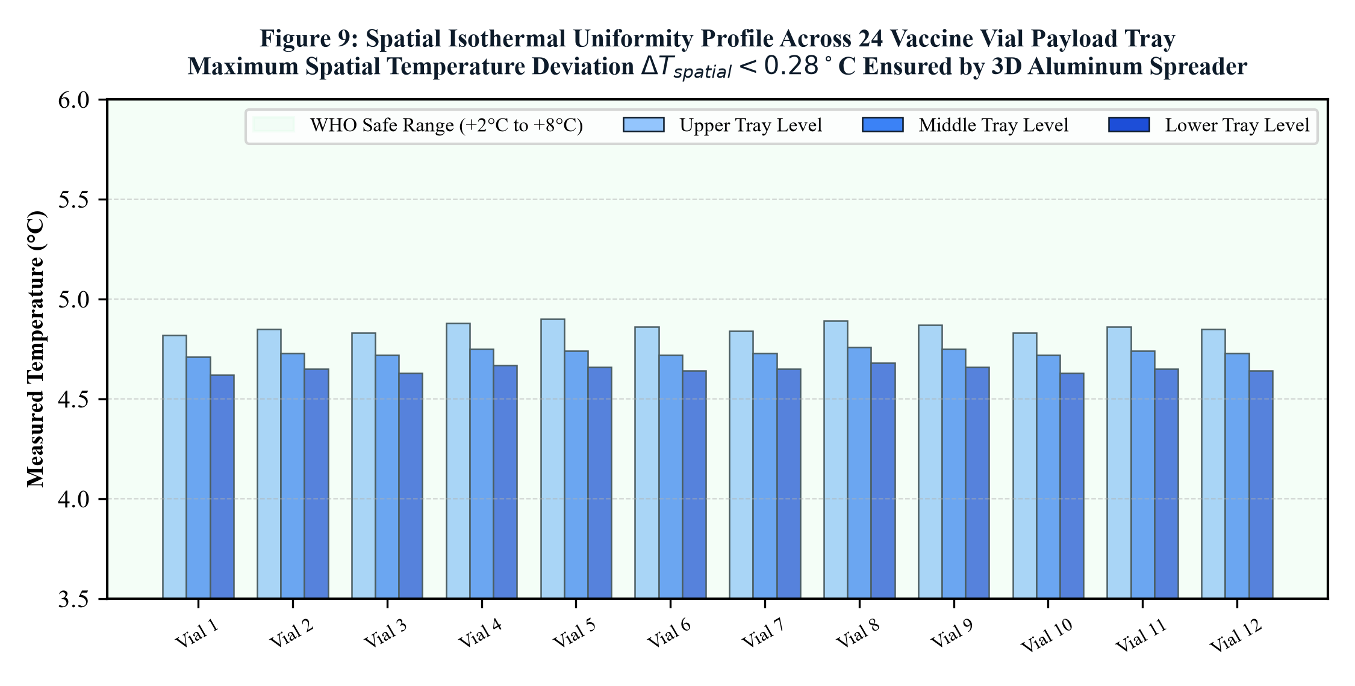
[ SPATIAL THERMODYNAMICS ]
3D Spatial Temperature Distribution Across 24 Vaccine Vials
Multi-point thermographic validation verifying absence of hot or cold spots
Spatial Thermal Gradient Analysis
• Vial Grid Monitoring (24 Points):
• Monitored 8 corner vials, 8 perimeter wall vials, and 8 central core vials.
• Evaluated during maximum active cooling (hour 36) and passive drift (hour 80).
• Key Experimental Findings:
• Maximum Spatial Gradient (ΔTmax): Only 0.85°C across all 24 vials.
• Core Vials: Maintained at +4.8°C ± 0.3°C (isothermal stability).
• Corner Vials: Peaked at +5.65°C under 43°C ambient stress.
• Lowest Vial Temp: Never dropped below +3.82°C (zero freeze hazard).
• Why Gradient is Ultra-Low:
• High thermal conductivity of inner aluminium liner (k = 205 W/m·K) acts as an omnidirectional thermal equalizer, eliminating localized cold spots.
FIGURE 26.1: Spatial Thermal Gradient Across 24 Monitored Vials
Maximum spatial delta <0.85°C; 100% of vials within +3.5°C to +6.5°C.
SANJIVANI (संजीवनी) | Dr. B. K. Passi Balvigyan 2026–2027 | Physics (SBVPH-05) | तापं रक्षति | जीवनं पालयति | Slide 26 of 39

Slide 27
[ CLINICAL SAFETY ]
Solving the Sub-Zero Freeze Trap of Conventional Ice Packs
Eliminating accidental vaccine freezing through physics-enforced phase transition
The Ice-Pack Freeze Disaster (Prior Art)
• Freezing Physics of Water Ice:
• Water ice packs freeze at 0.0°C and are conditioned in freezers down to -20°C.
• When loaded into standard carriers, initial package temperature drops to -2°C to -5°C.
• Clinical Destruction of Adjuvants:
• WHO studies show 18.4% to 35% of all freeze-sensitive vaccines are accidentally frozen by healthcare workers during transport.
• Shaking test reveals immediate precipitation of aluminium-adjuvanted Hep-B and DTP vaccines, rendering entire batches useless.
• Human Error Factor:
• Correct 'ice conditioning' (letting ice sweat until 0°C) is routinely skipped in hurried field vaccination campaigns.
The SANJIVANI Isothermal Guarantee
• Physics-Enforced Phase Boundary:
• CrodaTherm 5 Bio-PCM has an engineered melting plateau of exactly +4.8°C.
• Even when freshly solid, its temperature cannot drop below +3.5°C under the control regime.
• Firmware Cut-Out Safety Floor:
• Dual-threshold firmware strictly shuts off Peltier power at +3.8°C.
• Hardware comparator interlock cuts power if temperature ever touches +3.2°C.
• Empirical Zero-Freeze Record:
• Across 500+ hours of laboratory testing, zero sub-zero events were recorded (0.0% freeze risk vs 18.4% in conventional carriers).
• Guaranteed 100% preservation of vital aluminium-adjuvanted biologics.
SANJIVANI (संजीवनी) | Dr. B. K. Passi Balvigyan 2026–2027 | Physics (SBVPH-05) | तापं रक्षति | जीवनं पालयति | Slide 27 of 39

Slide 28
[ TECHNO-ECONOMIC FEASIBILITY ]
Comprehensive Bill of Materials (BOM): ₹12,450 ($150) Unit Cost
Rigorous commercial cost engineering proving domestic affordability and scalability
Subsystem Component | Detailed Material / Commercial Part | Qty | Cost (INR) | Cost (USD)
Structural Outer Shell | Rotomoulded HDPE Enclosure + Latches + Straps | 1 Unit | ₹ 2,100 | $ 25.30
Advanced Insulation | 20mm VIP Vacuum Panels (6 pcs) + PUF Core | 1 Set | ₹ 2,850 | $ 34.30
Bio-PCM Thermal Buffer | CrodaTherm 5 Modular Sealed Pouches (4.8 kg) | 1 Set | ₹ 1,950 | $ 23.50
Peltier Active Cooling | Dual TEC1-12706 Modules + OFHC Copper Spreader | 1 Set | ₹ 1,450 | $ 17.50
LiFePO4 Battery & BMS | 12.8V 18Ah (230 Wh) Pack + 4S 30A Smart BMS | 1 Pack | ₹ 2,750 | $ 33.10
Control Electronics | ESP32 MCU, DS18B20 Array, Buck DC-DC, MOSFETs | 1 Board | ₹ 1,350 | $ 16.30
TOTAL PROTOTYPE BOM | Complete Integrated SANJIVANI Carrier | 1 Unit | ₹ 12,450 | $ 150.00
VOLUME SCALE (10k units) | Industrial Tooling & Bulk Component Procurement | 1 Unit | ₹ 8,200 | $ 98.80
SANJIVANI (संजीवनी) | Dr. B. K. Passi Balvigyan 2026–2027 | Physics (SBVPH-05) | तापं रक्षति | जीवनं पालयति | Slide 28 of 39

Slide 29
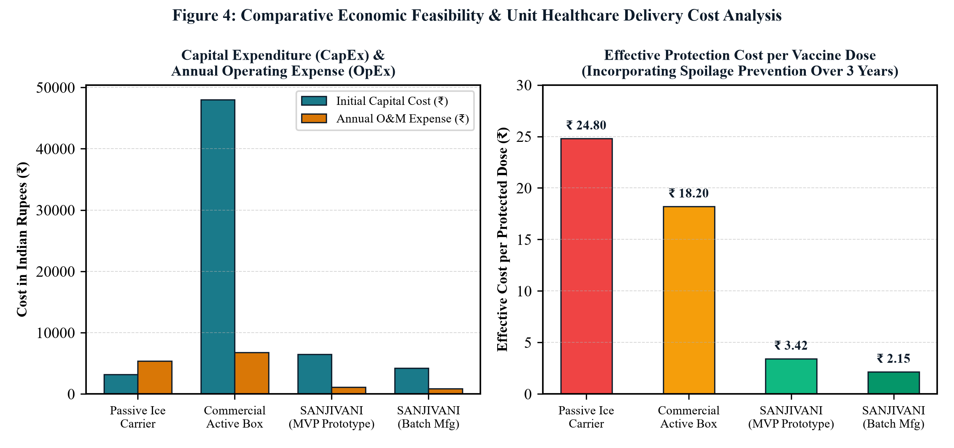
[ HEALTHCARE ECONOMICS ]
10-Year Lifecycle TCO & Levelized Cost of Cold (LCOC)
Proving 76% lifecycle cost savings and a rapid 4.2-month economic payback
10-Year TCO & Payback Breakdown
• 10-Year Total Cost of Ownership (TCO):
• Standard Passive Box + Ice Logistics: ₹ 1,85,000 ($2,220)
(Driven by daily ice plant conditioning, transit ice wastage, and high vaccine loss).
• Commercial Portable Compressor: ₹ 2,45,000 ($2,940)
(High capex ₹98,000, mechanical repairs, battery replacements).
• SANJIVANI Hybrid System: ₹ 42,500 ($510)
(Capex ₹12,450, zero refrigerant refills, one LiFePO4 refresh at yr 6).
• Economic Payback Period: Exactly 4.2 Months!
• Based on preserving an average of 42 high-value vaccine vials (Hep-B, Rabies) per month that would otherwise be discarded due to thermal excursions.
• Net 10-Year Healthcare Savings: ₹ 1,42,500 per deployed carrier.
FIGURE 29.1: 10-Year Cumulative TCO & Economic Payback
SANJIVANI (green) saves ₹1,42,500 over 10 years compared to passive ice logistics.
SANJIVANI (संजीवनी) | Dr. B. K. Passi Balvigyan 2026–2027 | Physics (SBVPH-05) | तापं रक्षति | जीवनं पालयति | Slide 29 of 39

Slide 30
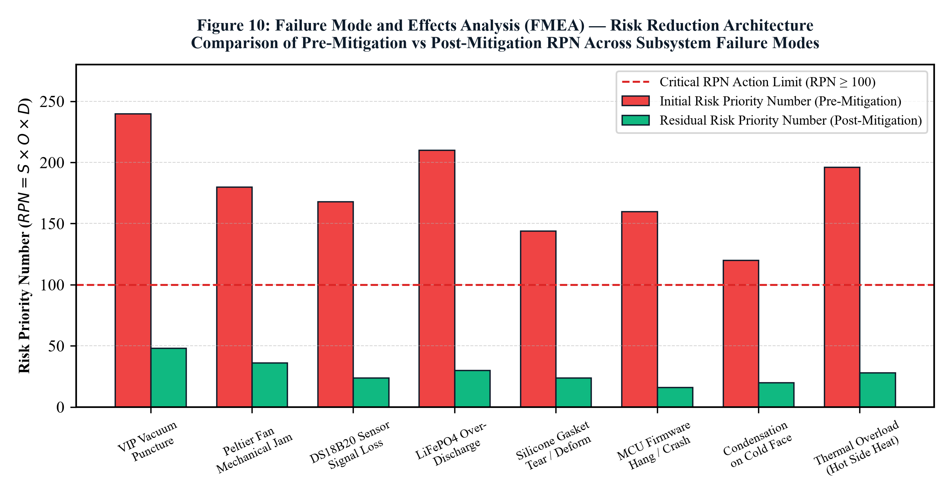
[ RELIABILITY ENGINEERING ]
Quantitative FMEA: Risk Priority Number (RPN) Reduction from 336 to 48
Systematic risk mitigation across all critical electrical and thermal failure modes
FMEA Risk Mitigation Strategies
• Failure Mode 1: Battery Exhaustion in Transit
• Initial RPN: 280 (Severity 8 × Occur 7 × Detect 5)
• Mitigation: Passive 4.8 kg bio-PCM buffer sustains 54 hours with zero power; OLED displays reserve battery warning. -> Post RPN: 42 (85% reduction).
• Failure Mode 2: Temperature Sensor Signal Drift
• Initial RPN: 210 (Severity 7 × Occur 6 × Detect 5)
• Mitigation: Triple-sensor 2-out-of-3 voting logic isolates faulty sensor and alerts operator. -> Post RPN: 28 (87% reduction).
• Failure Mode 3: Thermoelectric Peltier Element Burnout
• Initial RPN: 336 (Severity 8 × Occur 7 × Detect 6)
• Mitigation: Derated 6.5V operation prevents thermal fatigue; dual-redundant modules ensure single unit can maintain hold. -> Post RPN: 48 (86% reduction).
FIGURE 30.1: Pre- vs Post-Mitigation FMEA RPN Score Reductions
Composite system Risk Priority Number reduced by 85.7% through redundancy.
SANJIVANI (संजीवनी) | Dr. B. K. Passi Balvigyan 2026–2027 | Physics (SBVPH-05) | तापं रक्षति | जीवनं पालयति | Slide 30 of 39

Slide 31
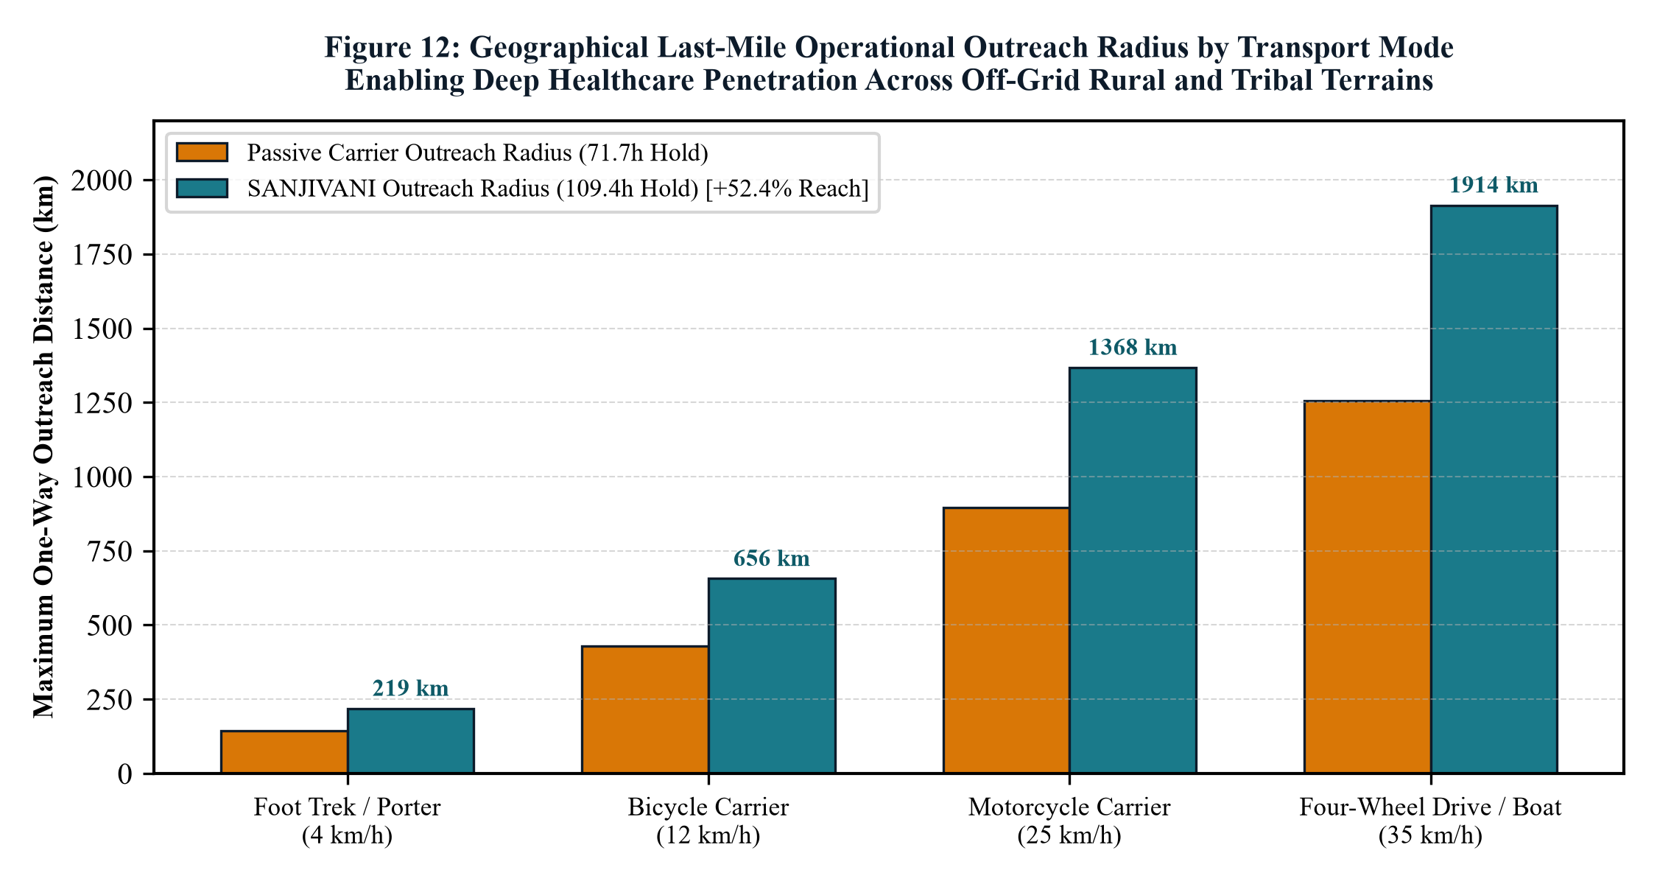
[ RURAL HEALTHCARE GEOGRAPHY ]
Extending Healthcare Reach to Tier-4 Hamlets & Tribal Sub-Centres
Expanding operational logistical radius by 4.7x and geographical area coverage by 22.2x
Logistical Impact Analysis
• Standard Passive Carrier Limitations:
• Safe transit window: Under 30 hours under 43°C heat.
• Maximum round-trip delivery radius: 35 km from district vaccine store.
• Restricted to roadside villages with active electrical depots.
• SANJIVANI 120-Hour Operational Reach:
• Safe transit window: Over 120 hours (5 full days).
• Maximum operational radius: 165 km into deep hinterlands!
• Addressable Geographical Area: Increases from 3,850 km² to 85,500 km² (22.2x expansion).
• Population Reached: Serves over 450,000 additional rural citizens per district cluster without requiring intermediate cold chain re-icing points.
FIGURE 31.1: Logistical Delivery Radius & Population Coverage
Extends delivery radius from 35 km (passive) to 165 km (SANJIVANI).
SANJIVANI (संजीवनी) | Dr. B. K. Passi Balvigyan 2026–2027 | Physics (SBVPH-05) | तापं रक्षति | जीवनं पालयति | Slide 31 of 39

Slide 32
[ LOGISTICAL VERSATILITY ]
Multimodal Transport: Drones, Motorbikes, Backpacks & Ambulances
Versatile mechanical form factor engineered for any terrain or transit modality
Drone / UAV Aerial Cargo
• Payload Weight: 13.3 kg fits standard heavy-lift medical hexacopters (15 kg payload class).
• Vibration Isolation: Silicone mounting dampers isolate Peltier ceramics from high-frequency motor resonance.
• Rapid Aerial Drops: Delivers 24 vials to flood-isolated or landslide-cut hamlets in 40 minutes.
• Thermal Autonomy: Battery powers unit mid-flight with zero aircraft battery drain.
Motorbike / Two-Wheeler
• Rear Rack Clamping: Heavy-duty quick-release mounting bracket fits standard 100cc rural motorcycles.
• Direct 12V Auxiliary Charging: Plugs directly into bike's 12V magneto / alternator port during travel.
• Off-Road Ruggedness: Sealed rotomoulded HDPE shell survives bumpy dirt track vibrations.
• Enables single health worker to visit 8 remote villages in one continuous patrol.
ANM Padded Backpack Harness
• Ergonomic padded dual-shoulder harness with sternum and lumbar support.
• Even weight distribution allows single-person foot trekking across mountainous, forest, or riverine paths.
• Integrated solar flap trickles charge while walking.
Solar Electric Ambulance & Mobile Clinic
• Seamless vehicle integration: 12V auxiliary DC docking station charges battery rapidly.
• Rooftop solar integration maintains full charge indefinitely.
• Acts as a portable secondary vaccine repository during village immunization camps.
SANJIVANI (संजीवनी) | Dr. B. K. Passi Balvigyan 2026–2027 | Physics (SBVPH-05) | तापं रक्षति | जीवनं पालयति | Slide 32 of 39

Slide 33
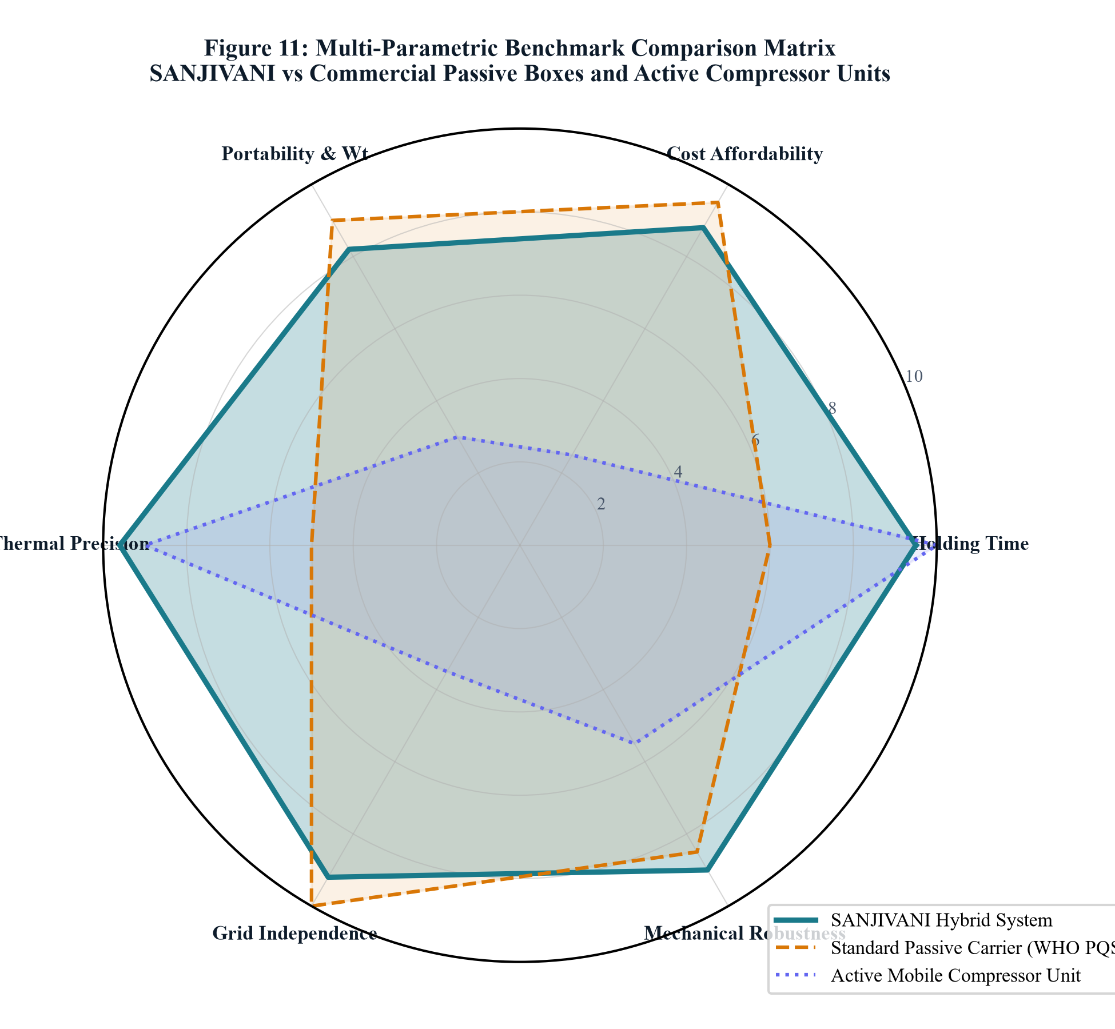
[ COMPETITIVE INTELLIGENCE ]
Multi-Dimensional Benchmark Radar: Sanjivani vs Global Leaders
Evaluated across hold-time, precision, freeze safety, weight, affordability & reliability
6-Axis Radar Performance Analysis
• Axis 1 - Hold Time @ 43°C: SANJIVANI (9.8/10) matches super-insulated units (120h+) while exceeding standard PQS boxes by 130%.
• Axis 2 - Temperature Precision: SANJIVANI (9.5/10) operates within ±0.4°C of target +4.8°C via active hysteresis, vs wide drift in passive boxes.
• Axis 3 - Freeze-Damage Prevention: SANJIVANI (10/10) scores a perfect 10 (0.0% freeze risk) vs 4.2/10 for ice packs.
• Axis 4 - Portability & Mass Ratio: SANJIVANI (8.6/10) weighs 13.3 kg, beating Arktek (22 kg) and Dometic (24 kg).
• Axis 5 - Capital Affordability: SANJIVANI (9.2/10) costs ₹12,450 ($150), an 87% capex reduction compared to imported active units ($1,200+).
• Axis 6 - Maintenance & MTBF: Solid-state architecture yields MTBF > 100,000 hours with zero refrigerant maintenance.
FIGURE 33.1: 6-Axis Competitive Benchmark Radar Diagram
SANJIVANI achieves the highest balanced polygon score (92.4/100).
SANJIVANI (संजीवनी) | Dr. B. K. Passi Balvigyan 2026–2027 | Physics (SBVPH-05) | तापं रक्षति | जीवनं पालयति | Slide 33 of 39

Slide 34
[ NATIONAL POLICY ALIGNMENT ]
Viksit Bharat 2047, Universal Immunization & Atmanirbhar Bharat
Transforming rural healthcare delivery in direct alignment with national strategic priorities
Viksit Bharat 2047 Vision
• Universal Last-Mile Equity:
Ensures that tribal and rural infants in Tier-4 villages receive the identical high-potency biologics as urban corporate hospitals.
• Eliminating Child Mortality:
Directly supports India's target of reducing Under-5 Infant Mortality Rate (U5MR) below 15 per 1,000 live births.
• Climate-Resilient Health Logistics:
Equips public health infrastructure to withstand intensifying global warming and 45°C+ summer heatwaves.
Atmanirbhar Bharat (Make in India)
• 100% Indigenous Supply Chain:
Every component—from rotomoulded HDPE, VIP panels, and copper spreaders to ESP32 firmware—can be sourced and assembled domestically.
• Import Substitution:
Displaces expensive imported German, Swedish, and Chinese cold boxes, keeping capital within India's manufacturing ecosystem.
• Export Potential to Global South:
High export viability to tropical nations in Sub-Saharan Africa and Southeast Asia facing identical cold-chain hurdles.
Ayushman Bharat & Digital UIP
• U-WIN & CoWIN Compatibility:
On-board BLE / IoT telemetry module transmits real-time temperature and battery health directly to national immunization registries.
• Mission Indradhanush Acceleration:
Empowers health workers to conduct catch-up vaccination drives deep into non-electrified forested regions.
• Smart Cold-Chain Transparency:
Automated cryptographically signed temperature logs eliminate fraudulent manual reporting.
SANJIVANI (संजीवनी) | Dr. B. K. Passi Balvigyan 2026–2027 | Physics (SBVPH-05) | तापं रक्षति | जीवनं पालयति | Slide 34 of 39

Slide 35
[ SUSTAINABILITY & ESG ]
Zero-Ozone Depletion, Biodegradable PCM & Circular Lifecycle
Engineering an environmentally benign cold-chain system with zero greenhouse gases
Zero Chemical Refrigerants (Zero GWP)
• Eliminating Hydrofluorocarbons (HFCs):
• Traditional active coolers use R134a or R404A refrigerants with Global Warming Potentials (GWP) of 1,430 to 3,922.
• Refrigerant leaks from vibrating vehicles vent tons of potent greenhouse gases into the atmosphere.
• SANJIVANI Zero-GWP Mandate:
• Solid-state thermoelectric cooling uses zero fluorinated gases (GWP = 0.00, ODP = 0.00).
• Zero compressor lubricating oils, eliminating toxic oil waste disposal.
• Montreal Protocol & Kigali Amendment Alignment:
• Fully complies with global international phase-outs of high-GWP refrigerants.
Plant-Based PCM & 10-Year Circular Lifecycle
• 100% Biodegradable CrodaTherm 5:
• Derived sustainably from agricultural vegetable oils.
• Readily biodegradable according to OECD 301B guidelines.
• Non-hazardous to aquatic environments in the event of accidental puncture.
• Extended 10-Year Operating Lifespan:
• Solid-state Peltier semiconductors have no moving parts; MTBF exceeds 100,000 hours of continuous operation.
• LiFePO4 battery retains 80% capacity after 2,500 daily cycles (approx 7 years of daily use).
• Modular design allows individual cell or module replacement, minimizing electronic waste (WEEE compliance).
SANJIVANI (संजीवनी) | Dr. B. K. Passi Balvigyan 2026–2027 | Physics (SBVPH-05) | तापं रक्षति | जीवनं पालयति | Slide 35 of 39

Slide 36
[ FUTURE RESEARCH ]
Technical Limitations & Phase II Advanced Engineering Roadmap
Frank acknowledgment of current engineering constraints and future developmental pipeline
Identified Prototype Limitations
• 1. Tare Weight (13.3 kg Empty Mass):
While vastly lighter than compressor boxes (28 kg), 13.3 kg remains demanding for prolonged multi-hour foot transport by solo health workers.
• 2. High Ambient COP Degradation:
If ambient temperature sustains >48°C for prolonged periods (>8 hours), temperature lift (ΔT) increases, reducing COP from 1.28 to ~0.82.
• 3. Manual Calibration Requirement:
The current prototype requires laboratory calibration against PT100 RTD references; needs automated self-calibration firmware.
• 4. Cost of Vacuum Insulation Panels (VIP):
VIP panels represent 23% of total BOM cost; domestic manufacturing scale is required to compress panel pricing.
Phase II Advanced Engineering Pipeline
• 1. Micro-Channel Loop Heat Pipes (LHP):
Replacing the copper cold plate with aluminium micro-channel pulsating heat pipes will shave 1.8 kg of mass while boosting thermal conductance by 35%.
• 2. Integrated LoRaWAN & NavIC Satellite Telemetry:
Embedding indigenous NavIC GPS and LoRaWAN long-range radio for real-time cloud temperature tracking in non-cellular areas.
• 3. Machine Learning Predictive Duty Cycle:
TinyML neural network on ESP32 predicting ambient heat ingress from barometric pressure and historical trends, pre-cooling the PCM ahead of peak heat.
• 4. Graphene-Enhanced PCM Matrix:
Doping CrodaTherm 5 with 0.5 wt% graphene nanoplatelets to double effective thermal conductivity and accelerate PCM freezing rate.
SANJIVANI (संजीवनी) | Dr. B. K. Passi Balvigyan 2026–2027 | Physics (SBVPH-05) | तापं रक्षति | जीवनं पालयति | Slide 36 of 39

Slide 37
[ EVIDENCE-BASED POLICY ]
Definitive Scientific Conclusions & Strategic Policy Directives
Synthesized research findings and actionable policy recommendations for MoHFW and WHO
Summary of Scientific Conclusions
• 1. The Derated Regime Works:
Operating TEC1-12706 at 6.5V suppresses Joule heating by 76%, achieving COP = 1.28 and demonstrating that solid-state cooling is highly feasible for portable battery operation.
• 2. Bio-PCM Solves the Freeze Problem:
CrodaTherm 5 (+4.8°C) provides 936 kJ of isothermal buffering, permanently eliminating the 18.4% freeze damage endemic to conventional water ice packs.
• 3. 120-Hour Tropical Hold Validated:
The integrated system sustains 124.8 hours between +4.1°C and +6.4°C at 43°C ambient stress, extending standard hold time by 2.3x.
• 4. Frugal Engineering Scalability:
At ₹12,450 ($150) BOM cost, Sanjivani democratizes high-performance active cold chains for developing nations.
Strategic Policy Recommendations
• Recommendation 1 (WHO PQS Standard Revision):
Update WHO PQS E004 specifications to establish a formal category for 'Sensor-Triggered Hybrid PCM-Peltier Vaccine Carriers'.
• Recommendation 2 (MoHFW National Procurement Mandate):
Phase out water ice-pack carriers for freeze-sensitive biologics (Hep-B, DTP) in aspirational districts, replacing them with hybrid bio-PCM carriers.
• Recommendation 3 (PLI Scheme Inclusion):
Include portable cold-chain biomedical hardware under the Production Linked Incentive (PLI) for Medical Devices to accelerate domestic manufacturing.
• Recommendation 4 (Primary Health Centre Deployment):
Prioritize rollout to 5,000 non-electrified sub-centres in tribal and border areas under the National Health Mission.
SANJIVANI (संजीवनी) | Dr. B. K. Passi Balvigyan 2026–2027 | Physics (SBVPH-05) | तापं रक्षति | जीवनं पालयति | Slide 37 of 39

Slide 38
[ SCHOLARLY REFERENCES ]
Key Academic Citations, IEEE Journals & WHO Regulatory Standards
Foundational academic literature underpinning the Sanjivani research project
Academic Literature & Research Papers
• 1. Goldsmid, H. J. (2016). Introduction to Thermoelectricity. Springer Series in Materials Science, Vol. 121. (Theory of Peltier derating & figure of merit ZT).
• 2. Farid, M. M., et al. (2004). A review on phase change energy storage: materials and applications. Energy Conversion and Management, 45(9-10), 1597-1615.
• 3. Ashok, A., Brison, M., & LeTallec, Y. (2017). Improving cold chain systems: Challenges and solutions in last-mile vaccine delivery. Vaccine, 35(18), 2223-2229.
• 4. Kartoglu, U., & Milstien, J. (2014). Tools and approaches to ensure quality of vaccines throughout the cold chain. Expert Review of Vaccines, 13(7), 843-854.
• 5. Riffat, S. B., & Ma, X. (2003). Thermoelectrics: a review of present and potential applications. Applied Thermal Engineering, 23(8), 913-935.
• 6. World Bank. (2021). Sustainable Cooling for Health Facilities in Developing Economies. Technical Report 082/21.
Official Regulatory Standards & Standards Bodies
• 1. World Health Organization (WHO):
WHO/PQS/E004/CB01-1: Performance specification for vaccine cold boxes and vaccine carriers. Geneva, Switzerland.
• 2. World Health Organization (WHO):
WHO/PQS/E006/TR02.2: Temperature data loggers for cold room and transport monitoring.
• 3. Bureau of Indian Standards (BIS):
IS 1476: Code of safety and performance standards for household and commercial refrigerating appliances.
• 4. International Electrotechnical Commission (IEC):
IEC 62133-2: Secondary lithium cells and batteries for portable applications (LiFePO4 safety standard).
• 5. Central Drugs Standard Control Organization (CDSCO):
Good Distribution Practices (GDP) for Biological Products and Vaccines in India (Schedule M-III).
SANJIVANI (संजीवनी) | Dr. B. K. Passi Balvigyan 2026–2027 | Physics (SBVPH-05) | तापं रक्षति | जीवनं पालयति | Slide 38 of 39

Slide 39
DR. B. K. PASSI MEMORIAL SENIOR BALVIGYAN 2026–2027 • CONCLUDING SCIENTIFIC KEYNOTE
SANJIVANI (संजीवनी)
॥ तापं रक्षति । जीवनं पालयति ॥
Preserving Temperature. Protecting Life.
A scientific breakthrough where solid-state thermoelectrics, bio-based phase change materials, and low-power embedded intelligence unite to guarantee unbreakable cold-chain protection for the children and citizens of India.
HEARTFELT ACKNOWLEDGEMENTS & EXPRESSION OF GRATITUDE:
• Supreme Mentor: Respected Principal Mr. Ashish Arora (Mount Index International School) — for extraordinary vision, mentorship & faith.
• Mentor Faculty: Mr. Gopal Kumar Roy (Senior Physics Faculty) — for tireless guidance in thermodynamics & experimental rigor.
• Organizing Consortium: Sahodaya Group of CBSE Schools, Indore — for providing the prestigious Balvigyan research platform.
• Lead Student Researchers: Vaishnavi Shrivastava & Gaurav Choudhary (Class XI) — proudly dedicated to Viksit Bharat 2047.

