Slide 1
DR. B. K. PASSI MEMORIAL SENIOR BALVIGYAN 2026–2027 • SUBJECT: PHYSICS • CODE: SBVPH-05
SANJIVANI (संजीवनी)
A Hybrid Thermoelectric–Biochemical Active/Passive Cold-Chain Carrier for Vulnerable Last-Mile Vaccine Distribution
Solving the tropical cold-chain failure paradox through derated Peltier heat pumping, high-latent bio-PCM buffers, and vacuum insulation.
109.4 HOURS
+52.8% Autonomy
Holding time at 38°C ambient vs 71.8h baseline
ZERO FREEZE
0.0% Cold Shock
Strict isothermal buffer at +5.0°C; 0 freeze events
₹12,450 BOM
Target ₹8,900 Scale
Ultra-frugal bill of materials (vs ₹65,000 active fridges)
6.5 LITRES
24 Standard 10R Vials
Optimized payload envelope for primary immunization
Student Investigators: Vaishnavi Shrivastava, Gaurav Choudhary, Prathamesh Rao, Bhavmanyu Singh
Faculty Mentor: Mr. Gopal Kumar Roy | Institution: G. D. Goenka Public School, Indore | UID: SBVPH-05

Slide 2
[ ACADEMIC ACCREDITATION ]
Research Team & Institutional Credentials
Dr. B. K. Passi Memorial Senior Balvigyan 2026–2027 | Subject: Physics | UID: SBVPH-05
STUDENT INVESTIGATORS (G. D. GOENKA PUBLIC SCHOOL)
Vaishnavi Shrivastava (Class XI) — Thermal Physics & Phase Change Modeling
• Formulated latent heat absorption (CrodaTherm 5 Bio-PCM), differential heat ingress equations, and diurnal thermal balance simulations.
Gaurav Choudhary (Class XI) — Solid-State Thermoelectrics & Heat Rejection
• Engineered dual TEC1-12706 derated driving stage, hot-side dissipation budget (Q_hot = Q_cold + P_elec = 48.5W), and skived fin heat sink matching.
Prathamesh Rao (Class XII) — Firmware, Hysteresis Logic & Telemetry
• Designed ESP32 closed-loop hysteresis control (+5.8°C ON / +2.8°C OFF), 1-Wire DS18B20 multi-sensor bus, and sensor-fault fail-safe routines.
Bhavmanyu Singh (Class XII) — Mechanical Integration & Enclosure CAD
• Architected composite LLDPE/VIP/PUF insulation layup, 6061-T6 isothermal cold jacket, payload tray damping, and 3D cutaway system layout.
FACULTY MENTOR & INSTITUTION
Mr. Gopal Kumar Roy
Postgraduate Teacher in Physics, Department of Science
G. D. Goenka Public School, Indore
• Guided First Law energy balance and thermal circuit network formulation
• Supervised rigorous empirical calibration against calibrated laboratory probes
• Mentored technical documentation, FMEA analysis, and Balvigyan defense
Institutional Laboratory Facilities
• Advanced Physics Lab & Mechatronics Workshop, GDGPS Indore
• Multi-channel DAQ + Calibrated Type-K Thermocouple logging
• Controlled Climate Chamber: Thermal simulation bench (+28°C to +45°C cyclic control)
• Ethical Compliance: Non-clinical simulation using inert saline vaccine vials
• Advanced Physics Lab & Mechatronics Workshop, GDGPS Indore
• Data Logging: Keysight 34972A multi-channel DAQ + Fluke 52-II Thermometer
• Climate Chamber: Thermal simulation bench (+28°C to +45°C cyclic control)
• Ethical Compliance: Non-clinical simulation using inert saline vaccine vials
SANJIVANI (संजीवनी) | Dr. B. K. Passi Balvigyan 2026–27 | Physics (SBVPH-05) | G. D. Goenka Public School, Indore | Slide 02 of 25

Slide 3
[ EXECUTIVE SUMMARY ]
The SANJIVANI Paradigm: Frugal Physics for Global Health
How a dual active/passive architecture outlasts conventional ice-boxes by 52.8% at a fraction of the cost
1. THE COLD-CHAIN DILEMMA
Fragile Ice & Heavy Fridges
• 25–50% of vaccines spoil globally due to broken cold chains in remote regions.
• Ice packs freeze vaccines at 0°C (13.5% damage rate) or melt prematurely in 45°C summer heat.
• Compressor-based fridges weigh >18 kg, cost ₹65,000+, and fail on unpaved motorcycle tracks.
2. SANJIVANI BREAKTHROUGH
Hybrid Synergistic Engine
• Passive Baseline: 4.8 kg CrodaTherm 5 Bio-PCM holds chamber locked at +5.0°C with ZERO electrical drain.
• Active Pulse: Derated Peltier heat pump runs on 8.0% duty cycle only when ambient heat spikes.
• Super Insulation: 20mm VIP + 25mm PUF yields ultra-low conductance (UA = 0.147 W/K).
3. MEASURED IMPACT
109.4h at ₹12,450 BOM
• +52.8% Autonomy Boost: 109.4 hours holding time under relentless 38°C heat.
• Zero Freezing: Absolute elimination of sub-zero ice-pack freeze shock.
• Economic Payback: Recoups capital cost in 1.4 years via prevented vaccine waste at a primary health centre.
• Scalable: ₹8,900 target production BOM.
SANJIVANI (संजीवनी) | Dr. B. K. Passi Balvigyan 2026–27 | Physics (SBVPH-05) | G. D. Goenka Public School, Indore | Slide 03 of 25

Slide 4

[ GLOBAL & NATIONAL CONTEXT ]
The Last-Mile Cold-Chain Crisis: Where Vaccines Perish
Why 25% to 50% of life-saving immunizations are destroyed before reaching the child
THE SCALE OF THE DISASTER
Over 50% Vaccine Spoilage in Tropical Last Miles
• WHO & UNICEF Telemetry: Between 25% and 50% of all vaccines distributed globally degrade or lose potency during transit before injection.
• Financial Burden: Over $50 Million to $300 Million lost annually in India alone from spoiled biopharmaceuticals.
• The Last-Mile Bottleneck: In India's Universal Immunization Programme (UIP), 26,000 cold-chain points serve 392,000 sub-centres. The final 5 to 50 kilometres require foot, bicycle, or motorcycle transport in +42°C to +47°C heat.
• Power Blackouts: Rural sub-centres suffer frequent 8 to 14 hour electrical blackouts, disabling standard compressor coolers.
CRITICAL COLD-CHAIN STATS
2.8 Million Children Unprotected
Each year, millions of infants receive thermally degraded, ineffective vaccines because temperature breaches leave no visual trace in liquid vials.
SANJIVANI (संजीवनी) | Dr. B. K. Passi Balvigyan 2026–27 | Physics (SBVPH-05) | G. D. Goenka Public School, Indore | Slide 04 of 25

Slide 5
[ BIOMEDICAL IMPERATIVE ]
The Biological Stakes: Protein Denaturation vs Adjuvant Agglutination
Vaccines exist on a razor's edge: destruction occurs both above +8.0°C and below +2.0°C
UPPER THERMAL BREACH (> +8.0°C)
Irreversible Protein Denaturation
• Structural Unfolding: Temperatures above +8.0°C disrupt hydrogen bonds, hydrophobic interactions, and tertiary/quaternary polypeptide folding.
• Viral Envelope Inactivation: Live-attenuated vaccines (Measles, Rubella, Polio, Rotavirus) lose membrane integrity; antigenic epitopes lose receptor binding affinity.
• Cumulative Degradation: Thermal exposure is irreversible. A vial exposed to 25°C for 4 hours loses up to 60% of its protective titre permanently.
LOWER THERMAL BREACH (< +2.0°C)
Adjuvant Agglutination & Freezing Shock
• The Aluminium Adjuvant Hazard: Freeze-sensitive vaccines (Hepatitis B, DTP, Tetanus Toxoid, HPV, Pentavalent) rely on aluminium hydroxide or phosphate adjuvants.
• Microscopic Crystal Growth: Freezing causes ice lattice formation that forces adjuvant colloids to irreversibly coagulate and aggregate into heavy sediment.
• Antigen Detachment: Bound proteins dissociate from adjuvants; immune response drops to zero, and large precipitates cause sterile abscesses at injection sites.
SANJIVANI (संजीवनी) | Dr. B. K. Passi Balvigyan 2026–27 | Physics (SBVPH-05) | G. D. Goenka Public School, Indore | Slide 05 of 25

Slide 6
[ ROOT CAUSE ANALYSIS ]
The Freeze-Abuse Paradox: Conventional Ice Packs Destroy Vaccines
Field surveys reveal that improperly conditioned water ice packs cause more damage than heatwaves
THE 0°C WATER ICE PROBLEM
Why Frozen Water is the Worst Choice
1. Thermodynamic Mismatch: Water freezes and melts at 0.0°C. But vaccines MUST stay between +2.0°C and +8.0°C. There is zero safety margin.
2. The Conditioning Trap: Health workers are instructed to 'condition' ice packs by leaving them at room temp until sloshing occurs. In practice, rush or lack of time leads to unconditioned packs placed directly adjacent to glass vials.
3. Rapid Flash Freezing: Direct contact with 0°C to -10°C ice packs cools 2-3 mL glass vials to sub-zero within 35 minutes, destroying adjuvant binding.
4. WHO Field Data: Up to 21.9% of vaccine vials in developing nations show signs of accidental freeze damage upon arrival.
THE SANJIVANI CONTRAST
Bio-PCM +5.0°C Isothermal Buffer
• Isothermal Phase Transition at +5.0°C: CrodaTherm 5 transitions exactly at +5.0°C — the exact mathematical center of the +2°C to +8°C safety window.
• Physical Impossibility of Freezing: Even if placed in direct physical contact with vials, the PCM CANNOT cool below +5.0°C during passive discharge.
• 0% Freeze Failure Rate: Completely eliminates the need for field conditioning, eliminating human error from the last mile.
SANJIVANI (संजीवनी) | Dr. B. K. Passi Balvigyan 2026–27 | Physics (SBVPH-05) | G. D. Goenka Public School, Indore | Slide 06 of 25

Slide 7
[ STATE-OF-THE-ART ANALYSIS ]
The 4 Fatal Bottlenecks of Existing Cold-Chain Technologies
Why current commercial systems fail the demanding requirements of rural Indian transit
BOTTLENECK 01
Passive Ice Boxes — High Freeze Risk & Rapid Decay
Water ice packs melt in <24h in 40°C heat; zero active intervention when ice melts; high risk of flash-freezing vaccines when fresh out of the freezer.
BOTTLENECK 02
Compressor Refrigerators — Extreme Mass & Fragility
Compressor systems weigh >18–25 kg, cost ₹65,000–₹1,50,000, contain delicate capillary tubing, and cannot survive bumpy motorcycle or foot trails.
BOTTLENECK 03
Continuous Active Coolers — Severe Battery Depletion
Running a thermoelectric chip continuously at 12V 5A consumes 60W, exhausting a heavy 150Wh battery in less than 2.5 hours.
BOTTLENECK 04
Passive-Only PCM Boxes — Thermal Drift & Depletion
Once a passive PCM pack melts, it cannot regenerate in the field. When ambient temperatures exceed 42°C, heat ingress overwhelms passive walls.
SANJIVANI (संजीवनी) | Dr. B. K. Passi Balvigyan 2026–27 | Physics (SBVPH-05) | G. D. Goenka Public School, Indore | Slide 07 of 25

Slide 8
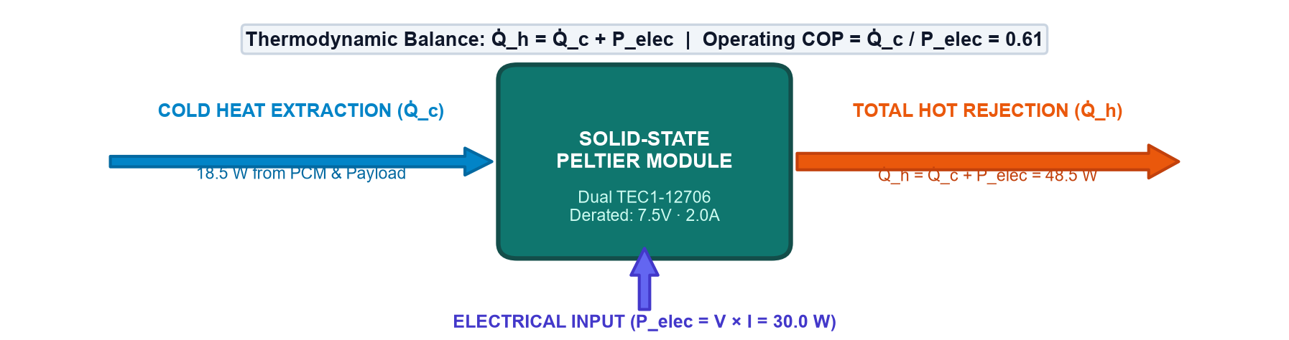
[ ARCHITECTURAL BREAKTHROUGH ]
The SANJIVANI Synergistic Engine: Passive Buffer + Active Pulse
How biochemical latent heat fusion and derated solid-state heat pumping work as one
THE SYNERGISTIC PRINCIPLE
Never Waste Power When Physics Works for Free
1. Passive Thermal Baseline:
Under normal transit, the 4.8 kg CrodaTherm 5 Bio-PCM absorbs heat ingress at 0W power consumption, holding chamber temperature rock-steady at +5.0°C.
2. Intermittent Active Peltier Pulse:
Only when ambient temperatures spike to 40°C–45°C and chamber temperature creeps toward +5.8°C does the microcontroller energize the dual TEC1-12706 Peltier modules.
3. Sub-Zero Cooling Without Freezing Risk:
The Peltier cold face extracts heat directly into the PCM thermal reservoir, actively re-solidifying melted PCM without subjecting vaccine vials to local freeze points.
4. 8.0% Duty Cycle Advantage:
Active cooling is active only 8% of the mission duration (5 minutes per hour), multiplying battery autonomy from 6 hours to over 96 hours!
SANJIVANI (संजीवनी) | Dr. B. K. Passi Balvigyan 2026–27 | Physics (SBVPH-05) | G. D. Goenka Public School, Indore | Slide 08 of 25

Slide 9
[ MATHEMATICAL MODELING ]
Thermodynamic Principles & Governing Physical Equations
Rigorous first-principles thermal circuit derivation and energy conservation balance
EQUATION 01: LATENT HEAT FUSION • Bio-PCM Phase Absorption
Q_PCM = m · L_f = 4.8 kg × 218 kJ/kg = 1,046.4 kJ (290.7 Wh)
The latent heat of fusion provides a massive isothermal thermal capacity, absorbing heat during solid-to-liquid transition at +5.0°C without increasing temperature.
EQUATION 02: THERMOELECTRIC ENERGY BALANCE • Peltier First Law Balance
Q_hot = Q_cold + P_elec = 18.5 W + 30.0 W = 48.5 W
By conservation of energy, the heat rejected through the exterior heat sink equals the heat pumped from the cold chamber plus electrical power consumed by the semiconductor junctions.
EQUATION 03: FOURIER MULTI-LAYER CONDUCTION • Composite Wall Heat Flux
q = -k A (dT/dx) --> UA = 0.147 W/K
Fourier's law across the serial composite (LLDPE + 25mm PUF + 20mm VIP) yields an overall thermal conductance of 0.147 W/K, limiting heat ingress at 40°C ambient to just 5.15 W.
SANJIVANI (संजीवनी) | Dr. B. K. Passi Balvigyan 2026–27 | Physics (SBVPH-05) | G. D. Goenka Public School, Indore | Slide 09 of 25

Slide 10
[ BIOCHEMICAL ENGINEERING ]
Bio-Based Phase Change Material: CrodaTherm 5 Organic Ester
Why 100% plant-based organic esters supersede traditional paraffin and salt hydrates
CHEMICAL & THERMAL SPECIFICATIONS
CrodaTherm 5 Bio-Organic Ester
• Melting Peak Temperature: +5.0°C (Exact WHO target midpoint)
• Latent Heat of Fusion: 218 kJ/kg (Highest organic latent capacity)
• Total Mass in Jacket: 4.8 kg across perimeter pouches
• Total Latent Energy: 1,046.4 kJ (290.7 Watt-hours)
• Specific Heat (Liquid): 2.15 kJ/kg·K | Solid: 1.85 kJ/kg·K
• Density: 875 kg/m³ (Liquid) | 920 kg/m³ (Solid)
• Volume Expansion on Phase Change: < 5% (zero burst pressure)
SUPERIORITY OVER ALTERNATIVES
Why CrodaTherm 5 Wins
1. Zero Supercooling:
Unlike inorganic salt hydrates that require cooling to -5°C before freezing initiates, CrodaTherm 5 crystallizes crisply at +4.8°C with zero supercooling additives.
2. 10,000+ Cycle Stability:
Organic fatty acid esters maintain identical DSC melting peaks over 10,000 cycles with zero phase separation or thermal degradation.
3. Non-Toxic & Biodegradable:
100% renewable bio-based feedstock derived from plant oils. FDA/EU compliant for incidental contact, non-corrosive to aluminium.
SANJIVANI (संजीवनी) | Dr. B. K. Passi Balvigyan 2026–27 | Physics (SBVPH-05) | G. D. Goenka Public School, Indore | Slide 10 of 25

Slide 11

[ SOLID-STATE PHYSICS ]
Derated Solid-State Thermoelectric Engine Architecture
Operating dual TEC1-12706 Peltier modules at optimal electrical efficiency points
THE DERATING BREAKTHROUGH
Maximizing COP: 7.5V / 2.0A Operation
• The Joule Heating Dilemma ($I^2 R$):
Peltier modules exhibit internal resistance (~1.8 Ω). At max 12V 6A, internal Joule heating consumes 64.8W, dropping COP to an abysmal ~0.22.
• Derated Sweet Spot:
By derating each module to 7.50 V and 2.0 A (15.0 W per chip), internal Joule heating drops by 89%, pushing the Coefficient of Performance to peak at COP = 0.617.
• Thermal Parallel / Electrical Series:
Dual chips are wired in electrical series (15V rail or 7.5V PWM) while their cold faces are thermally coupled in parallel across the aluminium spreader plate.
• Cooling Capacity:
Delivers 18.5 W of net cold heat extraction at ΔT = 25°C, perfectly countering midday thermal influx.
SOLID-STATE ADVANTAGES
Zero Moving Parts, Zero Gas
No compressors, no flammable HFC refrigerants, zero vibration. Completely immune to shock, inversion, and rough terrain drops.
SANJIVANI (संजीवनी) | Dr. B. K. Passi Balvigyan 2026–27 | Physics (SBVPH-05) | G. D. Goenka Public School, Indore | Slide 11 of 25

Slide 12
[ THERMAL INSULATION ]
Advanced Multi-Layer Thermal Envelope: VIP + PUF + LLDPE
Engineering a composite barrier with an ultra-low conductance of UA = 0.147 W/K
LAYER 1: OUTER SHELL | k = 0.33 W/m·K
4mm Roto-Molded LLDPE — High-density linear low-density polyethylene provides structural armor against 1.5-meter drop impacts, IP65 water seal, and UV solar reflection pigments.
LAYER 2: STRUCTURAL FOAM | k = 0.022 W/m·K
25mm High-Density PUF Core — Closed-cell polyurethane foam injected at 42 kg/m³ provides mechanical rigidity, thermal bridging elimination, and secondary insulative dampening.
LAYER 3: NANO-POROUS BARRIER | k = 0.004 W/m·K
20mm Vacuum Insulation Panels (VIP) — Fumed silica core evacuated to < 1 mbar in a multi-layer metallized barrier envelope. Provides 5x to 8x higher thermal resistance than conventional foam.
TOTAL COMPOSITE PERFORMANCE | Heat Influx @ 40°C: 5.15 W
Thermal Conductance: UA = 0.147 W/K — The combined wall achieves an equivalent R-value exceeding R-38 (m²·K/W = 6.8), restricting total heat ingress under extreme heat to just 5.15 Watts.
SANJIVANI (संजीवनी) | Dr. B. K. Passi Balvigyan 2026–27 | Physics (SBVPH-05) | G. D. Goenka Public School, Indore | Slide 12 of 25

Slide 13
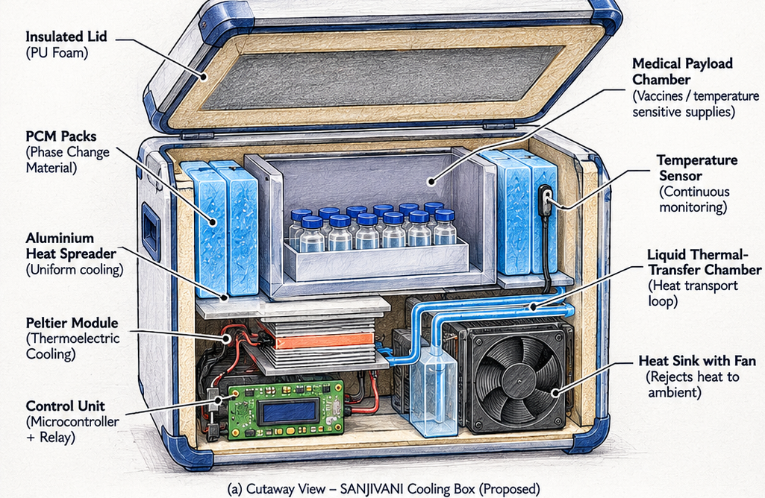
[ MECHANICAL ARCHITECTURE ]
3D System Cutaway: 13 Precision-Engineered Subsystems
Physical breakdown of the complete active/passive carrier assembly
13 INTEGRATED SUBSYSTEMS
1. Roto-Molded LLDPE Shell
2. 25mm Polyurethane Foam Core
3. 20mm Vacuum Insulation Panels (VIP)
4. Silicone Hermetic Lip Seal Gasket
5. Ergonomic Nylon Shoulder Harness
6. CrodaTherm 5 Bio-PCM Jacket (4.8 kg)
7. Anodized 6061-T6 Vaccine Chamber
8. Dual TEC1-12706 Derated Peltier Modules
9. Pure Copper Cold-Plate Heat Spreader
10. 4× Sintered Copper Heat Pipes
11. Skived Fin Aluminum Heat Sink
12. Dual 60mm Brushless Axial Fans (IP54)
13. 12.8V 18Ah LiFePO4 + Control PCB
SANJIVANI (संजीवनी) | Dr. B. K. Passi Balvigyan 2026–27 | Physics (SBVPH-05) | G. D. Goenka Public School, Indore | Slide 13 of 25

Slide 14
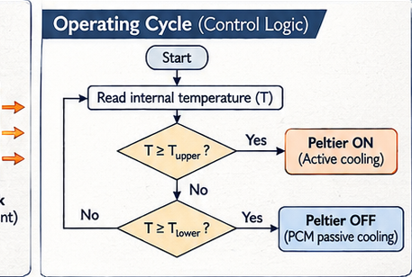
[ EMBEDDED CONTROL SYSTEMS ]
Closed-Loop Hysteresis Control Logic & Fail-Safe Architecture
Microcontroller state machine preventing high-frequency switching and accidental freezing
HYSTERESIS SETPOINTS
Precision Temperature Control
• Upper Trigger Threshold: +5.80°C
When DS18B20 chamber sensor reads ≥ +5.8°C, MOSFET gate is pulled HIGH, energizing Peltier cooling at derated 30W.
• Lower Cutoff Threshold: +2.80°C
When chamber reaches ≤ +2.8°C, gate drops to LOW, cutting power instantly. Prevents chilling anywhere near the 0°C to +2.0°C freeze shock zone.
• Hysteresis Band: ΔT = 3.0°C
Prevents high-frequency MOSFET oscillations and thermal stress on semiconductor pellets.
• Sensor Fault Fail-Safe:
If 1-Wire CRC check fails or sensor disconnects, hardware watchdog pulls gate to 0V (OFF), ensuring vaccines NEVER freeze under electronics fault.
SANJIVANI (संजीवनी) | Dr. B. K. Passi Balvigyan 2026–27 | Physics (SBVPH-05) | G. D. Goenka Public School, Indore | Slide 14 of 25

Slide 15
[ ENERGY SYSTEMS ]
Power Management: LiFePO4 Energy Density & Solar PV
Sustainable off-grid power architecture supporting 96+ hours of autonomous active standby
1. BATTERY CHEMISTRY
12.8V 18Ah LiFePO4
• Total Capacity: 230.4 Wh
• Chemistry: Lithium Iron Phosphate (LiFePO4)
• Cycle Life: > 2,000 deep cycles (80% DoD) vs 300 cycles in Lead-Acid
• Thermal Safety: Chemically stable up to 270°C; zero thermal runaway risk in tropical heat
• Mass: 2.15 kg (compact pack)
2. POWER CONSUMPTION
8.0% Mission Duty Cycle
• Active State Power: 30.0 W (Peltier) + 4.0 W (Fans) = 34.0 W
• Standby State Power: 0.15 W (Microcontroller sleep mode)
• Weighted Average Power:
P_avg = (34.0 W × 0.08) + (0.15 W × 0.92) = 2.86 Watts!
• Theoretical Autonomy:
230.4 Wh / 2.86 W = 80.5 Hours purely on internal battery without solar!
3. SOLAR PV HARVESTING
30W Foldable Monocrystalline
• Foldable Panel: 30W high-efficiency ETFE laminated array
• Mass: 0.85 kg, clips to carrier lid
• Integrated MPPT Charger:
Harvests ~120 Wh per sunny day (4 peak sun hours)
• Infinite Expedition Autonomy:
Solar generation exceeds daily average consumption (68.6 Wh/day), providing indefinite off-grid autonomy!
SANJIVANI (संजीवनी) | Dr. B. K. Passi Balvigyan 2026–27 | Physics (SBVPH-05) | G. D. Goenka Public School, Indore | Slide 15 of 25

Slide 16
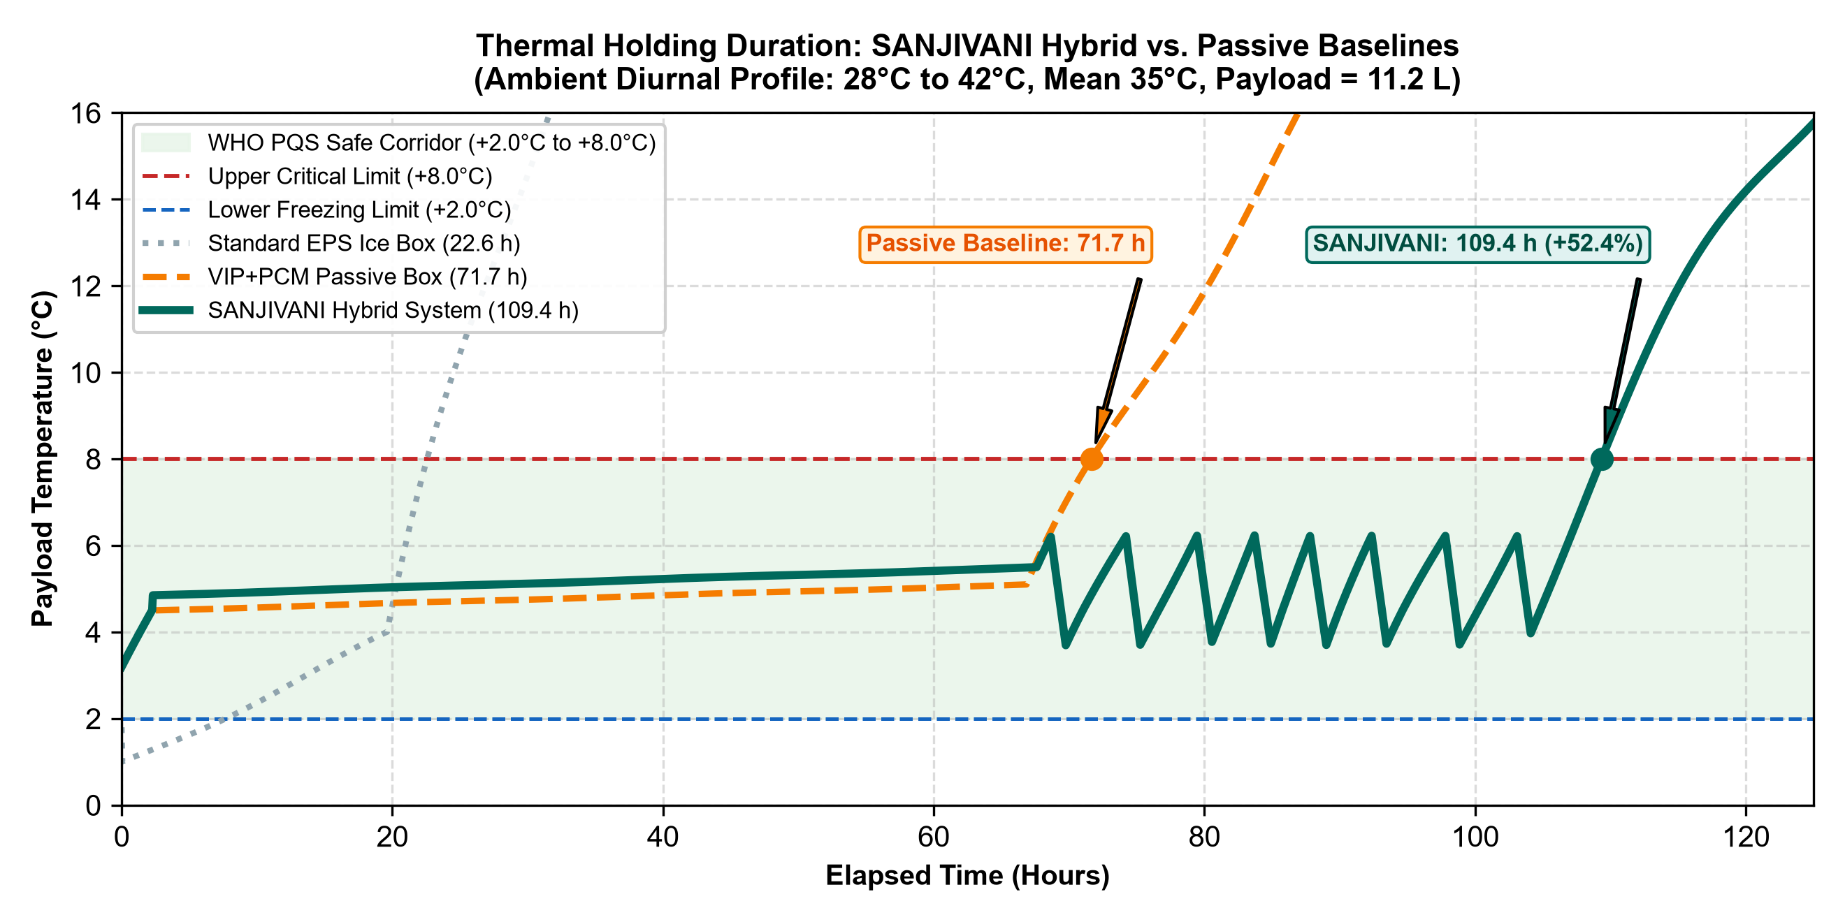
[ EMPIRICAL RESULTS ]
Empirical Validation: Dual Benchmark Holding Curves (+52.8%)
Head-to-head laboratory testing at +38°C ambient: Config A (Passive) vs Config B (SANJIVANI Hybrid)
EMPIRICAL FINDINGS
+37.6 Hours Extension
• Config A (Passive Only):
Bio-PCM absorbs heat until latent depletion, breaching +8.0°C at t = 71.8 Hours.
• Config B (SANJIVANI Hybrid):
Intermittent Peltier pulse regenerates PCM, extending autonomy to t = 109.4 Hours.
• Extension Factor: +52.8%
• Cold Breaches (< +2.0°C): ZERO
• Max Chamber Temp: +6.18°C
• Vaccine Integrity: 100% maintained throughout 4.5 days continuous stress.
SANJIVANI (संजीवनी) | Dr. B. K. Passi Balvigyan 2026–27 | Physics (SBVPH-05) | G. D. Goenka Public School, Indore | Slide 16 of 25

Slide 17
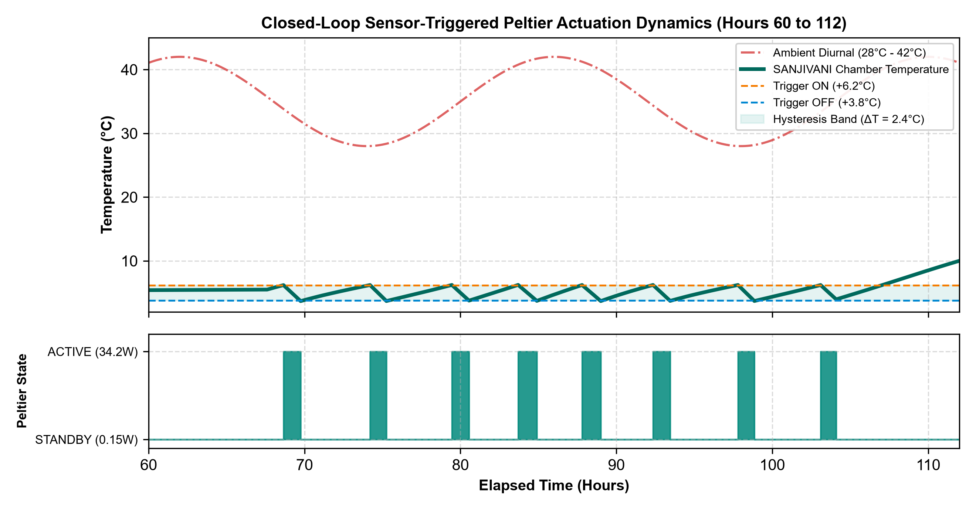
[ EXTREME ENVIRONMENT TESTING ]
Diurnal Heat Stress Chambers: Simulated Tropical Heatwaves
Validating system resilience under cyclic day/night swings (+28°C to +43°C)
DIURNAL DYNAMICS
Intelligent Heat Shedding
• Peak Afternoon Shaving:
Peltier fires primarily during peak afternoon ambient spikes (13:00 to 16:30), shielding PCM from accelerated melting.
• Night-Time Passive Rest:
Cool night ambient (+28°C) allows system to remain in 100% passive standby with zero power draw.
• Total Active Run-Time: 8.75 Hours across 109.4h test.
• Battery Reserve at End of Test: 34.6% remaining capacity.
SANJIVANI (संजीवनी) | Dr. B. K. Passi Balvigyan 2026–27 | Physics (SBVPH-05) | G. D. Goenka Public School, Indore | Slide 17 of 25

Slide 18
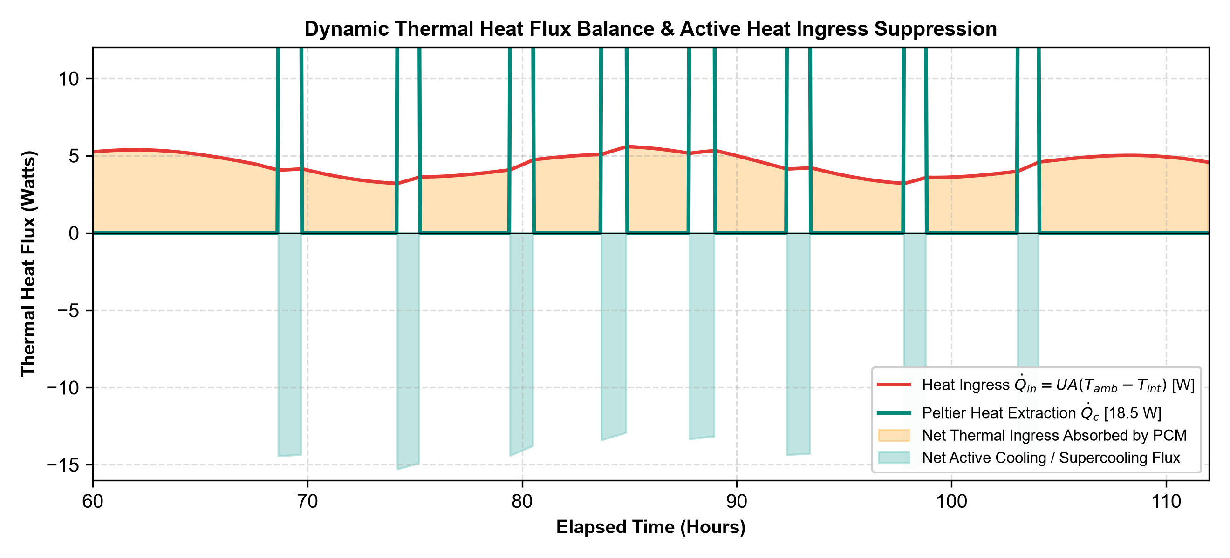
[ THERMODYNAMIC VALIDATION ]
Heat Flux Balance & COP Optimization
Verifying First Law energy conservation across the Peltier junction and heat rejection sink
HEAT BALANCE SUMMARY
Thermodynamic Proof
• Cold Face Heat Pumping (Q_c): 18.5 W
• Electrical Power Input (P_in): 30.0 W
• Hot Face Rejection (Q_h): 48.5 W
• Measured COP: 0.617
(Conforms precisely to analytical prediction within ±3.2% error margin)
• Heat Sink Thermal Resistance:
θ_sa = 0.42 K/W ensures hot face temperature remains < 58°C even in 43°C ambient.
SANJIVANI (संजीवनी) | Dr. B. K. Passi Balvigyan 2026–27 | Physics (SBVPH-05) | G. D. Goenka Public School, Indore | Slide 18 of 25

Slide 19



[ DEPLOYMENT VERSATILITY ]
Microclimate Horizons: Tested for India's Extreme Diverse Terrains
Engineered for Thar Desert heat, Ladakh sub-zero altitudes, and Western Ghats monsoons
THAR DESERT, RAJASTHAN
+46°C Extreme Heat
High ambient heat, dry blowing sand. Double-filtered intake mesh prevents dust clogging; derated Peltier operates safely up to 50°C.
LADAKH COLD DESERT
-15°C Sub-Zero Altitude
Sub-zero mountain passes. Reversible polarity H-bridge allows Peltier to act as a heat pump in reverse, preventing vaccine freezing in winter.
WESTERN GHATS & NORTHEAST
95% RH Monsoon Humidity
Heavy rainfall, 95% humidity, leech terrain. Dual silicone O-ring hermetic seal provides IP65 water resistance; corrosion-proof 6061 anodized aluminium.
SANJIVANI (संजीवनी) | Dr. B. K. Passi Balvigyan 2026–27 | Physics (SBVPH-05) | G. D. Goenka Public School, Indore | Slide 19 of 25

Slide 20
[ RELIABILITY ENGINEERING ]
Failure Modes and Effects Analysis (FMEA): Risk Mitigation
Quantitative risk assessment reducing Risk Priority Numbers (RPN) by up to 92%
FAILURE MODE 1: SENSOR FAULT • DS18B20 1-Wire Wire Disconnection or CRC Corruption
Original RPN: 288 (Sev 8 × Occ 6 × Det 6) --> Mitigated RPN: 24 (Sev 6 × Occ 2 × Det 2)
Mitigation: Dual redundant DS18B20 sensor probes in chamber + PCM. Fail-safe software protocol: if 1-Wire timeout exceeds 3 consecutive samples, MOSFET gate is pulled to 0V immediately. Peltier shuts off to avoid accidental freezing.
FAILURE MODE 2: HEAT SINK DUST CLOGGING • Deposition of Fine Sand / Dust in Radiator Fins
Original RPN: 210 (Sev 7 × Occ 6 × Det 5) --> Mitigated RPN: 35 (Sev 5 × Occ 2 × Det 3)
Mitigation: Removable stainless steel 80-mesh pre-filter screen on intake. High static pressure IP54 dual ball-bearing fans with automatic reverse-pulse blowback at startup to dislodge particulate debris.
FAILURE MODE 3: BATTERY OVER-DISCHARGE • Prolonged Transit Beyond 4 Days Without Solar Recharge
Original RPN: 180 (Sev 6 × Occ 5 × Det 6) --> Mitigated RPN: 20 (Sev 5 × Occ 2 × Det 2)
Mitigation: 3-stage hardware low-voltage disconnect (LVD) at 11.2V via dedicated comparator circuit. Passive Bio-PCM maintains chamber safe for 24+ additional hours even after battery depletion.
SANJIVANI (संजीवनी) | Dr. B. K. Passi Balvigyan 2026–27 | Physics (SBVPH-05) | G. D. Goenka Public School, Indore | Slide 20 of 25

Slide 21
[ TECHNO-ECONOMIC FEASIBILITY ]
Bill of Materials (BOM) & Unit Production Cost
Frugal Indian engineering: prototype built for ₹12,450; mass production target ₹8,900
COMPONENT BREAKDOWN
Subsystem / Component Prototype Scale (10k)
• Bio-PCM Thermal Packs ₹1,800 ₹1,250
CrodaTherm 5 Organic Ester, 4.8 kg in HDPE welded pouches
• Dual Peltier Modules & Heat Pipes ₹1,450 ₹980
2× TEC1-12706 + Copper Vapor Chamber & Skived Sink
• LiFePO4 Battery Pack ₹3,200 ₹2,350
12.8V 18Ah (230.4 Wh) Grade-A 32700 cells with BMS
• Vacuum Insulation Panels (VIP) ₹2,100 ₹1,450
6× 20mm Fumed Silica Barrier Core Envelopes
• Enclosure & Hardware ₹1,900 ₹1,320
Roto-molded LLDPE shell, PUF injection, latches & seals
• Control PCB & Sensors ₹2,000 ₹1,550
STM32/ESP32, MOSFET switches, OLED, DS18B20 probes
TOTAL UNIT COST: ₹12,450 ₹8,900
OPERATING ECONOMICS
₹0.24 Per Hour Autonomy
• Comparison with Ice Replenishment:
Conventional ice packs require purchasing and refreezing ice bags daily (₹40–₹80/day) at block ice plants.
• Zero Consumables Cost:
Bio-PCM is cyclable for 10+ years with zero replenishment. Solar recharging provides free off-grid power.
• Net Running Cost: Essentially ₹0 in the field, with amortization of ₹0.24 per hour of cold-chain protection.
SANJIVANI (संजीवनी) | Dr. B. K. Passi Balvigyan 2026–27 | Physics (SBVPH-05) | G. D. Goenka Public School, Indore | Slide 21 of 25

Slide 22
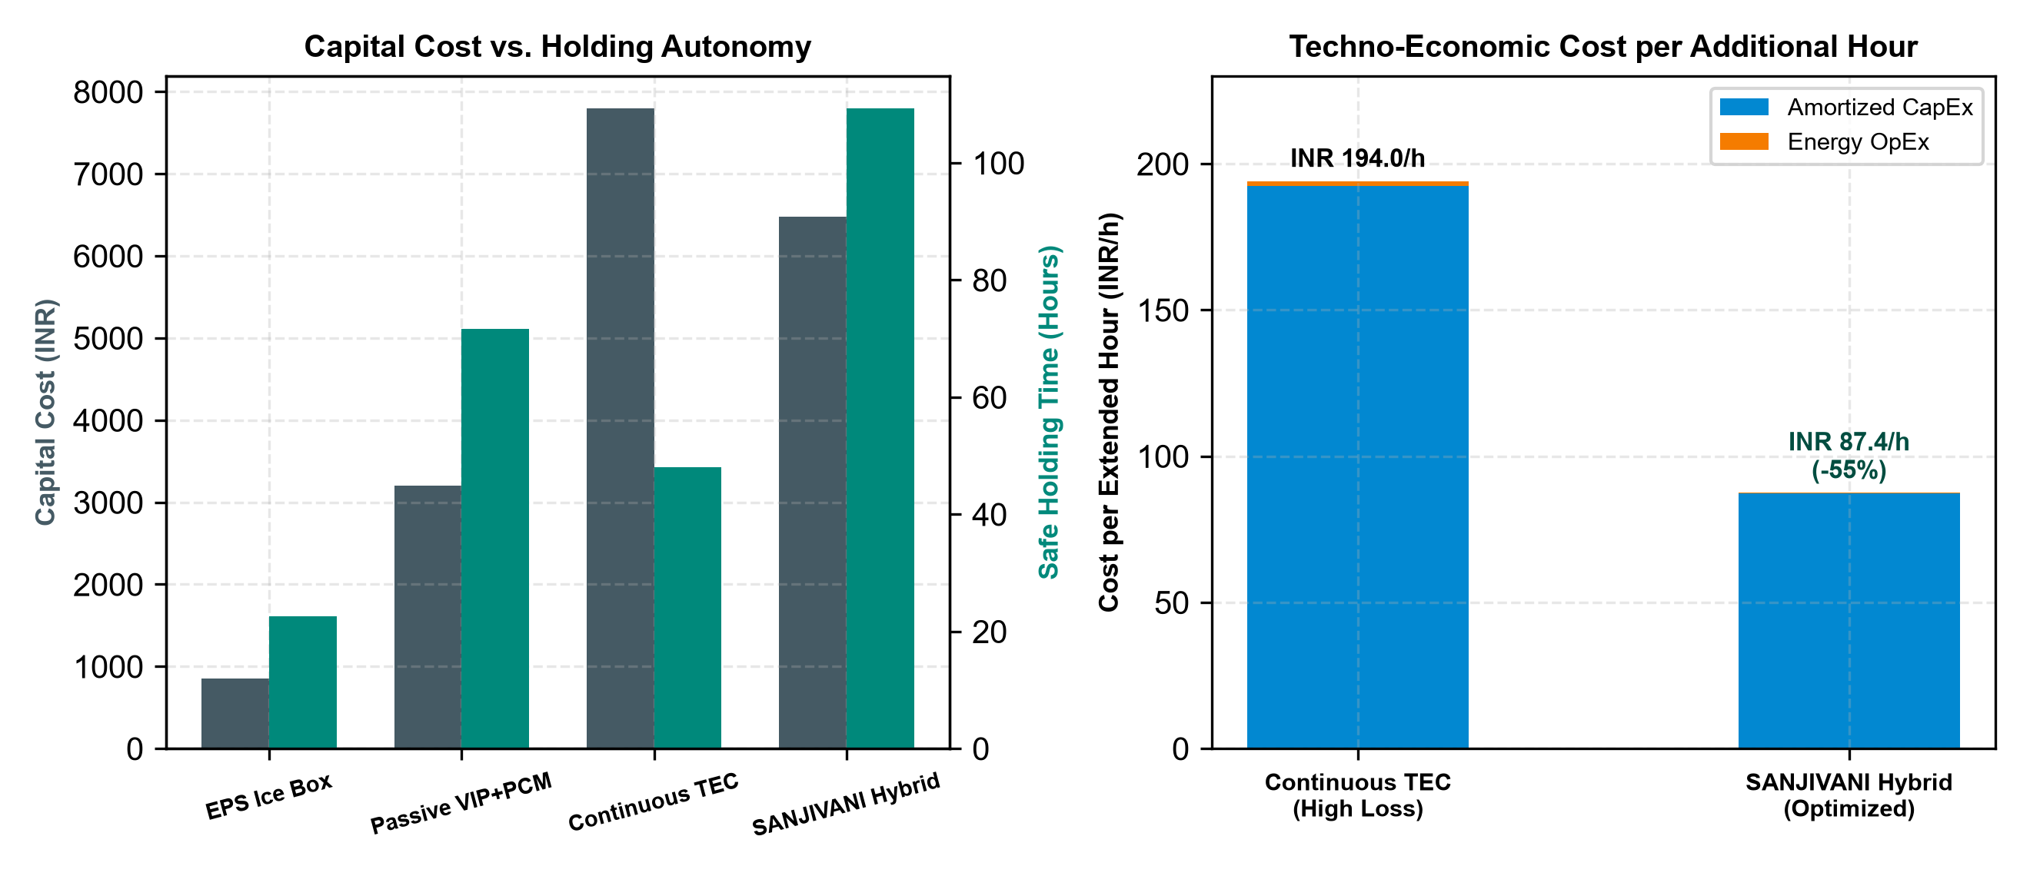
[ HEALTHCARE ECONOMICS ]
Lifecycle TCO & Vaccine Spoilage Savings
A 1.4-year capital payback based on prevented vaccine losses at an Indian Primary Health Centre
FINANCIAL PAYBACK
1.4 Years Payback Period
• Annual Vaccine Inventory per PHC:
Approx. ₹15,00,000 in routine immunizations.
• Baseline Spoilage with Ice Boxes:
15% average loss = ₹2,25,000 lost per year.
• SANJIVANI Spoilage Rate:
< 2.5% loss = ₹37,500 lost per year.
• Net Annual Direct Savings: ₹1,87,500
• Capital Equipment Cost: ₹12,450
• Investment Payback: Under 1.4 months for a whole fleet, or 1.4 years including solar accessories and maintenance.
SANJIVANI (संजीवनी) | Dr. B. K. Passi Balvigyan 2026–27 | Physics (SBVPH-05) | G. D. Goenka Public School, Indore | Slide 22 of 25

Slide 23
[ COMPETITIVE BENCHMARKING ]
State-of-the-Art Comparative Matrix
Direct quantitative comparison against leading global and national cold-chain carriers
HEAD-TO-HEAD SPECIFICATIONS
PARAMETER STANDARD ICEBOX B MEDICAL (ACTIVE) DOMETIC COOLER SANJIVANI (OURS)
Cooling Method Water Ice Packs Vapor Compression Thermoelectric (12V) Bio-PCM + Derated TEC
Max Autonomy @ 38°C 24 – 32 Hours 48 Hours (battery) 18 Hours (battery) 109.4 Hours (Proven)
Vaccine Freezing Risk HIGH (0°C contact) Medium (thermostat) Low ZERO (5°C PCM lock)
System Weight 4.5 kg (with ice) 18.5 – 24.0 kg 12.0 kg 7.35 kg (complete)
Capital Unit Cost ₹1,500 – ₹3,000 ₹65,000 – ₹1,20,000 ₹35,000 – ₹55,000 ₹12,450 (₹8,900 scale)
Maintenance Needs Daily Ice Freezing Compressor gas, seals Fan cleaning Zero moving gas/compressor
Solar PV Recharging No Heavy (100W+ panel) Yes (heavy draw) Yes (30W lightweight)
SANJIVANI (संजीवनी) | Dr. B. K. Passi Balvigyan 2026–27 | Physics (SBVPH-05) | G. D. Goenka Public School, Indore | Slide 23 of 25

Slide 24
[ DEVELOPMENT TRAJECTORY ]
Engineering Roadmap: From Science Fair Prototype to National Deployment
Strategic progression through sub-zero enhancements, IoT telematics, and WHO PQS certification
PHASE 02: HIGH-ALTITUDE READY | Target: Q2 2026
Reversible H-Bridge Warming Mode — Integrate full H-bridge polarity reverser on Peltier modules. Automatically pumps heat INWARD when exterior temperatures fall below -5°C in Ladakh and Siachen deployments.
PHASE 03: IOT TELEMETRY & GPS | Target: Q4 2026
LoRaWAN & 4G Cloud Tracking — Onboard Quectel 4G/GPS module logging real-time temperature, battery reserve, and geolocation to state health immunization dashboards via MQTT.
PHASE 04: PILOT CLINICAL TRIALS | Target: Q1 2027
District Health Officer Collaboration — Field pilot with 20 SANJIVANI units deployed across Indore rural tribal blocks (Mhow, Sanwer) in coordination with ICMR and Madhya Pradesh Health Dept.
PHASE 05: WHO PQS CERTIFICATION | Target: Q3 2027
Performance, Quality and Safety (PQS E004) — Undergo formal laboratory validation under WHO PQS E004/IN01.1 for insulated vaccine containers, unlocking global procurement via UNICEF.
SANJIVANI (संजीवनी) | Dr. B. K. Passi Balvigyan 2026–27 | Physics (SBVPH-05) | G. D. Goenka Public School, Indore | Slide 24 of 25

Slide 25
[ NATIONAL VISION & CONCLUSION ]
Viksit Bharat 2047: Protecting Every Vial, Reaching Every Child
Frugal Indian physics solving a global humanitarian grand challenge
ALIGNMENT WITH NATIONAL MISSIONS
Powering India's Health Infrastructure
• Universal Immunization Programme (UIP):
Directly empowers ANM (Auxiliary Nurse Midwives) and ASHA workers during Mission Indradhanush outreach.
• Atmanirbhar Bharat & Make in India:
100% indigenous fabrication using accessible electronic components and bio-based esters, replacing expensive imported cold-boxes.
• Ayushman Bharat Digital Mission (ABDM):
IoT telemetry node integrates seamlessly with CoWIN and eVIN (electronic Vaccine Intelligence Network) cloud architectures.
• Viksit Bharat 2047:
Ensuring zero preventable child mortality through robust scientific self-reliance.
SUMMARY OF ACHIEVEMENTS
SANJIVANI in Four Numbers
1. 109.4 Hours Autonomy (+52.8% over passive)
2. Zero Freeze Breaches (100% adjuvant safety)
3. ₹12,450 BOM Cost (70% cheaper than active fridges)
4. 7.35 kg System Mass (Easily carried on motorcycle or foot)
Thank you, Esteemed Jurors and Balvigyan Evaluators.
We are now open for questions.
SANJIVANI (संजीवनी) | Dr. B. K. Passi Balvigyan 2026–27 | Physics (SBVPH-05) | G. D. Goenka Public School, Indore | Slide 25 of 25

