Slide 1
World Values Systems
Vivienne Hay
July 2018

Slide 2
Agenda
0) Motivation
Question answered
Data sources
Exploratory data analysis
Modeling & evaluation
Takeaways & next steps

Slide 3
0) Motivation
Countries spend significant sums on Official Development Assistance (ODA), which is often designed to ‘improve’ socio-economic indicators
While ODA may benefit recipient countries, it can also have adverse consequences
Notes:
https://www.usaid.gov/results-and-data/budget-spending
For example, USAID’s budget is $16.8BN for FY’19

Slide 4
1) Question answered
a) What different values systems exist around the globe (focused on attitudes to work)?
b) What socio-economic factors influence a country's values system?
c) How well can we predict a country's values system, based on these factors?

Slide 5
2) Data sources
World Values Survey – responses from ~300K people to ~1000 questions over 50+ countries
World Bank Economic Indicators
World Bank Education Indicators
Gap Minder Political Indicators

Slide 6
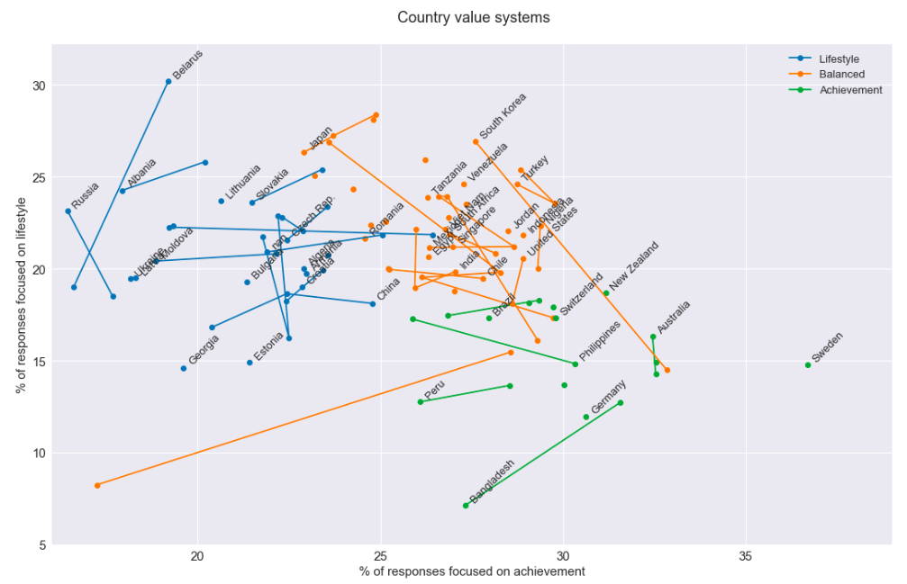
3) Exploratory data analysis
What different values systems exist around the globe (focused on attitudes to work)?
Notes:
Feature engineering :
Lifestyle – hours, holidays, pressure
Achievement – initiative, achievement, responsible
Income security – security, pay

Slide 7





4) Modeling & evaluation
What socio-economic factors influence a country’s values system? How well can we predict a country's values?
% employed in
primary industries
% employed in
secondary industries
% employed in
tertiary industries
GINI
GDP
Notes:
Icons: Flaticon.com

Slide 8




4) Modeling & evaluation
What socio-economic factors influence a country’s values system? How well can we predict a country's values?
Literacy
Democracy index
Life expectancy
Cell phones / 100 pax
Notes:
Icons: Flaticon.com

Slide 9
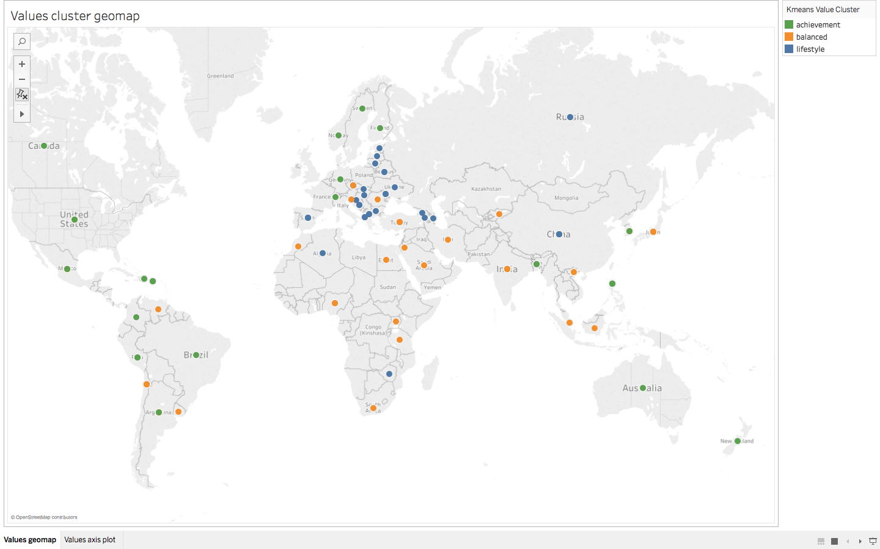
4) Modeling & evaluation

Slide 10
5) Takeaways & next steps
Many values systems coexist with positive development indicators
Our understanding will improve as subsequent waves of the World Values Survey are administered – next wave as early as 2018
Notes:
Values systems are complex to capture and require insightful data analysis
Our understanding will improve as subsequent waves of the World Values Survey are administered – next wave as early as 2018

