Slide 1
World Values Systems
Vivienne Hay
July 2018

Slide 2
Agenda
0) Motivation
Question answered
Data sources
Exploratory data analysis
Modeling, evaluation and takeaways

Slide 3
Motivation
Countries spend significant sums on Official Development Assistance (ODA), which is often designed to ‘improve’ socio-economic indicators
While ODA may benefit recipient countries, it can also have adverse consequences
It’s important to understand the secondary effects of ODA to enable better targeting and evaluation
Notes:
https://www.usaid.gov/results-and-data/budget-spending
For example, USAID’s budget is $16.8BN for FY’19

Slide 4
Question answered
This project focuses on understanding the differences between attitudes to work around the world, and what drives those differences. Specifically:
a) What different values systems exist around the globe (focused on attitudes to work)?
b) What socio-economic factors influence a country's values system?
c) How well can we predict a country's values system, based on these factors?

Slide 5
Data sources
World Values Survey – responses from ~300K people to ~1000 questions over 50+ countries
World Bank Economic Indicators – GDP, GINI
World Bank Education Indicators – Primary completion
Gap Minder Political Indicators – Democracy Index

Slide 6
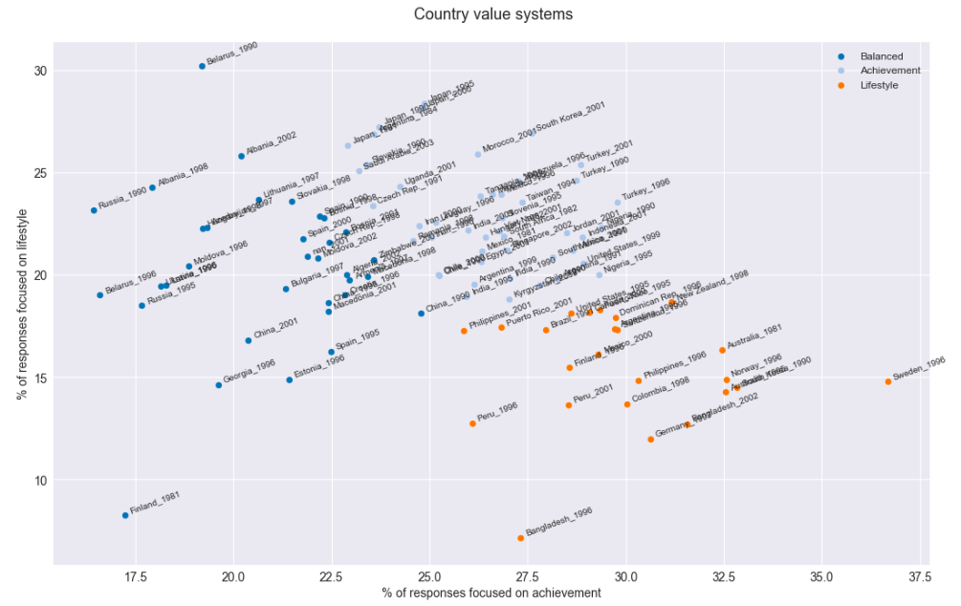
Exploratory data analysis
What different values systems exist around the globe (focused on attitudes to work)?
Notes:
Feature engineering :
Lifestyle – hours, holidays, pressure
Achievement – initiative, achievement, responsible
Income security – security, pay

Slide 7
Modeling, evaluation & takeaways
What socio-economic factors influence a country's values system?
Variables used: GDP, GINI, Primary school completion rates, Democracy Index
Explains ~30% of the variance among groups in terms of “responsibility” value

Slide 8
Takeaways & next steps
a) What different values systems exist ?
Three clusters
b) What socio-economic factors influence a country's values system?
GDP, GINI, Education and Democracy explain 30% of the variance of “responsibility” value
Next step: dive into income security and lifestyle
c) How well can we predict a country's values system, based on these factors?
Next step: predictive model

