Slide 1
EEG data classification with LSTM-RNN
Patakvölgyi Vivien
https://vivienpatakvolgyi-eeg.streamlit.app/

Slide 2
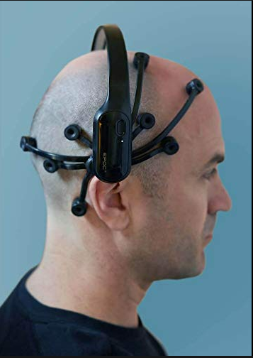
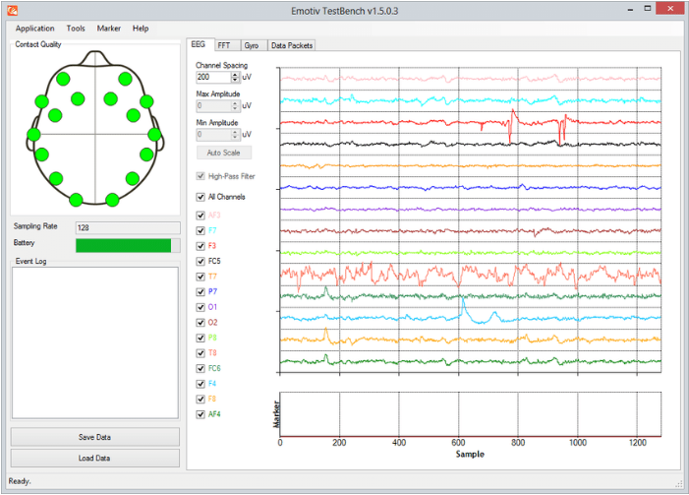
Data
EMOTIV EPOC + 14 Channel EEG

Slide 3
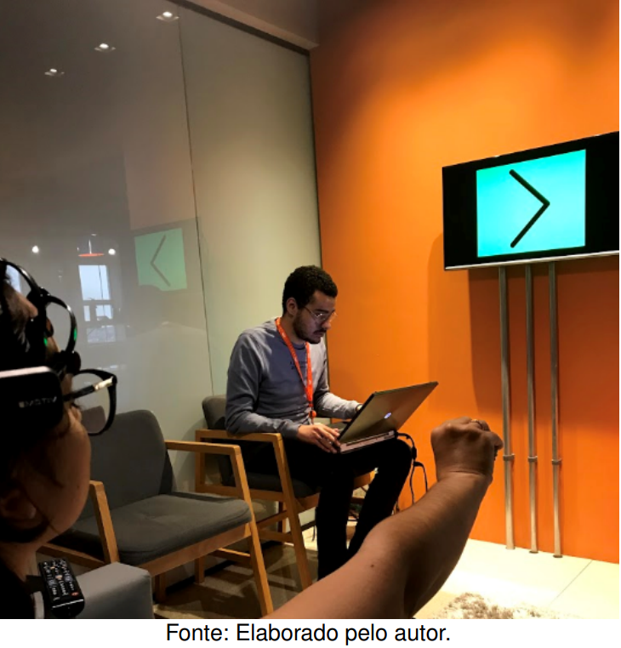
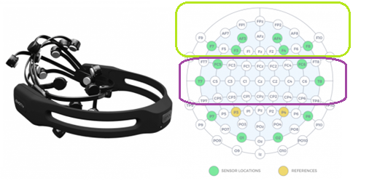
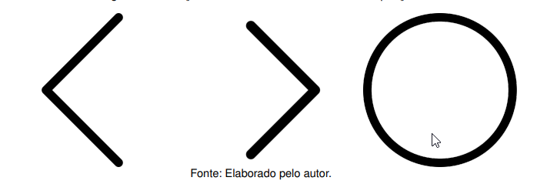
Data
112 feature (14*8), 1 label (3 classes)
4 users
11520 rows
Planning the movement or actual movement?

Slide 4
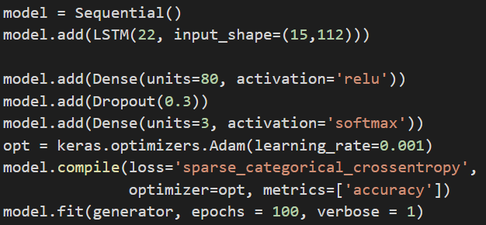
LSTM RNN
Time series data for training
15 steps (rows) for each items
We want to predict the label for the last moment of this section

Slide 5
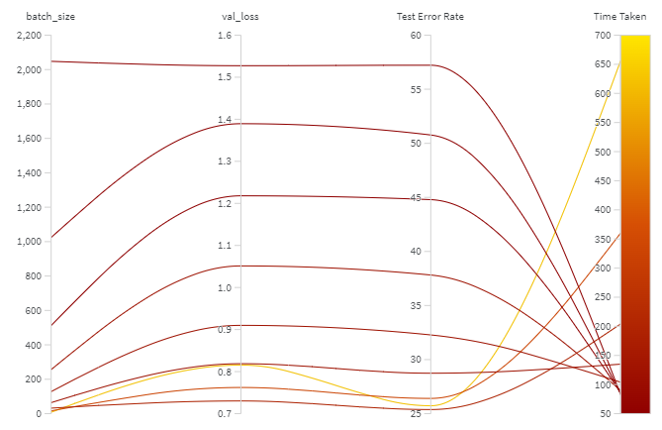
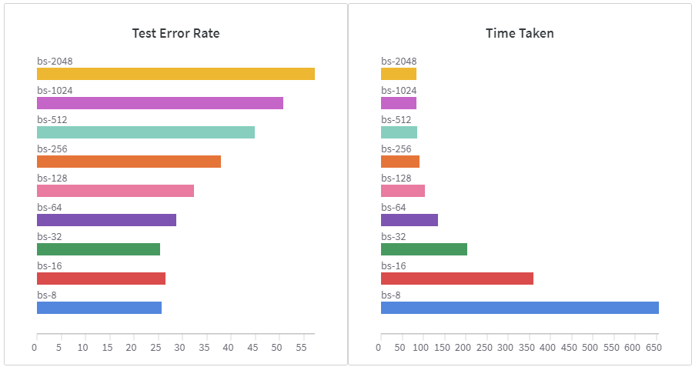
Batch size = 32
https://wandb.ai/ayush-thakur/dl-question-bank/reports/What-s-the-Optimal-Batch-Size-to-Train-a-Neural-Network---VmlldzoyMDkyNDU

Slide 6
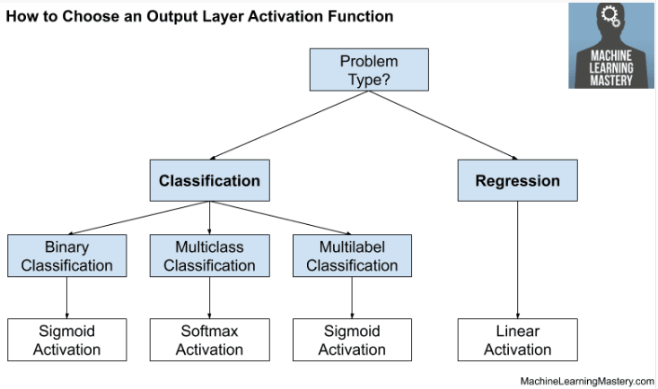
Activation function (output layer) = softmax
https://machinelearningmastery.com/choose-an-activation-function-for-deep-learning/

Slide 7
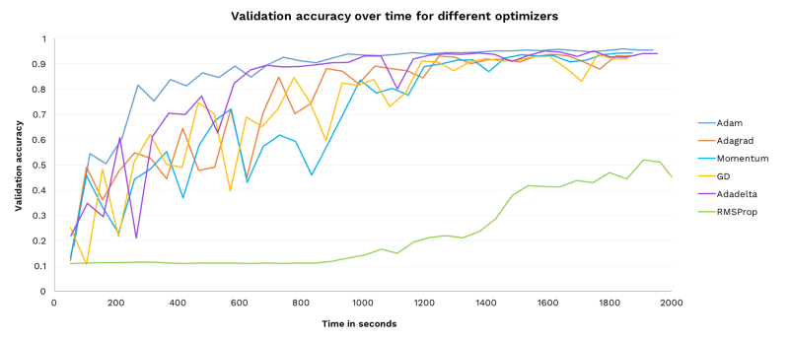
Optimizer = Adam
Adam learns the fastest
More stable than other optimizers
Has a relatively wide range of successful learning rates
„First try Adam in any case”
https://towardsdatascience.com/7-tips-to-choose-the-best-optimizer-47bb9c1219e
https://www.freecodecamp.org/news/how-to-pick-the-best-learning-rate-for-your-machine-learning-project-9c28865039a8/

